Slide 1
Semester Review
CSC 301

Slide 2
Programming Language Classes
There are many different programming language classes, but four classes or paradigms stand out:
  Imperative Languages
    assignment and iteration
  Functional Languages
    recursion and single valued variables
  Logic/Rule Based Languages
    programs consist of rules that specify the problem solution - axiomatization
  Object-Oriented Languages
    bundle data with the allowed operations  Objects

Slide 3
Formal Language Specification
Language Specifications consist of two parts:
  The syntax of a programming language is the part of the language definition that says what programs look like; their form and structure.
  The semantics of a programming language is the part of the language definition that says what programs do; their behavior and meaning.

Slide 4
Formal Language Specification
In order to insure conciseness of language specifications we need tools:
  Grammars are used to define the syntax.
  Mathematical constructs (such as predicates and sets) are used to define the semantics.

Slide 5
Grammars
Example: a grammar for simple English sentences.
Start Symbol
<Sentence>* ::= <Noun-Phrase> <Verb> <Noun-Phrase>
<Noun-Phrase> ::= <Article> <Noun>
<Verb> ::= loves | hates | eats
<Article> ::= a | the
<Noun> ::= dog | cat | rat
Production
Non-terminal
Terminal
☞ Grammars capture the structure of a language.

Slide 6
How do Grammars work?
We can view grammars as rules for building parse trees or derivation trees for sentences
in the language defined by the grammar. In these parse or derivation trees the
start symbol will always be at the root of the tree.
<Sentence>* ::= <Noun-Phrase> <Verb> <Noun-Phrase>
<Noun-Phrase> ::= <Article> <Noun>
<Verb> ::= loves | hates | eats
<Article> ::= a | the
<Noun> ::= dog | cat | rat
L(G) = { s | s can be derived from G }
<Sentence>*
Derivation:
<Noun-Phrase>
<Verb>
<Noun-Phrase>
<Article>
<Noun>
loves
<Article>
<Noun>
the
dog
the
cat
Derived String

Slide 7
Grammars and Semantics
Given grammar G, consider the sentence a+b+c; here we have
two possible parse trees:
G: <AddExp> ::= <AddExp> + <AddExp>
| <MulExp>
<MulExp> ::= <MulExpr> * <MulExp>
| a | b | c
A grammar is ambiguous if there exists more than one parse tree for a string of terminals.
<AddExp>*
<AddExp>*
<AddExp>
+
<AddExp>
<AddExp>
+
<AddExp>
<AddExp>
+
<AddExp>
<MulExp>
<MulExp>
<AddExp>
+
<AddExp>
<MulExp>
<MulExp>
c
a
<MulExp>
<MulExp>
a
b
b
c

Slide 8
Language Systems
What actually happens in your IDE? IDE ≡ Integrated Development Environment
Classical Sequence: C++, C, Fortran
IDE
Library
Code
Assembly
Language
File
Editor
Source
File
Compiler
Assembler
Object
Code
Linker
Executable
Code
Loader
NOTE: The IDE is not a compiler, it contains a compiler.
NOTE: Many different IDE structures possible, depending on the language.

Slide 9
Compilers vs. Interpreters
Compilers translate high-level languages (Java, C, C++) into low-level languages (Java Byte Code, assembly language).
Interpreters execute high-level languages directly (Lisp).
Observation: Virtual machines can be considered interpreters for
low-level languages; they directly execute a low-level language
without first translating it.
Observation: Compilers can generate very efficient code and,
consequently, compiled programs run faster than interpreted programs.

Slide 10
The Anatomy of a Compiler
Source Program
Syntax Analysis
Recognize the structure of a source program,
generate parse tree
Recognition
Phases
Semantic Analysis
Recognize/validate the meaning of a source program
Parse
Trees
(ASTs)
Optimization
Reorganize the parse tree/AST to make computations
more efficient
Code
Generation
Phases
Code Generation
Translate parse tree/AST into low-level language
Translated Program
Observations:
Language definitions have two parts: syntax and semantics
Compilers have two phases which deal with each of these
language definition components: syntax analysis, semantic
analysis.

Slide 11
ML
ML is a functional programming language, typical statements in this language are:
- fun reverse ([ ]) = [ ]
| reverse (x :: xs) = reverse(xs) @ [x];
- map (fn x => x + 2) [1,2,3];

Slide 12
Polymorphism
polymorphism ≡ comes from Greek meaning ‘many forms’
In programming:
Def: A function or operator is polymorphic if it has at
least two possible types.

Slide 13
Polymorphism
i) Overloading
Def: An overloaded function name or operator is one that has at least two
definitions, all of different types.
ii) Parameter Coercion
Def: An implicit type conversion is called a coercion.
iii) Parametric Polymorphism
Def: A function exhibits parametric polymorphism if it has a type
that contains one or more type variables.
iv) Subtype Polymorphism
Def: A function or operator exhibits subtype polymorphism if one or more
of its constructed types have subtypes.
Note: one way to think about this is that this is type coercion on
constructed types.

Slide 14
Scope & Namespaces
Def: A definition is anything that establishes a possible binding to a name.
Def: Scope is a programming language tool to limit the visibility of definitions.
Def: A namespace is a zone in a programming language which is
populated by names. In a namespace, each name must be unique.
The most common namespace in programming languages is the block.

Slide 15
Scoping with Blocks
Def: A block is any language construct that contains definitions and
delineates the region of the program where those definitions apply.
Example: Java
Example: ML
if (cond) {
int q = ...;
}
else {
int r = ...;
}
let
val q = ...;
in
...
end
def. q
def. q
block
block
def. r

Slide 16
Primitive Namespaces
Def: A primitive namespace is a language construct that contains
definitions and delineates a region of the program where those
definitions apply; but the region was defined at language design time
(similar to primitive data types, you can use them but not define them).
Most modern programming languages define two primitive namespaces –
one for user defined variable names and one for type names (both primitive
and constructed).
primitive namespace
for variable names
q, ...
int q = ...;
namespace
(e.g. block, implicit block,
labeled namespace, etc)
int, float, ...
primitive namespace
for type names

Slide 17
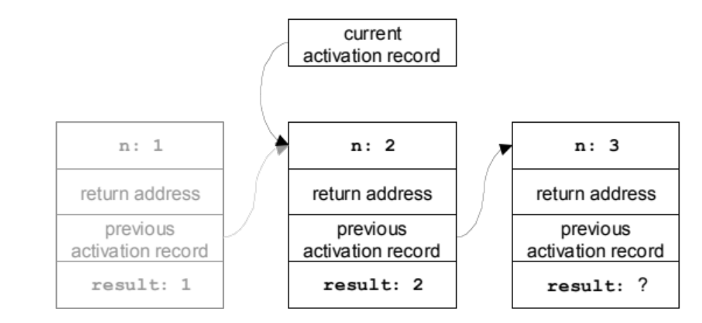
Activation Records & Runtime Stack
int fact(int n) {
int result;
if (n<2) result = 1;
else result = n * fact(n-1);
return result;
}
The second activation is about to return.

Slide 18
Memory Management
0
A typical memory layout for
languages such as C and Java
Compiled code,
RTS,
Library code
Heap Manager
static
Global data
Stack Pointer
NOTES:
if the runtime stack and the heap
meet ⇒ out of memory
Also: memory leaks, dangling pointers
and garbage collection…
Runtime stack
dynamic
Heap
FF..FF

Slide 19
Parameter Passing
How is the correspondence between acutal and formal parameters established?
  Most often positional correspondence
How is the value of an actual parameter transmitted to a formal parameter?
  Most popular techniques: by-value, by-reference

Slide 20
Prolog
Programming language based on first-order logic
  Predicates
  Quantification
  Modus-ponens
Can be made executable using Horn-clause logic
  Deduction is computation!

Slide 21
Prolog
Typical Programs:
last([A],A).
last([A|L],E) :- last(L,E).
append([ ], List, List).
append([H|T], List, [H|Result]) :- append(T, List, Result).
length([ ], 0).
length(L, N) :- L = [H|T], length(T,NT), N is NT + 1.

Slide 22
Formal Semantics
Grammars define the structure of a language, but what defines semantics
or meaning?
⇒ Behavior!
The most straight forward way to define semantics is to provide a
simple interpreter for the programming language that highlights the
behavior of the language,
⇒ Operational Semantics
We used Prolog to define abstract interpreters for our languages, I.e.,
operational semantics for these languages.

