Slide 1

Programming for Data Science
CSC310

Slide 2
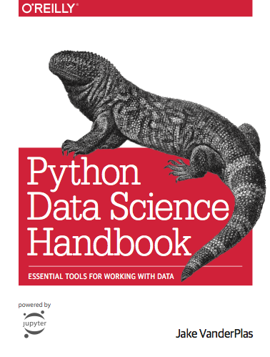
Course Details
Dr Lutz Hamel
Best way to get in touch - email:
lutzhamel@uri.edu
Everything is online
Assignments & Gradebook & Syllabus
BrightSpace
Lecture Notes
https://lutzhamel.github.io/CSC310/
Book
Python Data Science Handbook

Slide 3
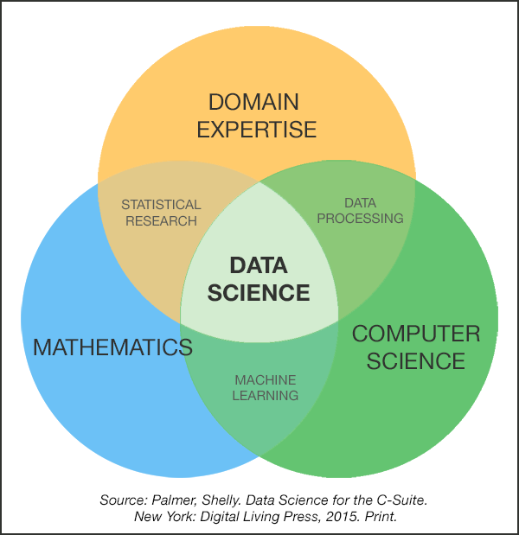
What is Data Science?
☞ Data science is the discipline of the extraction of knowledge from data.
It relies on
computer science
for AI, data structures, algorithms, visualization, big data support, and general programming
statistics/mathematics
for data models and inference
domain expertise
for asking questions and interpreting results

Slide 4
What is Data Science?
☞ Data science is the discipline of the extraction of knowledge from data.
How do we do that?
☞ We build MODELS of data!

Slide 5
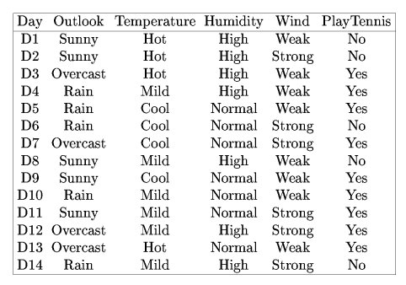
Models: Play Tennis
Lots of data - very little information!
Build a model - a decision tree!

Slide 6
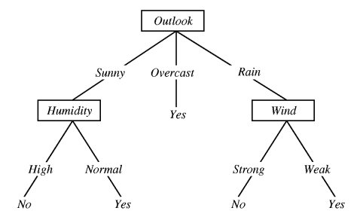
Models: Play Tennis
ID3 Decision Tree
☞This model summarizes the whole table correctly!

Slide 7
What is Data Science?
☞ Data science is the discipline of the extraction of knowledge from data.
Where does the data come from?
☞ The data pipeline!

Slide 8
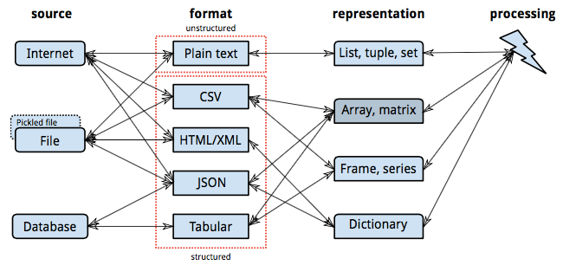
The Data Pipeline

Slide 9
What is Data Science?
☞ Data science is the discipline of the extraction of knowledge from data.
How do we preprocess our data for model building?
☞ Statistics!
Descriptive Statistics
Missing Value Processing
Normalization

Slide 10
Descriptive vs. Inferential Statistics
Purpose: Descriptive statistics aim to summarize data, while inferential statistics aim to make predictions or generalizations about a population from a sample.
Data coverage: Descriptive statistics deal with the entire dataset, whereas inferential statistics focus on samples from which to generalize about a population.
Analysis outcome: The outcome of descriptive statistics is a summary of data, while the outcome of inferential statistics is predictions, decisions, or inferences about population parameters.
In summary, descriptive statistics help describe, show, or summarize data in a meaningful way, allowing the data to be visualized easily, whereas inferential statistics take data from a sample and make inferences or predictions about a population.

Slide 11
What is Data Science?
☞ Data science is the discipline of the extraction of knowledge from data.
How do we ask the right questions?
☞ Domain Expertise!
Knowledge cannot be generated in a vacuum. You need the context of a domain in order to generate new insights. E.g. bioinformatics, climate modeling, sales forecasting, etc.

