Slide 1
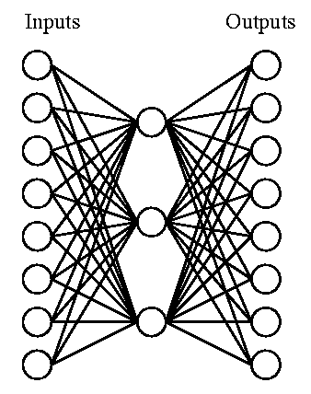
Artificial Neural Networks (ANNs)
Biologically inspired computational model:
Simple computational units (neurons).
Highly interconnected - connectionist view
Vast parallel computation, consider:
Human brain has ~10¹¹ neurons
Slow computational units, switching time ~10⁻³ sec (compared to the computer >10⁻¹⁰ sec)
Yet, you can recognize a face in ~10⁻¹ sec
This implies only about 100 sequential, computational neuron steps - this seems too low for something as complicated as recognizing a face
Parallel processing
ANNs are naturally parallel - each neuron is a self-contained
computational unit that depends only on its inputs.
Notes:
1

Slide 2
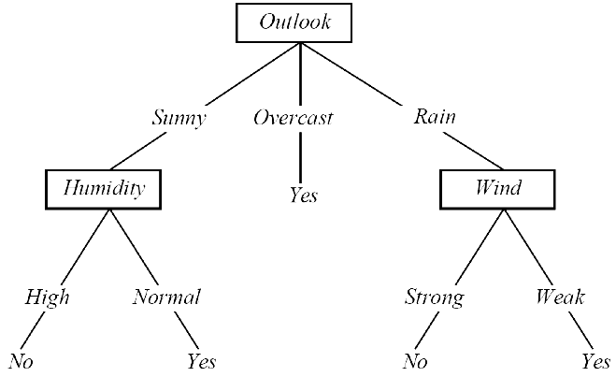
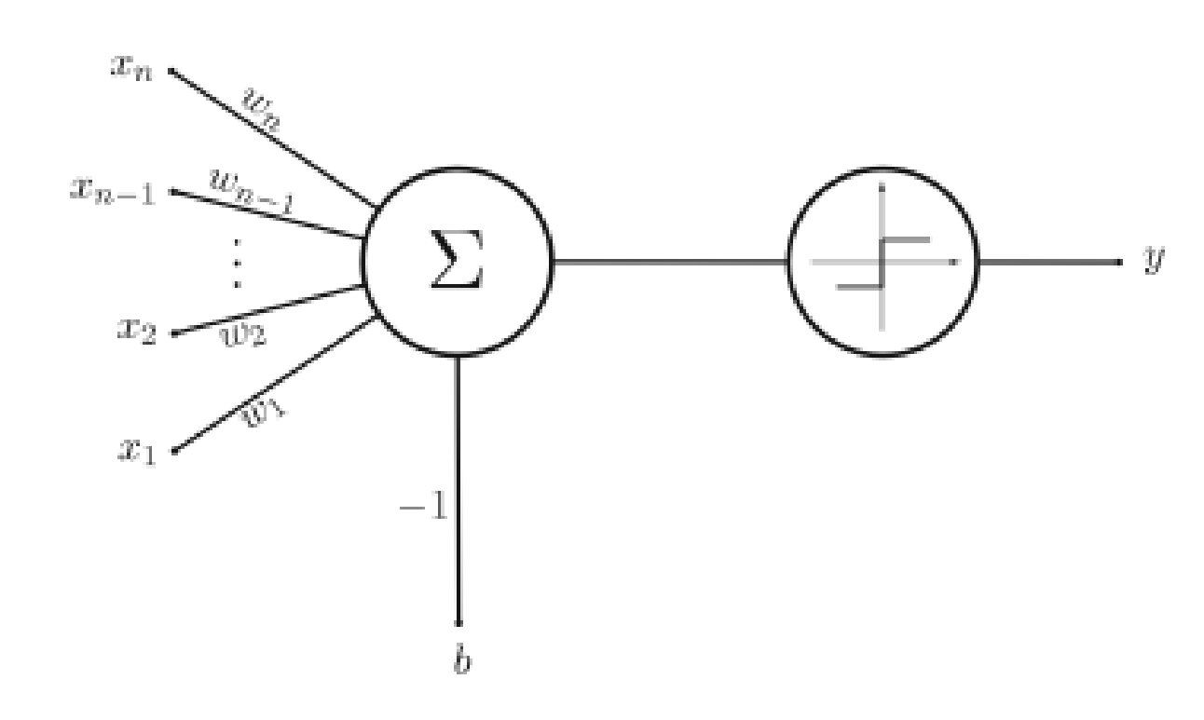
Learning
We have seen machine learning with different representations:
Decision trees -- symbolic representation of various decision rules -- “disjunction of conjunctions”
Perceptron -- learning of weights that represent alinear decision surface classifying a set of objects into two groups
Different representations give rise to different hypothesis or model spaces.
Machine learning algorithms search these model spaces for the best fitting model.
Notes:
2

Slide 3
The Perceptron
A simple, single layered neural “network” - only has a single neuron.
However, even this simple neural network is already powerful enough to perform (linear) classification tasks.
Notes:
3

Slide 4
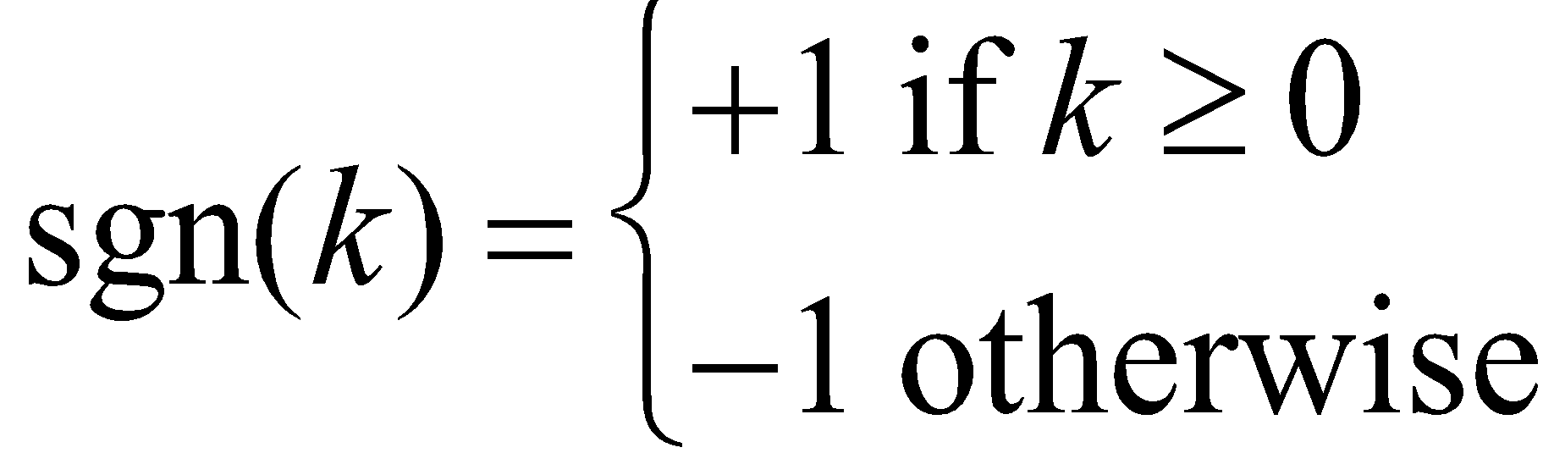
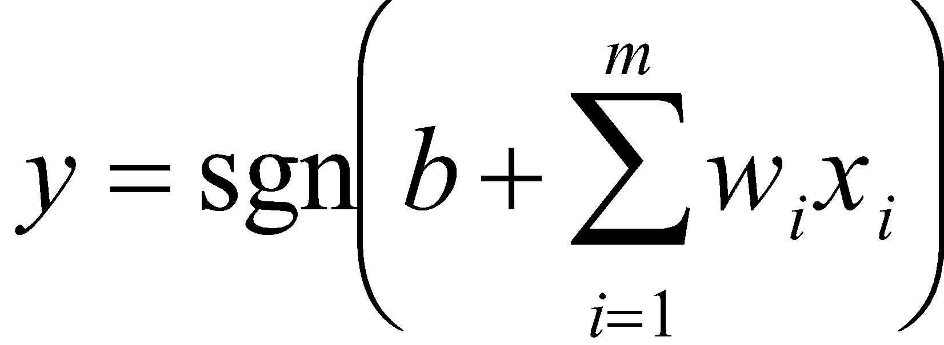
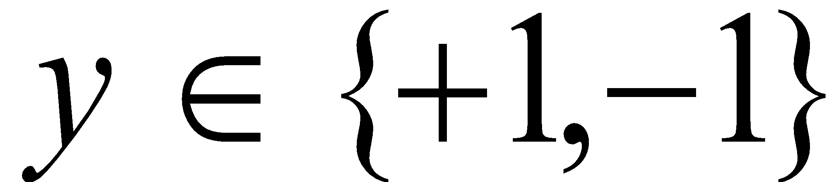
The Architecture
Weights
Computational Unit
Output
Inputs
Transfer Function:
Bias
Multiplication
Sum
Transfer Function
Perceptron Computation:
Note:
Binary Classification
Notes:
4

Slide 5
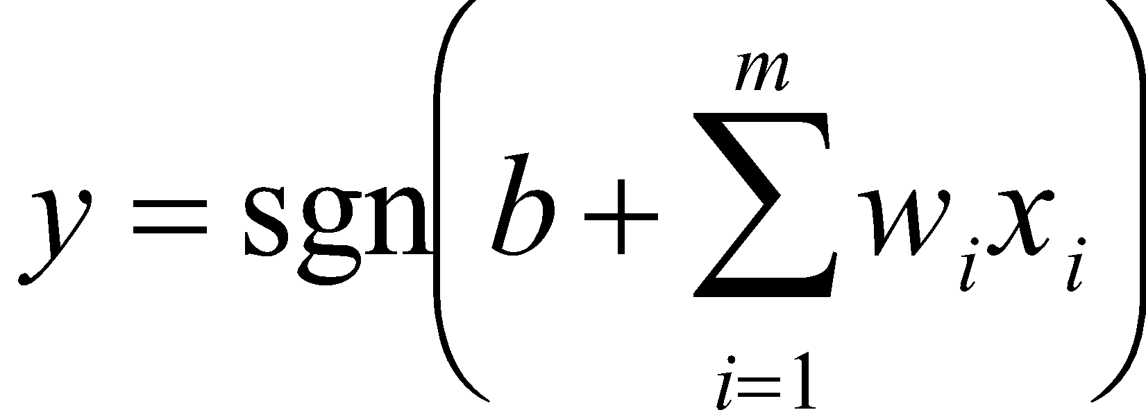
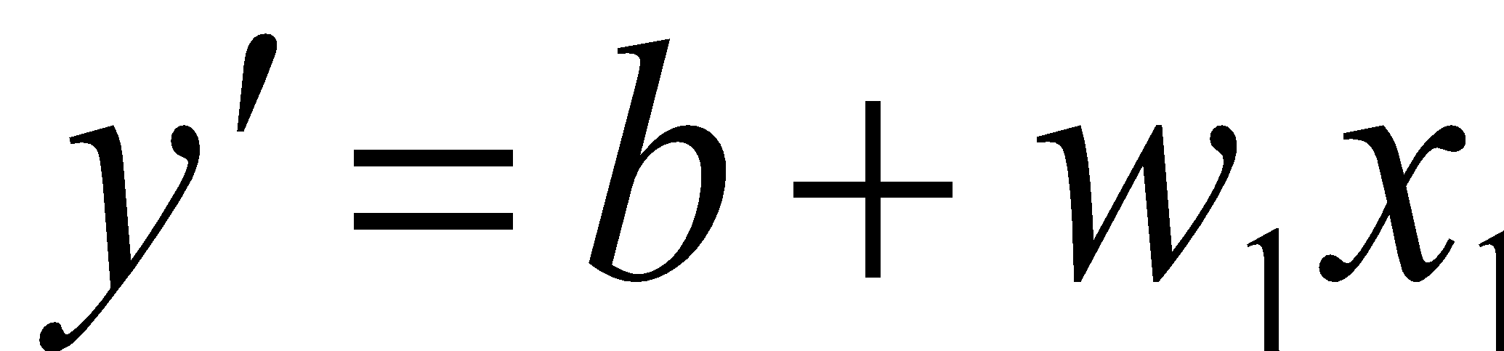
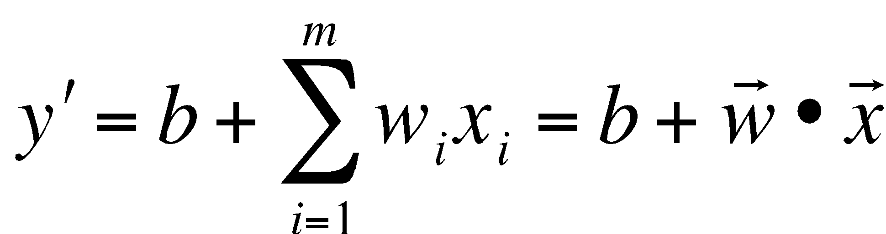
Computation
A perceptron computes the value,
Ignoring the activation function sgn and setting m = 1, we obtain,
But this is the equation of a line with slope w and offset b.
Observation: For the general case the perceptron computes a hyperplane in order
to accomplish its classification task,
Notes:
5

Slide 6
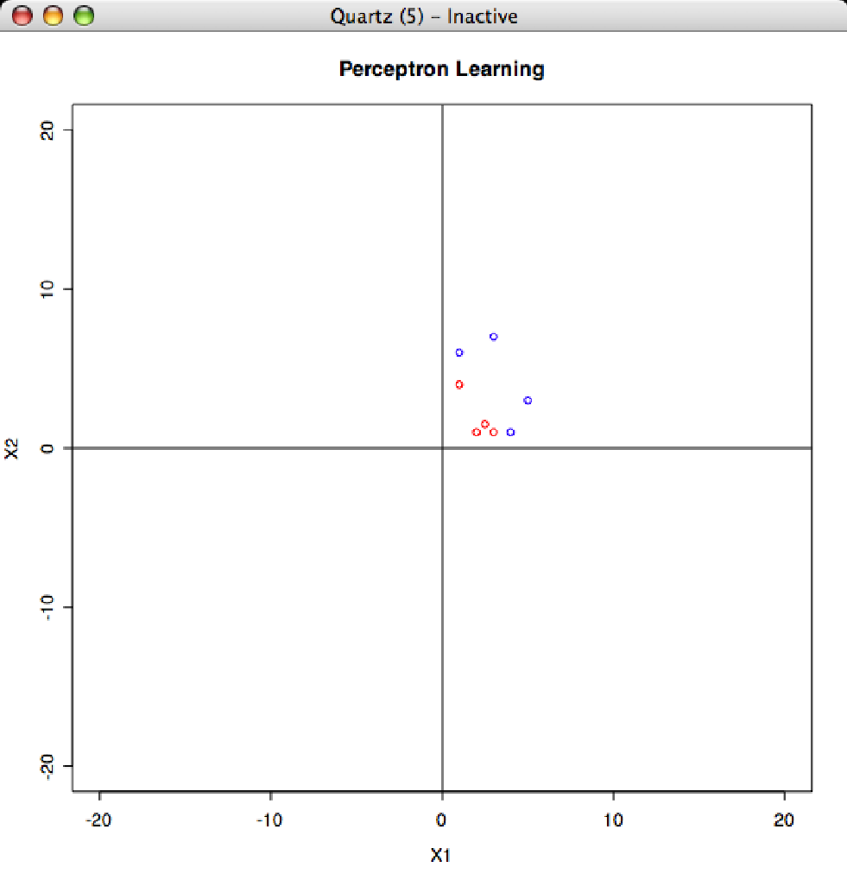
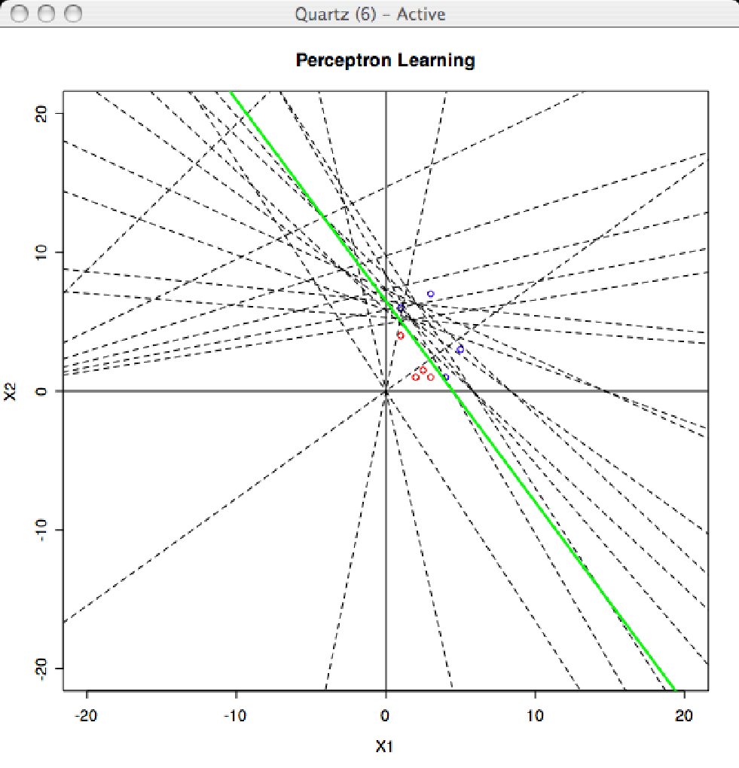
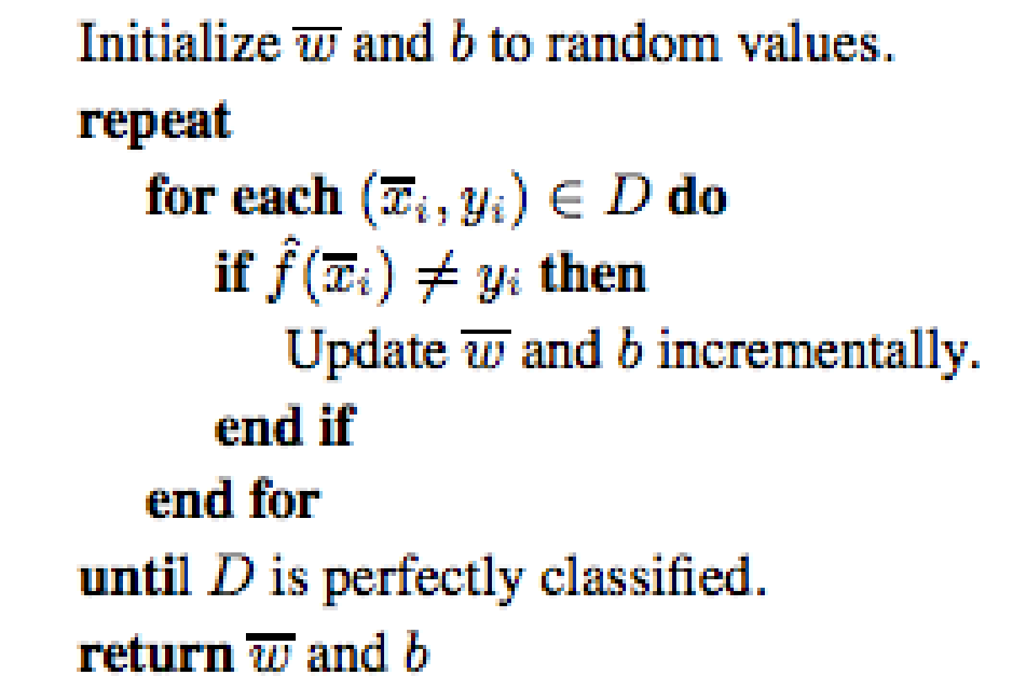
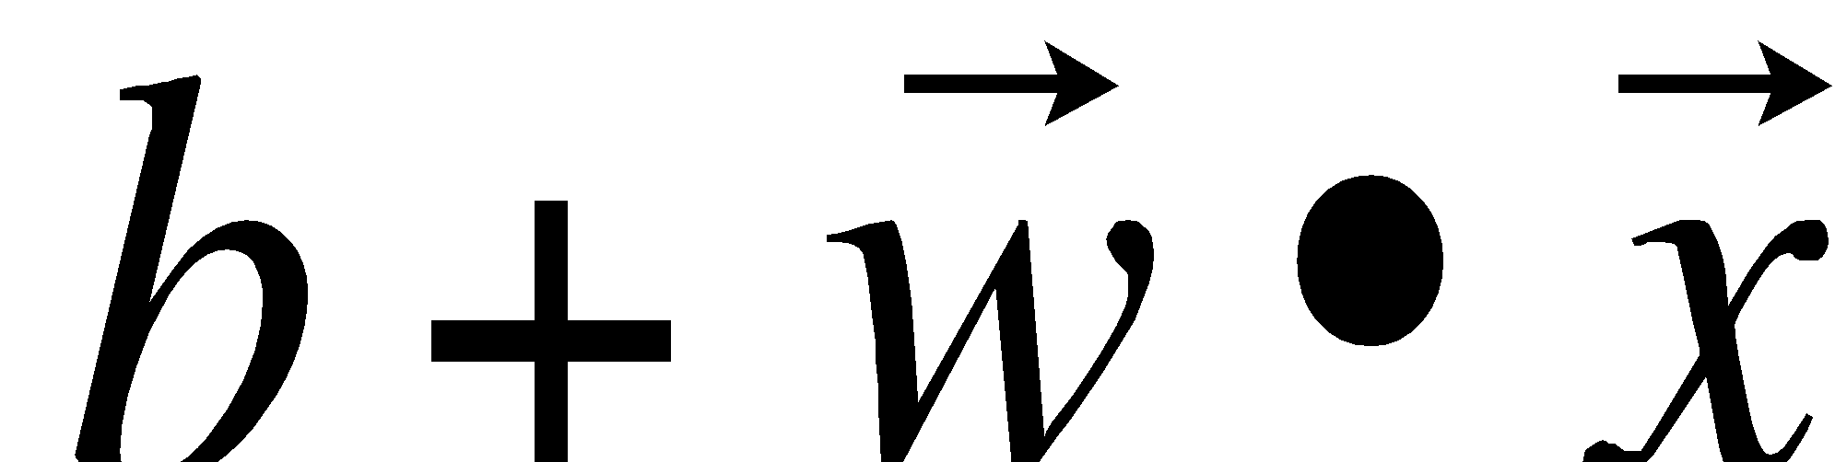
Perceptron Learning Revisited
Constructs a line (hyperplane) as a classifier
Notes:
6

Slide 7
Classification
x₂
= +1
= -1
x₁
In order for the hyperplane to become a classifier we need to find b and w => learning!
Notes:
7

Slide 8
What About Non-Linearity?
x₂
= +1
= -1
Decision Surface
x₁
Can we learn this decision surface? …Yes! Multi-Layer Perceptrons
Notes:
8

Slide 9
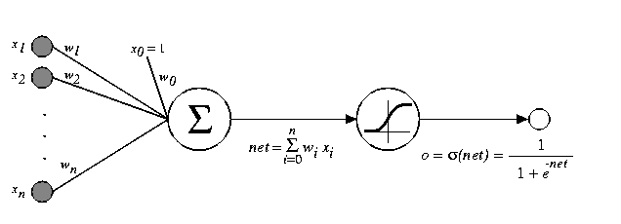
Multi-Layer Perceptrons (ANNs)
Input Layer
Hidden Layer
Output Layer
x_{n}
X_{n-1}
…
y
x₂
x₁
x₀
Notice the smooth
Transfer function!
≡
≡
Linear/Input Unit
Combination
Function
Transfer
Function
Notes:
9

Slide 10
How do we train?
Perceptron was easy:
error
Every time we found an error of the predicted value f(x_{i}) compared to the label in the training set y_{i}, we update w and b.
Not so easy in multi-layer neural networks – the error can occur deep in the network!

Slide 11
Artificial Neural Networks
Feed-forward with Backpropagation
Input Layer
Hidden Layer
Output Layer
We have to be a bit smarter in the case of ANNs: compute the signal (feed forward) and then use the error at the output to update all the weights by propagating the error back through the network.
x_{n}
X_{n-1}
…
y
x₂
x₁
x₀
Signal Feed-forward
Error Backpropagation

Slide 12






Backpropagation
$$α= \text{learning} \text{rate}$$
$$E= {(y^{′}−y)}^{2}$$
(output error)
Input Layer
Hidden Layer
Output Layer
$$δ_{0}=\frac{∂E}{∂w∙x}$$
(error at output node)
x_{n}
i
w_{ih}
δ_{h}
E_{h}
X_{n-1}
h
w_{ho}
…
δ_{o}
E
$w_{ho}←$ $w_{ho}$+ $αδ_{o}$
(weight update)
o
y
x₂
$$δ_{h}=\frac{∂E_{h}}{∂w∙x}=\frac{∂w_{ho}δ_{o}}{∂w∙x}$$
x₁
(error at hidden node)
x₀
$w_{ih}←$ $w_{ih}$+ $αδ_{h}$
(weight update)
Note: These computations only work if the transfer functions are differentiable.

Slide 13
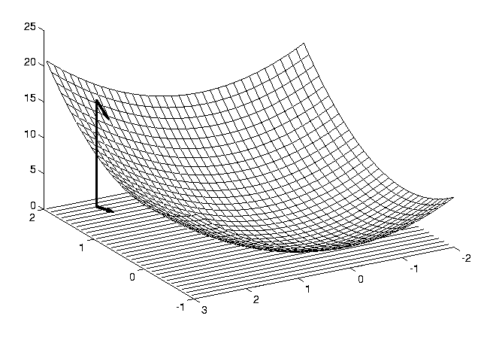
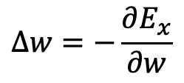

Neural Network Learning
Define the network error in terms of weights w as for some training instance x.
Use the gradient (slope) of the error surface to guide the search towards appropriate weights:
$$E_{x}(w)= {(y^{′}−y)}^{2}$$
E_{x}(w)
w₀
$$∆w=−\frac{∂E_{x}}{∂w}$$
w₁
☞ Backpropagation can be understood as a stochastic gradient
search on the error surface of the network.
Notes:
13

Slide 14
Backpropagation Algorithm
Note: this algorithm is for a NN with a single output node o and a single hidden layer. It can easily be generalized.
Initialize the weights in the network (often randomly)
Do
For each example e in the training set
// forward pass
y = compute neural net output
y’ = label for e from training data
Calculate error E = (y’ - y)² at the output units
// backward pass
Compute error δ_{o} for weights from a hidden node h to the output node o using E
Compute error δ_{h} for weights from an input node i to hidden node h using δ_{o}
Update the weights in the network
Until all examples classified correctly or stopping criterion satisfied
Return the network
Source: http://en.wikipedia.org/wiki/Backpropagation
Notes:
14

Slide 15
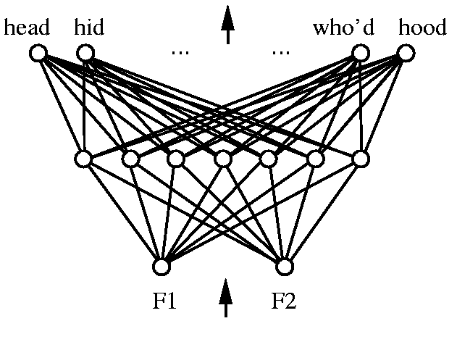
Representational Power
Every bounded continuous function can be approximated with arbitrarily small error by a network with one hidden layer.
Any function can be approximated to arbitrary accuracy by a network with two hidden layers.
Notes:
15

Slide 16
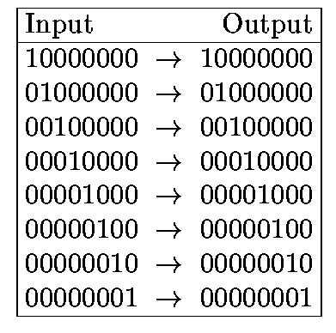
Hidden Layer Representations
Target Function:
Can this be learned?
Notes:
16

Slide 17
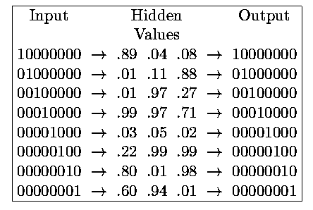
Hidden Layer Representations
1 0 0
0 0 1
0 1 0
1 1 1
0 0 0
0 1 1
1 0 1
1 1 0
☞ This neural network architecture is sometimes also called
autoencoder because of its ability to invent new representations of the
input data and is a popular building block in deep-learning.
Notes:
17

