Slide 1

Programming for Data Science
CSC310

Slide 2
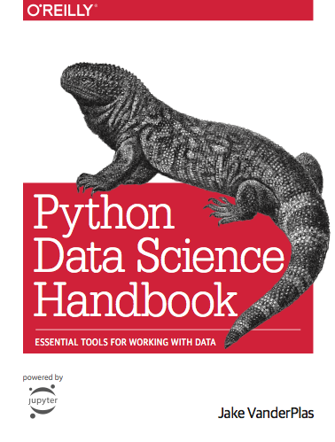
Course Details
Dr Lutz Hamel
Best way to get in touch - email:
lutzhamel@uri.edu
Everything is online
Gradebook (BrightSpace)
Course Website
homepage.cs.uri.edu/faculty/hamel/courses/home/csc310/
Shared Google Drive/Github Repo
Google Drive Link
github.com/lutzhamel/ds
Lecture Notes
Example Code
Python!
Python3
Google Colab Notebooks
colab.research.google.com/notebooks/intro.ipynb

Slide 3
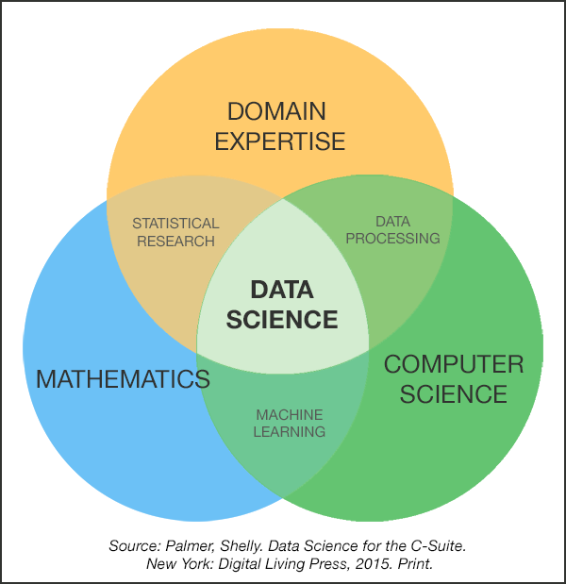
What is Data Science?
☞ Data science is the discipline of the extraction of knowledge from data.
It relies on
computer science
for AI, data structures, algorithms, visualization, big data support, and general programming
statistics/mathematics
for data models and inference
domain expertise
for asking questions and interpreting results

Slide 4
What is Data Science?
☞ Data science is the discipline of the extraction of knowledge from data.
How do we do that?
☞ We build MODELS of data!

Slide 5
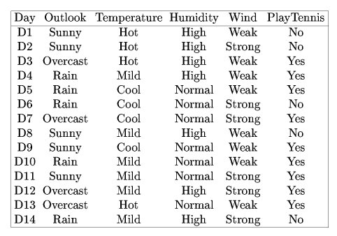
Models: Play Tennis
Lots of data - very little information!
Build a model - a decision tree!

Slide 6
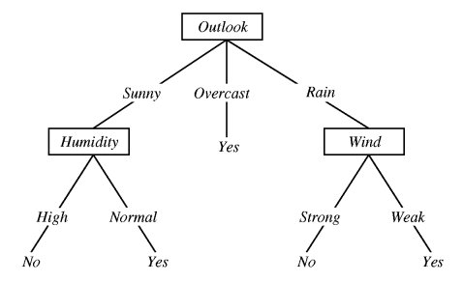
Models: Play Tennis
ID3 Decision Tree
☞This model summarizes the whole table correctly!

Slide 7
What is Data Science?
☞ Data science is the discipline of the extraction of knowledge from data.
Where does the data come from?
☞ The data pipeline!

Slide 8
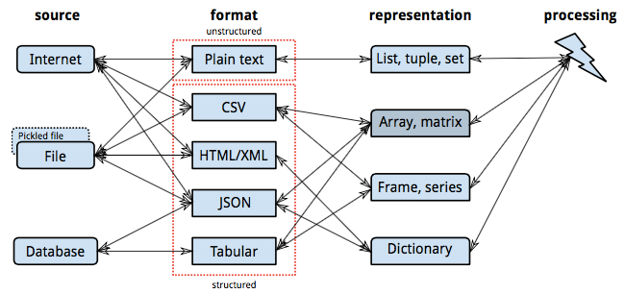
The Data Pipeline

Slide 9
What is Data Science?
☞ Data science is the discipline of the extraction of knowledge from data.
How do we preprocess our data for model building?
☞ Statistics!
Descriptive Statistics
Missing Value Processing
Normalization

Slide 10
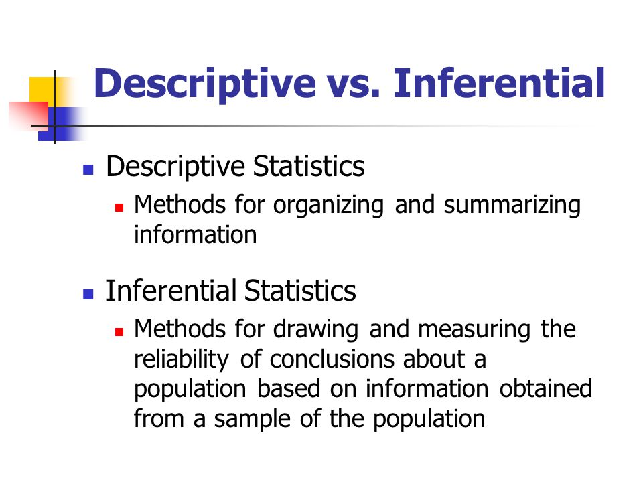

Slide 11
What is Data Science?
☞ Data science is the discipline of the extraction of knowledge from data.
How do we ask the right questions?
☞ Domain Expertise!
Knowledge cannot be generated in a vacuum. You need the context of a domain in order to generate new insights. E.g. bioinformatics, climate modeling, sales forecasting, etc.

