Slide 1
The Pipeline
We have looked at importing, exploring and transforming data.
Now it is time to do something with our data: MODELS!
Here we discuss one of the most straight forward machine learning models: the decision tree.

Slide 2
Machine Learning
What is Machine Learning?
Programs that get better with experience given a task and some performance measure.
Learning to classify news articles
Learning to recognize spoken words
Learning to play board games
Learning to navigate (e.g. self-driving cars)
Usually involves some sort of inductive reasoning step.
Notes:
2

Slide 3
Inductive Reasoning
Deductive reasoning (rule based reasoning)
From the general to the specific
Inductive reasoning
From the specific to the general
Deduction
General
Theory
Specific
Facts
Induction
Note: not to be confused with mathematical induction!
Notes:
3

Slide 4
Example - Deduction
Rules:
If Betty wears a white dress then it is Sunday.
Betty wears a white dress.
Deductive step:
You infer or deduce that today is Sunday.
If Betty wears a white dress then it is Sunday.
Betty wears a white dress.
Today is Sunday.
Deduction
Inference is the act or process of drawing a conclusion based solely on what one already knows.
Notes:
4

Slide 5
Example - Induction
Facts: every time you see a swan you notice that the swan is white.
Inductive step: you infer that all swans are white.
All Swans
are white.
Observed Swans
are white.
Induction
Inference is the act or process of drawing a conclusion based solely on what one already knows.
Notes:
5

Slide 6
Observation
Deduction is “truth preserving”
If the rules employed in the deductive reasoning process are sound, then, what holds in the theory will hold for the deduced facts.
Induction is NOT “truth preserving”
It is more of a statistical argument
The more swans you see that are white, the more probable it is that all swans are white.. But this does not exclude the existence of black swans
Notes:
6

Slide 7
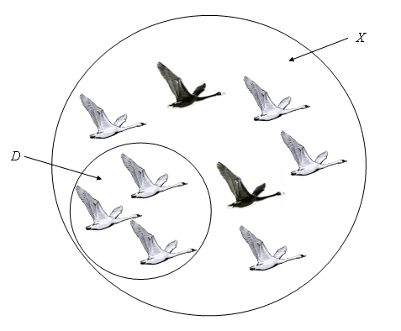
Observation
D ≡ observations
X ≡ universe of all swans
This is called the Black Swan Problem and is the classic example posed by the philosopher of science Karl Popper in the early twentieth century. It roughly states that learning/induction is always a probabilistic argument since we can only learn from a limited number of observations (D) and make generalization from those on the universe at large (X). On a more technical level it argues this point based on falsifiability of a hypothesis.
Notes:
7

Slide 8
Different Styles of Machine Learning
Supervised Learning
The learning needs explicit examples of the concept to be learned (e.g. white swans, playing tennis, etc)
Unsupervised Learning
The learner discovers autonomously any structure in a domain that might represent an interesting concept
Notes:
8

Slide 9
Knowledge - Representing what has been learned
Symbolic Learners (transparent models)
If-then-else rules
Decision trees
Association rules
Sub-Symbolic Learners (non-transparent models)
(Deep) Neural Networks
Clustering (Self-Organizing Maps, k-Means)
Support Vector Machines
Notes:
9

Slide 10
Decision Trees
Learn from labeled observations - supervised learning
Represent the knowledge learned in form of a tree
Example: learning when to play tennis.
Examples/observations are days with their observed characteristics and whether we played tennis or not
Notes:
10

Slide 11
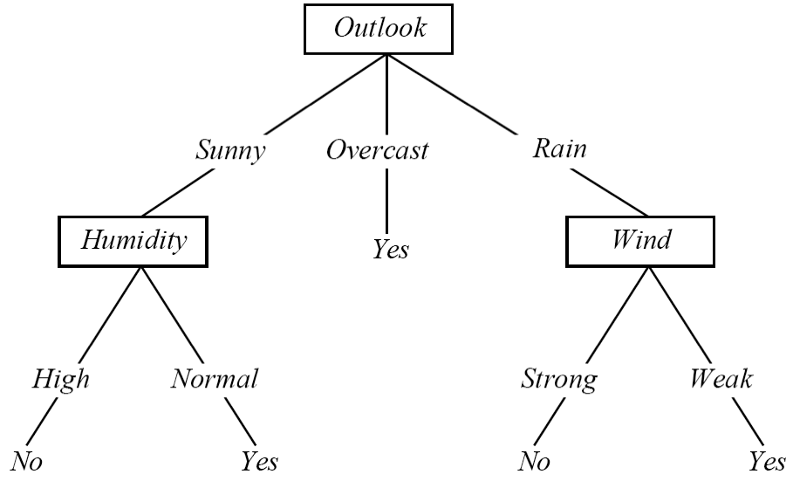
Play Tennis Example
Outlook | Temperature | Humidity | Windy | PlayTennis
Sunny | Hot | High | Weak | No
Sunny | Hot | High | Strong | No
Overcast | Hot | High | Weak | Yes
Rainy | Mild | High | Weak | Yes
Rainy | Cool | Normal | Weak | Yes
Rainy | Cool | Normal | Strong | No
Overcast | Cool | Normal | Strong | Yes
Sunny | Mild | High | Weak | No
Sunny | Cool | Normal | Weak | Yes
Rainy | Mild | Normal | Weak | Yes
Sunny | Mild | Normal | Strong | Yes
Overcast | Mild | High | Strong | Yes
Overcast | Hot | Normal | Weak | Yes
Rainy | Mild | High | Strong | No
Notes:
11

Slide 12
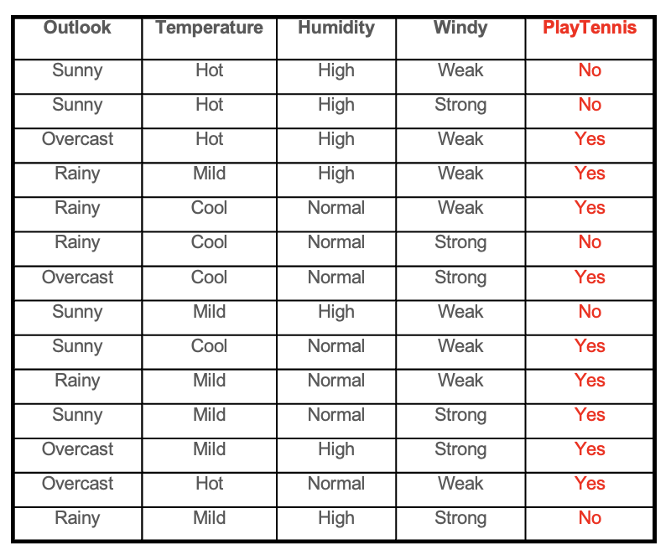
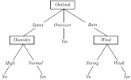
Decision Tree Learning
Induction
Facts or Observations
Theory
Notes:
12

Slide 13

Interpreting a DT
DT ≡ Decision Tree
A DT uses the features of an observation table as nodes and the feature values as links.
All feature values of a particular feature need to be represented as links.
The target feature is special - its values show up as leaf nodes in the DT.
Notes:
13

Slide 14
Interpreting a DT
Each path from the root of
the DT to a leaf can be
interpreted as a decision rule.
IF Outlook = Sunny AND Humidity = Normal THEN Playtennis = Yes
IF Outlook = Overcast THEN Playtennis =Yes
IF Outlook = Rain AND Wind = Strong THEN Playtennis = No
Notes:
14

Slide 15
DT: Explanation & Prediction
Explanation: the DT summarizes (explains) all the observations in the table perfectly ⇒ 100% Accuracy
Prediction: once we have a DT (or model) we can use it to make predictions on observations that are not in the original training table, consider:
Outlook = Sunny, Temperature = Mild, Humidity = Normal, Windy = Weak, Playtennis = ?
Notes:
15

Slide 16
Constructing DTs
ID3 Algorithm
How do we choose the attributes and the order in which they appear in a DT?
Recursive partitioning of the original data table
Heuristic - each generated partition has to be “less random” (entropy reduction) than previously generated partitions
Notes:
16

Slide 17
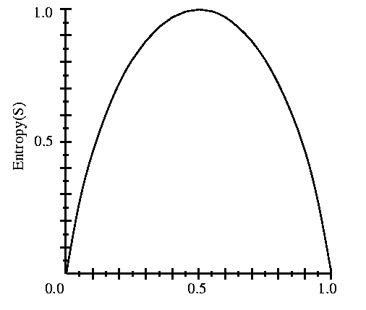
Entropy
S is a sample of training examples
p⁺ is the proportion of positive examples in S
p⁻ is the proportion of negative examples in S
Entropy measures the impurity (randomness) of S
S
p⁺
Entropy(S) ≡ - p⁺ log₂ p⁺ - p⁻ log₂ p⁻
Entropy(S) = Entropy([9+,5-]) = .94
Notes:
17

Slide 18
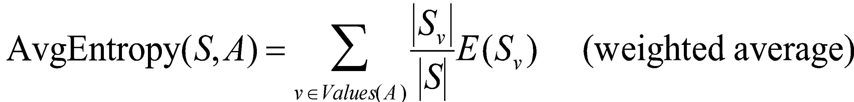
Partitioning the Data Set
Outlook | Temperature | Humidity | Windy | PlayTennis
Sunny | Hot | High | Weak | No
Sunny | Hot | High | Strong | No
Sunny | Mild | High | Weak | No
Sunny | Cool | Normal | Weak | Yes
Sunny | Mild | Normal | Strong | Yes
E = .97
Sunny
Outlook | Temperature | Humidity | Windy | PlayTennis
Overcast | Hot | High | Weak | Yes
Overcast | Cool | Normal | Strong | Yes
Overcast | Mild | High | Strong | Yes
Overcast | Hot | Normal | Weak | Yes
Outlook
Overcast
Average
Entropy = .64
(weighted .69)
E = 0
Rainy
Outlook | Temperature | Humidity | Windy | PlayTennis
Rainy | Mild | High | Weak | Yes
Rainy | Cool | Normal | Weak | Yes
Rainy | Cool | Normal | Strong | No
Rainy | Mild | Normal | Weak | Yes
Rainy | Mild | High | Strong | No
E = .97
Notes:
18

Slide 19
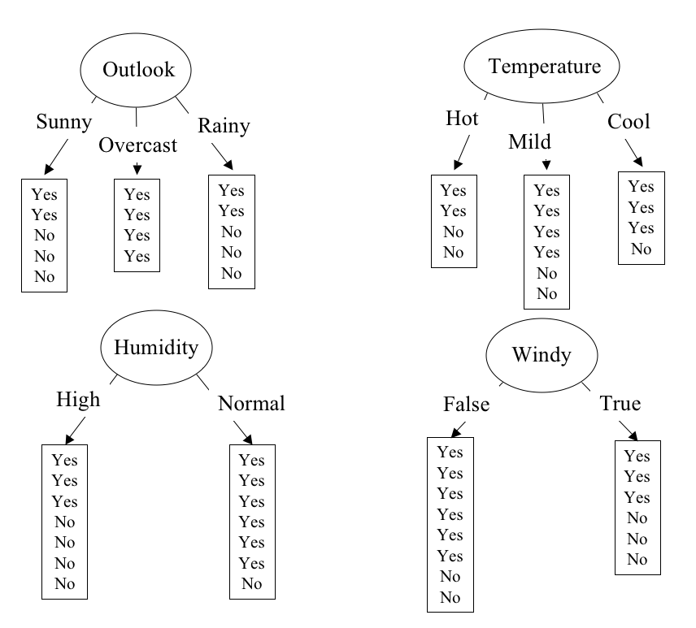
Partitioning in Action
E = .640
E = .789
Weak
Strong
E = .892
E = .911
Notes:
19

Slide 20
The ID3 Algorithm
Function ID3 (S:Dataset) return T:Tree
Calculate the entropy of every variable in S
Partition ("split") the S into subsets using the variable for which the resulting entropy after splitting is minimized.
Make a decision tree node containing that variable.
Create a branch for each label in the variable.
Recurse on subsets using the remaining variables.
Return the resulting tree.

Slide 21
Recursive Partitioning
Outlook | Temperature | Humidity | Windy | Play
Sunny | Hot | High | Weak | No
Sunny | Hot | High | Strong | No
Overcast | Hot | High | Weak | Yes
Rainy | Mild | High | Weak | Yes
Rainy | Cool | Normal | Weak | Yes
Rainy | Cool | Normal | Strong | No
Overcast | Cool | Normal | Strong | Yes
Sunny | Mild | High | Weak | No
Sunny | Cool | Normal | Weak | Yes
Rainy | Mild | Normal | Weak | Yes
Sunny | Mild | Normal | Strong | Yes
Overcast | Mild | High | Strong | Yes
Overcast | Hot | Normal | Weak | Yes
Rainy | Mild | High | Strong | No
Outlook
Outlook | Temperature | Humidity | Windy | Play
Sunny | Hot | High | Weak | No
Sunny | Hot | High | Strong | No
Sunny | Mild | High | Weak | No
Sunny | Cool | Normal | Weak | Yes
Sunny | Mild | Normal | Strong | Yes
Outlook | Temperature | Humidity | Windy | Play
Rainy | Mild | High | Weak | Yes
Rainy | Cool | Normal | Weak | Yes
Rainy | Cool | Normal | Strong | No
Rainy | Mild | Normal | Weak | Yes
Rainy | Mild | High | Strong | No
Outlook | Temperature | Humidity | Windy | Play
Overcast | Hot | High | Weak | Yes
Overcast | Cool | Normal | Strong | Yes
Overcast | Mild | High | Strong | Yes
Overcast | Hot | Normal | Weak | Yes
Notes:
21

Slide 22
Recursive Partitioning
Outlook
Outlook | Temperature | Humidity | Windy | Play
Sunny | Hot | High | Weak | No
Sunny | Hot | High | Strong | No
Sunny | Mild | High | Weak | No
Sunny | Cool | Normal | Weak | Yes
Sunny | Mild | Normal | Strong | Yes
Outlook | Temperature | Humidity | Windy | Play
Rainy | Mild | High | Weak | Yes
Rainy | Cool | Normal | Weak | Yes
Rainy | Cool | Normal | Strong | No
Rainy | Mild | Normal | Weak | Yes
Rainy | Mild | High | Strong | No
Outlook | Temperature | Humidity | Windy | Play
Overcast | Hot | High | Weak | Yes
Overcast | Cool | Normal | Strong | Yes
Overcast | Mild | High | Strong | Yes
Overcast | Hot | Normal | Weak | Yes
Notes:
22

Slide 23
Recursive Partitioning
Outlook
Outlook | Temperature | Humidity | Windy | Play
Sunny | Hot | High | Weak | No
Sunny | Hot | High | Strong | No
Sunny | Mild | High | Weak | No
Sunny | Cool | Normal | Weak | Yes
Sunny | Mild | Normal | Strong | Yes
Outlook | Temperature | Humidity | Windy | Play
Rainy | Mild | High | Weak | Yes
Rainy | Cool | Normal | Weak | Yes
Rainy | Cool | Normal | Strong | No
Rainy | Mild | Normal | Weak | Yes
Rainy | Mild | High | Strong | No
Outlook | Temperature | Humidity | Windy | Play
Overcast | Hot | High | Weak | Yes
Overcast | Cool | Normal | Strong | Yes
Overcast | Mild | High | Strong | Yes
Overcast | Hot | Normal | Weak | Yes
Humidity
Outlook | Temperature | Humidity | Windy | Play
Sunny | Cool | Normal | Weak | Yes
Sunny | Mild | Normal | Strong | Yes
Outlook | Temperature | Humidity | Windy | Play
Sunny | Hot | High | Weak | No
Sunny | Hot | High | Strong | No
Sunny | Mild | High | Weak | No
Notes:
23

Slide 24
Recursive Partitioning
Outlook
Outlook | Temperature | Humidity | Windy | Play
Sunny | Hot | High | Weak | No
Sunny | Hot | High | Strong | No
Sunny | Mild | High | Weak | No
Sunny | Cool | Normal | Weak | Yes
Sunny | Mild | Normal | Strong | Yes
Outlook | Temperature | Humidity | Windy | Play
Rainy | Mild | High | Weak | Yes
Rainy | Cool | Normal | Weak | Yes
Rainy | Cool | Normal | Strong | No
Rainy | Mild | Normal | Weak | Yes
Rainy | Mild | High | Strong | No
Outlook | Temperature | Humidity | Windy | Play
Overcast | Hot | High | Weak | Yes
Overcast | Cool | Normal | Strong | Yes
Overcast | Mild | High | Strong | Yes
Overcast | Hot | Normal | Weak | Yes
Humidity
Windy
Outlook | Temperature | Humidity | Windy | Play
Sunny | Cool | Normal | Weak | Yes
Sunny | Mild | Normal | Strong | Yes
Outlook | Temperature | Humidity | Windy | Play
Sunny | Hot | High | Weak | No
Sunny | Hot | High | Strong | No
Sunny | Mild | High | Weak | No
Outlook | Temperature | Humidity | Windy | Play
Rainy | Cool | Normal | Strong | No
Rainy | Mild | High | Strong | No
Outlook | Temperature | Humidity | Windy | Play
Rainy | Mild | High | Weak | Yes
Rainy | Cool | Normal | Weak | Yes
Rainy | Mild | Normal | Weak | Yes
Notes:
24

Slide 25
Recursive Partioning
Our hand-simulated algorithm created exactly the same tree that we have shown before for the tennis dataset.

Slide 26
The Pipeline
The last step in our pipeline is “Exploit”, meaning taking advantage of the knowledge gained through the models.
In this course we will not really delve into this because it is highly domain depended, e.g.
For the scientist, using the raw model to predict future research outcomes might be enough
For a banking application, like a loan scoring program, the model would have to be embedded in some sort of application that allows the bank employee to effectively take advantage of the model
For a network intrusion detection system, the model would have to be embedded in the network with appropriate access to the network and defensive systems

Slide 27
Models
Let’s continue to look at machine learning basics such as tree model building, evaluation, and visualization
Our main module for machine learning is the sklearn module

Slide 28
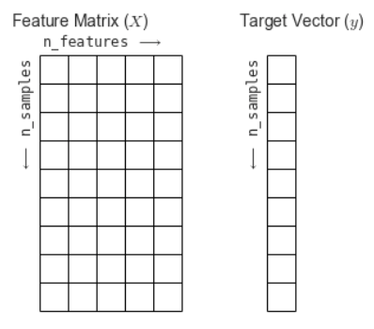
SKlearn ML Data Basics
Training data needs to be structured into a feature matrix and a target vector.
In the feature matrix one row for each observations.
In the target vector one entry for each observation.
NOTE: rows and vector entries have to be consistent!
Columns (1)
Index (0)

