Slide 1

Computational Mechanics
Date- 20 November, 2019
Group no: 5
MOMENTO
Group Members
Shashank Priyadarshi(19060)
Deepak Yadav(19024)
Abhishek Singh(19002)
Indraraj Biswas(19034)
Venkat(19014)
Vishnu(19065)
Gourav Singh(19031)
Sahitya(19036)

Slide 2
AIM
The aim of our project is to compute the centroid and area moment of inertia of the given figures:
Rectangular Channel
Rectangular Channel with Slot
MI and centroid of One Composite Section
Triangle
about x -axis, y-axis and about any given axis.

Slide 3
THEORY
What is Moment of Inertia?
The moment of inertia is defined as the quantity expressed by the body resisting angular acceleration which is the sum of the product of the mass of every particle with its square of a distance from the axis of rotation. ... It is also known as the angular mass or rotational inertia.
What are the Factors on which the moment of inertia Depends?
The density of the material
Shape and size of the body
Axis of rotation (distribution of mass relative to the axis)

Slide 4
Area Moment of Inertia:
The area moment of inertia is a property of a two - dimensional plane shape which characterizes its deflection under loading. It is also known as the second moment of area or second moment of inertia. The area moment of inertia has dimensions of length to the fourth power.

Slide 5
Centroid of an area:
The centroid of an area is similar to the center of mass of a body. Calculating the centroid involves only the geometrical shape of the area. The center of gravity will equal the centroid if the body is homogenous i.e. constant density.

Slide 6
ALGORITHM
The basic concept of how we find the Moment of Inertia about any axis is finding the Moments about the Centroid of Area and then we find the moments about the global centroid and then we apply Parallel axis theorem to find the Moment about any axis , the deciding factor of the moment about any axis is the distance between the centroid and the required.
Next how we are asking the user the axis is Standard , we ask the user to enter the point and then about this point from the global centroid we find the moments x and y with respect to the global centroid .

Slide 7
The slots , for the slots we made an algorithm which can handle a maximum of 4 types slots and if the user wants only one or two slots he/she could do that as well as as the algorithm is inbuilt , also we can calculate for 4 different (not same)slots at once , the basic logic is we have subtracted each moment of four slots about x and y to the main moment and in case the user doesn’t need a particular slot he/she can enter the slot dimensions as (0,0) wherever needed and the moments will become 0 and there wouldn’t be change in net moment which implies there is no slot .
Net Moment = Main figure moment about x – Moment of circle about x –Moment of rectangle about x – Moment of triangle about x –Moment of square about x

Slide 8
SOFTWARE DEMO

Slide 9
SAMPLE PROBLEM
https://drive.google.com/file/d/13DNI-qrYPnFbKIDH6hSEM31BkDXM9yBw/view?usp=drivesdk

Slide 10
User Interface
So the user interface of our system will be divided into 3 main parts namely:
Features
Documentation
Exit

Slide 11
Features Documentation
In the documentation part we will be able to access material that provides information as well as specifications and instructions.
In the Features part of our application we will be able to find the Moment of Inertia of any user given shape just by entering the coordinates.

Slide 12
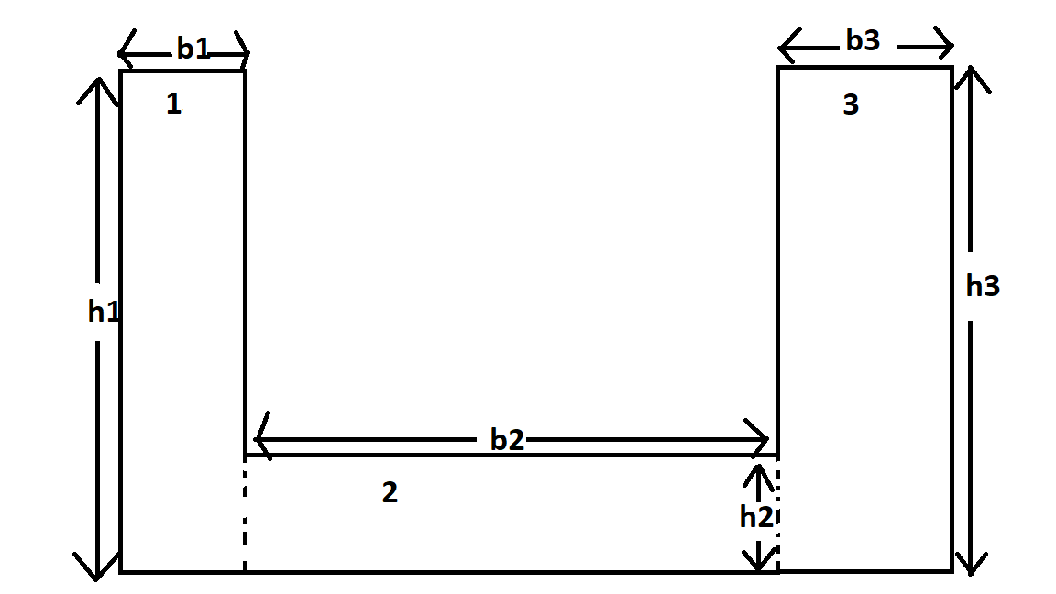
Centroid and Moment of Inertia of Rectangular Channel (About X,Y or any axes)

Slide 13
Centroid of (1) :
( b1 / 2 , h1 / 2)
As the centroid of a rectangle is half of its breadth and length .
Centroid of (2) :
( b2 / 2 , h2 / 2 )
Centroid of (3):
( b3 / 2 , h3 / 2 )
Global Centroid :
The centroid of the full composite figure derived from the individual component Centroids derived above
3
YBAR = ⅀ (h(i)/2) *AREA(i)
⅀ (AREA(i))
i = 1
AREA(i):(b(i)*h(i))

Slide 14
Moment of Inertia of a separate rectangle w.r.t to the perpendicular of centroidal axis is given by :
IRy = (h)*(b^3)/12
These are the individual moments , now we have to combine them and find the net moment about centroid .
I = 3
⅀ (IRx + A(i)*d(i)^2)
i = 1
IBAR :
3
⅀ IRy + A(i)*(d(i)^2)
i = 1
where d(i) = h(i)/2 – YBAR
where ,
d(i) = b(i)/2 – XBAR

Slide 15
About X axis :
Ix = ( I + A(i)*d^2)
where ,
d = distance between the global centroid and the x axis .
About Y axis :
Iy = (IBAR + A(i)*k^2)
where,
k = distance between the global centroid and y axis .
About any axis :
where
( I + A(i)*d^2) d = distance between the global centroid and the any axis .
---------------------------------------x------------------------x-------------------------------------------

Slide 16
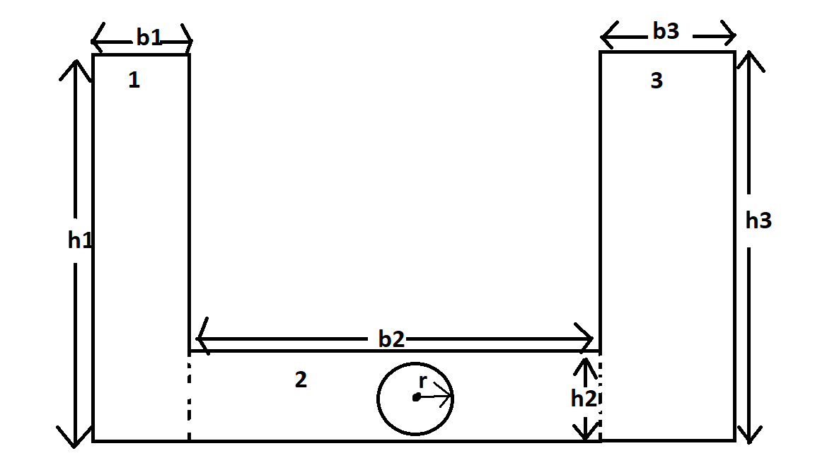
Rectangular channel with Slot :

Slide 17
While finding the moment of inertia of a figure with slot we just have to find the moment of the figure normally and then we have to remove the moment about the same axis and subtract it .
Centroid of a circle : always at centre
Moment of circle w.r.t centroidal axis or perpendicular centroidal axis(same) :
ICx or Icy : (∏ / 64 )* d^4
I = (( ICx or Icy) * A * y^2)
where :
y is the distance between the axis we are finding the moment and the centroid.
About any axis :
After we find “I” we should subtract it from the Rectangular channel’s Moment about the axis we are finding Moment .

Slide 18
Similarly few can find XBAR
YBAR =
3
⅀ (h(i)/2) *AREA(i)
i = 1
3
⅀ (AREA(i))
i = 1
Moment of Inertia of a separate rectangle w.r.t to the centroidal axis is given by :
IRx = (b)*(h^3)/12
where ,
AREA(i):(b(i)*h(i))

