Slide 1
Smart Parking System using IoT & RFID
An Automated Vehicle Monitoring and Parking Management Solution

Slide 2
Introduction
• Smart Parking System uses IoT and RFID to manage parking slots efficiently.
• Ultrasonic sensors detect vehicle presence, and RFID tags identify vehicles.
• Data is sent to a cloud server for monitoring and analysis.

Slide 3
Components Used
1. Ultrasonic sensors - detect vehicle presence in parking slots. 2. RFID tags - identify the vehicle details. 3. ESP8266 - connects to WiFi and sends data to the cloud. 4. LCD displays available parking slots. 5. Cloud server stores and analyzes data.

Slide 4
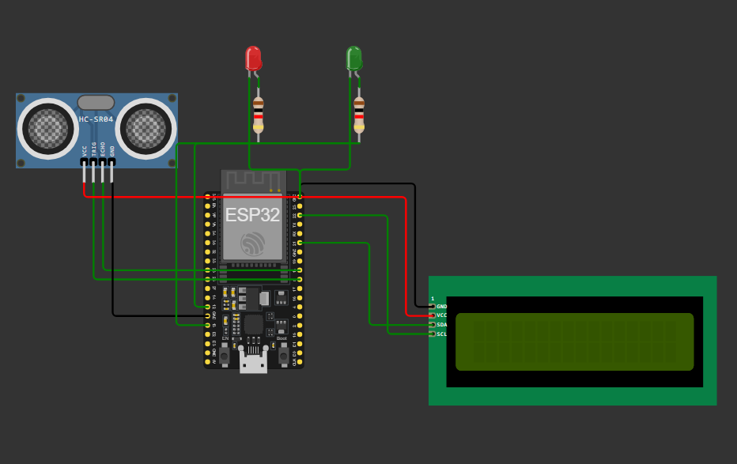
Circuit Diagram

Slide 5
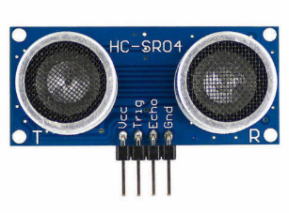
Ultrasonic Sensor Working
• Emits ultrasonic waves and measures the time for echo return.
• Determines the distance between sensor and object.
• If distance < threshold, parking slot is occupied.

Slide 6
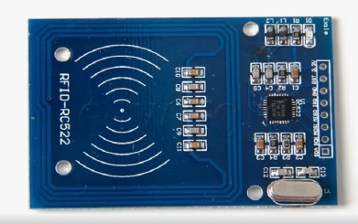
RFID Integration
• RFID reader scans vehicle RFID tags.
• Extracts unique vehicle ID.
• Sends data to cloud for record-keeping and monitoring.

Slide 7
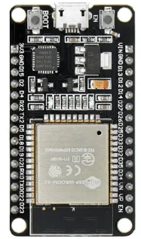
Cloud Connectivity
• ESP8266 connects to WiFi.
• Sends slot availability and RFID data to a cloud server.
• Enables remote monitoring of parking status.

Slide 8
LCD Display & LED Indicators
• LCD displays parking status and available slots.
• Green LED: Slot available.
• Red LED: Slot occupied.

Slide 9
Code Overview
The code uses ESP8266, Ultrasonic Sensors, and RFID for parking management.
Detects vehicle presence and uploads data to a cloud server.
Displays parking availability on an LCD screen.

Slide 10
Initialization & Setup
Initializes WiFi, RFID, LCD, and sensor pins.
Connects to WiFi for cloud communication.
Displays startup message on LCD.

Slide 11
Vehicle Detection Using Sensors
Ultrasonic sensors measure distance to detect parked vehicles.
If distance < threshold, slot is marked as occupied.
LEDs indicate slot status (Red = Occupied, Green = Available).

Slide 12
RFID Identification
RFID reader scans vehicle RFID tags.
Extracts unique ID and associates it with a parking slot.
Helps track vehicle entry and exit.

Slide 13
Cloud Communication
Data (vehicle ID and slot status) is sent to a cloud server.
HTTP POST request is used to upload data.
Enables remote monitoring of parking slots.

Slide 14
LCD Display Output
Shows parking status in real time.
Displays available slots or indicates full occupancy.
Helps drivers find parking easily

Slide 15
Advantages & Applications
• Reduces manual parking management efforts.
• Prevents unauthorized vehicle entry.
• Real-time parking data accessible from cloud.
• Used in malls, offices, and public parking lots.

Slide 16
Summary
The system automates parking management using IoT.
Detects vehicles, identifies them using RFID, and updates cloud data.
Provides real-time parking availability through an LCD display.

Slide 17
Conclusion
• The Smart Parking System enhances efficiency and security.
• IoT & RFID enable real-time monitoring.
• Future improvements: AI-based parking predictions and mobile app integration.

