Slide 1
Smart Parking System using IoT & RFID
An Automated Vehicle Monitoring and Parking Management Solution

Slide 2
Introduction
• Smart Parking System uses IoT and RFID to manage parking slots efficiently.
• Ultrasonic sensors detect vehicle presence, and RFID tags identify vehicles.
• Data is sent to a cloud server for monitoring and analysis.

Slide 3
Components Used
1. Ultrasonic sensors - detect vehicle presence in parking slots. 2. RFID tags - identify the vehicle details. 3. ESP8266 - connects to WiFi and sends data to the cloud. 4. LCD displays available parking slots. 5. Cloud server stores and analyzes data.

Slide 4
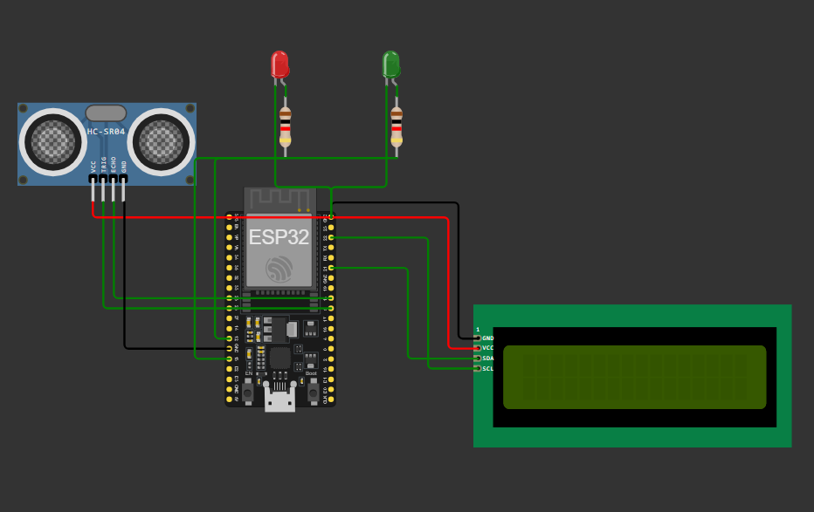
Circuit Diagram

Slide 5
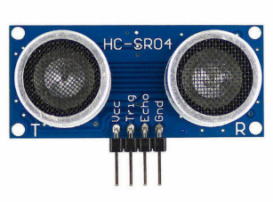
Ultrasonic Sensor Working
• Emits ultrasonic waves and measures the time for echo return.
• Determines the distance between sensor and object.
• If distance < threshold, parking slot is occupied.

Slide 6
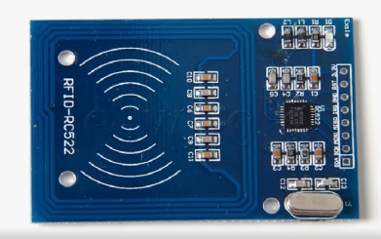
RFID Integration
• RFID reader scans vehicle RFID tags.
• Extracts unique vehicle ID.
• Sends data to cloud for record-keeping and monitoring.

Slide 7
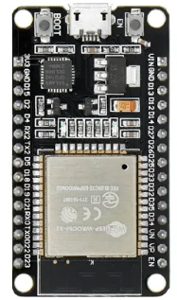
Cloud Connectivity
• ESP8266 connects to WiFi.
• Sends slot availability and RFID data to a cloud server.
• Enables remote monitoring of parking status.

Slide 8
LCD Display & LED Indicators
• LCD displays parking status and available slots.
• Green LED: Slot available.
• Red LED: Slot occupied.

Slide 9
Working of the System
1. Vehicle scans RFID tag.
2. System determines vehicle type.
3. Ultrasonic sensors check available parking slots.
4. Genetic Algorithm selects the best slot based on size & distance.
5. LCD displays the recommended slot.

Slide 10
Genetic Algorithm for Parking Slot Selection
Initial Population: Randomly selects available slots.
Fitness Calculation: Evaluates slots based on distance & size.
Selection: Chooses top-performing slots.
Crossover & Mutation: Generates better solutions.
Best slot is selected after multiple generations.

Slide 11
Code Breakdown
updateSlotOccupancy() - Checks if slots are occupied.
getVehicleType() - Retrieves vehicle type from RFID.
calculateFitness() - Assigns fitness to each slot.
geneticAlgorithm() - Runs optimization to find the best slot.
LCD & Serial Monitor display results.

Slide 12
Flowchart of the System
Start
Scan RFID
Get Vehicle Type
Check Slot Availability
Run Genetic Algorithm
Display Recommended Slot
End

Slide 13
Advantages & Applications
• Reduces manual parking management efforts.
• Prevents unauthorized vehicle entry.
• Real-time parking data accessible from cloud.
• Used in malls, offices, and public parking lots.

Slide 14
Summary
The system automates parking management using IoT.
Detects vehicles, identifies them using RFID, and updates cloud data.
Provides real-time parking availability through an LCD display.

Slide 15
Conclusion
• The Smart Parking System enhances efficiency and security.
• IoT & RFID enable real-time monitoring.
• Future improvements: AI-based parking predictions and mobile app integration.

