Slide 1
House sales and pricing over time
Indrė Balytė-Zykė

Slide 2
Data description: data is taken of Euro area countries from 2010 years
EURIBOR rates
HICP - annual data (average index and rate of change): The Harmonised Index of Consumer Prices (HICP) gives comparable measures of inflation for the countries and country groups for which it is produced. It is an economic indicator that measures the change over time of the prices of consumer goods and services acquired by households
House price index (HPI): measures inflation in the residential property market. The HPI captures price changes of all types of dwellings purchased by households
Convergence indicators - defined as the coefficient of variation of the price level indices (PLIs) and per capita volume indices (VIs) of gross domestic product (GDP). It measures the price and volume convergence across countries.
House sales

Slide 3
The main problem we want to analyse: how house sales are impacted (if there is relation) of inflations measures, price index and interest rates over the past years.
Data sources:
Euribor rates, daily values (suomenpankki.fi)
Eurostat: https://ec.europa.eu/eurostat

Slide 4
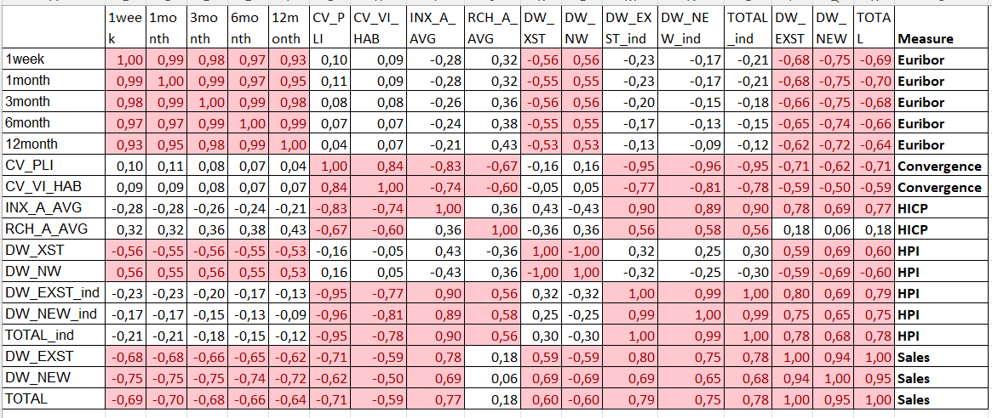
Correlation matrix
Findings:
Euribor has positive correlation with house prices index and house sales
Convergance indexes has negative correlation with house prices index and house sales
House prices are strongly related inflations measures (HICP)

Slide 5
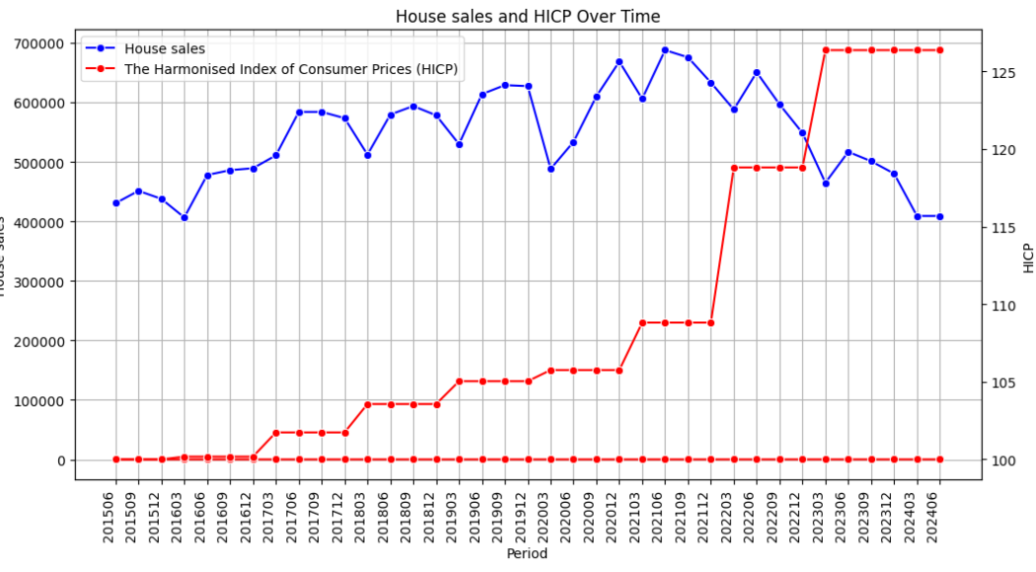
House sales have unchanging enough dinamic till 2022.06
Russian war with Ukraina has significant impact and house sales started decrease
HICP became high and this impacts sales also
If inflation is increasing than house sales are decreasing

Slide 6
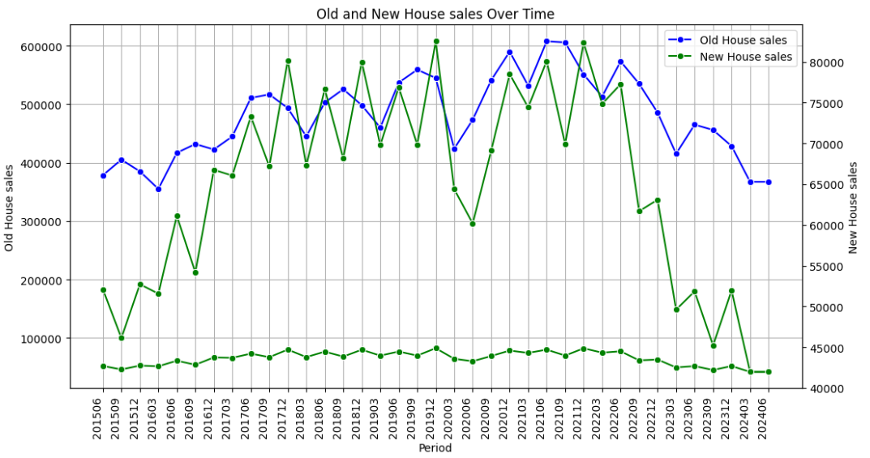
New and old houses sales has very similar dinamics but new houses are purchased 7 times less
After Russia war against Ukraina (2022.03) sales started decreasing and new houses are decreasinf faster than old house
In the beginning of COVID–19 period (2019.12-2020.06) sales of houses decreased significantly – unknown situation for current society
Later in COVID-19 period (2020.06-2020.12) sales increased – people stay more at home during quarantine and own space, yard are valued more than earlier

Slide 7
A/B testing
Parameter we are interested on: new and old houses sales
Null Hypothesis: new houses amount= old houses amount
Alternative Hypothosis: new houses amount <> old houses amount
sm.stats.ztest(df['DW_EXST'].dropna(), df['DW_NEW'].dropna())
The Statsmodels ztest function carries out the test and returns a test statistic (8.6287512347588) and p-value (6.202543025935738e-18). The p-value is quite small (<0.05), and therefore there is very strong evidence against the null hypothesis.This means that sales between new and old houses are very different
But if we look into index measures we see that we can't reject null hypothesis p-value (0.8275643076939203)

Slide 8
Scripts, data files and results are published in github: https://github.com/IndreBZ/SEB_Baltic Tools are used: Python for data analysis SQL for data preparations and dataset creation Jupyter notebook work Python scripts, results and comments GitHub for results saving

