Slide 1
C S 505: Artificial Intelligence I Project Demo Human vs AI Connect4 A Comparison of Minimax, Expectimax, and Machine Learning Approaches
Indronil Bhattacharjee

Slide 2
Contents
Problem
Solution
Findings
Comparison
Conclusion

Slide 3
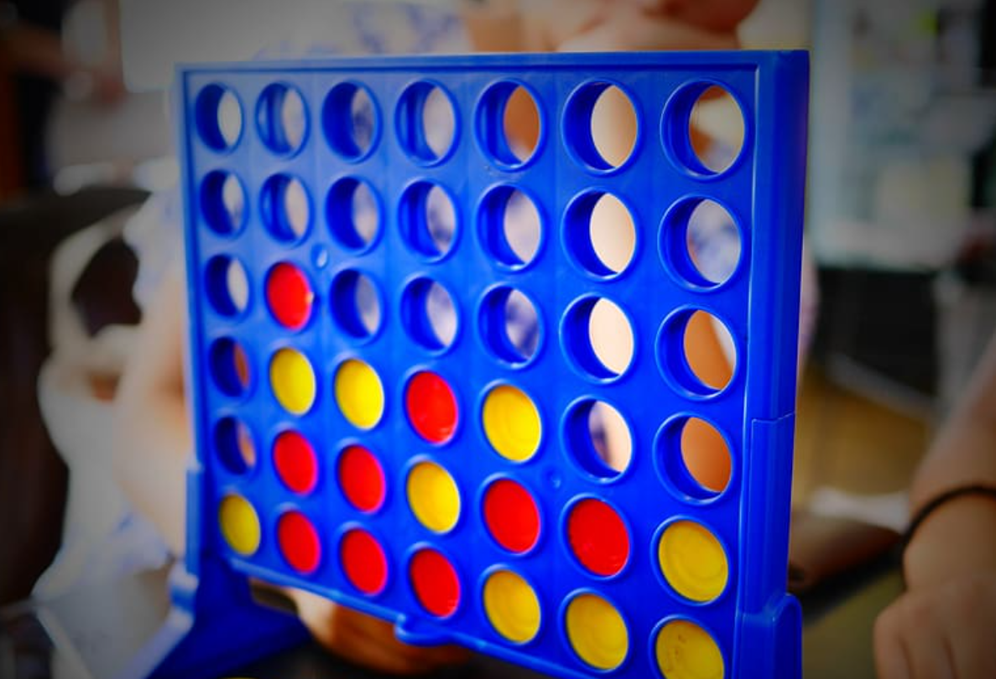

Problem
Human vs AI Connect4

Slide 4
Problem Statement
Connect4 is a popular two-player game where players aim to connect four of their colored pieces vertically, horizontally, or diagonally on a grid.
The problem is to develop an AI player capable of making optimal decisions to win the game or prevent the opponent from winning.
Making comparison among well-known approaches like Minimax, Expectimax and a machine learning solution.

Slide 5
Solution Approaches
Minimax
Expectimax
Machine Learning Approach

Slide 6
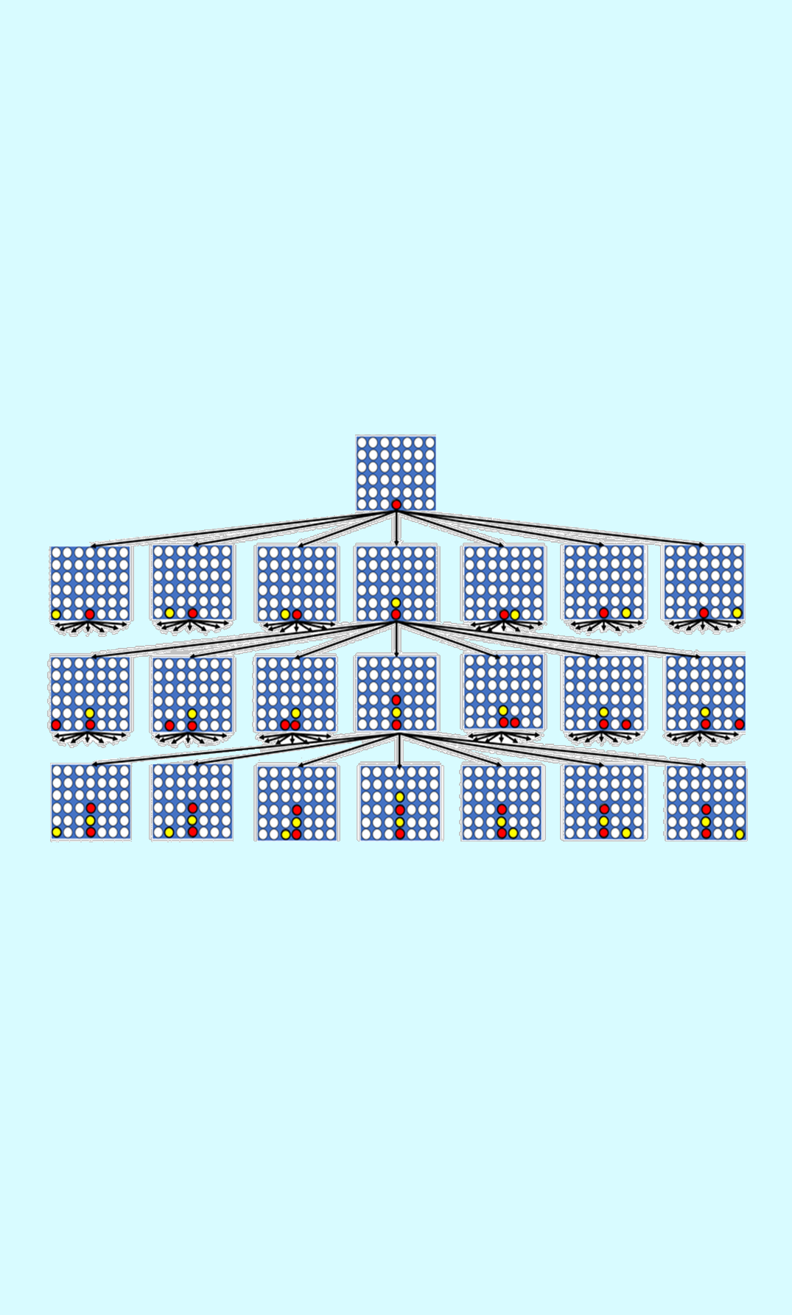

Minimax
Maximizer vs Minimizer

Slide 7
Minimax Approach
Minimax algorithm, a decision-making technique used in two-player games.
Develop an evaluation function to assign scores to potential game states based on a heuristic.
Construct a search tree representing all possible moves and counter-moves up to a certain depth.
Alternate between maximizing the AI player's score and minimizing the Human player score at each level of the tree.
Guarantees optimal play when using a perfect evaluation function.
Suitable for games with deterministic and finite state spaces.
Computationally expensive, especially for deeper search depths.

Slide 8
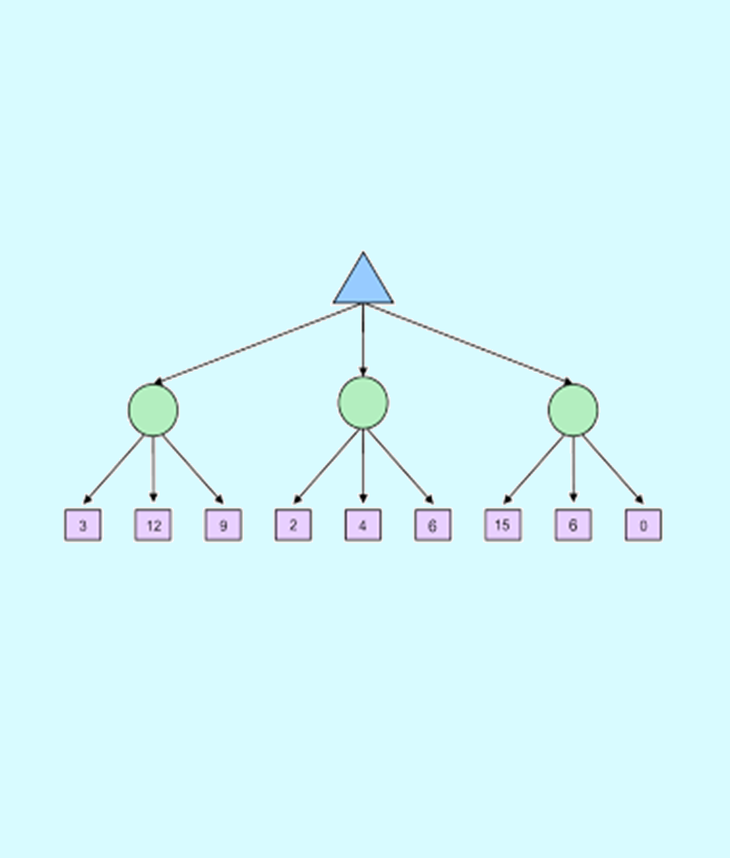
Expectimax
Maximizer vs Average move

Slide 9
Expectimax Approach
Extend the capabilities of the AI player to account for uncertainty and randomness.
Implemented the Expectimax algorithm, a variation of Minimax that incorporates chance events.
Develop an evaluation function to assess potential game states, considering both optimal moves and chance events.
Construct a search tree representing all possible moves and chance events up to a certain depth.
Alternate between maximizing the AI player's score and expecting the average score of possible outcomes for chance events.
More flexible than Minimax, suitable for games with randomness or imperfect information.

Slide 10
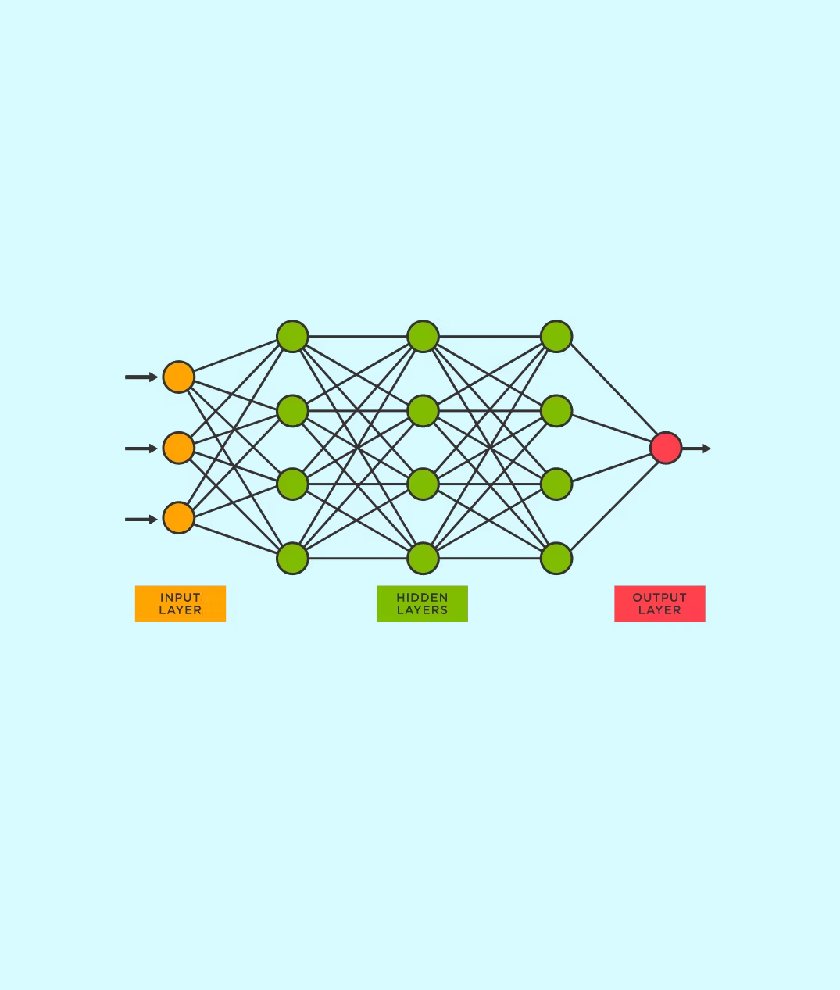
Machine Learning
Neural Network based model

Slide 11
Machine Learning Approach
Trained a neural network model to learn optimal strategies for Connect4 gameplay.
Define the state space and action space for the AI player.
Iterate through multiple training episodes to improve the model's performance.
Adaptable to complex patterns and strategies beyond human intuition.
May perform well with less domain knowledge or handcrafted heuristics. Requires large amounts of training data and computational resources.
Training process is time-consuming and may not always converge to optimal behavior.

Slide 12
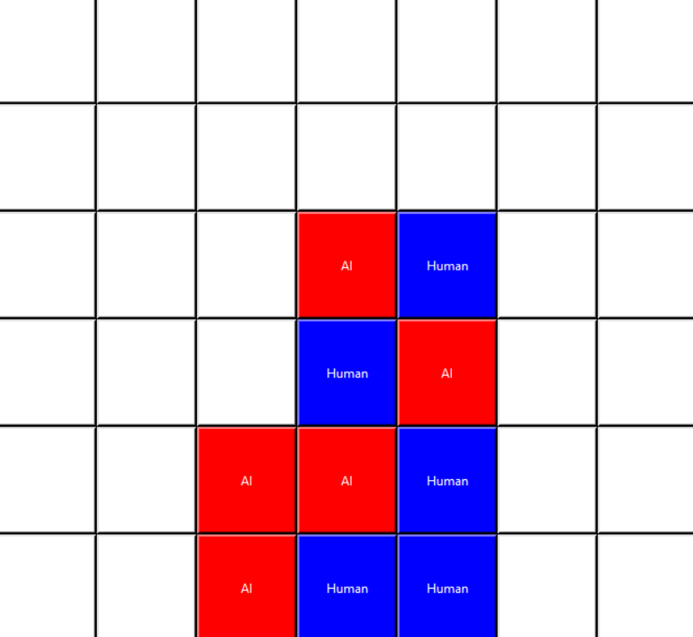
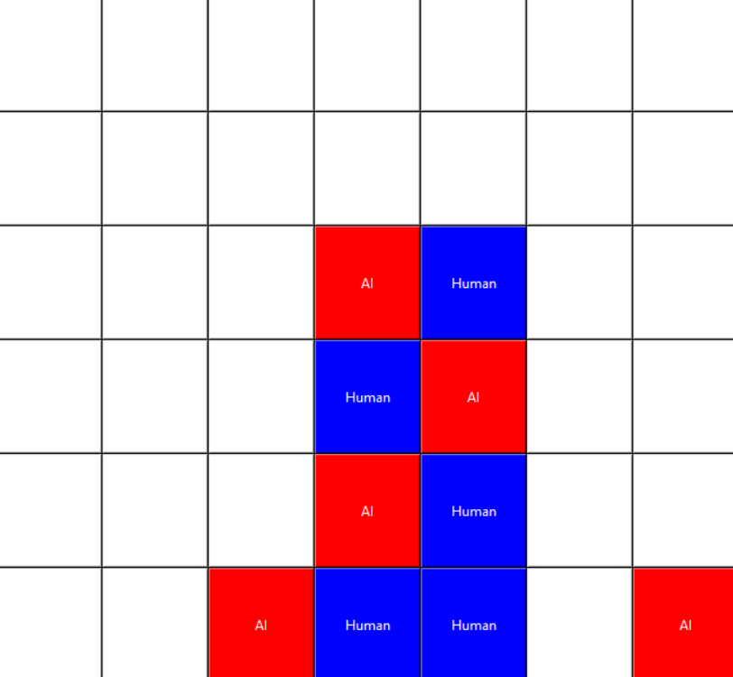
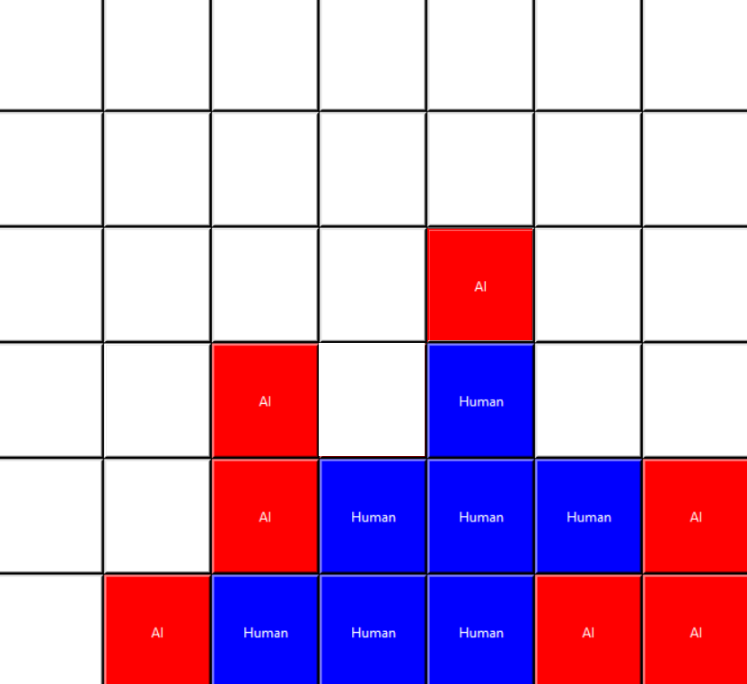
Findings
In our experiments, we found that Minimax and Expectimax algorithms performed well in providing optimal gameplay strategies.
The machine learning approach showed promise in adapting to complex gameplay patterns and strategies. However, it required extensive training data and computational resources.
We observed that the choice of approach depended on factors such as performance requirements, interpretability, and scalability.
Minimax
Expectimax ML

Slide 13
Performance Comparison
Impact factor | Total Played | AI Won
Minimax Approach | 10 | 10
Expectimax Approach | 10 | 8
Machine Learning Approach | 10 | 5

Slide 14
Conclusion
In conclusion, my project demonstrates the effectiveness of Minimax, Expectimax, and machine learning approaches in creating AI players for Connect4.
Though Minimax performs the best here, each approach has its strengths and limitations, and the choice depends on the specific requirements of the application.
Future work could involve further optimizing the algorithms for better performance and exploring hybrid approaches that combine the strengths of different methods.

Slide 15
Thank you
Indronil Bhattacharjee
PhD Student Department of Computer Science New Mexico State University
indronil@nmsu.edu

