Slide 1
Binary Search Tree

Slide 2
Date:14.05.2017
1507101:Fahim Ahmed
1507102:Tanzim Tamanna Shitu
1507103:Anik Pramanik
1507104:Mubasshir Hossain Kanon
1507105:Indronil Bhattacharjee

Slide 3
Introduction...

Slide 4
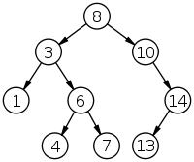
Introduction :
A binary search tree (BST), also known as an ordered binary tree, is a node-based data structure in which each node has no more than two child nodes. Each child must either be a leaf node or the root of another binary search tree. The left sub-tree contains only nodes with keys less than the parent node; the right sub-tree contains only nodes with keys greater than the parent node.
BST :
root
parent
17
<
>
left child
11
19
right child
Fig 1 : BST Fig 2 : BST

Slide 5
Introduction :
Data
left
child
right
child
A Binary Search Tree :
-> A Binary Tree
-> A node based data structure
-> Each node has no more than two child
-> Every element has a unique key.
The left sub-tree contains only nodes with keys less
than the parent node
-> right sub-tree contains only nodes with keys greater than
the parent node.
-> Each child must be leaf node or root of another binary
search tree.
Root →
40
<
>
1 2
20
60
Root ->
10
30
50
70
Fig : BST

Slide 6
Introduction
Accessing a item from a linked list takes O(N) time for an arbitrary element.
Binary trees can improve upon this and reduce access to O(log N) time for the average case
Expands on the binary search technique and allows insertions and deletions
Binary search trees keep their keys in sorted order, so that lookup and other operations can use the principle of binary search when looking for a key in a tree (or a place to insert a new key), they traverse the tree from root to leaf, making comparisons to keys stored in the nodes of the tree and deciding, based on the comparison, to continue searching in the left or right subtrees.
The major advantage of binary search trees over other data structures is that the related sorting algorithms and search algorithms such as in-order traversal can be very efficient; they are also easy to code.
Sets, multi-sets and associative arrays & containers are created based on BST.

Slide 7
CREATING A BINARY SEARCH TREE

Slide 8
CREATING A BINARY SEARCH TREE
KEY FACTS:
All smaller elements will be in the left subtree of the root.
All greater elements will be in the right subtree of the root.
No duplication of data.
Quicker insertion.

Slide 9

Insert 40
Insert 20
Insert 30
Insert 60
Insert 10
Insert 70
Insert 50
40
20
60
10
30
50
70

Slide 10
BST does not contain duplicate content. So if we insert an existing element in the tree the tree will not change.
Suppose we INSERT 30 in this tree…
40
20
60
10
30
50
70

Slide 11
It will continue traversing.
When it finds that 30 already exists, it will ignore inserting 30 again.
So, 30 will not be inserted and the tree will remain as it was.
40
20
60
10
30
30
50
70
30
Therefore, the BST will remain the same while a duplicate value is inserted.
.

Slide 12

The same can be done with a linear sorted array. Then why will we use Binary search tree?
10 | 20 | 30 | 40 | 50 | 60 | 70
Insert 45
45
10 | 20 | 30 | 40 |  | 50 | 60 | 70
A lot of works to be done, which takes much time. Comlexity will be higher.

Slide 13
But in case of a BINARY SEARCH TREE…
40
40
20
60
20
60
10
30
50
70
10
30
50
70
45
Insert 45
Which is quicker than that of linear sorted array. Complexity is minimum, which is our need for any data structure. That’s why BST is chosen over a linear array for quicker insertion of data.

Slide 14
Finding a node in a Binary Search Tree
.

Slide 15
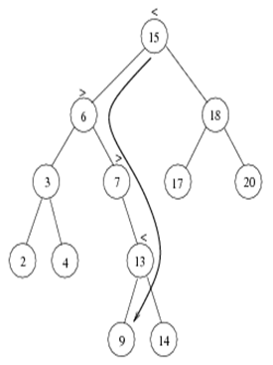
Find in BST :
Searching a binary search tree for a specific key can be programmed recursively or iteratively.
Steps :
-> We begin by examining the root node.
-> If the tree is null, the key we are searching for does not exist in the tree. Otherwise, if the key equals that of the root, the search is successful and we return the node.
-> If the key is less than that of the root, we search the left subtree. Similarly, if the key is greater than that of the root, we search the right subtree.
-> This process is repeated until the key is found or the remaining subtree is null. If the searched key is not found after a null subtree is reached, then the key is not present in the tree.
Searching 9 in BST

Slide 16
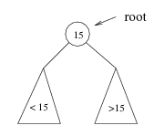
Searching BST
->If we are searching for 15, then we are done.
->If we are searching for a key < 15, then we should search in the left subtree.
->If we are searching for a key > 15, then we should search in the right subtree.

Slide 17
Search in BST :

Slide 18
Search in BST :
In the worst case ,
this algorithm must search from the root of the tree to the leaf farthest from the root.
The search operation takes time proportional to the tree's height .
On average, binary search trees with n nodes have O(log n) height.

Slide 19
Deleting a node from a Binary Search Tree

Slide 20
Deleting a Node :
Removing a node in binary search tree is little complex. But it’s algorithm is easy to understand. Basically, it can be divided into two stages:
1.search for a node to remove.
2.if the node is found, run remove algorithm.
It depends primarily on the number of child of the node.

Slide 21
Deleting a Node :
Case
1
node to be removed has no child
node to removed has only one left or right child
Case
3
node to be removed has two child both left and right
Case
2
.

Slide 22
Deleting a Node :
CASE 1 :
Algorithm sets corresponding link of the parent to NULL and disposes the node to be removed.

Slide 23
Case 1
Example:
5
3
18
1
2

Slide 24
Case 1
Example: Removing 1
5
3
18
1
2

Slide 25
Case 1
After removing:
5
3
18
2

Slide 26
Case 2:
In this case node is cut from the tree and algorithm links single child directly to the parent of the removed node tree.

Slide 27
Case 2
Example:
5
3
18
1
2
21
19
25

Slide 28
Case 2
Removing 18:
5
3
18
1
2
21
19
25

Slide 29
Case 3
:
5
3
18
1
2
21
19
25

Slide 30
Case 2
After removing:
5
3
21
1
2
19
25

Slide 31
Case 3
In this case we need to know the concept of in order traversing. After applying that traversing, the element after the node to be removed have to be inserted in that place.

Slide 32
In Order Traverse
to traverse the left sub-tree by recursively calling the in-order function.
to display the data part of the root (or current node).
to traverse the right sub-tree by recursively calling the in-order function.

Slide 33
Case 3:
Example:
5
2
12
1
3
9
21
19
25

Slide 34
Case 3:
Removing 12:
5
2
12
1
3
9
21
19
25

Slide 35
In order traversing:
1 2 3 5 9 12 19 21 25

Slide 36
Case 3:
After removing:
5
2
19
1
3
9
21
19
25

Slide 37
Case 3
:
5
2
19
1
3
9
21
25

Slide 38
Complexity

Slide 39
COMPLEXITY OF BINARY SEARCH TREE
Best case
Worst case
Random/average case

Slide 40
Complexity in
Search operation
Insertion operation
Deletion operation

Slide 41
Searching
Searching in a BST always starts at the root.We compare a data stored at the root with the key we are searching for.If the node does not contain the key we proceed either to the left or right child depending upon comparison.
It has O(h) worst-case runtime complexity,where h is the height of the tree.Since a binary search tree with n nodes has a minimum of O(log n) comparisons to find a particular node.

Slide 42
Now , we can understand it easily by a chart
Operation | Average | Worst case | Best case
Search | O(log n) | O(n) | O(1)
Insertion | O(log n) | O(n) | O(1)
Deletion | O(log n) | O(n) | O(1)

Slide 43
Complexity :
In insertion and deletion both cases are same as searching.
Average case O(log n),worst case O(n),best case O(1)
Best case stands for if we find it at root node in first comparison.

Slide 44
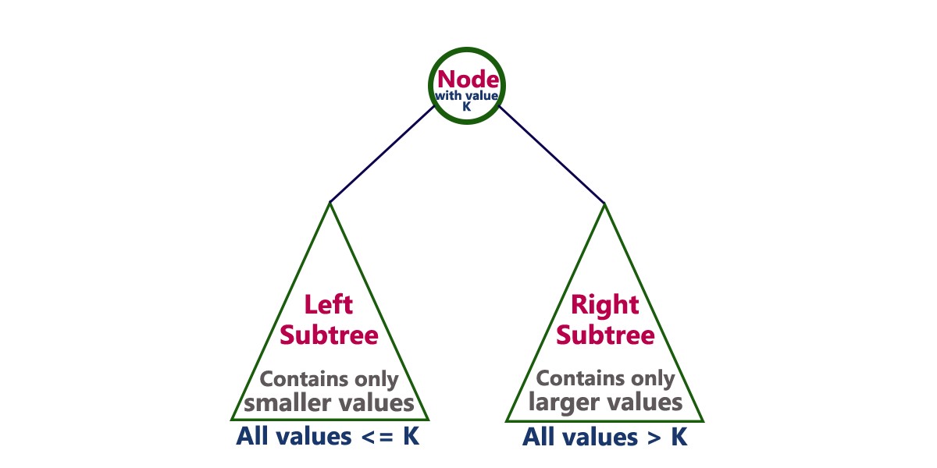
Complexity :

Slide 45
The End...
.

