Slide 1
Player role design pattern
Presented by :
1507104 --- Md. Mubashshir hosain
1507105 --- indronil bhattacharjee
1507116 --- amrita biswas

Slide 2
Player role pattern
Context :
In computer science, the Player Role Model is a role analysis pattern described by Francis G. Mossé in his article on Modeling Roles. The role class pattern provides the ability for a class to play multiple roles and to embed the role characteristic in a dedicated class.
In our society, as we built it, roles are everywhere. Anyone trying to work in a team to create something has a role. In cinematography, many different persons take part in the creation of a film: the film director, the producer, actors, play writer, etc. Even our State organizations are based on various roles. In a Republic, you have a President, Ministers, Deputies, etc.
2

Slide 3
Introduction
Definition
A model that allows a class to play one or more roles at the same time. A role - as defined by Francis Mossé in Modeling Roles - is a concept of a purpose that a class could have in a certain context.
Types
Regarding to problems player role model are of 5 types:
Inheritance role
Association roles
Role classes
Generalized player role classes
Association class roles
3

Slide 4
Strengths and weaknesses of using player role model
The employment of this model depends on the business process. The analysis pattern “player role model” offers a possibility to employ a model with linking between a base class and the client. In addition inheritance is not a part of the solution because of the flexibility of zero or multiple roles (role-specific attributes and operations). Strength implies also its counterpart's weakness. The problem of the player role model is the redundancy, for example the method getName is visible in all of the role classes described in Figure. If this is considered inconvenient, the role class generalization model as defined in Modeling Roles is a possible way to go.
4

Slide 5
Logical Problem
Using inheritance to play more than one role cannot be considered, because a class could not play two roles at the same time in such a context .
The expectation is to have a model where a class could be seen as more than one concept or role, and where attributes specific to one of those concepts can be specified
5

Slide 6
Solution
A solution to the previous problem could be to use the Association Role Model, which could create an association between a person and a film. However, specific information on each role could not be stored in such a case. The player role model provides the flexibility of the association with role-specific attributes and even class operations, if needed.
6

Slide 7
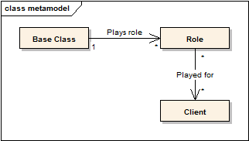
Solution
7

Slide 8
Detailed
This meta model - in Figure - shows the role class like an element linking the Client and the BaseClass. For the Client interacting with the Role is like interacting with the Base Class itself, but from the perspective, it is expecting. The advantage having the role as a class is that attributes can be bound to it.
Another situation where the Role pattern is interesting is when you've the following situation:
8

Slide 9

9

Slide 10
Then you realize that as a contract holder, the Person has specific attributes. The holder UML role becomes a dedicated class ContractHolderwith these specific attributes. Note that in that case that the multiplicity near Person and Contract are always 1. It means that you've one ContractHolder object for each association between a Contract and a Person.
10

Slide 11
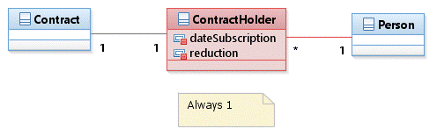
Another solution
11

Slide 12

Real-world example
12

Slide 13
Solution
A simple application of the player role model in a real example is in the 7th art (see Figure), the cinematography. This art involves a creation (the Film) and people to create it. Each person has a different role in the film, they could be actors and play characters, they could be director or scenarist, etc. A person is not limited to one role in a film, they can be both actors and directors and even more. For example, the film Scoop (2006)has been directed by Woody Allen, he is also the scenarist and he plays the role of Sid Waterman.
13

Slide 14
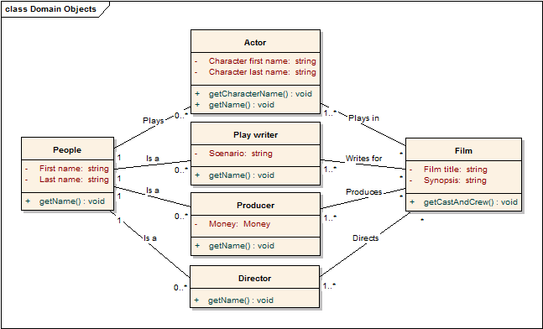
The 7th art in more details
14

Slide 15
detail
In Figure ,one can see in more detail the role that each person can play in a film. From the film, it is possible to ask the list of crews and cast that help elaborated it. Each person has one or more roles (e.g. actor, director, producer, cameraman, etc.) in the film and can participate in more than one film. A person could even be an actor in a film and a producer in another. One advantage of using a role class in the case of the actor role is that the character qualities can be stored within the role. This is true for the actor role, this is also true for other roles, however maybe not all.
Only a few of the possible role have been modeled in Figure . One remark easily visible is that not all the role needs attributes and using the player role model for all of them is unnecessary (like for the Director role). In addition, there is a lot of redundancy between each role class. Redundancy in computer science means more work in maintenance, which is not wished.
15

Slide 16
Thank You

