Slide 1


MySQL vs. MongoDB
Team 3 Query Crushers

Slide 2
Introduction to MySQL and MongoDB
MySQL: Traditional RDBMS, structured data, SQL support.
MongoDB: NoSQL, document-oriented, flexible and schema-less.
Strengths Comparison
MySQL: Structured data, ACID-compliant, ensuring data integrity and reliable transactions.
MongoDB: Flexible document model for faster, agile development with high scalability.
Use Cases: MySQL for high integrity, MongoDB for scalability.
Notes:
MySQL: Traditional relational database (RDBMS) known for structured, table-based storage.
Uses SQL (Structured Query Language) optimized for complex transactions and data consistency.
Row-oriented format with predefined schemas, ideal for structured data and transactional reliability.
Best suited for applications requiring high data integrity, e.g., financial systems, e-commerce.
MongoDB: NoSQL, document-oriented database that uses flexible, schema-less JSON-like documents.
Manages unstructured and semi-structured data efficiently.
Uses collections and self-describing documents with nested fields, ideal for complex data structures.
Popular for web applications, real-time analytics, and high scalability.
Strengths Comparison:
MySQL: Structured data, ACID-compliant, ensuring data integrity and reliable transactions.
MongoDB: Flexible document model for faster, agile development with high scalability.
Use Case Insight: Choice depends on application needs, scalability requirements, and data structure type.

Slide 3
Key Features of MySQL & mongodb
MySQL
Structured Data: Table-based storage with predefined schemas.
Optimized for Transactions: ACID compliance ensures data integrity.
Efficient Joins and Indexes: Critical for handling complex queries.
Use Cases: Financial systems, e-commerce platforms.
MongoDB
Document-Oriented: Schema-less JSON-like storage.
Flexibility: Handles unstructured and semi-structured data.
Scalable and Agile: Ideal for real-time analytics and web applications.
Use Cases: Applications requiring high scalability and frequent updates.

Slide 4
Experiment Overview
Objective: Compare MySQL and MongoDB on query execution times and resource usage.
Queries Used: Top genres by revenue, business revenue per store, sales by staff, etc.
Devices:
 | Windows | MacBook
Processor | 11th Gen Intel(R) Core i7 @ 2.80GHz | M2
Installed RAM | 32.0 GB | 8.0 GB
System Type | 64-bit Operating System | 64-bit ARM Architecture
Operating System | Windows 11 | 15.0.1
HDD Storage | 2TB | 512GB

Slide 5
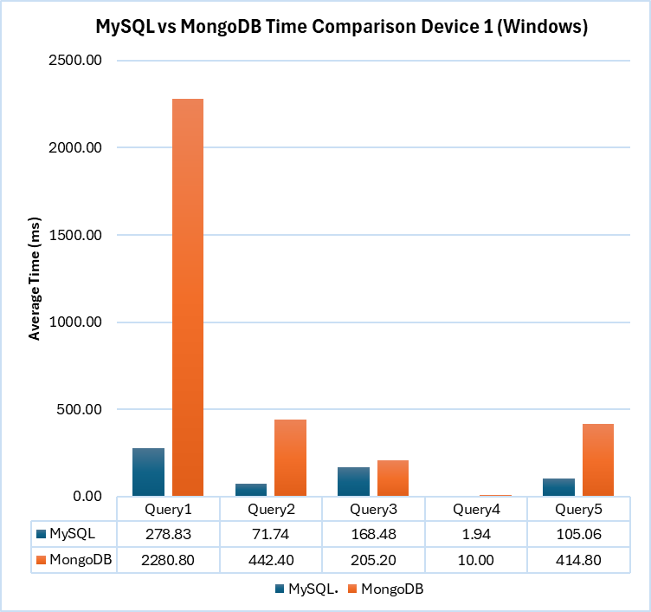
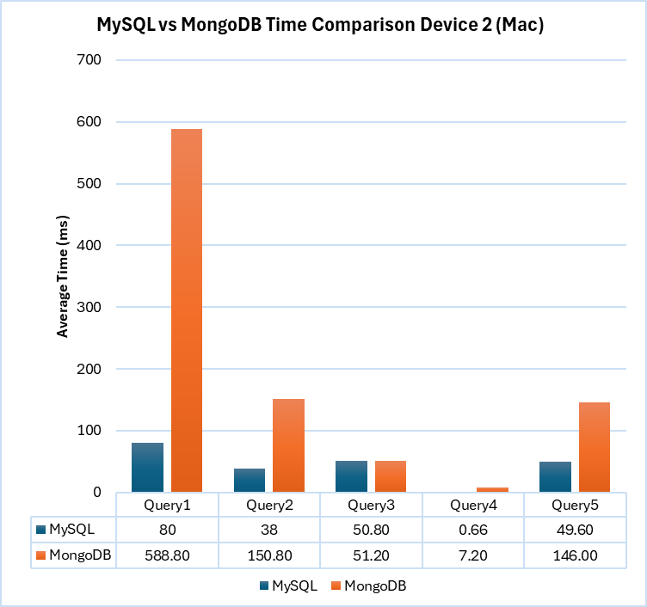
TIME COMPARISON

Slide 6
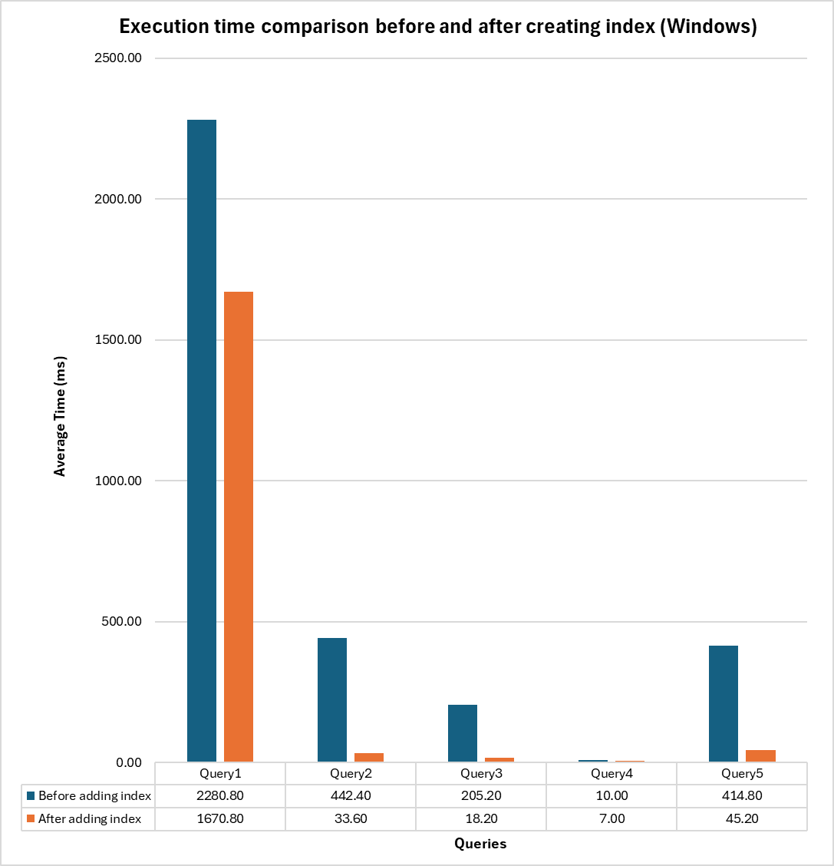
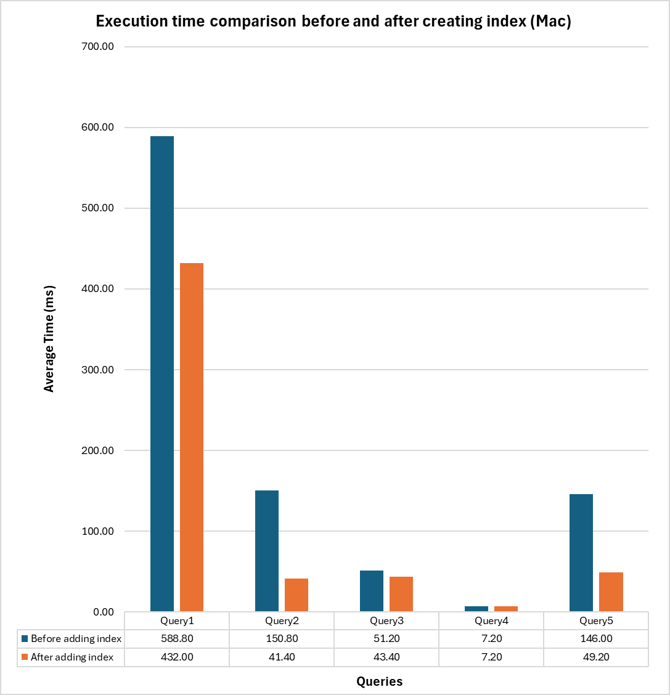
Time comparison after indexing

Slide 7
Indexing impact
Impact on Execution Time:
Indexing in MongoDB led to significant reductions in execution time across queries.
For Query 1, adding indexes reduced execution time from 2280.80 seconds to 1670.80 seconds.
Query 2: Execution time dropped from 442.40 seconds to 33.60 seconds with indexing on customer and payment IDs.
Efficiency Gains:
Indexing expedited $lookup operations by reducing document scans, leading to faster joins and aggregations.
With proper indexing, MongoDB’s performance approached MySQL’s for certain operations.
Memory and Resource Optimization
Indexing also optimized memory use by reducing the volume of data MongoDB had to load, particularly in join operations.

Slide 8
Memory Usage and Optimization Insights
 | MySQL | MongoDB
Memory Usage Patterns | Used nested loop joins and covering indexes to reduce data loaded into memory, minimizing memory usage. | Initially required more memory for document processing due to collection scans and $lookup operations without indexes.
Optimization Techniques | Covering indexes and efficient aggregation minimized resource usage. | Indexing reduced memory and processing load by cutting down on full collection scans.
Overall Resource Use | MySQL generally exhibited more efficient memory management with its relational structure and indexing. | MongoDB required careful indexing and query design for comparable resource efficiency.

Slide 9
Scalability
MySQL
Relies on upgrading hardware resources (CPU, memory) to improve performance.
Key Advantages: Supports ACID compliance for transaction consistency.
Requires minimal application changes during scaling.
Challenges: Limited by hardware constraints.
Higher costs for scaling as workload grows.
MongoDB
Adds more servers/nodes to distribute data and workload.
Key Advantages: Handles massive datasets with sharding for distributed storage.
Supports replication and high availability for large-scale applications.
Challenges: Complex setup and cluster management.
Requires robust strategies to maintain data consistency.

Slide 10
Conclusion
Performance: MySQL is faster and more resource-efficient, especially with complex queries, while MongoDB benefits from indexing for unstructured data.
MySQL Strength: Optimized for structured, transaction-heavy applications with ACID compliance.
MongoDB Strength: Flexible, scalable, ideal for unstructured data and agile development.
Recommendation: Use MySQL for relational data needs; MongoDB for flexible, scalable, and diverse data projects.

