Slide 1
Diabetic Retinopathy Classification from Retinal Images using Machine Learning Algorithms
Tareq Mahmud Indronil Bhattacharjee
Roll no : 1507089 Roll no : 1507105
Supervised by :
Al-Mahmud
Assistant Professor
Department of CSE, KUET.

Slide 2
Outline
Introduction
Objective
Motivation
Related Methods
Methodology
Expected Outcome
Discussion
Conclusion

Slide 3
Introduction
People with diabetes can have an eye disease called diabetic retinopathy.
It happens when high blood sugar levels cause damage to blood vessels in the retina.
It can damage the patient’s vision, even leads to blindness.
Our aim is to develop a system that will be able to identify patients with Diabetic Retinopathy from retinal colour fundus images.

Slide 4
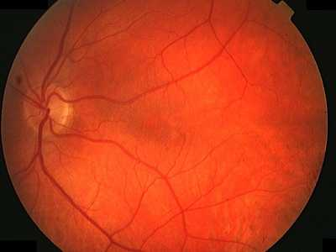
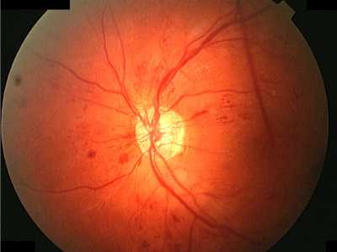
Introduction
(a) (b) (c)
Fig 1 : (a) Healthy Eye (b) Eye with Non-Proliferative DR (c) Eye with Proliferative DR

Slide 5
Objective
Our objective is to -
Process colour fundus retinal images for Diabetic Retinopathy detection.
Extract key features from the pre-processed images.
Detect the presence of Diabetic Retinopathy.
Classify whether the Diabetic Retinopathy is Proliferative or Non-proliferative.

Slide 6
Motivation
Diabetic Retinopathy (DR) is one of the common eye diseases and is a diabetes complication that affects eyes.
Diabetic retinopathy may cause no symptoms or only mild vision problems. Eventually, it can cause blindness.
So early detection of symptoms could help to avoid blindness.

Slide 7
Related Methods
DR detection using feature of color fundus image like area and number of microaneurysm. Classification of DR has done by linear SVM.
Early exudates detection in retinal image. Best features from exudates are selected using naïve Bayes model . Different classifiers perform on those features like Naïve Bayes , SVM and NN classifier.

Slide 8
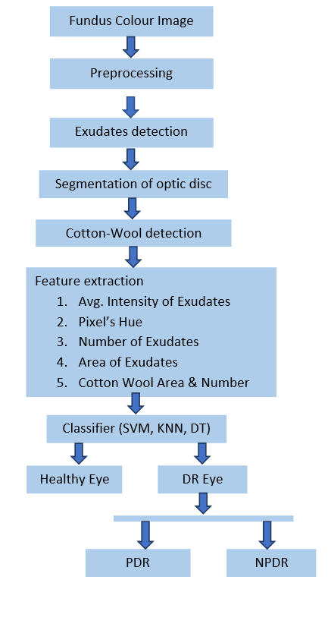
Methodology
Diabetic retinopathy detection system mainly consists three main steps:
Pre-processing of colour fundus images
Diagnostic feature extraction
Classification of Diabetic Retinopathy

Slide 9
Preprocessing
Pre-processing of colour fundus images contains following steps
• Green Channel Extraction
• Contrast Limited Adaptive Histogram Equalization
• Morphological Process
• Median Filtering
• Thresholding

Slide 10
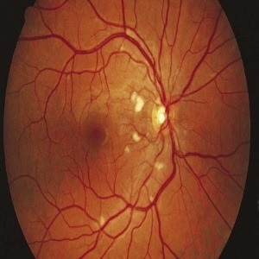
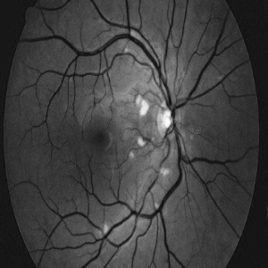
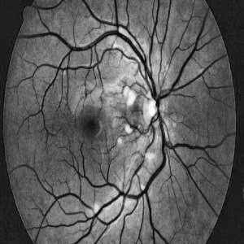
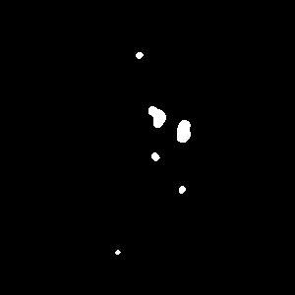
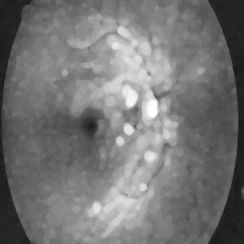

Preprocessing
(a) Input Image
(b) Green Channel
(c) CLAHE image
(f) After thresholding
(e) Median Filtered
(d) After Dilation

Slide 11
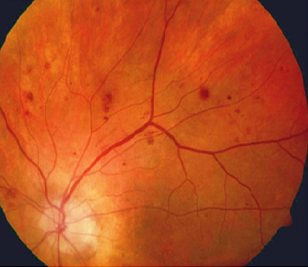
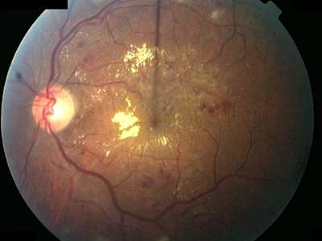
Feature Extraction
The proposed features that are to be extracted to detect Diabetic Retinopathy are-
• Average Intensity of Exudates
• Number of Exudates
• Area of Exudates
• Number of microaneurysms
• Cotton Wool Area and Number
• Cotton Wool Intensity
• Cluster intensity
Fig : Microaneurysms
Fig : Exudates
Fig :Cotton Wool Spots

Slide 12
Classification
Classification is performed using Support Vector Machine, Decision Tree and K-Nearest Neighbor classifier.
Firstly, it classifies whether the eye is DR affected or not.
If affected, then classify the stage of DR.
Whether it is proliferative or non-proliferative.

Slide 13
Expected Outcomes
We expect that using our proposed method it will be possible to detect Diabetic Retinopathy.
Not only detecting Diabetic Retinopathy but also we will be able to classify whether the DR is Proliferative or Non-proliferative, i.e. the condition is in primary stage or in a severe state that may lead into blindness.

Slide 14
Discussions
Support Vector Machine, Decision Tree and K-Nearest Neighbor classifiers are used.
Three classifiers are used because any of them may not give good accuracy for any one of the features.
So our objective of classifying with several classifiers will be accuracy comparison and to get the best accuracy.

Slide 15
Conclusion
After studying the existing systems, we conclude that our proposed technique will successfully detect Diabetic Retinopathy. Along with this, the proposed method will also classify Proliferative Diabetic Retinopathy and Non-Proliferative Diabetic Retinopathy.

Slide 16
THANK YOU

