Slide 1
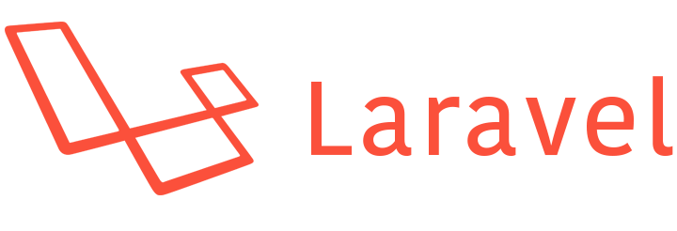
Laravel: The PHP Framework
Indronil Bhattacharjee

Slide 2


What is Laravel
Laravel is a free, open-source PHP web framework
It was created by Taylor Otwell in 2011
Laravel follows the Model-View-Controller (MVC) architectural pattern
It includes many built-in features such as routing, middleware, authentication, authorization, database migrations, and more
Laravel also has a robust ecosystem of packages and libraries

Slide 3
Features
MVC Architecture
Simple way of routing
Blade templating engine
Artisan command-line interface
Middleware allows add functionality such as authentication and authorization
Eloquent ORM
Easy-to-use authentication functionality, including authentication scaffolding, password resets, and more.
Events and broadcasting

Slide 4
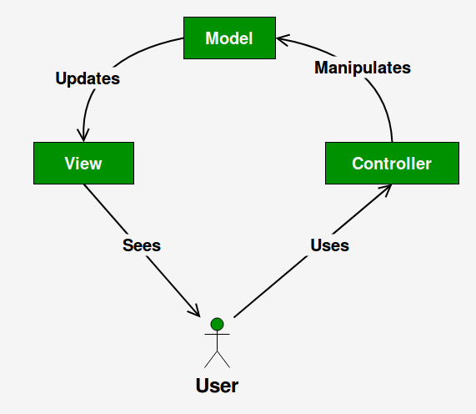
MVC Architecture
Model: The Model layer represents the data and business logic of the application.
View: The View layer represents the user interface of the application
Controller: The Controller layer acts as an intermediary between the Model and View layers. It handles user requests, retrieves data from the Model layer, and passes that data to the View layer for rendering
Image: https://www.geeksforgeeks.org/mvc-design-pattern/

Slide 5



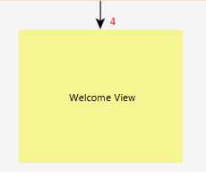
Routing
The easiest routing system
Routing per prefix or namespace
Routing per request method (GET, POST, DELETE, etc.)

Slide 6

Blade
Blade is the powerful template engine provided by Laravel
All the code inside blade file is compiled to static html file
Supports plain PHP
Saves time
Better components mobility, extend and include partials
Image: https://www.imdb.com/title/tt0187738

Slide 7
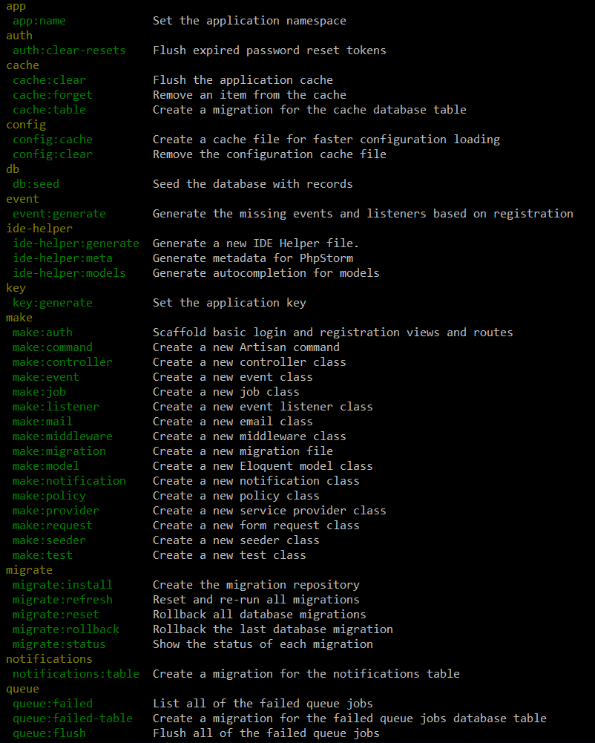
Artisan
Artisan is command-line interface for Laravel
Commands that are saving time
Generating files with artisan is recommended

Slide 8
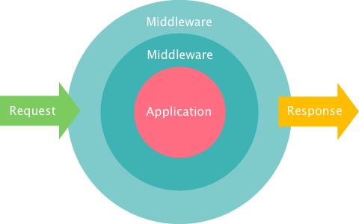
Middleware
The middleware is mechanism for filtering the HTTP requests
Laravel includes several middlewares – Authentication, CSRF Protection
The auth middleware checks if the user visting the page is authenticated through session cookie
The CSRF token protection middleware protects your application from cross-site request forgery attacks by adding token key for each generated form
Image: https://blog.servage.net/2015/03/17/using-and-building-own-middleware-in-laravel

Slide 9
Eloquent ORM
The Eloquent Object-relational mapping provides simple implementation for working with the database
$student = new Student();
$student -> name = ‘Indronil’;
$student -> email = ‘indronil@nmsu.edu’;
$student -> save();
INSERT INTO ‘Student’ (‘name’, ‘email’) VALUES (‘Indronil’, ‘indronil@nmsu.edu’);

Slide 10
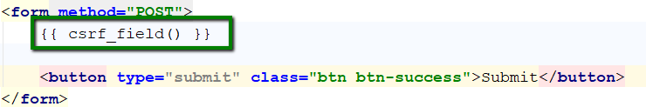
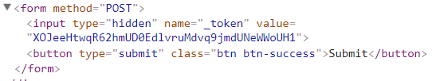
Cross Site Request Forgery
Using CSRF token protection that Laravel provides in forms you create, the hackers will not be able to spam your forms and database

Slide 11
Cons
Version Compatibility
Some packages or modules may not be compatible with the latest version of Laravel, which can cause issues for developers.
Complexity
Laravel's many features and functionality can also make it complex, which can lead to issues with scalability and maintainability.
Code Generation
While Laravel's code generation features can be useful for quickly setting up new projects, they can also generate a lot of code that may not be necessary or efficient.

Slide 12
It’s time for a
D E M O
Image: https://gifdb.com/gif/cute-penguin-doing-fast-typing-6ma4ulaar2x2gimo.html

Slide 13
Questions
?

Slide 14

Thank you!

