Slide 1

PEARL Lab Website
Indronil Bhattacharjee
Abdur Razzak

Slide 2

Agenda
Features
Architecures
Pages
Topic four

Slide 3

Features
Research Areas
List of Publications
News and Events
Lab Members’ Profile
Interactive Updates
Multiple User-Level Access

Slide 4
Architectures

Slide 5
Previous Architecture
Github API Repositories
MongoDB for User data
User Pages
JS com
Public Users
Publish pages
Cascade Pages
Private Users
JavaScript Scrolling News
Admin Users

Slide 6
Final Architecture
3rd Party API
Github
GH-Card
Blade PHP Pages
Apache Server
Laravel Framework
Public Users
MySQL Database
CRUD Operations
Private Users
Admin Users

Slide 7
Pages

Slide 8
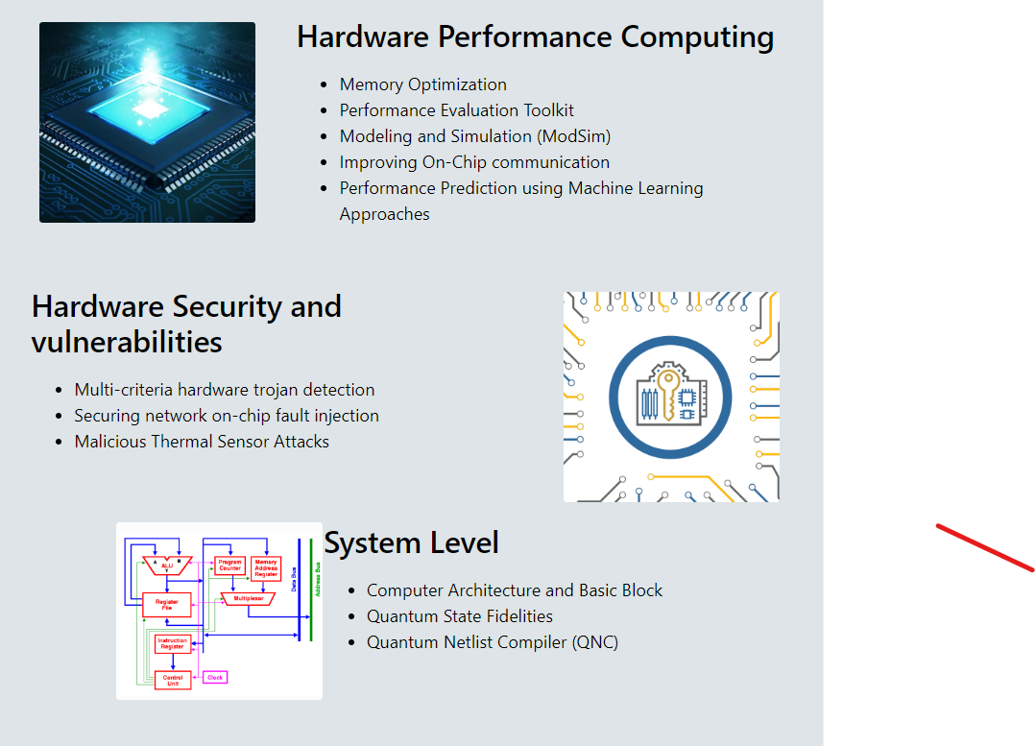
Research Area
Static page
No database involved

Slide 9
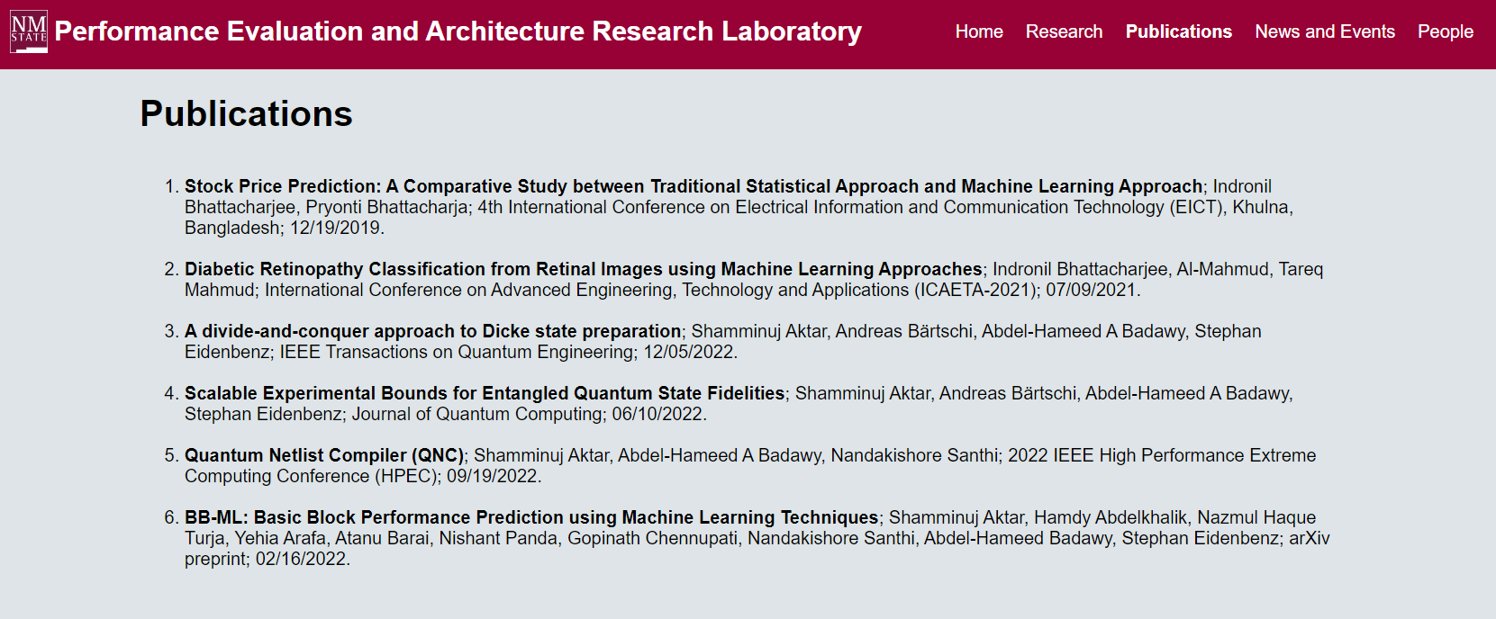
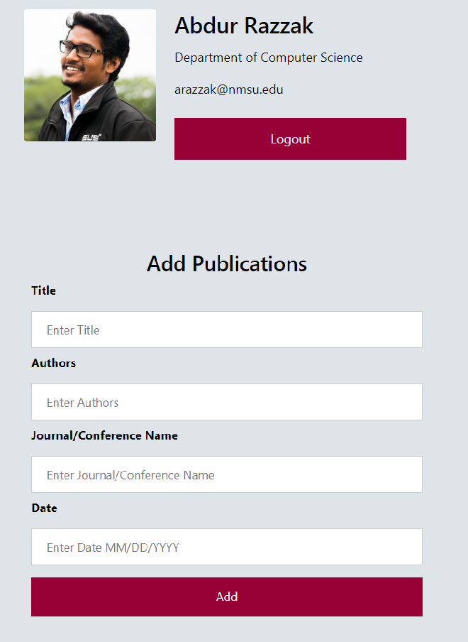
Publications
User Interactive
Only Member can update
Merged publications from DB

Slide 10

News and Events
Accessible by all
Modified by Members only
Database query
Sorted by Date

Slide 11
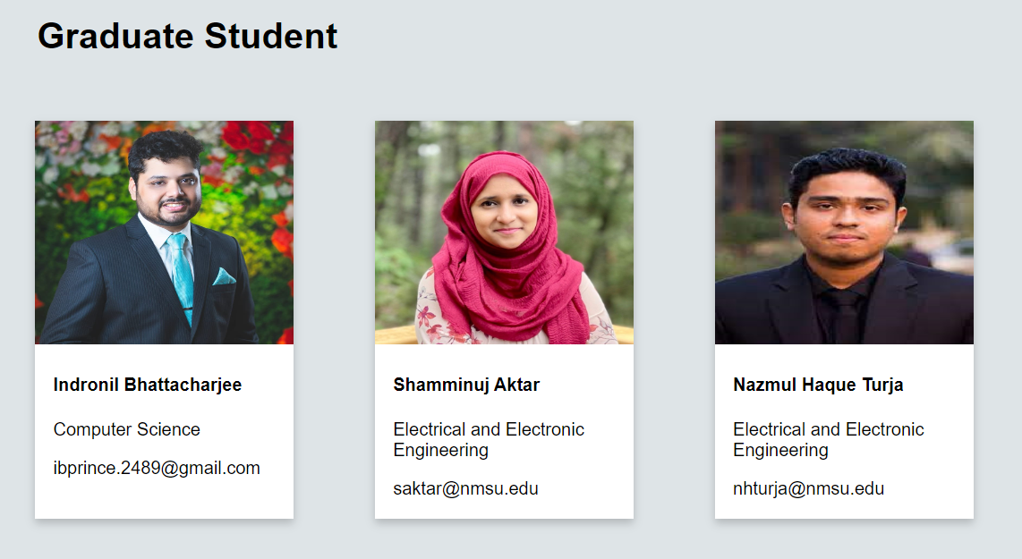
People Page
Public Page
Bootstrap Cards
Updated from User table
Only admin can modify
Option for Member login

Slide 12
Member Dashboard

Slide 13
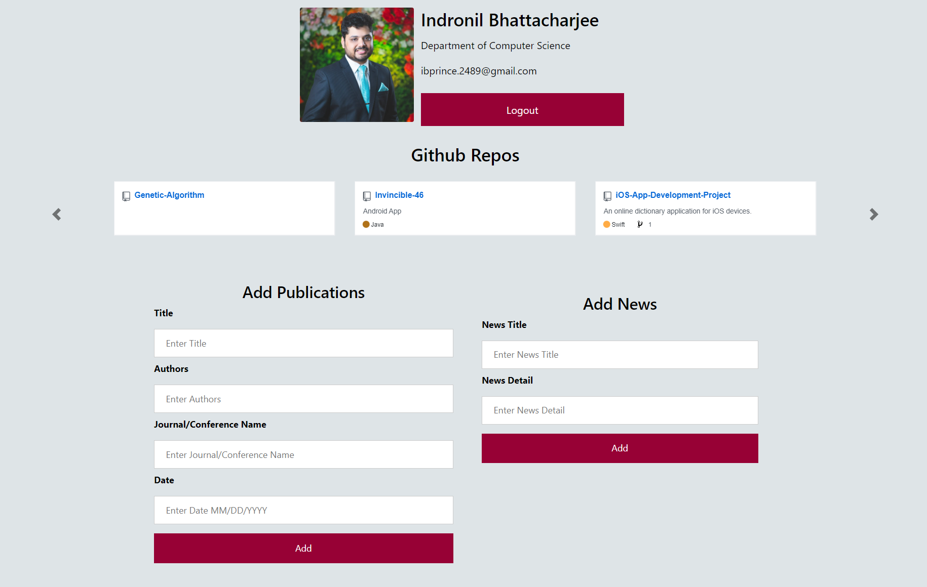
Member Dashboard
User Information after Login
Database Query using User Session
Repos using github and gh-card API
Sliding Carousel
Insert to News table of DB
Automatically update News page
Insert to Publication table of DB
Automatically update publications page

Slide 14
Multi Level User Access

Slide 15
Multiple Level Access
Add Lab Members
User Level Modification
All Public Pages
Dashboard
Add publications
Add News
Github repository
Admin
(Full Modification Access)
Member
(Partial Update)
All Public Pages
Dashboard
Add publications
Add News
Github repository
Public
(View Only)
Research
Publications
News and Events
People

Slide 16
Authorization

Slide 17
People Page
Public Page
Bootstrap Cards
Updated from User table
Only admin can modify
Option for Member login

Slide 18
Contributions
Indronil Bhattacharjee
Abdur Razzak
Research Page
Authentication
Github repos
Carousel Sliders
Database handling
New and Events
Publication
User dashboard
People
Database handling

Slide 19
Bites and Cakes
Difficulties
Counter measures
Cascade
For Dynamic update
MongoDB
For User authentication
Remove cascade from life
Easier dynamic updates
Shifting to Laravel
Authentication, Binding, Routing
MySQL
Structured and easy to handle

Slide 20
Bites and Cakes
It’s time for a
D E M O
Image: https://gifdb.com/gif/cute-penguin-doing-fast-typing-6ma4ulaar2x2gimo.html

Slide 21

Thank you

