Slide 1

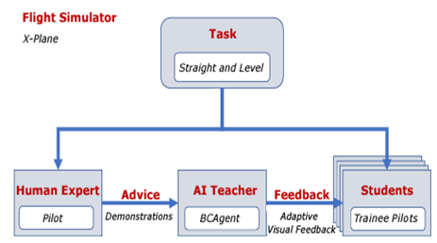
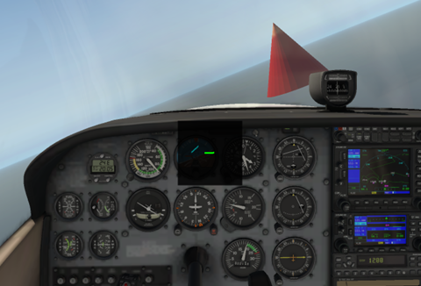
Enhancing Pilot Training: Adaptive Flight Exercises with AI-Driven Reinforcement Learning Indronil Bhattacharjee Department of Computer Science, NMSU
Introduction:
Traditional pilot training lacks adaptability and real-time feedback.
Proposal:
Integrate AI-driven Reinforcement Learning (RL) into flight training
Advancing it with climbing, turning, and descent exercises.
Objective:
Develop an adaptive training framework.
Dynamically adjust exercise parameters based on pilot proficiency.
Optimize skill acquisition and performance outcomes.
Approach:
Create a virtual flight environment.
Pilots engage in exercises under AI guidance.
Personalized training experiences and real-time assessment.
Methodology:
Implement RL algorithms for adaptive exercise generation.
Training the model with Behavior Cloning with expert pilot’s demonstrations.
Feedback will be the required actions for the flight task at that specific moment.
Conduct controlled experiments comparing with conventional methods.
Anticipated Outcomes:
Accelerated pilot competency.
Improved maneuver precision.
Impact:
Revolutionize pilot training methodologies.
Foster safer aviation practices.
Set new standards for pilot education in the 21st century.
System Architecture
Feedback

