Slide 1




ALVINN: An Autonomous Land Vehicle In A Neural Network
Dean A. Pomerleau
Presented by:
Indronil Bhattacharjee New Mexico State University

Slide 2
Problem Statement
The problem addressed in the paper is the development of an autonomous land vehicle capable of following roads.
Specifically, the authors aim to design a neural network-based system that takes input from a camera, and based on this input, generates directional instructions for the vehicle to navigate and follow the road.
The challenge is to create a system that can effectively perform road following in real-world conditions.
Notes:
After you’ve done your research, it’s time to put your presentation together. The first step in the process is to introduce the topic. This is a great time to connect your topic to something that your audience can relate. In other words, why should they listen to all the information you will be sharing in your research presentation? What is in it for them? You may also want to include a graphic or image to grab their attention.
Feel free to duplicate this slide by right-clicking on this slide in the slides pane to the left and select Duplicate Slide.
The next step in your presentation is to state your claim or topic clearly. Your teacher may even call this your thesis. As you state your thesis, you may find that this layout is not the best layout for your claim or topic. You can change the layout by clicking the drop-down menu next to the Layout in the Slides menu section. You can choose Two Content, Comparison, or Picture with Caption. Note: A different layout might change the look of the icons on this page.
You will also want to state your facts. You have done the research now share some of the interesting facts with your audience. Facts do not have to be boring; you can communicate facts in a variety of ways by going to the Insert Tab. In the Insert tab you can:
Insert pictures from your computer or online.
Add a chart
Create some SmartArt
Insert a variety of icons to help your facts come to life. Note: You can change the color of the icons by selecting the icon and then click on the Format tab and then Graphics Fill. From there, you will choose a color from the list or choose More Fill Colors to give you more options.
Since this research presentation is a result of your hard work and searching, you want to make sure you support the claims or points in your presentation with facts from your research findings. Make sure you give the author proper credit for helping you share your ideas. If one of your sources has a video that is relevant to your topic, you can add the video as added support. Keep in mind the length of the video and the amount of time you have for your presentation. For a 5 minute speech, the video should be no longer than 30 seconds.
Questions to consider:
How will you state the author of the source?
Will you need to cite the source on the slide?
What are some ways you can engage your audience so they feel like they are a part of the presentation? Some ideas to consider is by taking a quick poll like: by a show of hands, how many of you think school uniforms are a way to cut down on bullying? Another suggestion is to have them hold up a certain number of fingers to see if they agree or disagree. Finally, you can share a story that the audience can relate to that makes them laugh.
After all the applause, your audience may have some questions. Be prepared to answer some of their questions by making a list of questions you think they might ask. You may also want to share the presentation with them by providing the link to your presentation, if they want more information.

Slide 3
Solution
The proposed solution is ALVINN, which stands for Autonomous Land Vehicle In a Neural Network.
ALVINN is described as a 3-layer back-propagation neural network.
It takes input in the form of images from a camera and a laser range finder.
The network is trained using simulated road images.
After training, ALVINN is capable of producing output that guides the vehicle in the correct direction to follow the road.
Successful tests on the Carnegie Mellon autonomous navigation test vehicle demonstrate that ALVINN can effectively navigate real roads under specific field conditions.
Notes:
After consulting a variety of sources, you will need to narrow your topic. For example, the topic of internet safety is huge, but you could narrow that topic to include internet safety in regards to social media apps that teenagers are using heavily. A topic like that is more specific and will be relevant to your peers. Some questions to think about to help you narrow your topic:
What topics of the research interest me the most?
What topics of the research will interest my audience the most?
What topics will the audience find more engaging? Shocking? Inspiring?

Slide 4
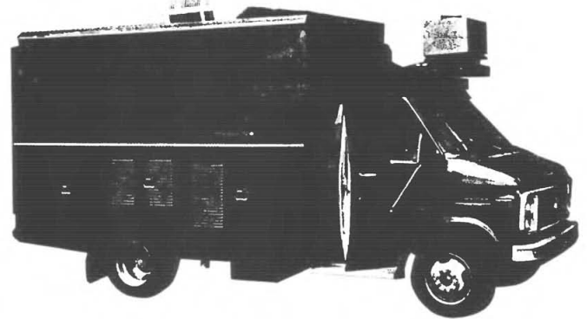
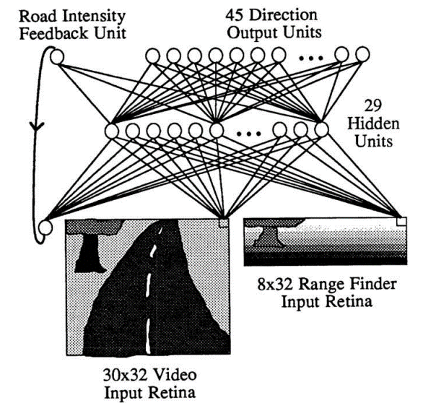
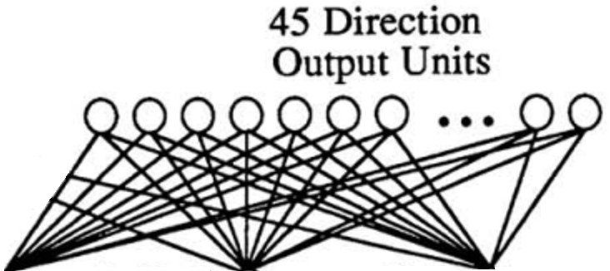
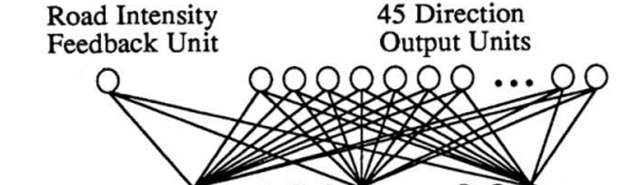
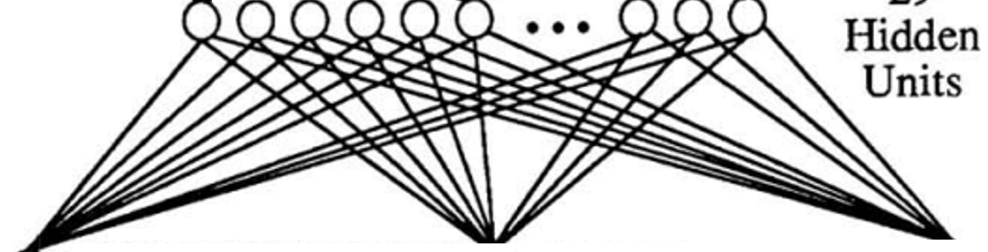

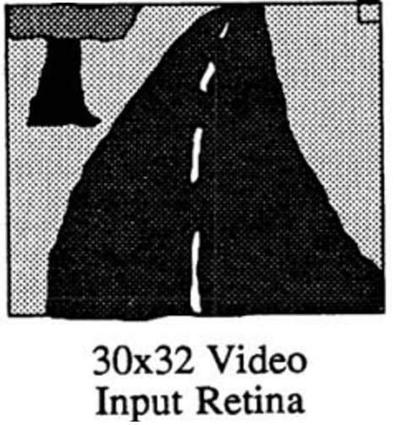
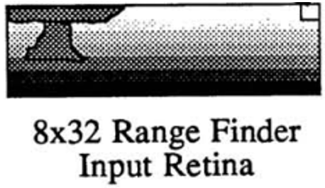
ALVINN Architecture
The Autonomous Land Vehicle In a Neural Network (ALVINN) is a perception system which learns to control the NAVLAB vehicles by Neural Network.
One of the first examples that neural-networks could do "real-driving". It can drive 70mph on highways.
ALVINN's architecture consists of a single hidden layer.
The input layer of the network is a 30x32 unit two dimensional retina which receives input from the vehicles video camera, a 8x32 Range Finder and a feedback of road intensity from the last state.
Each input unit is fully connected to a layer of 29 hidden units which are in turn fully connected to a layer of 46 output units.
The output layer is a linear representation of the direction the vehicle should travel in order to keep the vehicle on the road.
Figure: ALVINN Architecture

Slide 5
Training
The authors generated a dataset comprising 1200 artificial road snapshots. These snapshots depicted roads with varying retinal orientations, positions, lighting conditions, and realistic noise levels. This dataset aimed to capture the diversity of real-world road scenarios.
Dataset creation
Back-Propagation Training
Introducing Randomness
Incorporating Brightness Information
Back-propagation, a neural network training algorithm, was employed using the dataset of artificial road snapshots. Training continued until only asymptotic performance improvements were expected.
During the early training stages, the input road intensity unit was given a random activation level. This was done intentionally to prevent the network from simply copying the activation level of the input road intensity unit to the output road intensity unit. In practice, these levels should usually match because the relative intensity of the road and non-road areas tends to remain consistent between successive images.
As training progressed and the network developed a representation based on image characteristics, it was provided with additional information regarding the relative brightness of the road compared to the non-road in the previous image. This extra information improved the network's ability to determine the correct vehicle travel direction.
Notes:
Now, that you have narrowed your topic, you will want to organize your research in a structure that works. There are some common organizational patterns based on the kind of research you are doing.
Organizational Structures:
Cause and Effect- this kind of structure is great for explaining the causes and effects of a topic
Compare and Contrast- in this pattern you highlight the similarities and differences of the topic
Explain process- this structure is great for outlining a series of steps to follow;
Definition- if you want to make sure your audience understands what something is using illustrations, meanings, clarifying misconceptions, you may want to use this structure
Classification- a common organizational structure is grouping like topics or facts from the research together. For instance, in the internet safety about social media apps, you may organize the research where you look at each social media app one at a time

Slide 6

Results
Subsequent testing was conducted on the NAVLAB, a modified Chevy van equipped with computing hardware, a video camera, and a laser range finder.
After 40 training epochs on the 1200 simulated road snapshots, the network demonstrated a remarkable capability, approximately 90% of cases when tested on novel simulated road images.
Under specific conditions (Driving at a speed of 1/2 meter per second along a 400-meter path through a wooded area under sunny fall conditions), ALVINN's performance was comparable to the best traditional vision-based autonomous navigation algorithm at CMU.
ALVINN was simulated using only an onboard Sun computer at this stage, and it is expected to achieve significant speed improvements when tested using the more powerful Warp computer.
Further improvements are anticipated, particularly in terms of processing speed, as the system is tested with more advanced computing hardware.
Notes:
Now, that you have narrowed your topic, you will want to organize your research in a structure that works. There are some common organizational patterns based on the kind of research you are doing.
Organizational Structures:
Cause and Effect- this kind of structure is great for explaining the causes and effects of a topic
Compare and Contrast- in this pattern you highlight the similarities and differences of the topic
Explain process- this structure is great for outlining a series of steps to follow;
Definition- if you want to make sure your audience understands what something is using illustrations, meanings, clarifying misconceptions, you may want to use this structure
Classification- a common organizational structure is grouping like topics or facts from the research together. For instance, in the internet safety about social media apps, you may organize the research where you look at each social media app one at a time

Slide 7

Limitations
While the paper highlights ALVINN's responsiveness to different conditions, it also suggests challenges in ensuring that the neural network can generalize effectively to a wide range of real-world scenarios. There is a need for further research to enhance ALVINN's adaptability to different weather, lighting, and road conditions.
Generalization to Diverse Conditions
Training on Real Image
Handling Complex Intersection
Sensor Dependence
Real-time Processing
The idea of training the network "on-the-fly" with real images presents difficulties, as mentioned in the paper. Ensuring that the network receives sufficient variability in training exemplars and exposure to recovery from mistakes is a challenge. This limitation underscores the importance of a diverse and representative training dataset.
ALVINN struggles when encountering road forks and intersections, leading to oscillations in travel direction. This limitation highlights the need for improved planning strategies to handle complex road scenarios effectively.
The paper discusses the weighting of information from different sensors, such as the video camera and laser range finder. However, the relative importance of each sensor's data may vary depending on the scenario. Further research is needed to optimize sensor integration for different conditions.
The paper does not provide extensive details about the real-time processing capabilities of ALVINN. Efficient real-time processing is crucial for practical autonomous navigation, especially in safety-critical applications.
Notes:
Once you find your sources, you will want to evaluate your sources using the following questions:
Author:
Who is the author?
Why should I believe what he or she has to say on the topic?
Is the author seen as an expert on the topic? How do you know?
Current:
How current is the information in the source?
When was the source published?
Is the information out-of-date?
Accuracy:
Is the content accurate?
Is the information presented objectively? Do they share the pros and cons?

Slide 8
Future Works
Robustness Testing
Speed Improvement
Network Architecture Exploration
Obstacle Avoidance
Planning Algorithms
Map Integration
Performance Benchmarking
Conducting extensive tests of ALVINN's performance under a broader range of weather and lighting conditions is essential to assess its robustness. This testing will help provide more comprehensive performance comparisons with other autonomous navigation techniques.
Increasing the driving speed by implementing the network simulation on an on-board computer is a practical step forward. Improved real-time processing capabilities can enhance ALVINN's applicability.
Exploring different network architectures, such as adding feedback information, additional hidden layers, or local connectivity, can lead to improvements in ALVINN's internal representations and overall performance.
Developing and testing an off-road version of ALVINN that prioritizes obstacle avoidance is an important extension. This version can assess the significance of the range finder data in various driving conditions.
The paper does not provide extensive details about the real-time processing capabilities of ALVINN. Efficient real-time processing is crucial for practical autonomous navigation, especially in safety-critical applications.
Integrating map data into the system for global point-to-point path planning is a significant future direction. This can enhance route planning and navigation in unfamiliar environments.
Ongoing extensive testing should be performed to benchmark ALVINN against other autonomous navigation systems, providing a clearer understanding of its strengths and weaknesses.
Notes:
When conducting research, it is easy to go to one source: Wikipedia. However, you need to include a variety of sources in your research. Consider the following sources:
Who can I interview to get more information on the topic?
Is the topic current and will it be relevant to my audience?
What articles, blogs, and magazines may have something related to my topic?
Is there a YouTube video on the topic? If so, what is it about?
What images can I find related to the topic?

Slide 9
Thank you
Notes:
You can use this slide as your opening or closing slide. Should you choose to use it as a closing, make sure you review the main points of your presentation. One creative way to do that is by adding animations to the various graphics on a slide. This slide has 4 different graphics, and, when you view the slideshow, you will see that you can click to reveal the next graphic. Similarly, as you review the main topics in your presentation, you may want each point to show up when you are addressing that topic.
Add animation to images and graphics:
Select your image or graphic.
Click on the Animations tab.
Choose from the options. The animation for this slide is “Split”. The drop-down menu in the Animation section gives even more animations you can use.
If you have multiple graphics or images, you will see a number appear next to it that notes the order of the animations.
Note: You will want to choose the animations carefully. You do not want to make your audience dizzy from your presentation.

