Slide 1




Reinforcement Learning for the Adaptive Scheduling of Educational Activities
Jonathan Bassen et al
Presented by:
Indronil Bhattacharjee New Mexico State University

Slide 2
Problem Statement
Online education has gained widespread popularity, but it often faces challenges related to optimizing the scheduling of educational activities for learners.
Many learners struggle to stay engaged, complete courses, and achieve desired learning outcomes in online environments.
Traditional, linearly structured courses may not effectively cater to individual needs, resulting in suboptimal learning experiences and high dropout rates.
The objective of this research is to develop adaptive scheduling strategies that can enhance learning outcomes and reduce the burden on both learners and course designers.
Notes:
After you’ve done your research, it’s time to put your presentation together. The first step in the process is to introduce the topic. This is a great time to connect your topic to something that your audience can relate. In other words, why should they listen to all the information you will be sharing in your research presentation? What is in it for them? You may also want to include a graphic or image to grab their attention.
Feel free to duplicate this slide by right-clicking on this slide in the slides pane to the left and select Duplicate Slide.
The next step in your presentation is to state your claim or topic clearly. Your teacher may even call this your thesis. As you state your thesis, you may find that this layout is not the best layout for your claim or topic. You can change the layout by clicking the drop-down menu next to the Layout in the Slides menu section. You can choose Two Content, Comparison, or Picture with Caption. Note: A different layout might change the look of the icons on this page.
You will also want to state your facts. You have done the research now share some of the interesting facts with your audience. Facts do not have to be boring; you can communicate facts in a variety of ways by going to the Insert Tab. In the Insert tab you can:
Insert pictures from your computer or online.
Add a chart
Create some SmartArt
Insert a variety of icons to help your facts come to life. Note: You can change the color of the icons by selecting the icon and then click on the Format tab and then Graphics Fill. From there, you will choose a color from the list or choose More Fill Colors to give you more options.
Since this research presentation is a result of your hard work and searching, you want to make sure you support the claims or points in your presentation with facts from your research findings. Make sure you give the author proper credit for helping you share your ideas. If one of your sources has a video that is relevant to your topic, you can add the video as added support. Keep in mind the length of the video and the amount of time you have for your presentation. For a 5 minute speech, the video should be no longer than 30 seconds.
Questions to consider:
How will you state the author of the source?
Will you need to cite the source on the slide?
What are some ways you can engage your audience so they feel like they are a part of the presentation? Some ideas to consider is by taking a quick poll like: by a show of hands, how many of you think school uniforms are a way to cut down on bullying? Another suggestion is to have them hold up a certain number of fingers to see if they agree or disagree. Finally, you can share a story that the audience can relate to that makes them laugh.
After all the applause, your audience may have some questions. Be prepared to answer some of their questions by making a list of questions you think they might ask. You may also want to share the presentation with them by providing the link to your presentation, if they want more information.

Slide 3
Solution
This paper proposes a solution in the form of a Reinforcement Learning (RL) model for the adaptive scheduling of educational activities in real time. The key elements of the solution include:
Reinforcement Learning Model
The paper leverages RL, which is a technique capable of learning complex relationships between course activities, learner actions, and educational outcomes. The RL model is trained to make real-time decisions on the sequence of course activities for individual learners.
Maximizing Learning Gains
The primary objective of the RL model is to maximize learning gains, ensuring that learners receive content and activities that are most beneficial to their progress.
Minimizing Workload
The RL model also aims to minimize the number of items assigned to learners, reducing the workload on both learners and instructors.
Experimental Validation
The authors conduct a controlled experiment involving over 1,000 learners to evaluate the effectiveness of this RL-based scheduling policy. The study investigates its impact on learning gains, dropout rates, and gathers qualitative feedback from learners.
Notes:
After consulting a variety of sources, you will need to narrow your topic. For example, the topic of internet safety is huge, but you could narrow that topic to include internet safety in regards to social media apps that teenagers are using heavily. A topic like that is more specific and will be relevant to your peers. Some questions to think about to help you narrow your topic:
What topics of the research interest me the most?
What topics of the research will interest my audience the most?
What topics will the audience find more engaging? Shocking? Inspiring?

Slide 4
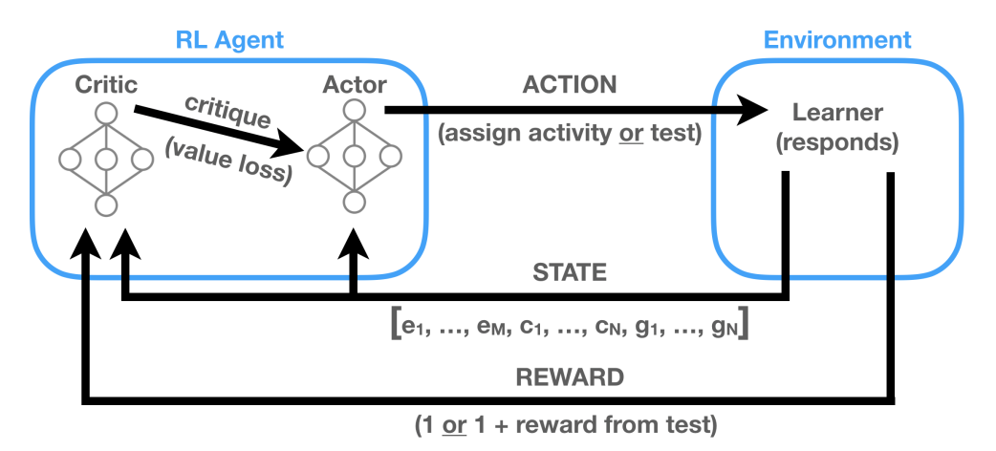
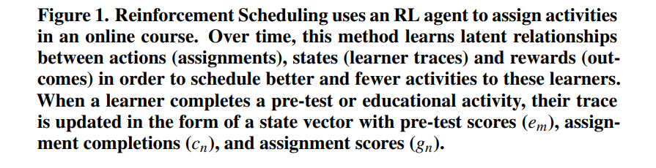
Model Development
For the development of the reinforcement scheduling (RS) model, the primary goal was to maximize learning gains while reducing the time spent on educational activities. This research adopted three key design principles for generalizability:
Courses with various educational activities and topics
Meaningful, non-redundant features
No requirement for human labels
To achieve these objectives, Reinforcement Learning (RL)-based model was chosen as it excels in making real-time decisions and learning continuously.
In summary, the RS model was developed with a clear focus on maximizing learning gains and reducing the time spent on educational activities, adhering to the principles of generality and efficiency. The use of PPO in policy optimization significantly improved the learning speed of the model, making it suitable for online education.

Slide 5

Model Development (Action and Space)
Action Space: Under our navigation strategy, the RL agent's sole action is to prescribe the next educational activity or the post-test. We set constraints to prevent repeated assignments of the same activity to the same learner and to ensure that the course length does not exceed 12 activities.
A_{i} a single binary vector with
a position for each of the N activities and
the post-test (at position N +1)
State Space: The state space is built on test scores and educational activity scores, which are core to making inferences about learning gains. This research experimented with various state space designs and found that a compact state space, ignoring the ordering of previous activities, was efficient.
State space at step i (S_{i}) is a concatenation of the
a vector consisting of M pre-test scores (e)
a vector indicating which of the N educational activities have been completed so far (c)
a vector that holds the grade for each of the N activities once they have been attempted (g)

Slide 6
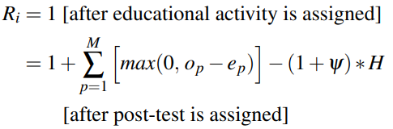
Model Development (Reward and Policy Optimization)
Reward Function: The step-wise reward function prioritizes learner test performance improvements and penalizes the inclusion of extra activities. It considers individual improvements between pre-test and post-test scores and imposes a penalty based on the number of educational activities in the episode. This penalty is a proxy for the minimum expected test improvement required to justify scheduling an activity.
Here, e=pre-test scores and o=post-test scores, ψ=penalty in proportion to the number of educational activities in the episode (H).
Policy Optimization: Proximal policy optimization (PPO), an efficient actor-critic algorithm that uses neural networks for actor and critic functions, was employed . PPO addresses the exploration-exploitation trade-off, and the actor network outputs action probabilities based on the state. The loss function is designed to maximize the probability of actions that maximize expected cumulative discounted reward. PPO demonstrated faster learning compared to other methods, making it suitable for RS in online education.

Slide 7
Experimental Design
To assess the impact of the reinforcement scheduling method on learners, a randomized controlled trial was conducted. This trial compared the reinforcement scheduling method with two baseline conditions.
Linear Assignment Condition
Self-Directed Assignment Condition
Key Metrics:
Learning gains were measured as the difference between a learner's post-test and pre-test scores.
Learner traces were collected, including the number and type of activities completed, their correctness, and any dropout occurrences.
Recruitment
Recruitment for the "Introduction to Linear Algebra" course was initiated through an internal email campaign. Participants were randomly assigned as follows: 95% to reinforcement scheduling, 2.5% to linear assignment, and 2.5% to self-navigation.
All participants received instructions explaining the course's objectives, their participation in a learning experiment, and how course navigation would work. To obtain a certificate of completion, all learners were required to fill out a post-course survey.
In summary, a total of 1,987 people enrolled in the course, with 1,830 in the reinforcement scheduling condition, 91 in the linear condition, and 66 in the self-navigation condition.

Slide 8

Research Questions
Through this experiment, the authors aimed to answer four research questions:
R1
How does reinforcement scheduling affect learning gains, the number of activities completed, and dropout?
R2
Do early participants suffer from a worse assignment policy under reinforcement scheduling?
R3
What can instructors and course designers learn from reinforcement scheduling?
R4
What are the qualitative experiences of learners under reinforcement scheduling?

Slide 9
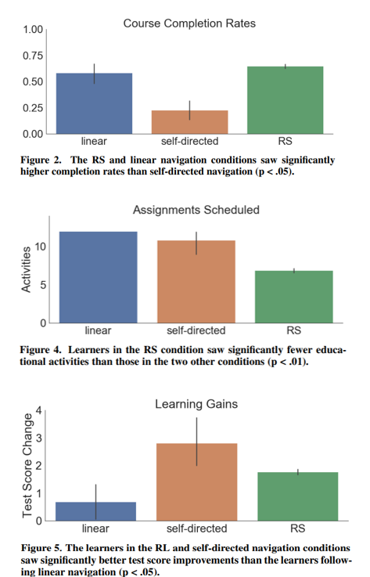
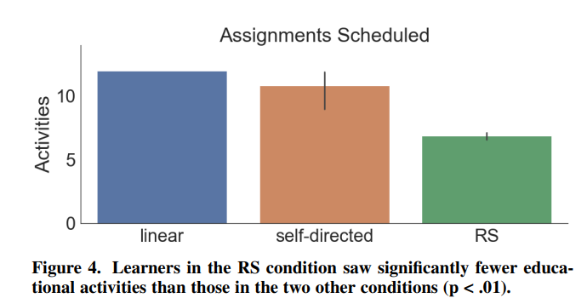
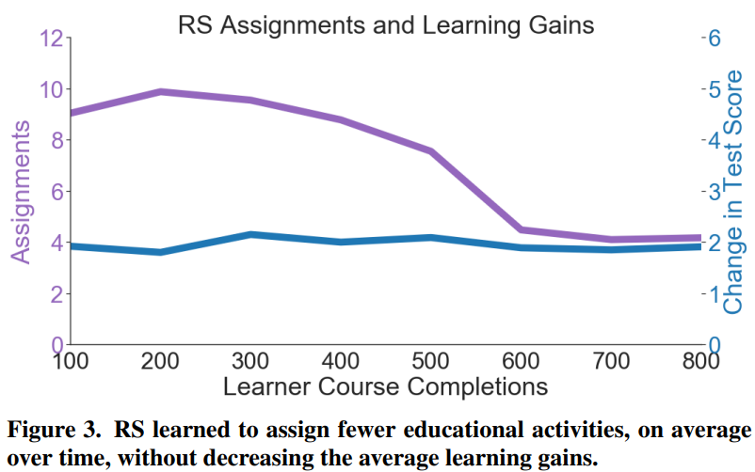
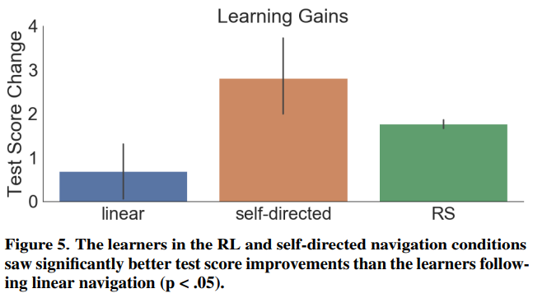
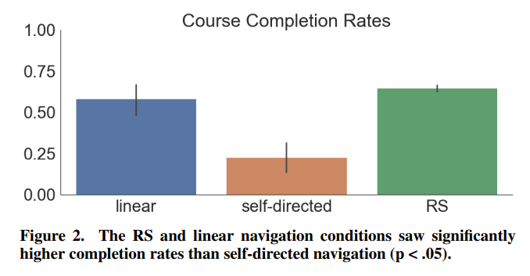
R1: Comparing RS and Control Conditions
In this analysis, the researchers compared the impact of Reinforcement Scheduling (RS) on learning gains, the number of activities completed, and course dropout rates.
The method involved collecting data on the number of activities completed, computing dropout rates, and calculating learning gains by comparing pre-test and post-test scores. T-tests and chi-squared tests were used for comparisons.
Results:
RS and the linear condition led to significantly higher course completion.
Learners in the RS condition completed significantly fewer activities.
Learning gains were significantly higher for learners in the self-directed and RS conditions.
No significant difference in learning gains between the self-directed and RS conditions.
Discussion:
RS had a positive impact on course completion and learning gains, with learners completing fewer activities.
The self-directed condition had high dropout rates, potentially due to the loss of less-motivated learners.
The number of activities did not strongly affect dropout rates, and learners were more likely to complete a course when they didn't have to decide what to do next.

Slide 10
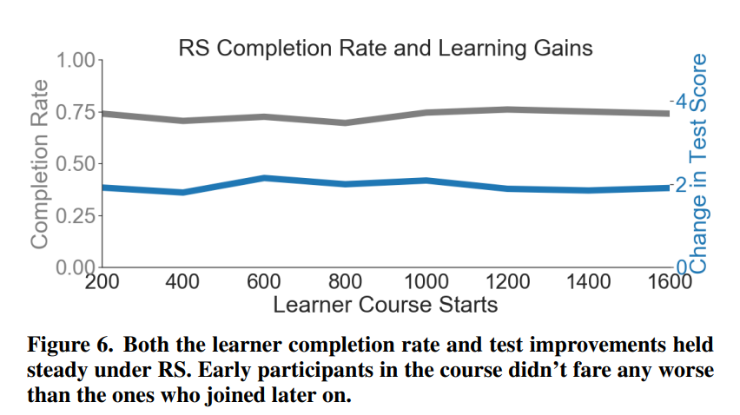
R2: The Cold Start Problem
This analysis addressed the Cold Start problem, which concerns the potential negative impact of RS on early learners. The researchers tracked learning gains and completion rates over time as learners progressed through the course.
Results:
Learning gains and completion rates remained steady throughout the course, even for early participants.
Early participants in the RS condition completed more activities than later participants but still engaged with fewer total educational activities compared to linear and self-directed navigation conditions.
Discussion:
RS did not disproportionately harm early users, thanks to adjustments in the reward function and initial exploration strategies.
Early learners in the RS condition still had a more efficient educational experience compared to linear and self-directed navigation.

Slide 11
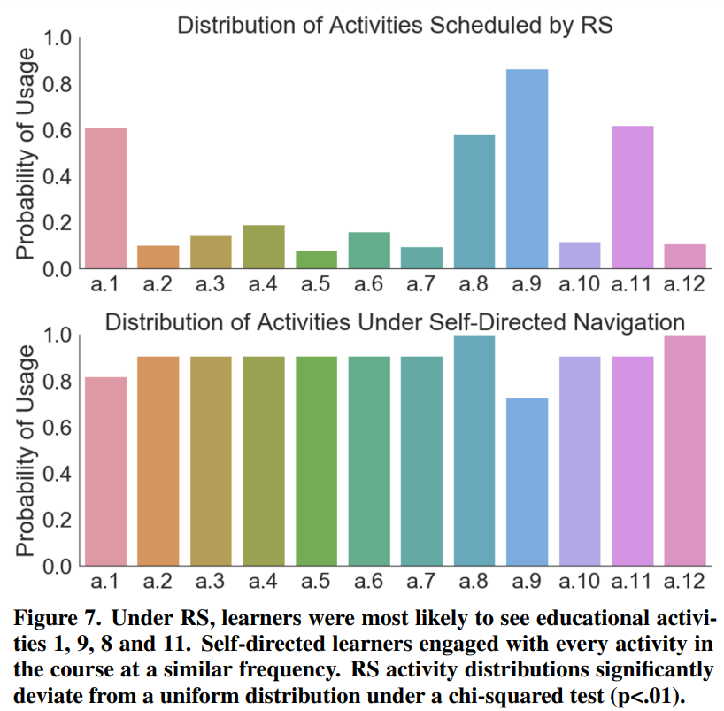
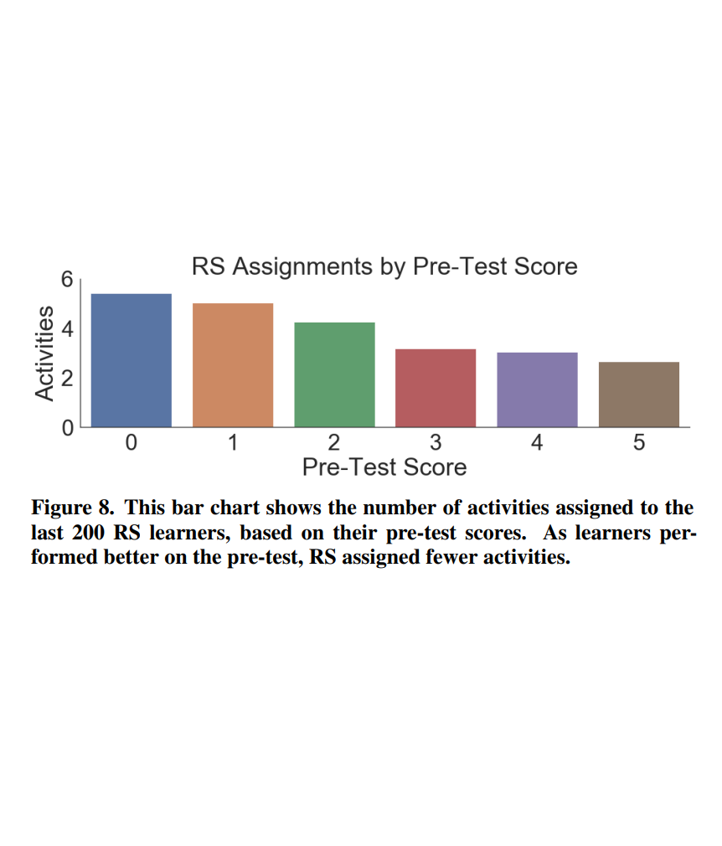
R3: RS Scheduling Patterns
This analysis aimed to identify patterns in the RS scheduling policy, helping instructors and course designers understand how activities were assigned.
The researchers examined the assignment frequency distribution for educational activities and their relationship with pre-test scores.
Results:
RS assigned activities based on learner states, with certain activities being assigned more frequently than others.
As pre-test scores increased, the number of activities assigned by RS decreased.
Discussion:
The analysis revealed that RS adapted to different learner states and assigned activities strategically.
This information can guide instructors and designers in developing more effective educational activities and improving the order of assignments.

Slide 12
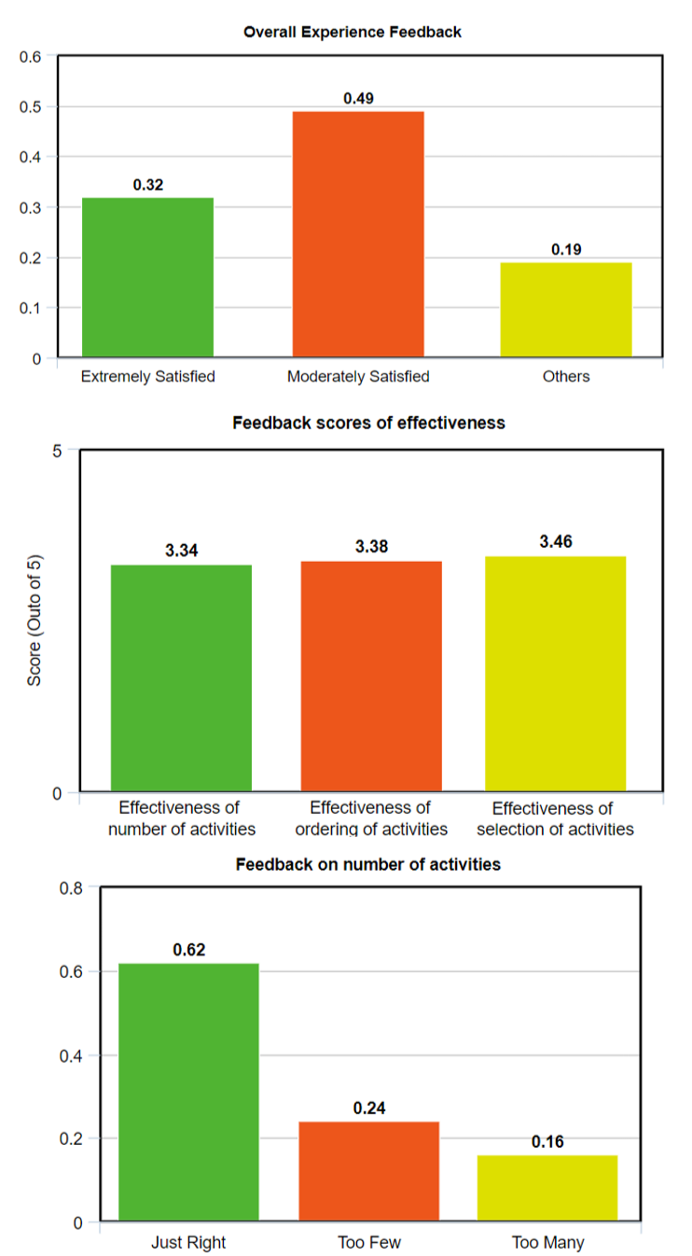
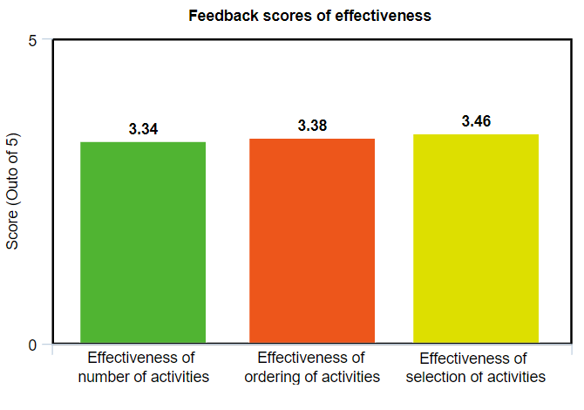
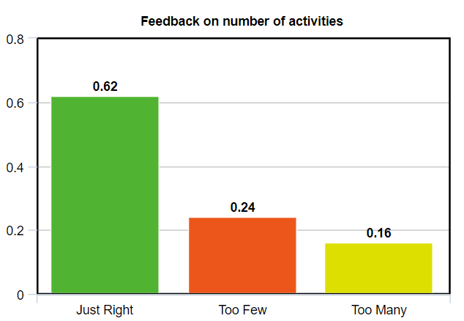
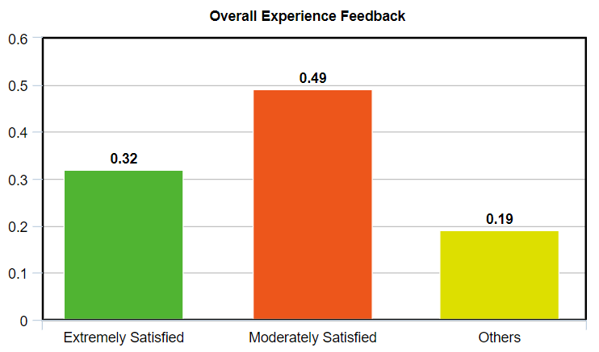
R4: Qualitative Feedback From Learners
This analysis collected qualitative feedback from learners through an exit survey, focusing on demographics, course quality, and textual feedback.
Results:
Learners generally expressed satisfaction with the course and appreciated the adaptive nature of RS.
Learners noticed and liked how the course adapted to their knowledge state.
Some learners preferred fewer assignments, while others found them insufficient.
There was a demand for similar courses and positive feedback on the potential of using RL for adaptive assignment.
Discussion:
The feedback from learners indicated overall positive experiences with RS and a preference for adaptive learning.
Some learners expected a certain number of activities per skill, and their feedback highlighted the importance of balancing the quantity and quality of assignments in adaptive learning environments.

Slide 13

Limitations
Generalizability
Data Requirements
Skill Acquisition Depth
Algorithm Convergence
While Reinforcement Scheduling (RS) is versatile, it may not be suitable for courses with complex qualitative evaluation metrics or those that continuously assess learners. RS also requires a substantial amount of data to converge effectively, limiting its application in courses with very few participants. It does not inherently support mastery learning models.
RS's effectiveness can improve with an even larger dataset. A larger user base would offer more opportunities for analysis, policy refinement, and the potential elimination of redundant educational activities.
RS may not effectively address courses where the depth of skill acquisition is critical. In courses requiring deep understanding and extensive practice, RS may not provide the required intensity and continuity, leading to potential gaps in learners' knowledge.
The convergence of the RS algorithm may still require improvement. Larger datasets may offer opportunities for further refining the scheduling policy, but it's important to monitor and ensure that RS consistently produces optimal assignments as it learns. The learning dynamics of RS over more extended periods need to be explored to assess its adaptability to changing learner behaviors effectively.
Notes:
Once you find your sources, you will want to evaluate your sources using the following questions:
Author:
Who is the author?
Why should I believe what he or she has to say on the topic?
Is the author seen as an expert on the topic? How do you know?
Current:
How current is the information in the source?
When was the source published?
Is the information out-of-date?
Accuracy:
Is the content accurate?
Is the information presented objectively? Do they share the pros and cons?

Slide 14
Future Works
Algorithmic Improvements
Emulating Mastery Learning
Optimizing Policy
Addressing Dropout
Exploring advanced algorithms like soft actor-critic can reduce the sample complexity and enhance generalizability to new learners and courses.
To support mastery learning models, RS can be adjusted by including more problems in pre-tests and post-tests. Additionally, requiring learners to repeat a course until they demonstrate mastery can be implemented.
RS can be further enhanced by potentially eliminating the penalty for extra educational activity assignments. This may allow RS to naturally reduce the number of assignments. Experimenting with a cap on assignments while allowing for repeats could yield interesting results.
Introducing a term in the reward function to penalize learner dropout may help improve learner engagement and reduce dropout rates.
Notes:
When conducting research, it is easy to go to one source: Wikipedia. However, you need to include a variety of sources in your research. Consider the following sources:
Who can I interview to get more information on the topic?
Is the topic current and will it be relevant to my audience?
What articles, blogs, and magazines may have something related to my topic?
Is there a YouTube video on the topic? If so, what is it about?
What images can I find related to the topic?

Slide 15
Thank you
Notes:
You can use this slide as your opening or closing slide. Should you choose to use it as a closing, make sure you review the main points of your presentation. One creative way to do that is by adding animations to the various graphics on a slide. This slide has 4 different graphics, and, when you view the slideshow, you will see that you can click to reveal the next graphic. Similarly, as you review the main topics in your presentation, you may want each point to show up when you are addressing that topic.
Add animation to images and graphics:
Select your image or graphic.
Click on the Animations tab.
Choose from the options. The animation for this slide is “Split”. The drop-down menu in the Animation section gives even more animations you can use.
If you have multiple graphics or images, you will see a number appear next to it that notes the order of the animations.
Note: You will want to choose the animations carefully. You do not want to make your audience dizzy from your presentation.

