Slide 1
WELCOME

Slide 2
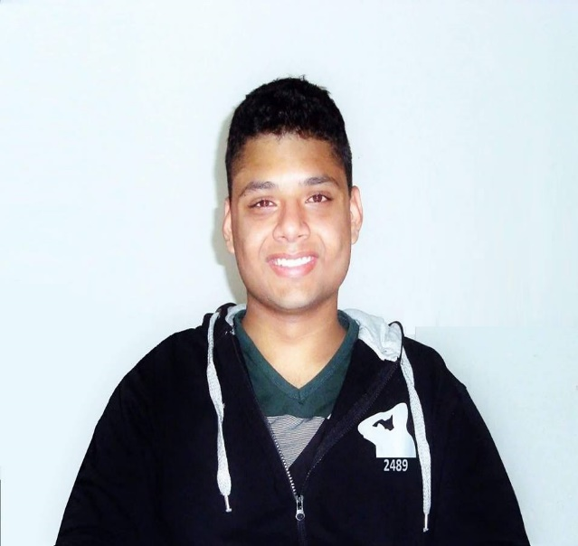
Personal Information
INDRONIL BHATTACHARJEE
Date of Birth : 13 June, 1997
Present Address : Fazlul Haque Hall, KUET
Permanent Address : Polashpole, Satkhira Sadar, Satkhira
Education
B.Sc. in Computer Science and Engineering
Khulna University of Engineering & Technology
CGPA : 3.17 (Current)
Passing Year : 2020
Higher Secondary Certificate
Jhenidah Cadet College
GPA : 5.00
Passing Year : 2015
Secondary School Certificate
Jhenidah Cadet College
GPA : 5.00
Passing Year : 2013
+8801853089724
ibprince.2489@gmail.com
sites.google.com/
indronilbhattacharjee
9, Dolkhola Lane, Khulna

Slide 3
Technical Skills
Programming Activities
Programming Language : C, C++, Java, C#, Python, Assembly
Web Based : ASP.NET, JavaScript, HTML, CSS, AJAX
Database : SQL, PL/SQL, MySQL, SQL Server
IDE : Eclipse, Code Blocks, Android Studio, Microsoft Visual Studio, Python IDLE
Simulation Tools : Packet Tracer
Version Control System : Git
Operating System : Windows, Ubuntu, Mac OS
Problems Solved :
200 Problems in different online judges
Codeforces : Handle: Indronil_Prince
Uva Online Judge : Handle: Indronil Prince (Indronil_105)
HackerRank : Handle: Indronil Prince (@Indronil_105)
Projects
Android Application Development (LiveSoccer)
Operating System (Mini OS)
Web Development (E-Commerce Website)
Peripherals & Interfacing (Gas Detector)
iOS App Development (Smart Dictionary)
Database (Soccer Tournament Management)
System Development (Online Business Platform)
Extra Curricular
Activities
British Council's Active Citizens Youth Leadership Training
Social Action Project with British Council and Rupantar.
Different sports like Football, Cricket, Basketball and Table Tennis.

Slide 4
THANK YOU

