Slide 1
ONLINE BUSINESS PLATFORM (Desktop Based E-commerce Application)
1
Course no :
CSE 3200
Course name :
System Development Project

Slide 2
Supervised by: Md. Abdus Salim Mollah Assistant Professor Department of Computer Science and Engineering Khulna University of Engineering & Technology KUET, Khulna.
2
Presented by:
Md Mubashshir Hosain
Roll no : 1507104
Indronil Bhattacharjee
Roll no : 1507105

Slide 3
E-Commerce:
3
E-commerce app is the one type of CMS (Content Management System) which offer's us complete system for manage all the features which are available in our app which means we can manage easily our system in a single place and that is easy.
Simply to say E-commerce is the platform where users and sellers can buy and sell their products through internet.

Slide 4
Online Business Platform:
4
An online business platform is the complete solution for the E-commerce business, here we will get the automated system for our online business need. You will get two section of the website one is front that is for users one is back for website owner operation with a single dashboard. We can operate our app and update all the categories, products, banners, picture, generate invoice. We can manage the orders and so many operation we can do. Current situation in the market, E-Commerce software is performing well and here all the things are integrated whatever we need for our buying process it will provide with easy interface.

Slide 5
Desktop Application
5
An application that runs stand-alone in a desktop or laptop computer. Contrast with Web-based application, which requires the Web browser to run. The term may be used to contrast desktop applications with mobile applications.
In Windows, a desktop application is one that runs in the traditional Windows desktop in contrast to a tablet application that runs full screen

Slide 6
Software and environment:
6
Windows platform
Microsoft Visual Studio
Firebase realtime database
Firebase storage
C#
.Net framework
Windows UI Library
Windows forms

Slide 7
Why Windows Desktop App?
7
A well designed desktop app will considerably be more usable than a well designed web app. This is because a web app is limited by what is allowed by the browser, limited by the fact that the browser has controls (toolbar buttons, menus, etc.) that aren't related to the application, limited by latency inherent in the network, etc.
For many types of problems this isn't important and the benefits of a web based app outweigh the usability concerns. But at least with the state of the browser today, very few web apps can complete with a desktop app in the areas of usability and responsiveness.

Slide 8
Desktop Apps vs Web Apps
8
Parameters | Desktop Apps vs Web Apps
Maintenance | Web based applications need to be installed only once whereas desktop applications are to be installed separately on each computer. Also updating the applications is cumbersome with desktop applications as it needs to be done on every single computer which is not the case with web applications.
Usage Scale | Desktop applications are confined to a physical location and hence have usability constraint. Web applications development on the other hand makes it convenient for the users to access the application from any location using the Internet.
Speed and performance | Web application development relies significantly on Internet connectivity and speed. Absence of Internet or its poor connectivity can cause performance issues with web applications. Desktop applications are standalone in nature and hence do not face any hindrances resulting from Internet connectivity.
Bandwidth cost | As web applications are internet dependent, they cost more bandwidth usage than desktop applications do.

Slide 9
Windows platform privileges:
9
Rapid application development Rich text data capabilities Large collection of controls from Microsoft and partners .NET runtime environment Dense UI Support for Windows 7 Keyboard and mouse input

Slide 10
Why Firebase?
10
Firebase is all about data and we can’t have an e-commerce store without it. The biggest would be the server hosting, authentication, and data syncing.
It just makes easier for the authenticated user to log in . Our users can make their carts and it helps that relevant changes will be updated in system for all users. Plus it is free, so we did our project like a dummy of an fully activated business app.
It will provide more scalability for increasing demand.

Slide 11
App Description
11
The application mainly consists of three sections-
User section
Admin section
Database section

Slide 12
User Features:
12
User registration
Log in and log out
Search products
Detailed view of products
Cart
Orders
Payment

Slide 13
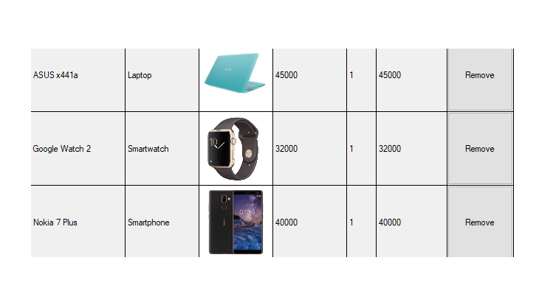
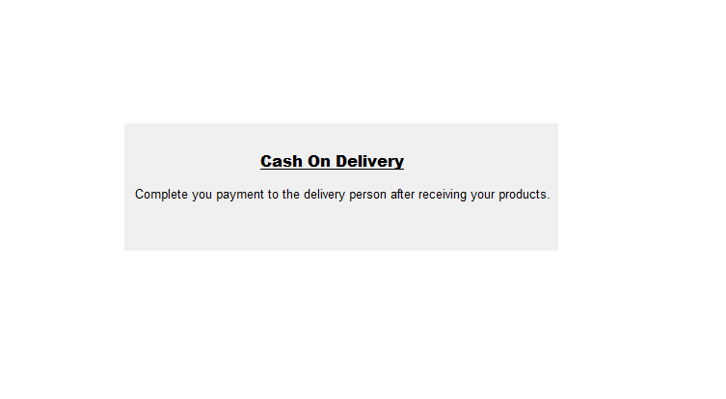
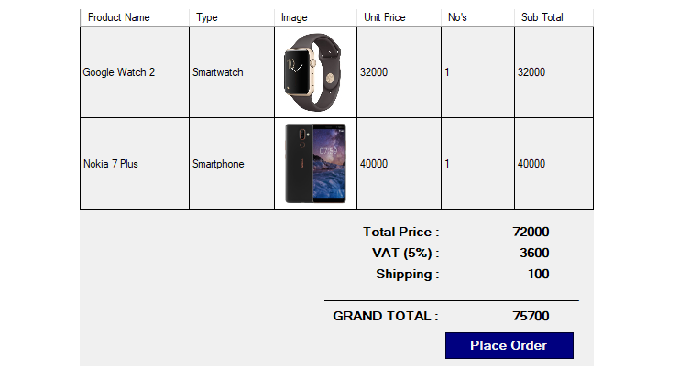
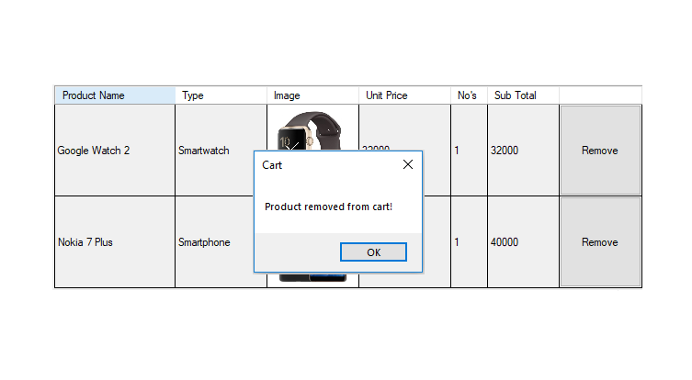
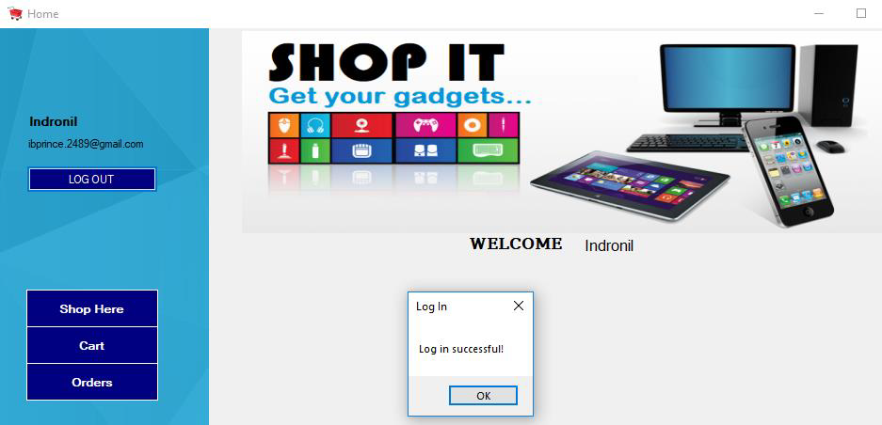
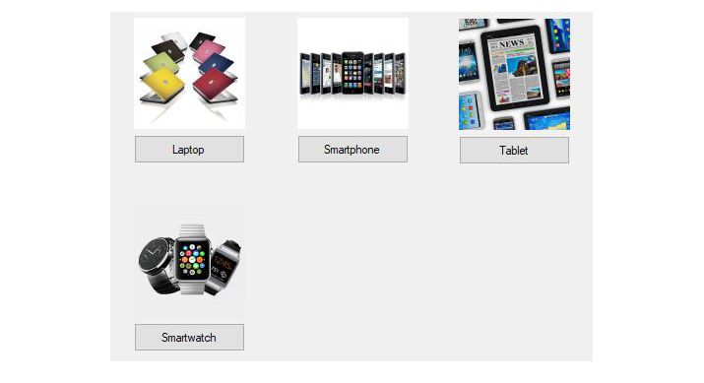
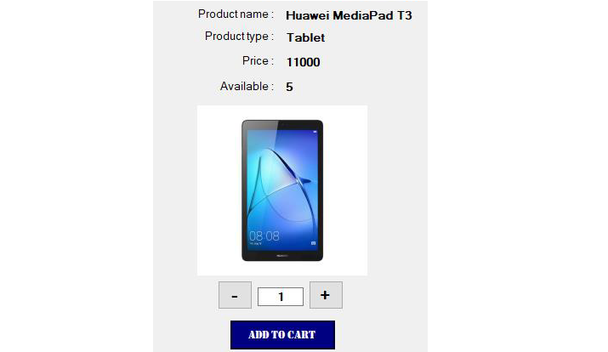
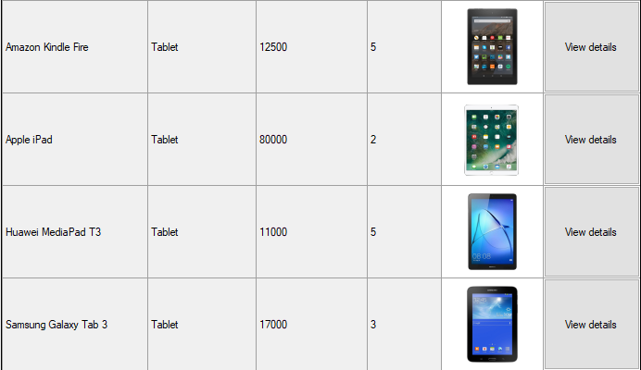
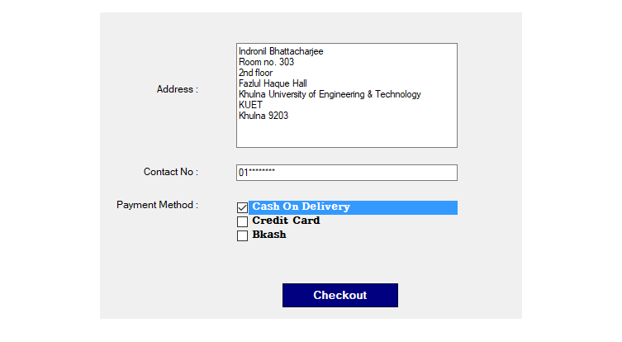
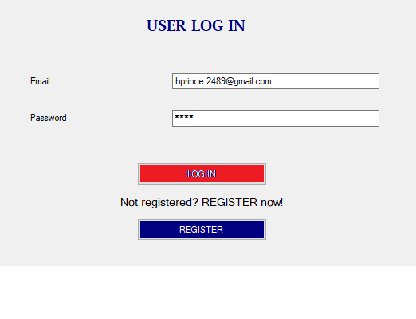
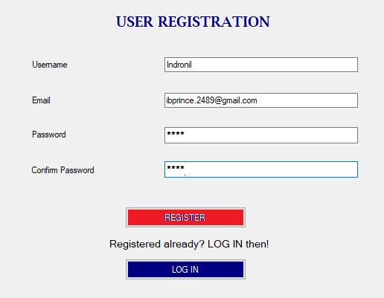
13
User Registration
Product Details
Place Order
Add to Cart
Remove from Cart
Payment
Home
List of Products
User Login
Checkout
Search Products

Slide 14
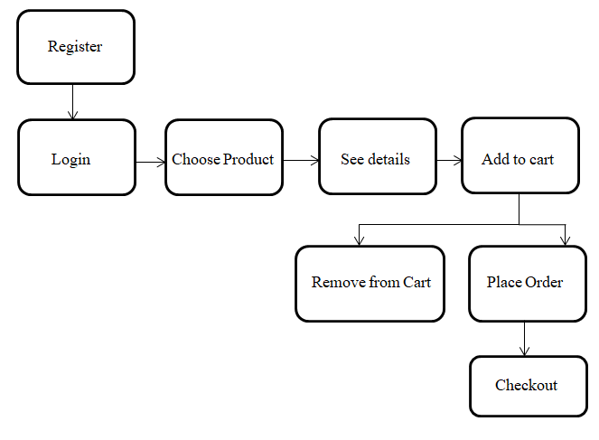
User’s Activity Diagram:
14

Slide 15
Admin Features:
15
Order Management
User Management
Add and remove products
Deliver orders

Slide 16
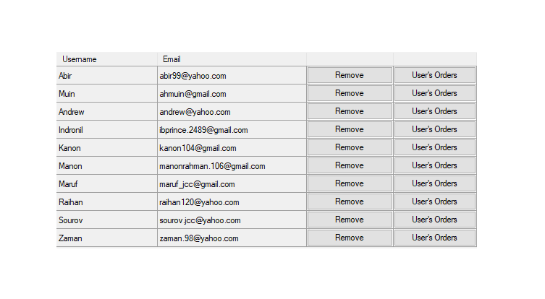
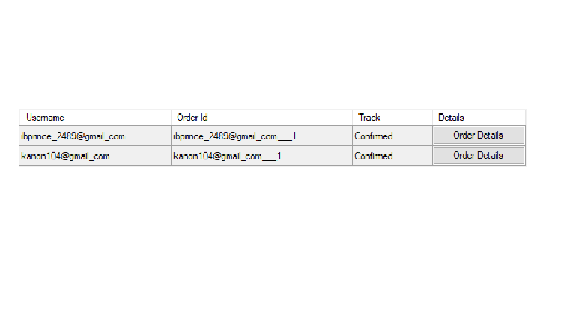
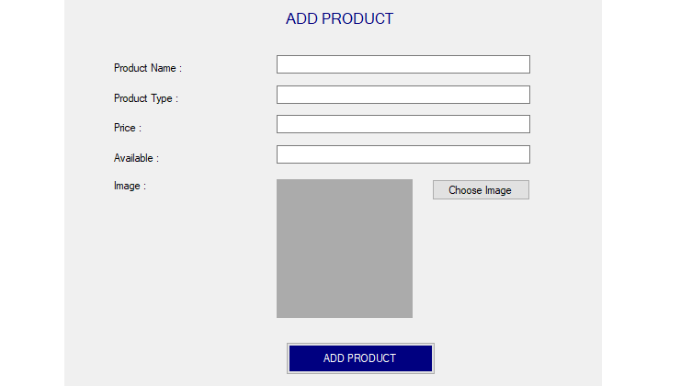
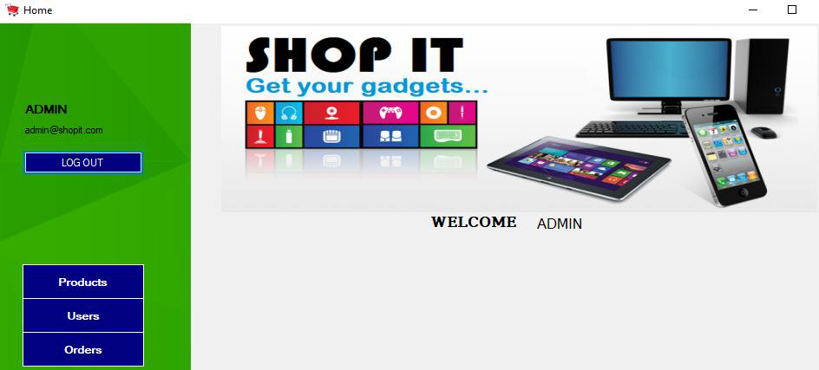
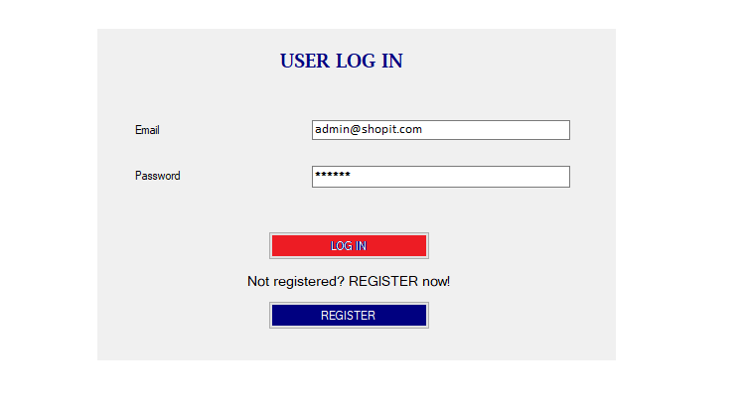
Admin Login
16
Admin Home
User Management
Order Management
Add New Products

Slide 17
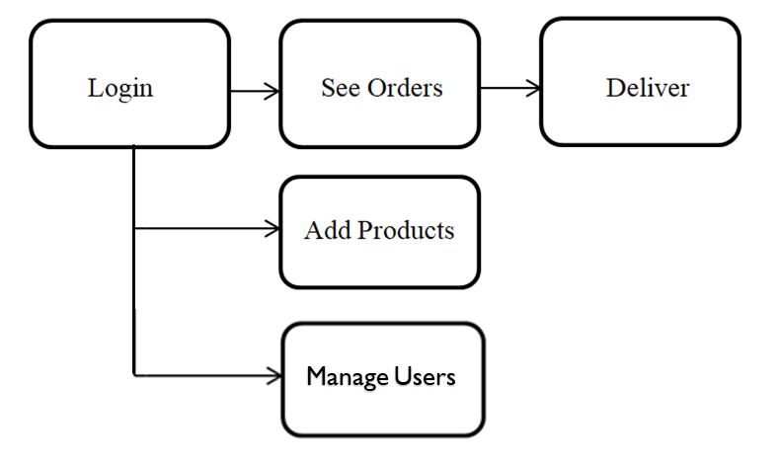
Admin’s Activity Diagram:
17

Slide 18
Database Section:
18
Firebase Realtime Database - Firebase realtime database has been used in this application to use from any windows device and update realtime.
Four nodes have been used named as User(with sub-nodes username, email, password), Cart(with sub-nodes user id and user’s products), Product(with sub-nodes product name, type, price, image and available) and Order(with sub-nodes id, address, track, contact information) to register, login, carts, orders, detail of the orders etc.

Slide 19
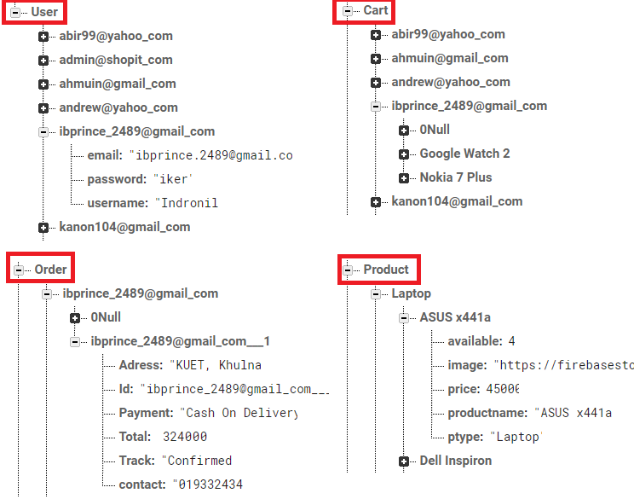
Database Section:
19

Slide 20
Challenges faced:
20
Payment method:
An active payment method, backup payment method for subscriptions, edit or change method when purchase.
There can be various types like credit/debit cards, Google pay balance, mobile phone billing, Google play gift cards, PayPal, unsupported payment option.

Slide 21
Limitations:
21
That payment system we have just mentioned, is not fixed properly .We have an option to purchase but not active. It’s just a dummy of purchasing products. But it shows the process how to buy it online.

Slide 22
Future of the project:
22
Our project has just lacked the automaticity of payment system. But it is an on going option that needs an active business system. If We can complete the various methods of payment, we will be in our final step to launch an active small business of ours with marketing logistics.

Slide 23
Learning Outcomes:
23
Desktop based e-commerce system
C# language
.Net framework
Realtime database
Cloud Storage
Windows forms

Slide 24
Conclusion:
24
After all, it was a great experience throughout the semester. It shows the way, the benefits of doing a project as a team. Our supervisor Sir helped us a lot with his precious instructions.
We have tried our best to do the necessities for the completion of the project. However, some lacking will be always in a work, we have too. We will try to do better in future.

Slide 25
25
THANK YOU

