Slide 1
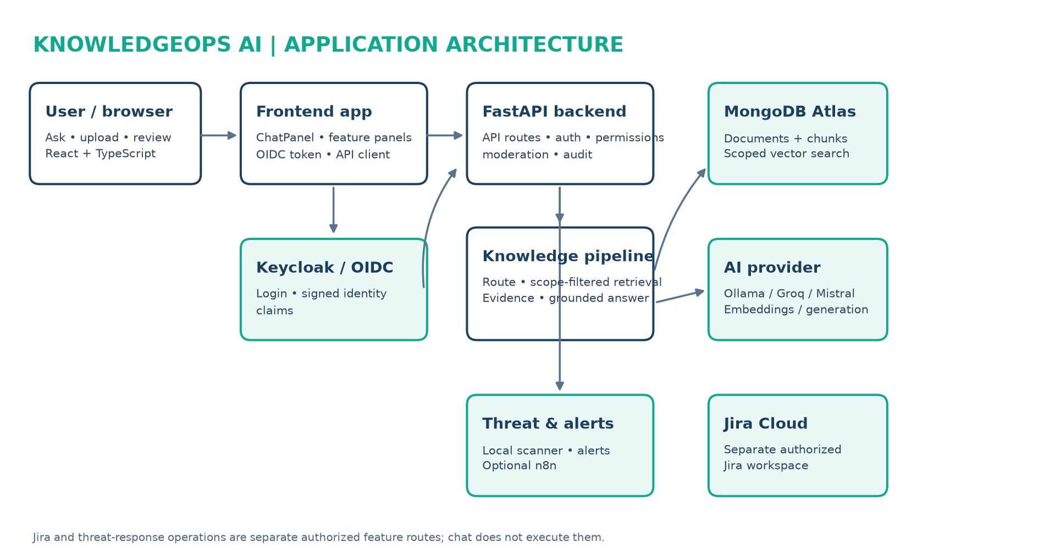
KNOWLEDGEOPS AI
Whole-Project Architecture

Slide 2
FRONTEND • IDENTITY • API
How a request enters the system
FRONTEND
App.tsx initializes OIDC and user state.
ChatPanel.tsx captures a question and displays result/citations.
api/chat.ts posts to /api/v1/chat. api/http.ts attaches the bearer token.
IDENTITY & API
oidc.ts uses authorization-code + PKCE with Keycloak.
core/auth.py verifies signed token claims.
core/permissions.py derives capabilities and scopes.
main.py mounts FastAPI and request IDs; router.py connects feature routes.
api/v1/chat.py checks access, moderates, orchestrates, audits, responds.

Slide 3
ORCHESTRATION • RETRIEVAL • LLM
From question to evidence-backed answer
1 routing.py classifies knowledge, analytical, workflow, or unsupported intent.
2 orchestration/service.py checks scope and chooses the path.
3 knowledge/index.py selects Atlas, Qdrant, or local retrieval.
4 mongodb_index.py / retrieval.py retrieve only allowed-scope chunks and rank vector + keyword evidence.
5 generation.py abstains without evidence or passes evidence to the configured LangChain model.
6 guardrails.py checks input, retrieved text, and output before response.
KEY RELATION
chat() → route_question() → orchestrate_request() → index.search(user_scopes) → grounded generation → answer with citations.
PROVIDERS
Ollama locally; Groq/Mistral only when configured. Embeddings support vector search; chat model drafts from retrieved context.

Slide 4
DOCUMENTS • STORAGE • CONNECTED FEATURES
Other important lanes and their boundaries
DOCUMENT INGESTION
knowledge_documents.py validates permission, size/type, duplicates, and settings; format handlers extract text; security inspection precedes chunking and indexing. Original upload bytes are not retained.
MONGODB ATLAS
storage/mongodb_knowledge.py stores document metadata and chunks separately. mongodb_index.py handles vector indexing and scoped search.
JIRA CLOUD
Dedicated UI/API and jira_cloud.py integration. Reads require jira:read; writes require jira:approve plus confirmation. Backend-only credentials.
THREAT & ALERTS
Dedicated scan routes use local rules; findings can create redacted alerts. Optional n8n notifications/response dispatch are separate authorized actions.
GOVERNANCE
Audit records route, outcome, and source count; it omits chat text. Capabilities, scopes, source policy, and AI-provider settings govern access.

Slide 5
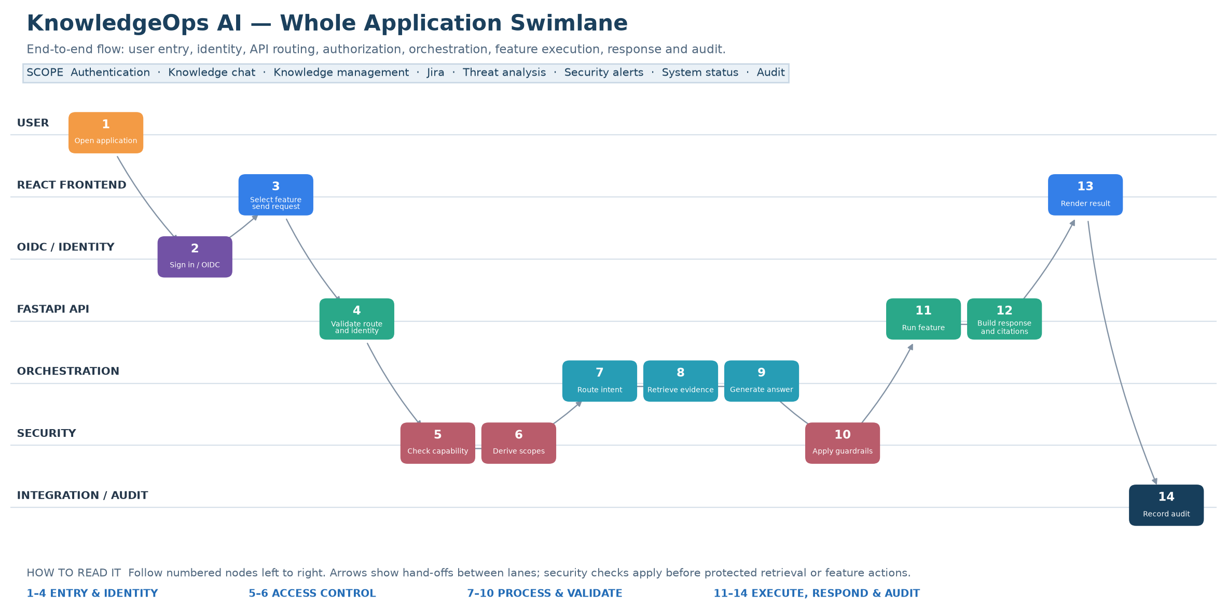
WHOLE-APPLICATION SWIMLANE
End-to-end request flow • 14 numbered hand-offs

