Slide 1
JAVA TRAINING

Slide 2
SYLLABUS
Basic Java
Advance Java
Spring Framework

Slide 3
Basic Java
Java Introduction
Fundamental Programming Structures
Classes and Objects
Object Oriented Programming(OOP)

Slide 4
Advance Java
Collection Framework
JDBC
JSP
Servlet

Slide 5
Spring
Introduction
Arhitecture
IoC Containers
Beans
Java Based Configuration
Event Handling
Web MVC Framework

Slide 6
Java Introduction
Java was developed by James Gosling at Sun Microsystem in the year 1995, and later acquired by Oracle Corporation. It is a simple programming language.
Java is a class-based, object-oriented programming language and is designed to have as few implementation dependencies as possible.
A general-purpose programming language made for developers to write once run anywhere that is compiled Java code can run on all platforms that support Java.

Slide 7
Spring Introduction
Spring framework is an open-source Java platform that provides comprehensive infrastructure support for developing robust Java applications very easily and very rapidly. Spring framework was initially written by Rod Johnson and was first released under the Apache 2.0 license in June 2003.

Slide 8
Java Introduction
Short History of Java
Java Buzzwords
Java Virtual Machine (JVM)
Java Runtime Environment(JRE)
Bytecode
Object Oriented Programming and its Principles
Writing Simple Java Programs
Command Line Arguments
Scanner

Slide 9
Java Introduction
Java was developed by James Gosling at Sun Microsystem in the year 1995, and later acquired by Oracle Corporation. It is a simple programming language.
Java is a class-based, object-oriented programming language and is designed to have as few implementation dependencies as possible.
A general-purpose programming language made for developers to write once run anywhere that is compiled Java code can run on all platforms that support Java.

Slide 10
Short History Of Java
James Gosling, Mike Sheridan, and Patrick Naughton, a team of Sun engineers known as the Green team initiated the Java language in 1991. Sun Microsystems released its first public implementation in 1996 as Java 1.0. It provides no-cost -run-times on popular platforms.
Java1.0 compiler was re-written in Java by Arthur Van Hoff to strictly comply with its specifications. With the arrival of Java 2.0, new versions had multiple configurations built for different types of platforms.
In 1997, Sun Microsystems approached the ISO standards body and later formalized Java, but it soon withdrew from the process. Sun generated revenue from Java through the selling of licenses for specialized products such as the Java Enterprise System.
On November 13, 2006, Sun released much of its Java virtual machine as free, open-source software. On May 8, 2007, Sun finished the process, making all of its JVM’s core code available under open-source distribution terms.

Slide 11
Java Buzzwords/features
Platform Independent
Object-Oriented Programming Language
Simple
Secure
Multithreading
Portable

Slide 12
Platform Independent: The compiler converts source code to bytecode and then the JVM executes the bytecode generated by the compiler. This bytecode can run on any platform be it Windows, Linux, or macOS which means if we compile a program on Windows, then we can run it on Linux and vice versa.
Object-Oriented Programming Language: Organizing the program in the terms of a collection of objects is a way of object-oriented programming, each of which represents an instance of the class.
The four main concepts of Object-Oriented programming are:
Abstraction
Encapsulation
Inheritance
Polymorphism

Slide 13
Simple: Java is one of the simple languages as it does not have complex features like pointers, operator overloading, multiple inheritances, and Explicit memory allocation.
Secure: Java programs run in an environment that is independent of the operating system environment which makes java programs more secure.
Multithreading: Java supports multithreading. It is a Java feature that allows concurrent execution of two or more parts of a program for maximum utilization of the CPU.
Portable: As we know, java code written on one machine can be run on another machine. The platform-independent feature of java in which its platform-independent bytecode can be taken to any platform for execution makes java portable.

Slide 14
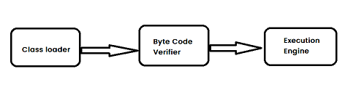
Java Virtual Machine(JVM)
Java Virtual Machine (JVM) is an engine that provides a runtime environment to drive the Java Code or applications. It converts Java bytecode into machine language. JVM is a part of Java Runtime Environment (JRE).
dd
Working Of JVM

Slide 15
Java Runtime Environment(JRE)
The Java Runtime Environment (JRE) is software that Java programs require to run correctly. Java is a computer language that powers many current web and mobile applications. The JRE is the underlying technology that communicates between the Java program and the operating system.

Slide 16
Simple Java Program
public class Hello {
public static void main(String args[]) {
System.out.println("Hello World");
}
}

Slide 17
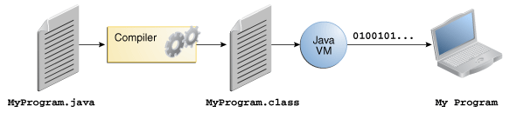

Slide 18
Bytecode
Byte Code can be defined as an intermediate code generated by the compiler after the compilation of source code.This intermediate code makes Java a platform-independent language.

Slide 19
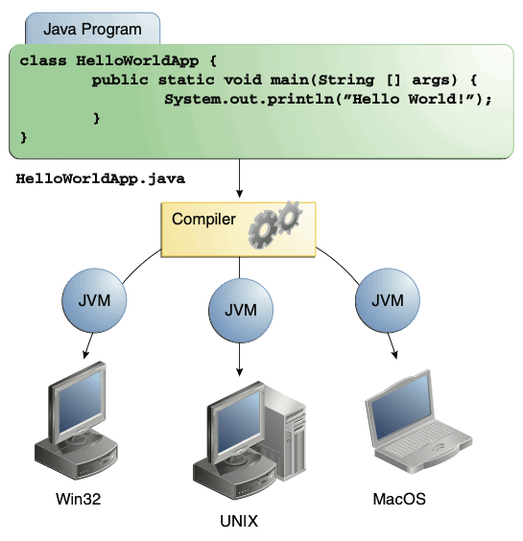

Slide 20
Command Line Argument
The java command-line argument is an argument i.e. passed at the time of running the java program.
The arguments passed from the console can be received in the java program and it can be used as an input.

Slide 21
Example
public class CommandLineExample{
public static void main(String args[]){
System.out.println("Your first argument is: "+args[0]);
}
}

Slide 22
Example 2
class Commandline_demo{
public static void main(String args[]){
for(int i=0;i<args.length;i++) {
System.out.println(args[i]);
}
}
}

Slide 23
Scanner
The Scanner class is used to get user input, and it is found in the java.util package.

Slide 24
Example
Import java.util.Scanner;
class DemoScanner{
public static void main(String args[]) {
// Create an object of Scanner
Scanner sc = new Scanner(System.in);
System.out.println(“Enter Your name: ”);
//takes input from the keyboard
String name = sc.nextLine();
System.out.println(“My name is ” + name);
}
}

