Slide 1
Evaluating model fit: ROC-AUC
Joseph Nelson, Data Science Immersive

Slide 2
Agenda
Logistic Regression Quick Review
Confusion Matrix
Sensitivity & Specificity Tradeoff
AUC and ROC Graphs
Coding Implementation

Slide 3
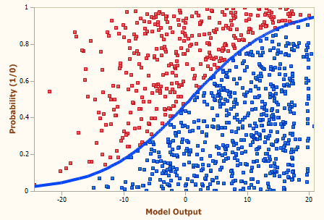
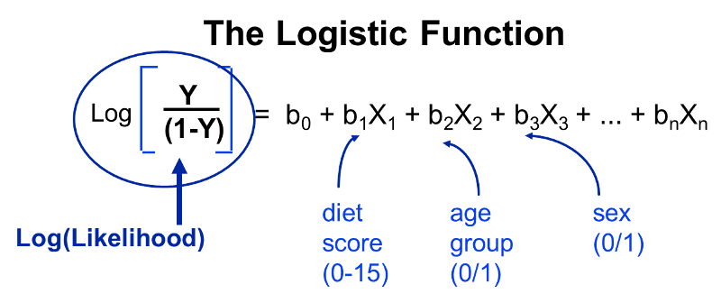
Quick review: logistic regression
Logistic regression is a modeling tactic where our dependent variable is bound by [0,1] used for class predictions
If a value exceeds some threshold, we can say the outputted response is of class =1, or of class =0 if we’re below some threshold

Slide 4
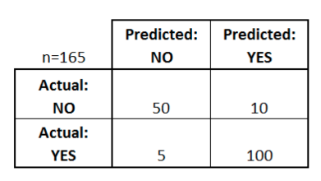
Confusion matrix
A confusion matrix is a table of how we plot the output of our classifier
How many classes are there?
How many patients?
How many times is a disease predicted?
How many patients actually have the disease?

Slide 5
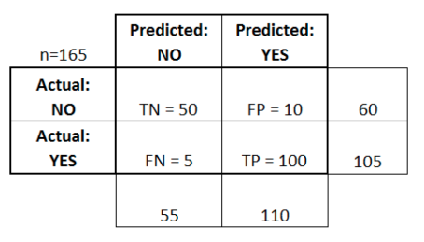
Confusion matrix
A confusion matrix is a table of how we plot the output of our classifier
True Positives
True Negatives
False Positives
False Negatives
Accuracy: Overall, how often is this correct?
Misclassification: Overall, how often is this wrong?
Notes:
Accuracy = (TP+TN)/Total = (150/165) = 0.91
Misclassification = (FP + FN)/Total = 15/165 = 0.09

Slide 6
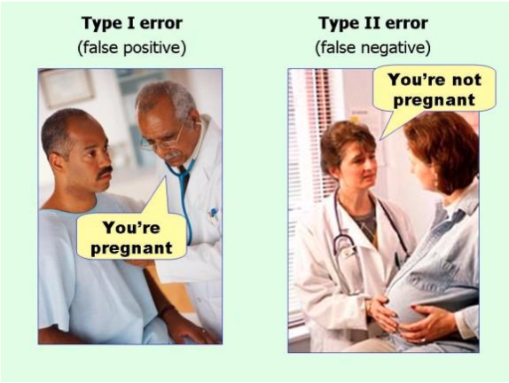
Confusion matrix

Slide 7
Confusion matrix
Sensitivity: when actual value is positive, how often is our prediction correct?
(True Positive/Recall)
Specificity: when actual value is negative, how often is our prediction correct?
False Positive Rate: When actual value is negative, how often is our prediction wrong?
Notes:
Sensitivity = TP/Actual Yes = 100/105 = 0.95
Specificity = TN/Actual No = 50/60 = 0.83
False Pos Rate = FP/Actual No = 10/60 = 0.17
Recall – I am correct for the current class – TP: (TP/(TP+FN))
Precision – Ability to avoid mislabeling current class – True Positives / (True Positives + False Positives)

Slide 8
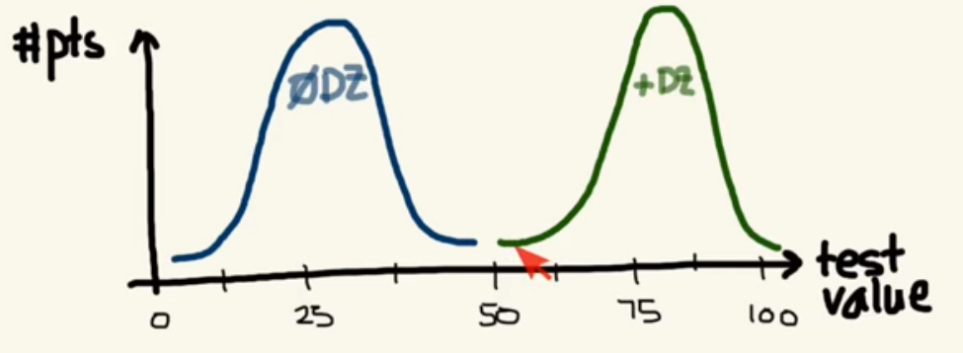
Sensitivity/specificity trade off
Notes:
Sensitivity = TP/Actual Yes = 100/105 = 0.95
Specificity = TN/Actual No = 50/60 = 0.83
False Pos Rate = FP/Actual No = 10/60 = 0.17
Recall – I am correct for the current class – TP: (TP/(TP+FN))
Precision – Ability to avoid mislabeling current class – True Positives / (True Positives + False Positives)

Slide 9
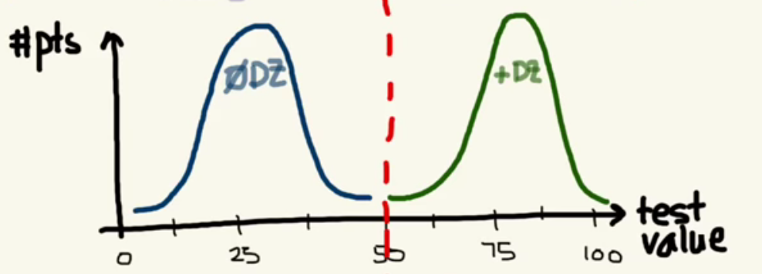
Sensitivity/specificity trade off
Notes:
Sensitivity = TP/Actual Yes = 100/105 = 0.95
Specificity = TN/Actual No = 50/60 = 0.83
False Pos Rate = FP/Actual No = 10/60 = 0.17
Recall – I am correct for the current class – TP: (TP/(TP+FN))
Precision – Ability to avoid mislabeling current class – True Positives / (True Positives + False Positives)

Slide 10
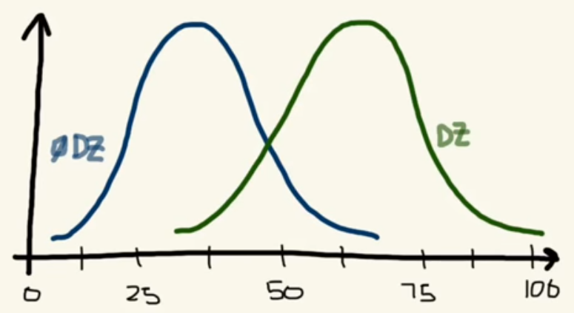
Sensitivity/specificity trade off
Notes:
Sensitivity = TP/Actual Yes = 100/105 = 0.95
Specificity = TN/Actual No = 50/60 = 0.83
False Pos Rate = FP/Actual No = 10/60 = 0.17
Recall – I am correct for the current class – TP: (TP/(TP+FN))
Precision – Ability to avoid mislabeling current class – True Positives / (True Positives + False Positives)

Slide 11
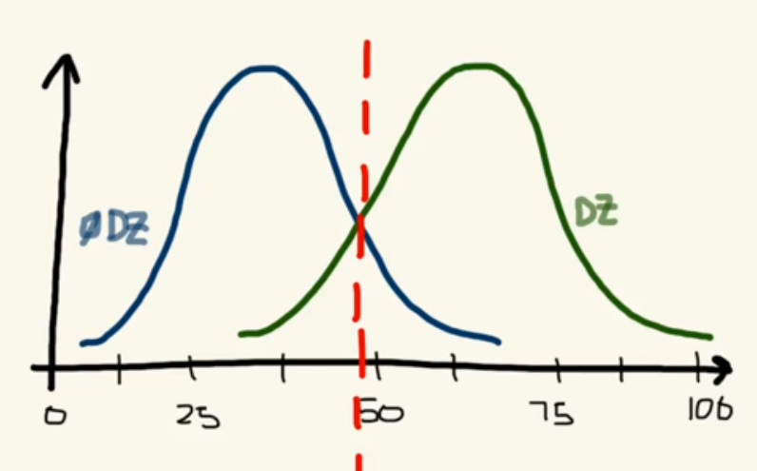
Sensitivity/specificity trade off
Notes:
Sensitivity = TP/Actual Yes = 100/105 = 0.95
Specificity = TN/Actual No = 50/60 = 0.83
False Pos Rate = FP/Actual No = 10/60 = 0.17
Recall – I am correct for the current class – TP: (TP/(TP+FN))
Precision – Ability to avoid mislabeling current class – True Positives / (True Positives + False Positives)

Slide 12
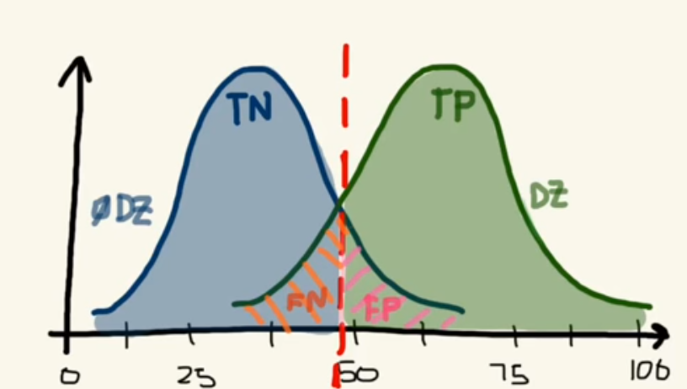
Sensitivity/specificity trade off
Notes:
Sensitivity = TP/Actual Yes = 100/105 = 0.95
Specificity = TN/Actual No = 50/60 = 0.83
False Pos Rate = FP/Actual No = 10/60 = 0.17
Recall – I am correct for the current class – TP: (TP/(TP+FN))
Precision – Ability to avoid mislabeling current class – True Positives / (True Positives + False Positives)

Slide 13
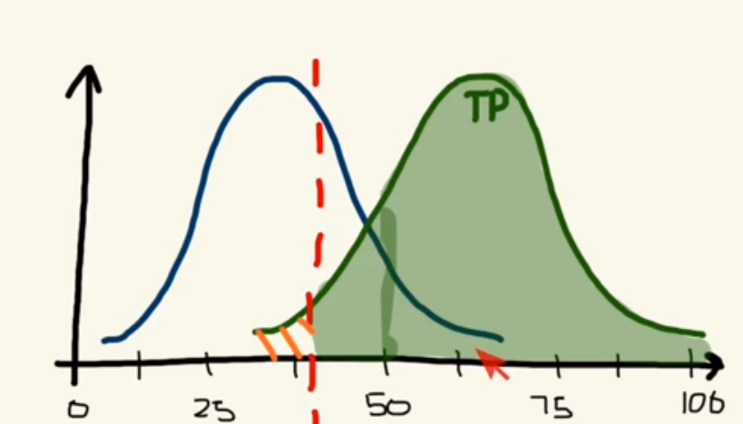
Sensitivity/specificity trade off
Notes:
Sensitivity = TP/Actual Yes = 100/105 = 0.95
Specificity = TN/Actual No = 50/60 = 0.83
False Pos Rate = FP/Actual No = 10/60 = 0.17
Recall – I am correct for the current class – TP: (TP/(TP+FN))
Precision – Ability to avoid mislabeling current class – True Positives / (True Positives + False Positives)

Slide 14
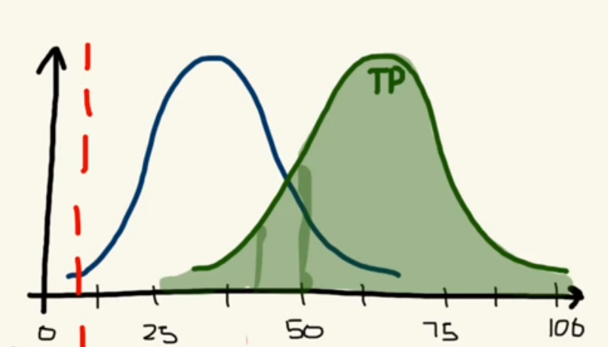
Sensitivity/specificity trade off
Notes:
100% sensitivity – everyone has the disease!

Slide 15
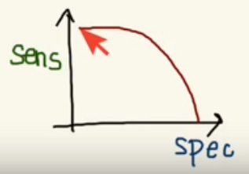
AUC and ROC Curves
Sensitivity and Specificity move in opposite directions – but there is an optimum value to be found
Area under the curve – plotting the sensitivity and specificity against one another yields the strength of our classifier (we want to bring this value to one)
The most popular AUC is the Receiver Operating Characteristic (ROC) Curve
Notes:
100% sensitivity – everyone has the disease!

Slide 16
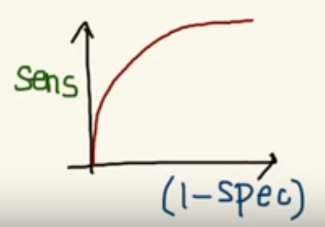
AUC and ROC Curves
We plot Sensitivity vs 1-Specificity so that the two move in the same direction
The ROC curve compares the true positive rate against the false positive rate. It is unaffected by the distribution of class labels since it is only comparing the correct vs. incorrect label assignments for one class.
Notes:
100% sensitivity – everyone has the disease!

Slide 17
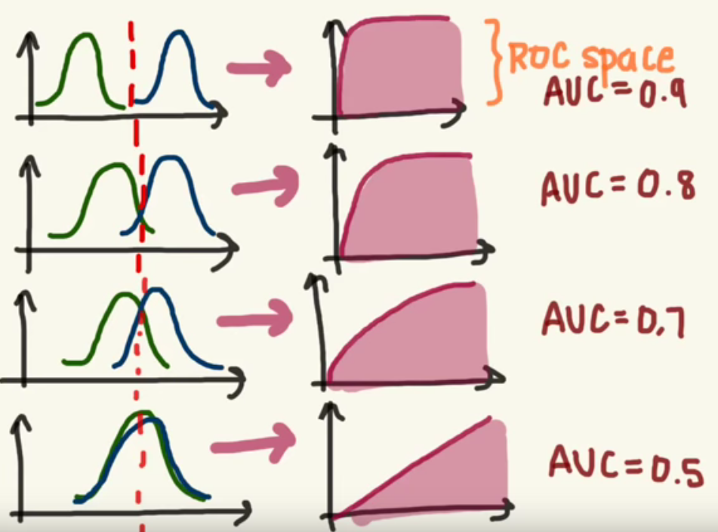
AUC and ROC Curves

