Slide 1
FEATURE SELECTION
Joseph Nelson, Data Science Immersive

Slide 2
Agenda
What is Feature Selection?
Types of Feature Selection
Regularization
Coding Implementation
Sklearn documentation

Slide 3
What is Feature selection?
And why is it useful?

Slide 4
What is Feature selection?
We have many potential features that may be used, but only some may have predictive power
Envision text data or music data – many features produced, only some have predictive power
Given an n x d pattern matrix (n patterns in d dimensional space), generate an n x m pattern matrix, where m << d
Three types of feature selection: bottom up, top down, and random shuffling
Selection vs extraction: Selection chooses current features, extraction produces interactions of current features (linear or non-linear combinations)
Notes:
Images, sound, movies, text, etc all examples of data producing lots of (unnecessary) features

Slide 5
Bottom up feature selection
Iteratively adding additional features to our model based on performance
We’ll discuss two types:
1. Sequential forward selection – Start with an empty set (X=0) and iteratively add best performing features
Disadvantage:
Notes:
once a feature

Slide 6
Bottom up feature selection
Iteratively adding additional features to our model based on performance
We’ll discuss two types:
1. Sequential forward selection – Start with an empty set (X=0) and iteratively add best performing features
Disadvantage: once a feature is added, it cannot be discarded. Does not consider feature interaction
Notes:
once a feature

Slide 7
Bottom up feature selection
Iteratively adding additional features to our model based on performance
We’ll discuss two types:
1. Sequential forward selection (SFS) – Start with an empty set (X=0) and iteratively add best performing features
Disadvantage: once a feature is added, it cannot be discarded. Does not consider feature interaction
2. Sequential backward selection (SBS) – Start with X= D, iteratively delete least significant features
Disadvantage:

Slide 8
Bottom up feature selection
Iteratively adding additional features to our model based on performance
We’ll discuss two types:
1. Sequential forward selection (SFS) – Start with an empty set (X=0) and iteratively add best performing features
Disadvantage: once a feature is added, it cannot be discarded. Does not consider feature interaction
2. Sequential backward selection (SBS) – Start with X= D, iteratively delete least significant features
Disadvantage: nesting problem (as above), plus computationally more expensive than SFS
Generalized versions of these searches: do the same, but model entire subsets

Slide 9
Bottom up feature selection
Sequential floating forward search (SFFS):
Step 1: Inclusion. Use the basic SFS method to select the most significant feature with respect to X and include it in X. Stop if d features have been selected, otherwise go to step 2.
Step 2: Conditional exclusion. Find the least significant feature k in X. If it is the feature just added, then keep it and return to step 1. Otherwise, exclude the feature k. Note that X is now better than it was before step 1. Continue to step 3.
Step 3: Continuation of conditional exclusion. Again find the least significant feature in X. If its removal will (a) leave X with at least 2 features, and (b) the value of J(X) is greater than the criterion value of the best feature subset of that size found so far, then remove it and repeat step 3. When these two conditions cease to be satisfied, return to step 1.
Notes:
h/t Michigan State

Slide 10
Top DOWN feature selection
Another way to select features is to impose a global constraint on the model. For example, in the case of text vectorization, we could impose that a feature needs to have a document frequency higher than a certain threshold to be considered relevant
Fairly common in text data, visual/auditory data

Slide 11
Random Shuffling feature selection
There are other ways to check if a feature has any predictive power, such as random shuffling. First, we calculate the score of the model, then we randomize the values along that column. If the feature has any predictive power, this should yield a worse score. On the other hand, if the feature has no predictive power at all, this will result in no change in the score and thus we can toss that feature.

Slide 12
regularization
Regularization is an example of a top-down technique that works with parametric models (such as Logistic Regressions and Support Vector Machines). It imposes a global constraint on the values of the parameters that define the model. The regularized model is found solving a new minimization problem where two terms are present: the term defining the model and the term defining the regularization.

Slide 13
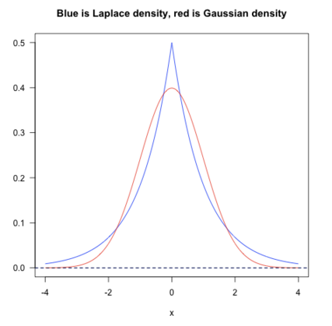
L1 and l2 regularization
Regularization works by adding the penalty associated with the coefficient values to the error of the hypothesis. This way, an accurate hypothesis with unlikely coefficients would be penalized while a somewhat less accurate but more conservative hypothesis with low coefficients would not be penalized as much.
Notes:
L1 – Laplacean
L2 – Gaussian
Quora

Slide 14
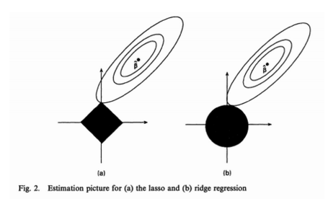
L1 and l2 regularization
L1: Stricter constraints: more angular distribution for inclusion
L2: Looser constraints, increases inclusion of features
Notes:
The feasible point that minimizes the loss is more likely to happen on the coordinates on graph (a) than on graph (b) since graph (a) is more angular. This effect amplifies when your number of coefficients increases, i.e. from 2 to 200.

Slide 15
regularization
Bottom line: regularization allows us to reduce over fitting by generalizing the values we have available in our training set.

Slide 16
feature_selection.GenericUnivariateSelect([...]) feature_selection.SelectPercentile([...]) feature_selection.SelectKBest([score_func, k]) feature_selection.SelectFpr([score_func, alpha]) feature_selection.SelectFdr([score_func, alpha]) feature_selection.SelectFromModel(estimator) feature_selection.SelectFwe([score_func, alpha]) feature_selection.RFE(estimator[, ...]) feature_selection.RFECV(estimator[, step, ...]) feature_selection.VarianceThreshold([threshold])

