Slide 1

Facets Guide Tool
June 23, 2011

Slide 2
Agenda
Facets Guide Tool
How to use?
Screenshots
CareMore
Integration

Slide 3
Facets Guide Tool
Need for the Tool
While retrieving Data from FACETS database, developers, and other people who use FACETS application face problems trying to figure out how the data is synced from the Online Application to the backend, how the data in the database is updated/inserted.
Comparing the data in the Front End and Back End every time, and enabling a SQL trace to find out which DB Objects have an impact takes time and lot of efforts.
Facets Guide Tool helps in checking the data mapping between the FrontEnd UI and BackEnd Database.
Benefit of the Tool
Reducing the time and effort on data analysis.
With this tool, analysis Effort will be reduced by ~% , which turns out to ~ hours/year.
C
A
R
E
M
O
R
E
I
N
T
E
R
A
T
I
O
N
G

Slide 4
Facets Guide Tool
Technology
Windows Application(.NET) has been built, which will display the mapping between the frontend UI and the backend DB for various modules and sub-modules.
The mappings are configurable – i.e. can be updated without having to change the code.
Tool Usage
Select the Module for which the mappings are required.
Select the sub-module.
Select the FrontEnd field for which the mapping is required.
View the mapping.
Export to Excel.
C
A
R
E
M
O
R
E
I
N
T
E
G
R
A
T
I
O
N

Slide 5
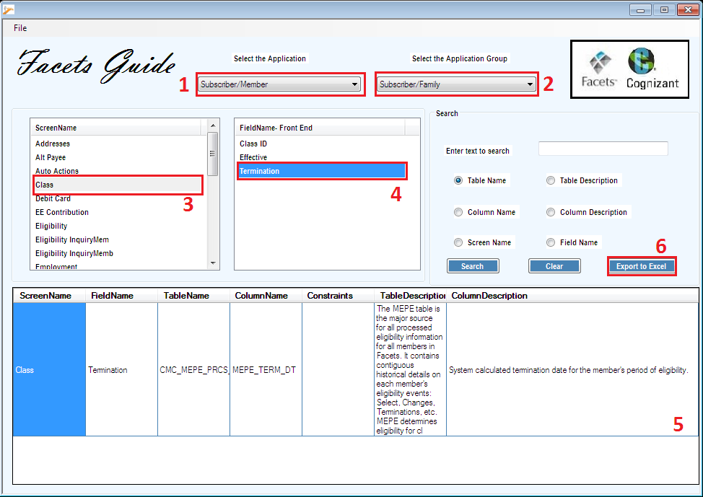
Screenshots – View the Mappings
1. Select the Application i.e. Module.
2. Select the Application Group i.e. Sub-module.
3. Select the Screen Name.
4. Select the Front End Field Name.
5. View the mapping and descriptions.
6. Export the information to excel.
1
2
3
C
A
R
E
M
O
R
E
I
N
T
E
G
R
A
T
I
O
N

Slide 6
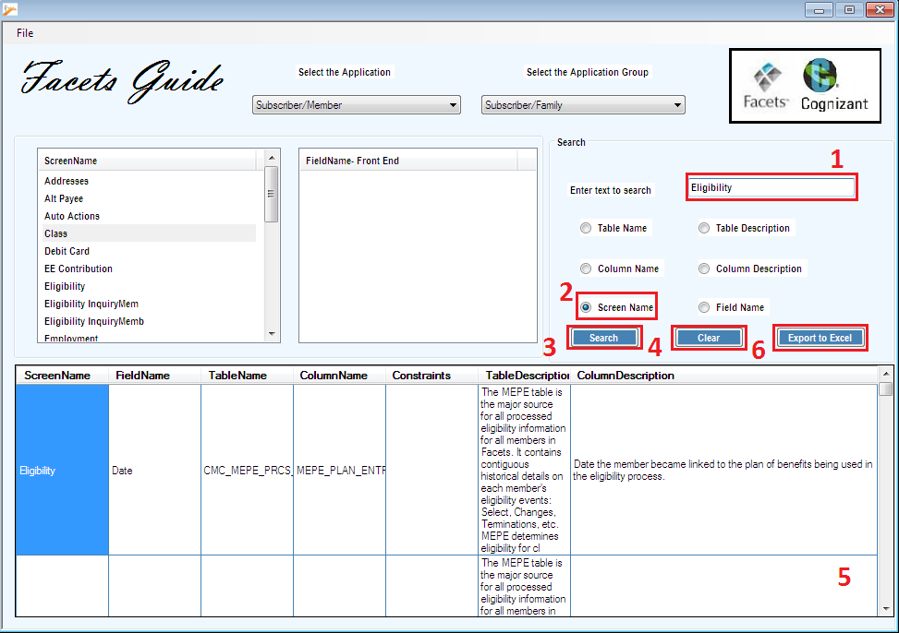
Screenshots - Search
1. Enter the text to search.
2. Select the Search Criteria.
3. Click on Search Button to display the search results.
4. Click on the Clear button to clear the search text and selection.
5. View the search results.
6. Click on Export to excel to save the results in an excel file.
C
A
R
E
M
O
R
E
I
N
T
E
G
R
A
T
I
O
N

Slide 7

Thank You!

