Slide 1
Unid
Sells
Buy & Sell Anything — Marketplace Web Application
🛒
💬
Buy & Sell
Real-time Chat
Project By:
L.INDU
Department of Computer Science
Product Listings
Socket.io
🔐
👤
Secure Auth
User Dashboard
Login + OTP Reset
My Ads + Account
Built with Node.js · MongoDB · Express · Socket.io · Claude AI

Slide 2
SLIDE 2 | INTRODUCTION
Introduction to the Project
UnidSells is a full-stack web marketplace platform that enables users to buy and sell products online — built entirely using Claude AI (Anthropic) as the coding assistant.
12
HTML Pages
Key Features:
3
User registration, login (email/mobile), forgot password with OTP
Post ads with multiple images — upload from device or paste URL
Real-time buyer-seller chat using Socket.io
Wishlist, budget filter, category search
My Ads dashboard — edit, delete, mark as sold
Admin panel — manage users (block/delete), flag/delete listings
Database Models
REST
API Architecture
100%
Github copilot by giving prompt
2

Slide 3
SLIDE 3 | OBJECTIVES
Project Objectives
01
AI-Driven Development
02
Full-Stack Implementation
Build a complete full-stack web application using only github copilot by giving prompt — no manual code writing.
Node.js + Express backend, MongoDB database, REST APIs, Socket.io real-time features.
03
User Authentication
04
Complete Marketplace
Email/mobile login, signup, OTP-based forgot password, role-based access control.
Multi-image listings, wishlist, budget filter, category search, real-time chat.
05
Admin Control Panel
06
Prompt Engineering
Manage all users (block/delete), moderate all listings (flag/delete), monitor chats.
Demonstrate how to craft effective AI prompts to generate working, production-ready code.
3

Slide 4
SLIDE 4 | STAKEHOLDERS
Project Stakeholders
👤
Buyers (Users)
Browse listings by category or budget, search products, add to wishlist, and message sellers directly through the real-time chat.
🛍️
Sellers (Users)
Register and post product ads with multiple images, manage their listings (edit/delete/mark sold), and respond to buyer messages.
👑
Administrator
Access the admin panel to manage all users (view/block/delete), moderate listings (flag/delete), and monitor chat activity.
🎓
Evaluators / Faculty
Review the project for AI tool usage, prompt quality, technical depth, UI design, and overall functionality of the marketplace.
4

Slide 5
SLIDE 5 | TECH STACK
Languages, Tools & Software
Backend
Frontend
Node.js (Runtime Environment)
Express.js (Web Framework)
Socket.io (Real-time Chat)
Multer (Image File Upload)
Bcrypt (Password Hashing)
HTML5 (Structure)
CSS3 (Styling & Animations)
Vanilla JavaScript (Logic)
Google Fonts — Playfair Display + DM Sans
Responsive Design (Mobile-first)
Database
AI & Tools
MongoDB (NoSQL Database)
Mongoose ODM (Schema + Queries)
3 Models: User, Listing, Chat
Embedded documents for messages
Population for joined queries
Github copilot (Code Generation)
Prompt Engineering Techniques
VS Code (Code Editor)
Git & GitHub (Version Control)
5

Slide 6
SLIDE 6 | PROMPTS (1 of 2)
Prompts Used to Generate the Code
P1
Project Setup
"Create a full-stack marketplace web application using Node.js, Express, MongoDB, HTML, CSS, and JavaScript with user authentication and product listing features."
P2
Authentication System
"Implement user authentication with login and signup functionality using MongoDB, including session handling and local storage for user data."
P3
Product Management
"Develop CRUD operations for product listings, including image uploads, product details page, and category-based filtering."
P4
Wishlist Feature
"Add a wishlist system using localStorage to save and retrieve user-selected products with navigation to product details."
6

Slide 7
SLIDE 7 | PROMPTS (2 of 2)
More Prompts — Chat, Notifications & Routing
P5
Chat System
"Implement a real-time-style chat system between buyers and sellers with message storage in MongoDB and a chat interface."
P6
Chat Inbox UI
"Design a chat list interface displaying all conversations with last message preview and unread message indicators."
P7
Notifications
"Implement notification badges for unread chat messages and update counts dynamically on the homepage."
P8
UI Enhancements
"Improve UI with responsive layouts, image sliders, modal zoom for product images, and clean navigation design."
7

Slide 8
SLIDE 6 | PROMPTS (3 of 3)
Final Prompts — Routing, API and Deployment
P9
Routing & API Integration
"Connect frontend with backend APIs using Express routes for users, listings, and chat functionalities."
P10
Deployment Ready Structure
"Organize project structure with models, routes, public assets, and server configuration for scalability."
P11
Summary
"All 10 prompts were used iteratively to build, debug, and enhance the UnidSells platform from scratch using Claude AI."
pp
p12
AI tool Used
used github copilet to generate all code, fix errors, and build complete features through prompt engineering."
.
8

Slide 9
SLIDE 8 | WORKFLOW
System Workflow Flowchart
Visit Site
Sign Up/Login
Forgot Password?
Admin Panel
Block/Delete/Flag
Browser → login.html
Email or Mobile
OTP → Reset
Users & Listings
Home Page
Search/Filter
View Product
Wishlist
Message Seller
Browse Listings
Category or Budget
Image Slider + Info
Save for Later
Socket.io Chat
Post Ad
Upload Images
Listing Saved
Mark as Sold
My Ads Panel
Title, Price, Images
Device File or URL
MongoDB + Multer
Status Update
Edit / Delete
Chat Inbox
Unread Badge
Budget Filter
Account Page
Admin Panel
All Conversations
🔴 Notification
Min–Max Range
Edit Profile + Pwd
Monitor Activity
Auth / Chat
Browse / Post
Key Actions
Seller Control
Admin Only
9

Slide 10
SLIDE 9 | FRONTEND VIEWS
Application Frontend — Page Overview
🔐
Login Page
🏠
Home / Index
📦
Product Detail
Sign In / Sign Up tabs + Forgot Password with OTP inline — all on one page
Hero banner, category filter bar, live search, product grid with wishlist toggle
Multi-image slider ◄ ►, thumbnail strip, zoom modal, Message Seller button
➕
Post Ad
💬
Chat / Messages
📊
My Ads Dashboard
Upload device photos or paste URL, drag & drop, all images saved to MongoDB
Real-time Socket.io messaging, unread count badge, listing preview banner
Active/Sold tabs, edit ads, mark sold, delete, photo count shown on thumbnails
💰
Budget Filter
❤️
Wishlist
👑
Admin Panel
6 preset ranges + custom min-max slider + category filter + live results
localStorage saved items, animated remove, clear all, redirects to product
4 tabs: All Users (block/delete) · Listings (flag/delete) · Chats · Flagged
10

Slide 11
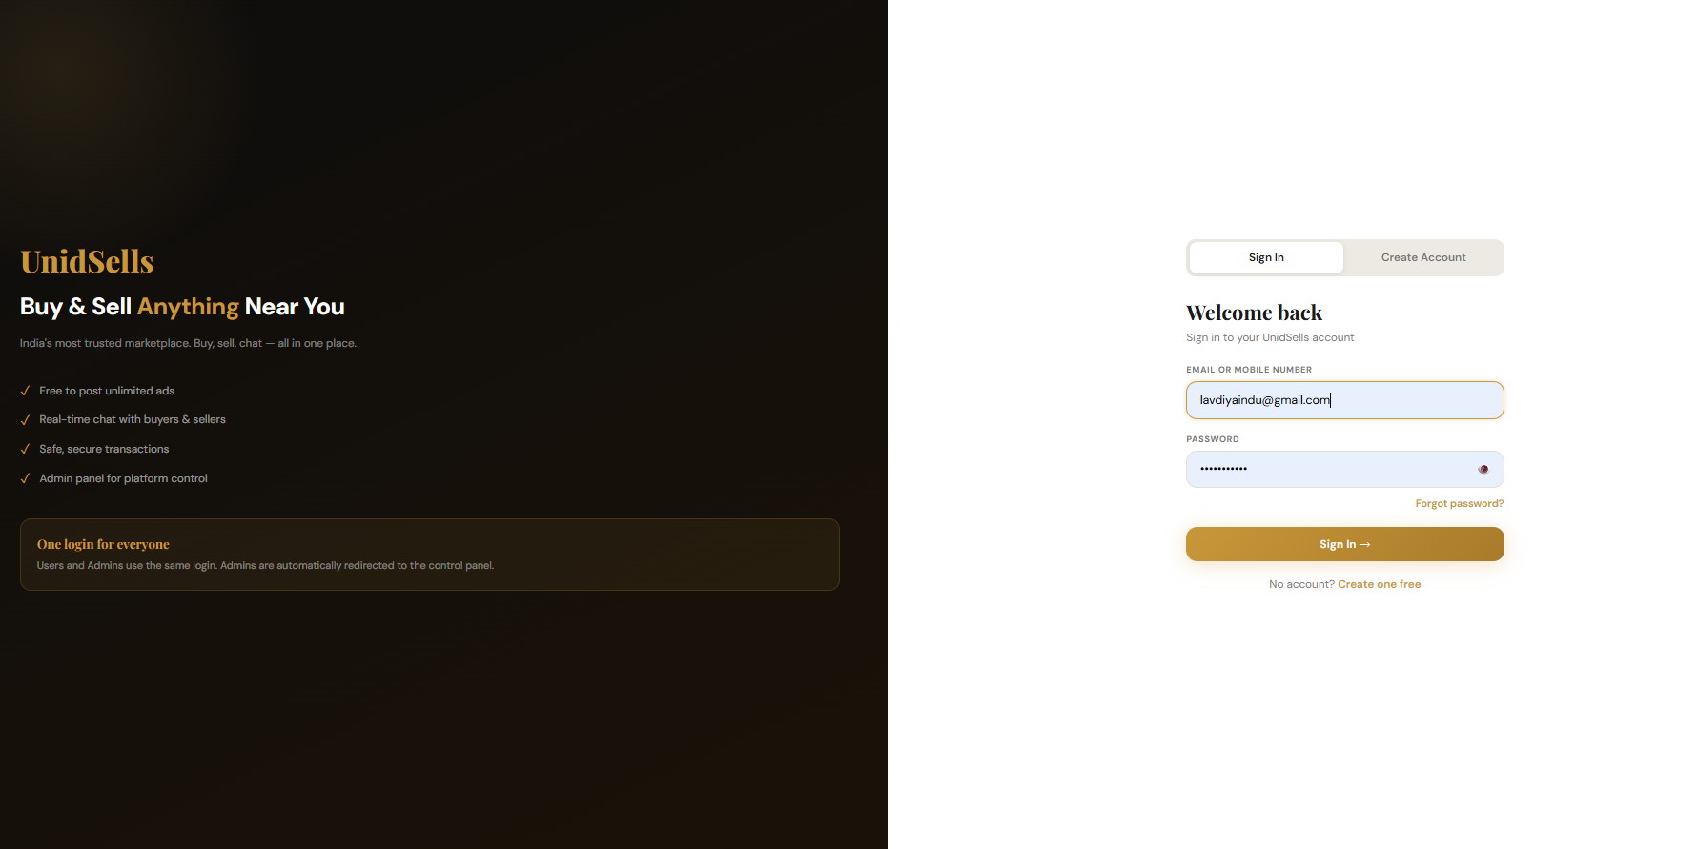
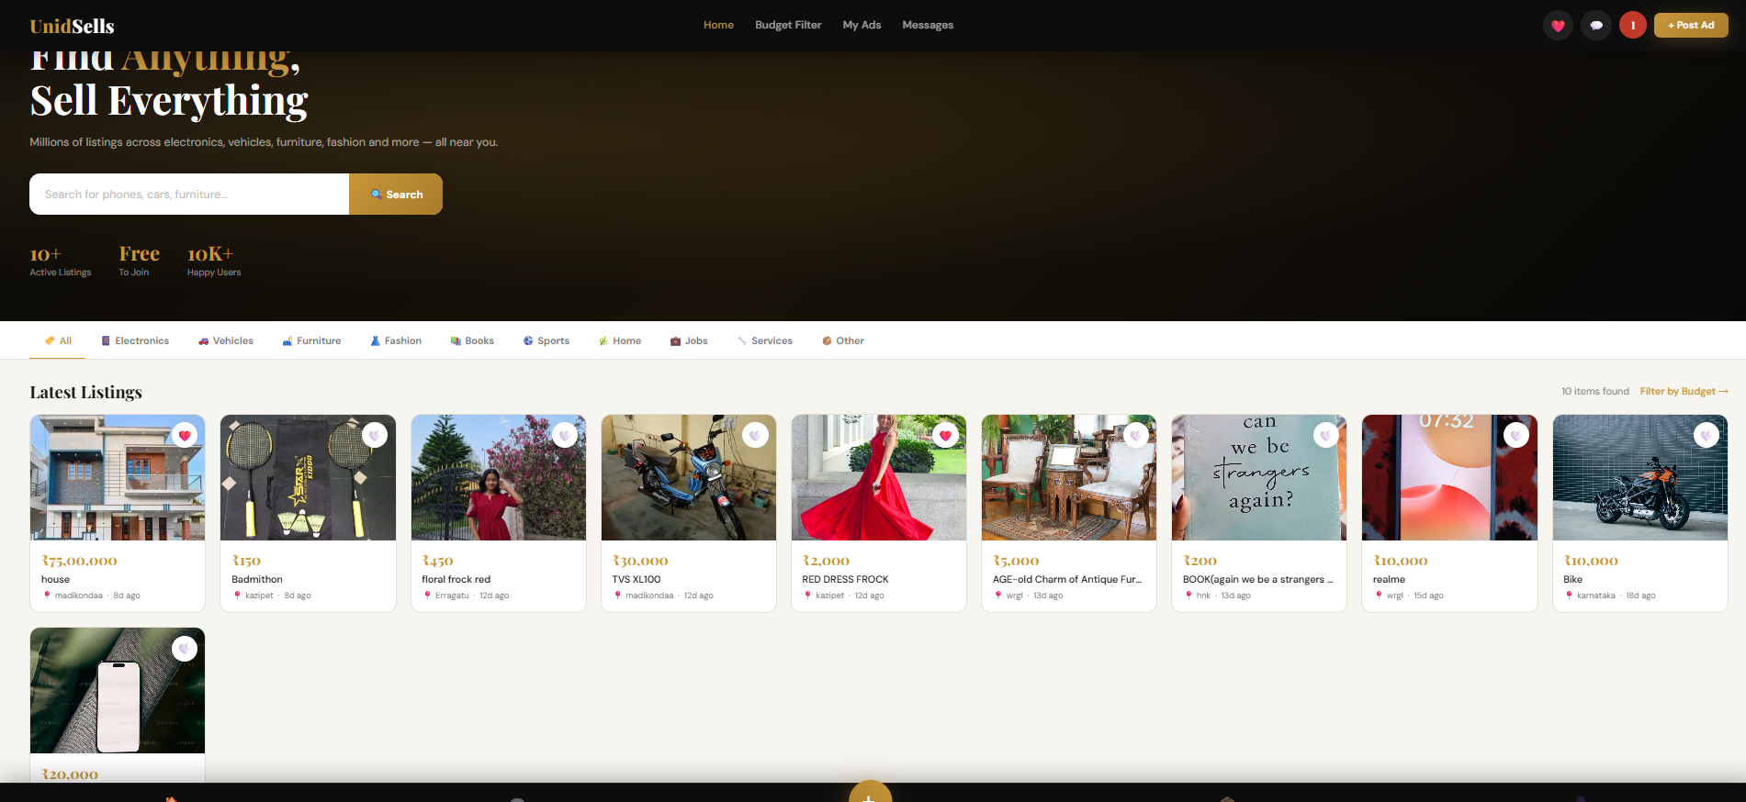
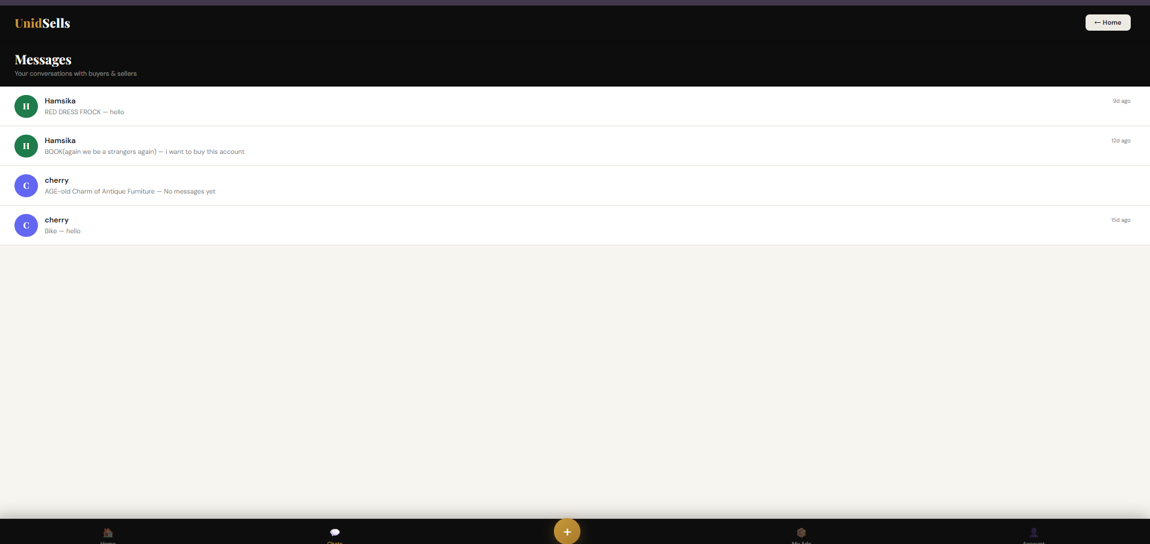
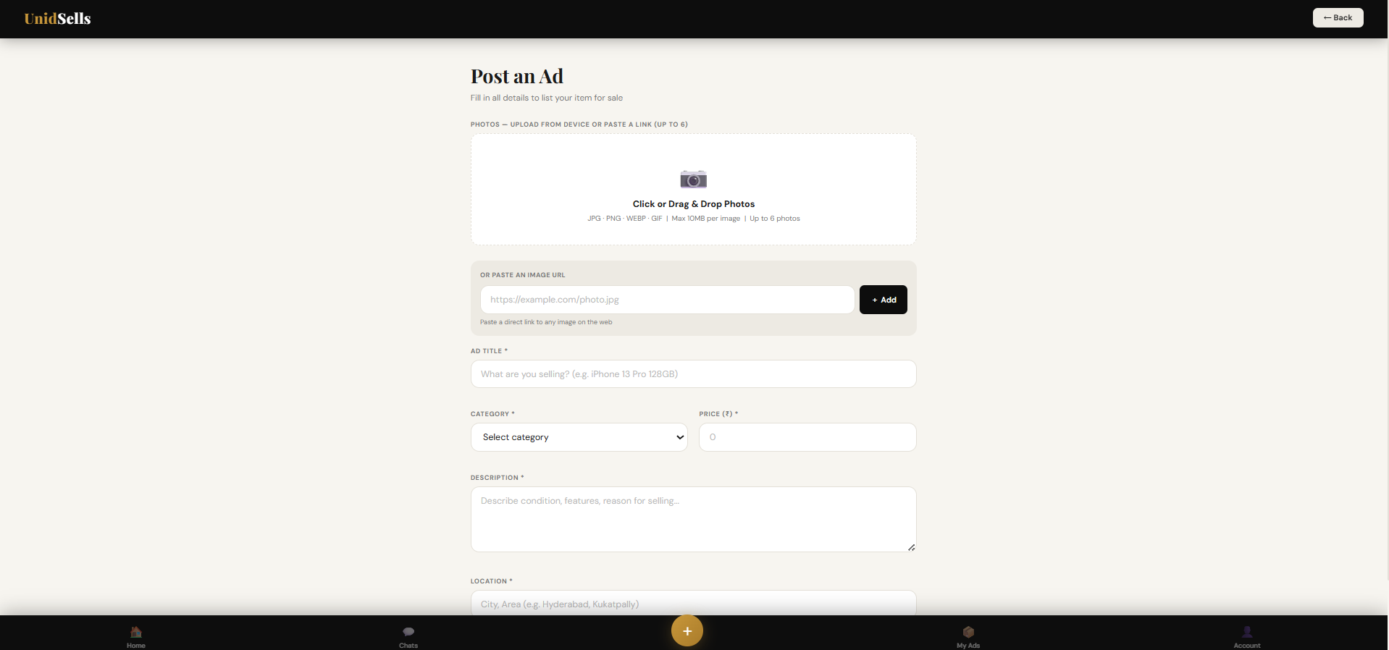
SLIDE 10 | PROOF OF PROMPTS
Proof of Prompts Generating Code
📷
📷
Initial project prompt → full code generation
Screenshot 1
Screenshot 2
Image upload bug prompt → fix generated
📷
📷
Screenshot 3
Screenshot 4
New features prompt → updated code
Final refinements → single login + slider fix
How to add screenshots: Open this file in PowerPoint → Go to Insert → Pictures → select your claude.ai conversation screenshots.
11

Slide 12
SLIDE 11 | REFERENCES
References
[1]
Github copilot
https://claude.ai
[AI Tool]
Primary AI used to generate all code through prompt engineering.
[2]
Node.js Official Documentation
https://nodejs.org
[Backend]
Runtime and Express.js framework used for server and API.
[3]
MongoDB & Mongoose Docs
https://mongodb.com
[Database]
NoSQL database and ODM for User, Listing, and Chat models.
[4]
Socket.io Documentation
https://socket.io
[Real-time]
WebSocket library used for real-time buyer-seller chat and notifications.
[5]
Google Fonts
https://fonts.google.com
[Design]
Playfair Display & DM Sans fonts used for the premium dark/gold UI theme.
[6]
OLX India & Quikr
https://olx.in · https://quikr.com
[Reference]
Inspiration for marketplace features, UI patterns, and user experience flow.
12

Slide 13
Thank You
UnidSells · Buy & Sell Marketplace
· Node.js · MongoDB · Socket.io
http://localhost:3000

