Slide 1



Django
Web development team -APSSDC
Prepared by:
InduPriya

Slide 2
Super User creation (admin part)
First we’ll need to create a user who can login to the admin site. Run the following command:
Enter your desired username and press enter.

Slide 3
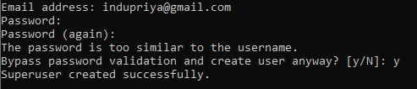
Super User creation (admin part)
You will then be prompted for your desired email address:
The final step is to enter your password. You will be asked to enter your password twice, the second time as a confirmation of the first.

Slide 4
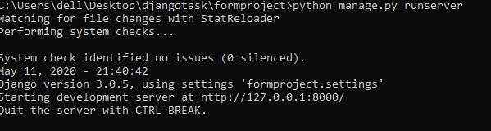
Start the development server¶
The Django admin site is activated by default. Let’s start the development server and explore it.
Run the development server
python manage.py runserver

Slide 5
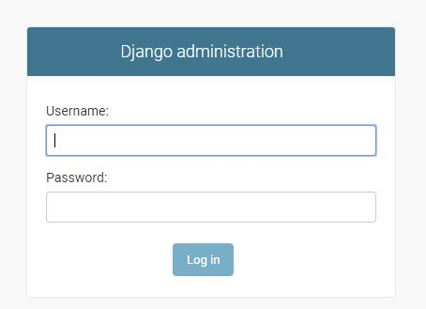
Django admin
Now, open a Web browser and go to “/admin/” on your local domain – e.g., http://127.0.0.1:8000/admin/. You should see the admin’s login screen:

Slide 6
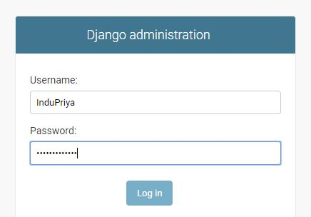
Django admin
Login with the username and password you setup when you added your super user.

Slide 7
Django admin
You should see a few types of editable content: groups and users. They are provided by django.contrib.auth , the authentication framework shipped by Django.
Once you’re logged in , the first thing you will see will be admin home page

Slide 8
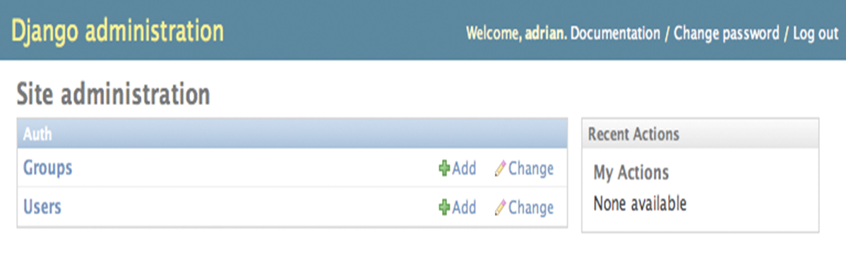
Django admin
List all the available types of data that can be edited
The two default admin-edible models are only Groups and Users

Slide 9
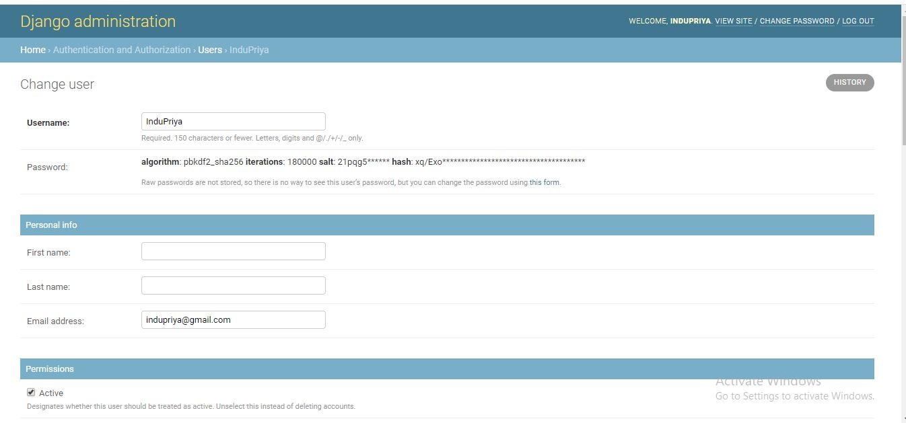
Django admin
We are some special features for admin

Slide 10
Using the Admin Site
A click the “change “ link in the “Users “ row to load the change list page for users
This page displays all users in the database
There are useful filtering, sorting and searching options
Filtering options are at right , sorting is available by clicking a column header ,and search box at the top lets you search by user name
.

Slide 11
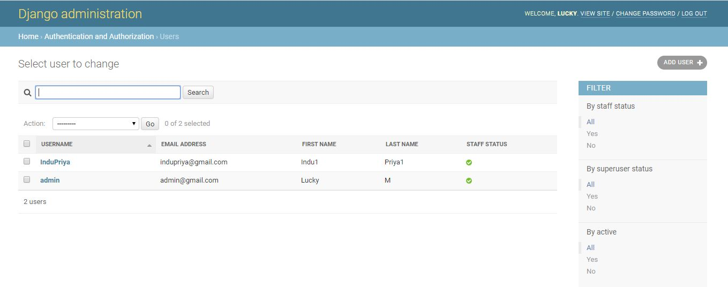
Using the Admin Site
.

Slide 12
Using the Admin Site
click the user name of the user you created, and you’ll see the edit form for that user
This page lets you change the attributes of the user ,like the first /last names and various permissions
To change a users password ,you should click “change password form” under the password field rather than editing the hashed code
You can delete a record by clicking the delete button at the bottom left of its edit form
You can add a record by clicking “Add” in the appropriate column of the admin home page
Admin interface also handles input validation

Slide 13
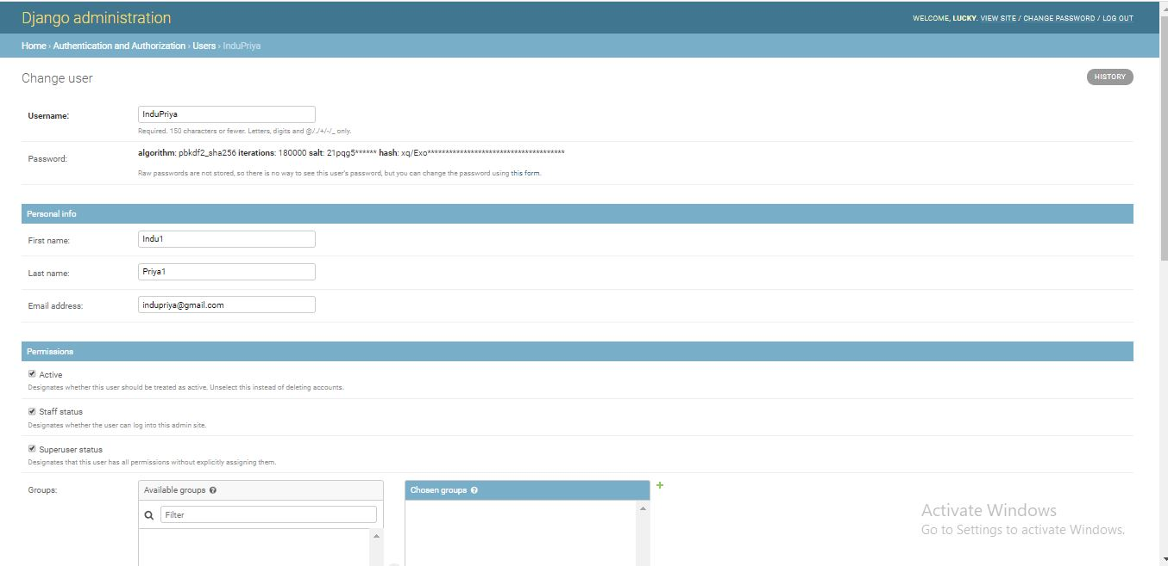
Using the Admin Site

Slide 14
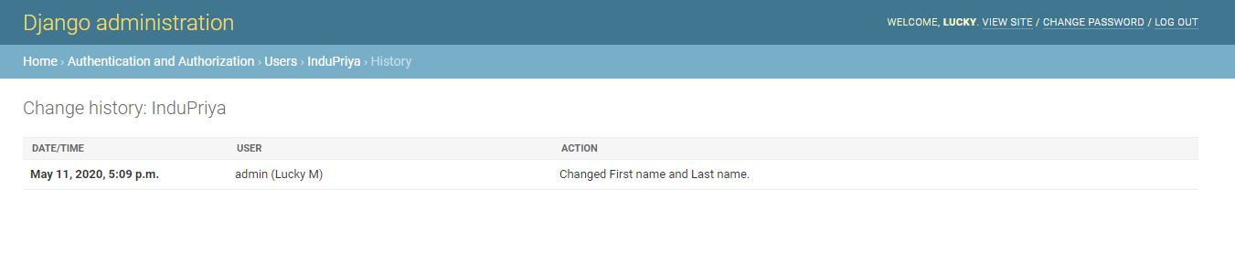
Using the Admin Site
When you edit an existing object , You’ll notice a history link in the upper-right corner of the window
Every change made through a admin interface is logged , and you can examine this log by clicking the history link

Slide 15
Model Queries (Django Shell)
A model is the single, definitive source of information about your data. It contains the essential fields and behaviors of the data you’re storing. Generally, each model maps to a single database table.
The basics:
Each model is a Python class that subclasses django.db.models.Model.
Each attribute of the model represents a database field.
With all of this, Django gives you an automatically-generated database-access API; see Making queries.

Slide 16
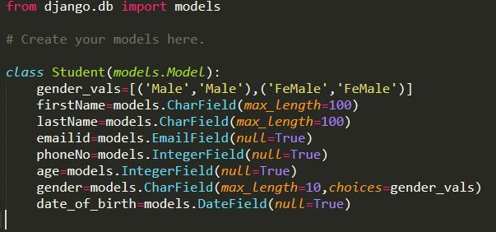
Model Queries (Django Shell)
Quick example¶
This example model defines a Student, which has a firstName,lastName, emailid, phoneNo,age,gender,date_of_birth,gender_vals.

Slide 17
Model Queries (Django Shell)
firstName,lastName, emailid, phoneNo,age,gender,date_of_birth,gender_vals.
are fields of the model. Each field is specified as a class attribute, and each attribute maps to a database column.
Using models:
Once you have defined your models, you need to tell Django you’re going to use those models. Do this by editing your settings file and changing the INSTALLED_APPS setting to add the name of the module that contains your models.py.

Slide 18
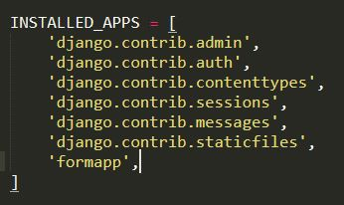
Model Queries (Django Shell)
For example, if the models for your application live in the module myapp.models (the package structure that is created for an application by the manage.py startapp script), INSTALLED_APPS should read, in part:

Slide 19


Model Queries (Django Shell)
When you add new apps to INSTALLED_APPS, be sure to run manage.py migrate, optionally making migrations for them first with manage.py makemigrations.
After this we should gave migrate

Slide 20
Django shell
If you don’t specify primary_key=True for any fields in your model, Django will automatically add an IntegerField to hold the primary key, so you don’t need to set primary_key=True on any of your fields unless you want to override the default primary-key behavior. For more, see Automatic primary key fields.
The primary key field is read-only. If you change the value of the primary key on an existing object and then save it, a new object will be created alongside the old one. For example:

Slide 21
Django shell
After enter into the shell we import our class name which have to create in models.py
After that we have to apply CRUD operations through Django shell
Insert
Retrive
Delete

Slide 22

Django shell
Insert:
To show all outputs We use differe ways one is:
Here obj is a temperory variable

Slide 23

Django shell
In the above Query we have display all the fields displayed in our class
If we want only one paticular field only displayed:
Here we call only firstname so..Its diplayed only fiestnames.

Slide 24
Django shell
If we want to display our output in Dictionary format:
Syntax: data=Students.objects.values()
If we want to display our output in List format:
Syntax: data=Students.objects.values_list()

Slide 25

Django shell
It displays in list inside dictionary
Sytax:data=Student.objects.values()
To get the records with Primary Key
Syntax:info=Student.object.get(id=1)

Slide 26
Django shell
Differences between get() and Filter():
Basically use get() when you want to get a single unique object, and filter() when you want to get all objects that match your lookup parameters. you will get: Pol does not exist. I.e. If you want to run some code depending on whether a single object can be found, use filter.
To say in simple way filter(): multiple times display full record
get() :-Use for single record
Syntax: mymodel=Student.objects.get(name='InduPriya')
Syntax: mymodel=Student.objects.filter(name='InduPriya')

Slide 27



Django shell
If we want to display first record in all records
Syntax:
If we want to display last record in all records
Syntax:
If we want to display n no of records ,Here I want 3 records so i gave[:3]
Syntax: 3

Slide 28
Django shell
If we want to display a records in ascending order depend on our requirement, We use order_by()
Syntax:
If we want to display a records in decending order depend on our requirement,We use order_by(-)
Syntax:
If we want to display no of records use [:3]

Slide 29


Django shell
Update:
If we want to update a field in all record.Here all the age fields in records changed age=26
If we want to update a field in one record.Here all the DOB fields is changed .

Slide 30

Django shell
Delete:
If we want to delete a particular record in shell:
Note: Here first we call particular field with our requirement,Then we applay delete query

Slide 31

Thank you
Slides created, maintained and distributed by Web development Team - Andhra Pradesh State Skill Development Corporation (All these Slides are open source)

