Slide 1
Student Exam Score
Prediction
Using Machine Learning Regression Models
Capstone Project │ PG Certificate — Applied Data Science & AI │ Dataset: Kaggle
5 ML Models
Regression Task
10-Fold CV
GridSearchCV Tuned

Slide 2
Objective
Problem Statement
Goal of the Project
Given a student's academic behaviour, attendance, and demographic data, can we accurately predict their ExamScore before results are published?
Train and compare 5 regression models across baseline, regularized, bagging, and boosting approaches.
Identify the best-performing model using 10-fold CV
Tune the winning model with GridSearchCV
Surface the features that matter most for early intervention
⚠️ Critical Design Decision — Avoiding Data Leakage
The FinalGrade column was removed before training. FinalGrade is derived from ExamScore after results are published — keeping it would let the model see post-exam information, inflating performance metrics artificially.
Dataset: Kaggle — Student Performance and Learning Behavior Dataset | 14,003 records | Regression task (continuous target: ExamScore)

Slide 3
Project Workflow
14,003
14
1,534
0
80/20
Total Records
Final Features
Duplicates Removed
Missing Values
Train / Test Split
Data Preprocessing Steps
Project Workflow Pipeline
1. Remove Leakage
1
2
3
Dropped FinalGrade (correlation ≈1.0 with target)
2. Remove Duplicates
Load Data
Exploratory Data Analysis
Data Cleaning & Train/Test Split
1,534 exact duplicate rows removed
3. Train/Test Split
80% / 20% split, random_state=42
6
5
4
4. Handle Missing Values
Model Training & 10-Fold Comparison
Feature Importance Analysis
Preprocessing on Training Data
No missing values detected — imputation not required.
5. Outlier Check (IQR)
0 rows removed — target has no extreme outliers
7
8
6. Feature Scaling
Feature scaling applied only to linear models where required.
Hyper parameter Tuning – Best Model
Inference / New Student Prediction
Final dataset: 12,469 rows × 14 features | Train: 9,975 rows | Test: 2,494 rows

Slide 4
Model Evolution: Baseline to Boosting
📐
🔒
🌳
Linear Regression
Ridge Regression
Random Forest
Baseline
Regularised
Ensemble (Bagging)
Simple linear baseline. Establishes the minimum bar every other model must beat.
L2-regularised linear model. Tests whether penalising large coefficients helps.
Bagged decision trees. Averages many trees to reduce variance.
⚡
⚙️
Extra Trees
XGBoost
Best Model
Ensemble (Boosting)
Extremely randomised trees. Full-data training + random split thresholds — won this comparison.
Gradient-boosted trees with regularisation. Tests the boosting paradigm.
🚀 Progressive benchmarking from baseline to advanced ensemble methods to identify the most robust predictor.

Slide 5
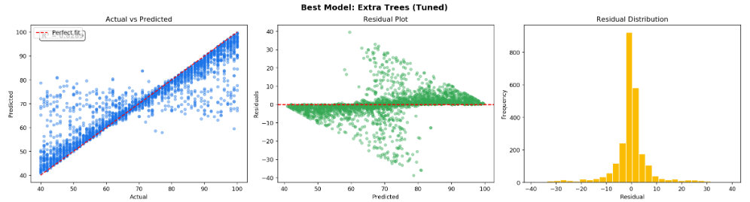
Model Evaluation & Hyperparameter Tuning
10-Fold CV Leaderboard
BEST MODEL
Extra Trees Regressor (Tuned)
Model
CV MAE
CV RMSE
CV R²
Test RMSE = 7.34 | Test MAE = 4.10 | Test R² = 0.829
★ Extra Trees
4.998
8.314
0.778
Random Forest
5.504
8.588
0.764
GridSearchCV Tuning — Extra Trees
XGBoost
9.442
12.047
0.535
Hyper parameter tuning performed using GridSearchCV (90 total model evaluations).
Grid : n_estimators[100,200,300] × max_depth[None,10,20] ×
min_samples_split[2,5]
Best Params : n_estimators=300, max_depth=None, min_samples_split=2
Scoring : neg_mean_squared_error
Ridge Regression
15.319
17.683
−0.002
Linear Regression
15.319
17.683
−0.002
🚀 Best model: Extra Trees (Tuned via GridSearchCV) | All CV metrics are 10-fold cross_val_score() outputs on the training set | Test metrics from held-out 20% test set

Slide 6
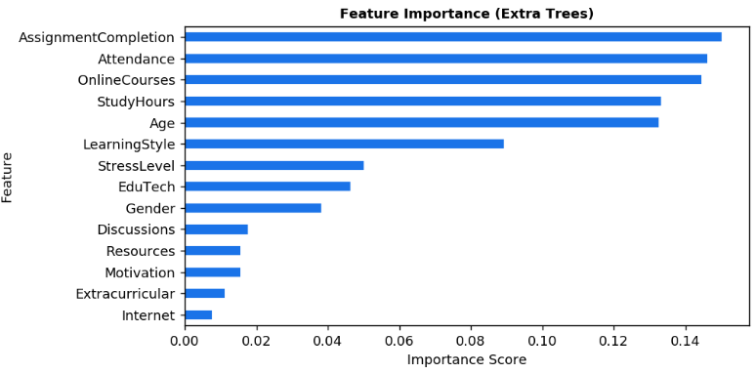
Feature Importance & Key Predictors
Top Predictors
#1
AssignmentCompletion 15.04%
Regular attendance showed the highest impact on exam performance.
#2
Attendance 14.64%
Consistent assignment completion strongly influenced scores.
#3
OnlineCourses 14.48%
Higher study hours were associated with better performance.
#4
StudyHours 13.33%
Participation in online courses positively contributed to scores.
#5
Age 13.26%
Age showed moderate influence on learning patterns and outcomes.
📌 Feature importance derived from the tuned Extra Trees model highlights the strongest predictors influencing student exam performance..

Slide 7
Inference - Predicting a New Student’s Score
Sample Student Profile:
StudyHours
17
OnlineCourses
16
Attendance
65
Discussions
0
Resources
1
AssignmentCompletion
79
Extracurricular
0
EduTech
1
Motivation
1
StressLevel
2
Internet
1
Gender
0
Model Prediction:
Age
21
★ Predicted ExamScore (Tuned Extra Trees) : 58.00
LearningStyle
1
Predicted outcomes can help identify at-risk students early and guide timely interventions.

Slide 8
References & Other Comments
References
Future Improvements
Dataset Source
Kaggle — "Student Performance and Learning Behavior Dataset" (https://www.kaggle.com/datasets/adilshamim8/student-performance-and-learning-style)
Libraries / Tools Used
Python 3 · Pandas · NumPy · Matplotlib
Scikit-Learn (LinearRegression, Ridge, RandomForestRegressor, ExtraTreesRegressor)
XGBoost (XGBRegressor)
GridSearchCV, cross_val_score, StandardScaler
Real-Time Dashboard
Build an interactive Flask app for teachers to predict individual student scores in real time.
Early Warning System
Alert system that flags students at risk of scoring below threshold before exams — enabling proactive support.
SHAP Explainability
Integrate SHAP values for granular, per-student feature attribution and model interpretability.
Multi-Subject Extension
Extend model to predict scores across multiple subjects using subject-specific feature engineering.

Slide 9
Thank You
for your time and evaluation
Student Exam Score Prediction
🎓 Capstone Project — PG Applied Data Science & AI
📊 Dataset: Kaggle — Student Performance & Learning Behavior
5 Models | Best: Extra Trees| RMSE = 7.34 | MAE = 4.10 | R² Score = 0.83
Open to Questions & Discussion

