Slide 1
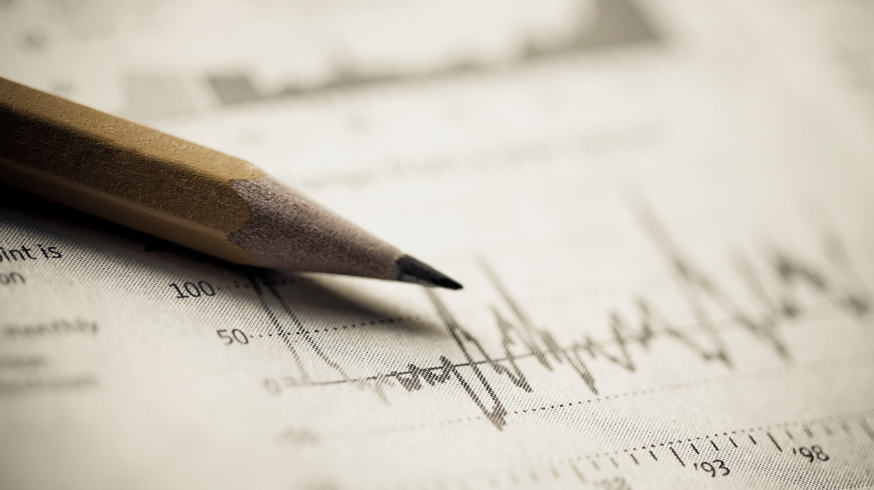
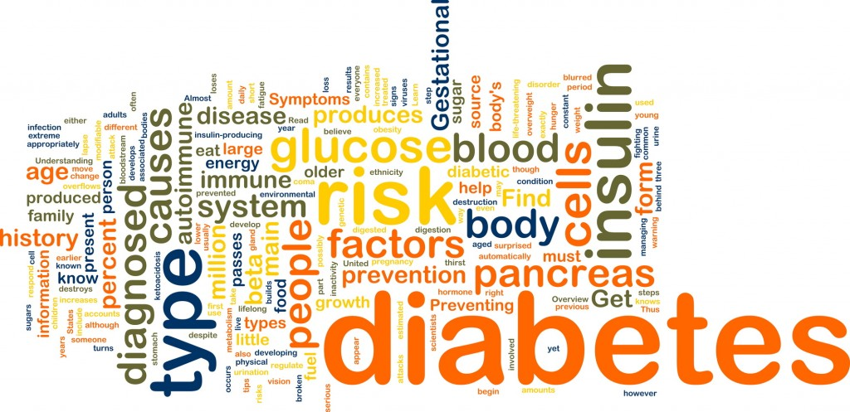
DIABETES PREDICTION USING ML WITH -PYTHON -SUPPORT VECTOR MACHINE
u.Indu
This Photo by Unknown Author is licensed under CC BY-NC-ND

Slide 2
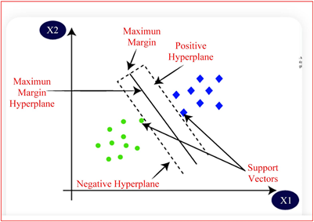
Support vector machine

Slide 3
