Slide 1

Counterfactuals
Andi Fugard

Slide 2



“Experimental and quasi-experimental approaches infer the impact of an intervention through statistical comparison to a group or time period unaffected by the intervention. This unaffected group acts as a proxy for what would have happened to the affected group in the absence of the policy and is commonly called the counterfactual.”
(p. 34; emphasis added)

Slide 3
Counterfactuals supply one way to understand causation
A caused C
=
If A had not occurred, C would not have occurred

Slide 4
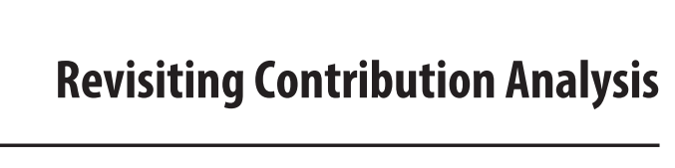
“In many situations a counterfactual perspective on causality—which is the traditional evaluation perspective—is unlikely to be useful; experimental designs are often neither feasible nor practical…”
“[Contribution analysis] uses a stepwise (generative) not a counterfactual approach to causality.”
(Mayne, 2019; emphasis added)

Slide 5
Do counterfactuals need a comparison group?
“… having no comparison group is not the same as having no counterfactual. There is a very simple counterfactual: what would Y have been in the absence of the intervention? The counterfactual [in a particular example given] is that it would have remained unchanged, that is, the same as before the intervention.”
White, H. (2010). A contribution to current debates in impact evaluation. Evaluation, 16(2), 153–164.

Slide 6
Issues your counterfactual theory has to deal with: alternative causes
Online maths tuition
Pass maths
BBC Bitesize

Slide 7
Issues your counterfactual theory has to deal with: defeaters
Online maths tuition
Pass maths
Dodgy broadband

Slide 8
Example counterfactuals
(Jo is in an intervention school and passed maths)
If Jo had been in a control school, they would have failed maths
(Oswald killed Kennedy)
If Oswald hadn’t killed Kennedy, someone else would have

Slide 9
Interlude: indicative conditionals
Indicatives are statements about the actual world like: If Jo is in an intervention school, they passed maths
The truth of the statement depends on information we know (now) about its constituent parts
School | Maths result | Pass | Intervention
Intervention | Pass | True
Intervention | Fail | False
Control | Pass | –
Control | Fail | –

Slide 10
When is a counterfactual true?
If Jo had been in a control school, they would have failed maths
We don’t know Jo’s result in a control school since they weren’t in one
School | Maths result | Control ☐→ Fail
Intervention | Pass | –
Intervention | Fail | –
Control | Pass | False
Control | Fail | True
???

Slide 11
Solutions – the gist
Start with the actual world (Jo was in the intervention group; passed maths) and the desired counterfactual (Control ☐→ Fail)
Produce (some kind of) a model describing what the actual world is like
Modify this model in some minimal way to make the antecedent true (put Jo in a control school)
Check if Jo passed maths in that “nearest possible world”

Slide 12
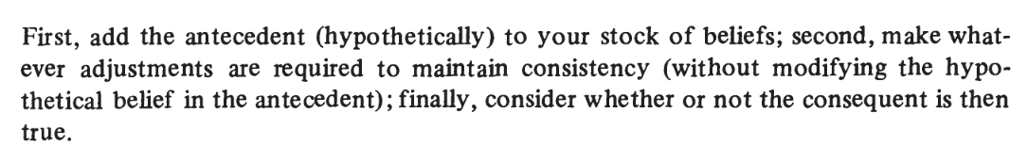
Jo was in a control school
Jo failed maths
(All of this was outside the context of RCTs or QEDs)
Stalnaker (1968)

Slide 13
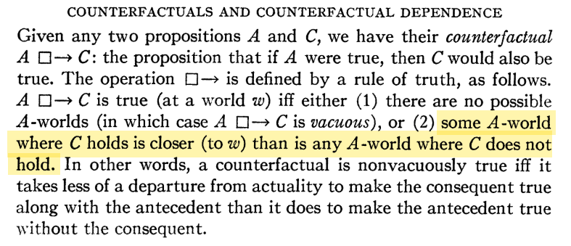
Lewis (1973)

Slide 14

challenge
Without using an RCT or QED, how do we develop a model which responds to our various tweaks in a reasonable way and allows us to infer whether Jo would have failed maths in a control school?

Slide 15
Rubin’s approach – treat as a missing data imputation problem
Student | Potential outcome |  | Covariates
Student | Intervention | Control
Jo | Pass | ? | …
Lou | ? | Fail | …
Ash | Fail | ? | …
…

Slide 16
With a good model of how people were assigned to groups (plus, optionally, of sampling), you can say something about averages
SATE | Sample average treatment effect
SATT | Sample average treatment effect on the treated
PATE | Population average treatment effect
PATT | Population average treatment effect on the treated
Efficacy
Effectiveness

Slide 17
Does this help work out the truth of the counterfactual for Jo?
If Jo had been in a control school, they would have failed maths
Not precisely Maybe probabilistically for people like Jo
We still can’t get at the potential outcome for Jo in a control school

Slide 18
Does the Magenta Book suggest other ways to think about counterfactuals? YES (p. 43)
“Simulation modelling […] can be used quantitatively to represent complex scenarios and model the Theory of Change, the impact of an intervention and unobserved outcomes. Types of simulation for dynamic systems include: discrete event simulation, system dynamics, and agent-based modelling. Model strength depends on quality of the inputs and simulation logic, which often have flaws. Simulation modelling can also be used to generate virtual counterfactuals.”

Slide 19

Suggested test
Examine an example application of a technique that doesn’t require a comparison group
Did it persuade you whether an intervention was effective?

