Slide 1
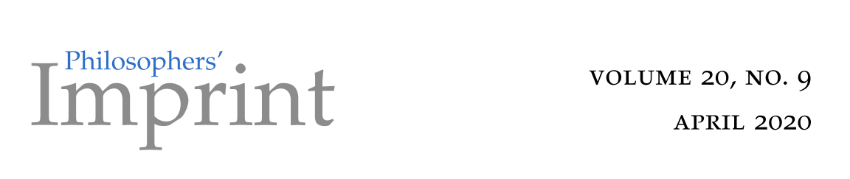
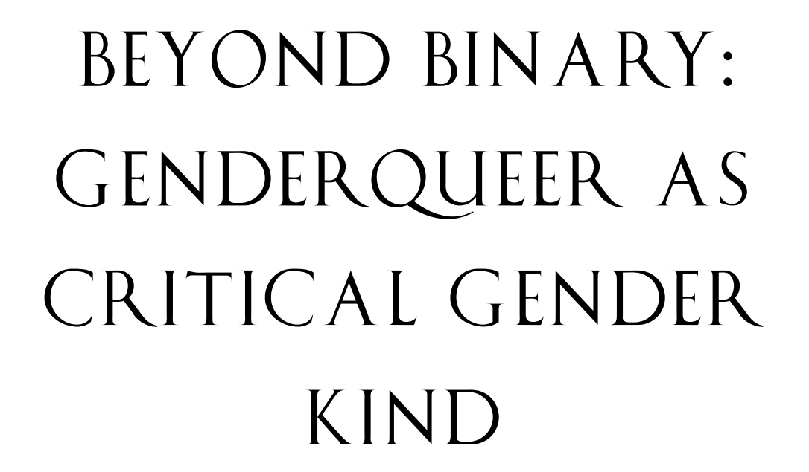
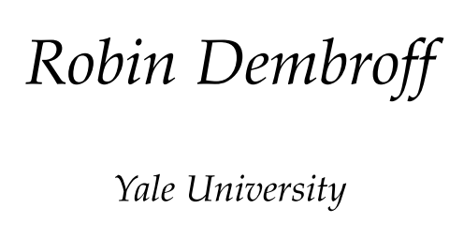

Slide 2
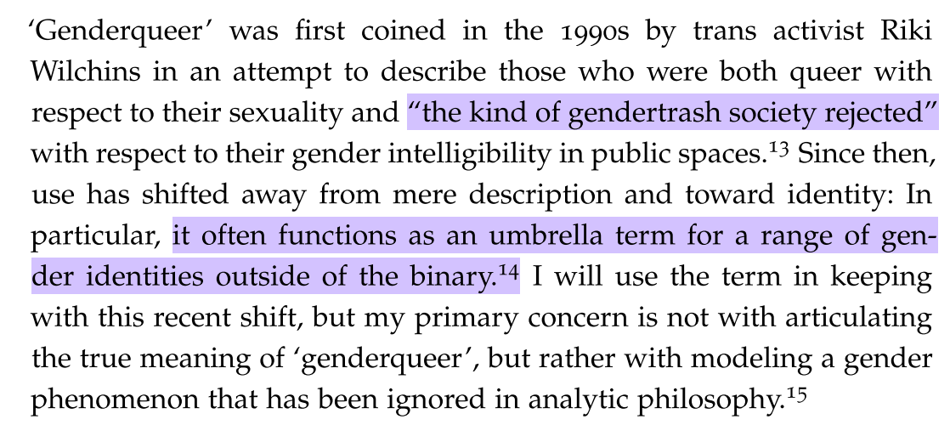

Slide 3



Non-binary
Trans
Genderqueer

Slide 5

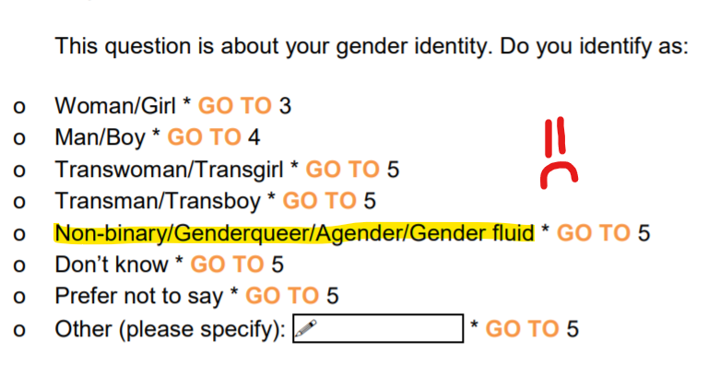

Slide 6
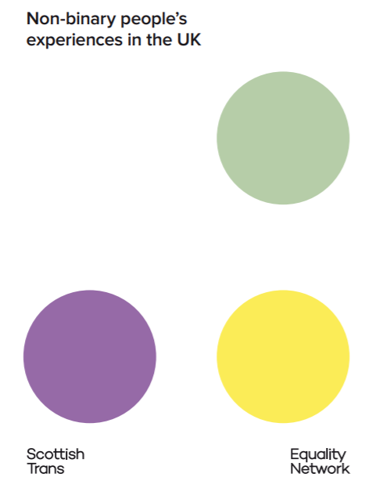
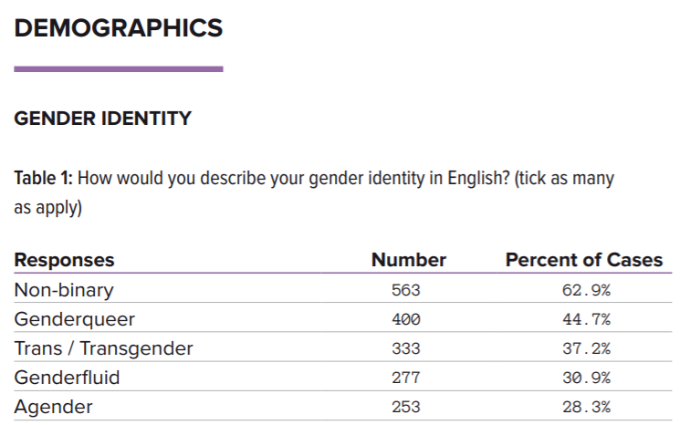
…
…
…

Slide 7
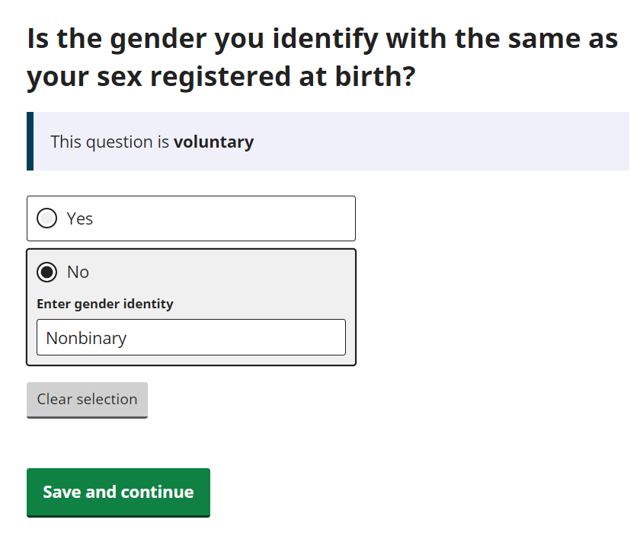
Will Census 2021 tell us what we want…?

Slide 8

Back to the paper

Slide 9
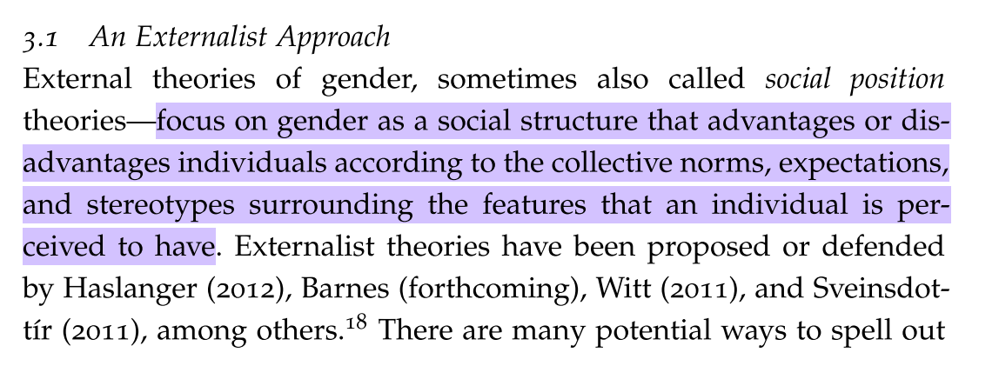
Externalist approaches (social position)

Slide 10
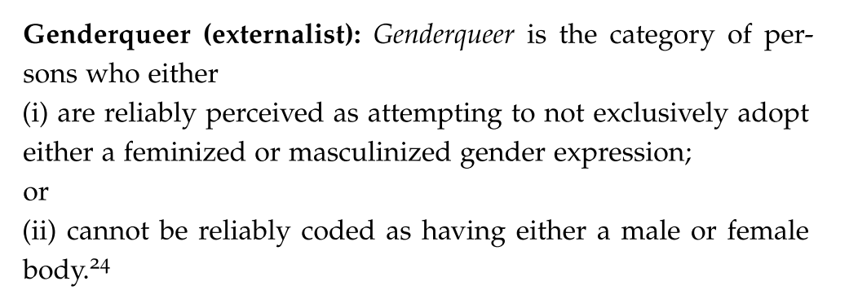

Slide 11
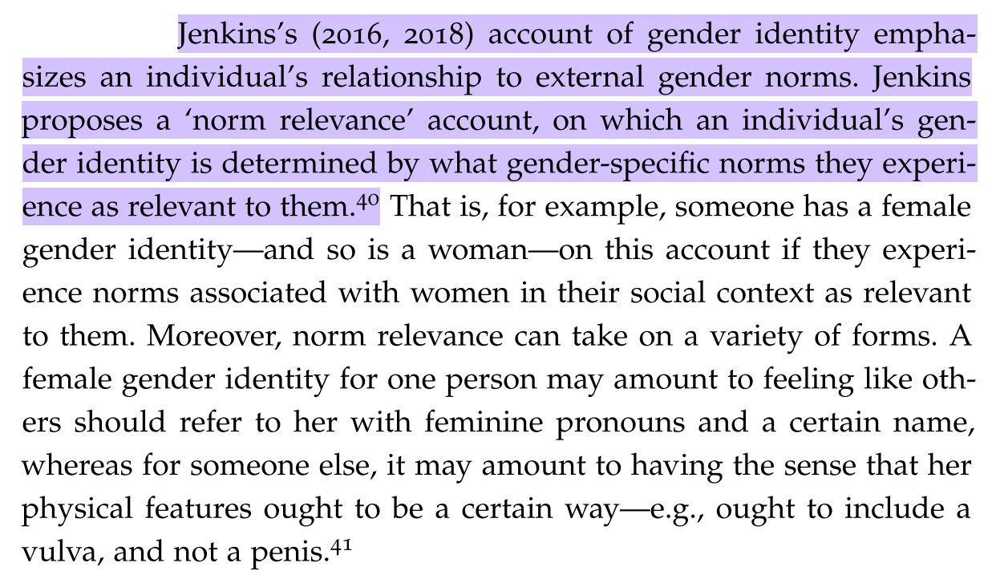
Internalist approach (identity)

Slide 12
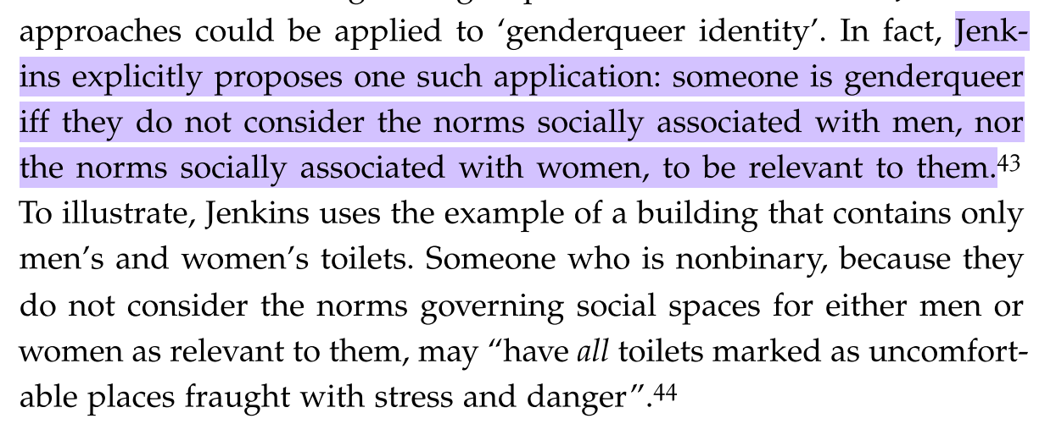

Slide 13
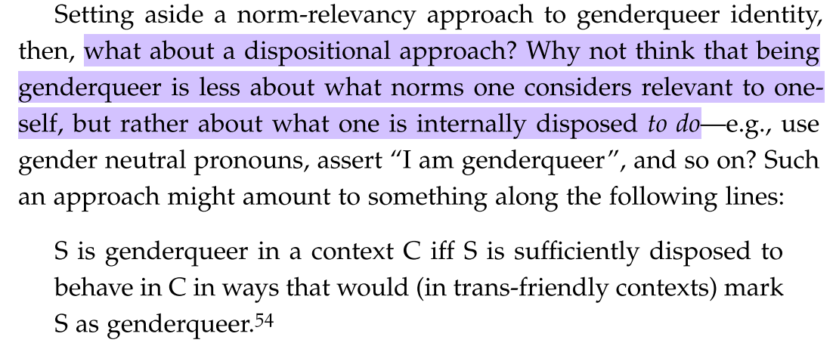

Slide 14
Dembroff’s critique of both approaches
Externalist (social position) | Internalist (psychological identity)
Genderqueer people reject particular (e.g., androgenous) gender expressions | Norm relevancy would require genderqueer people to reject all male and all female norms as being relevant – excludes many genderqueer people
Many non-genderqueer people reject binary expression norms, e.g., “Butch lesbians, queens, cross-dressing men and women…” | Discomfort complying with binary norms doesn’t work either since it would apply to many non-genderqueer people
Genderqueer people reject the idea that their way of being in the world should be seen through a binary masculine/feminine lens – not particular masc/fem expressions | Disposition accounts reduce to linguistics, roughly “I tell people I’m genderqueer, therefore I am” – Dembroff argues we can and should do better

Slide 15
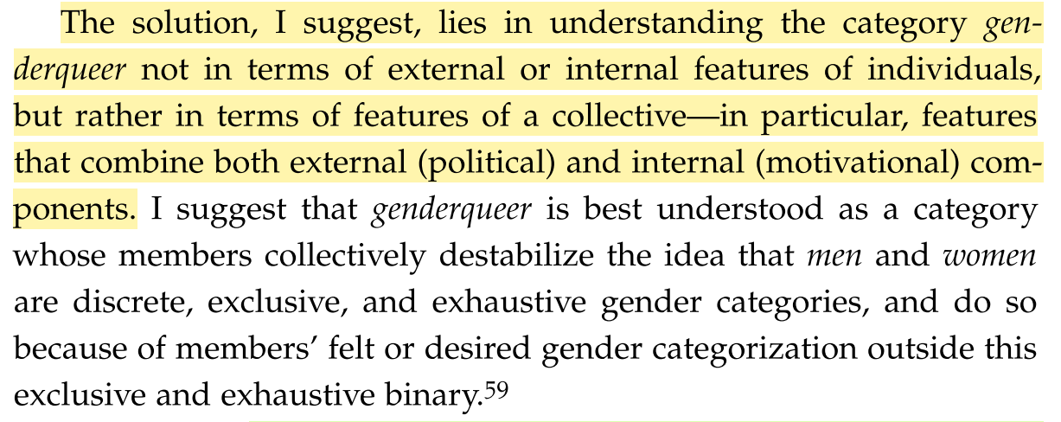

Slide 16
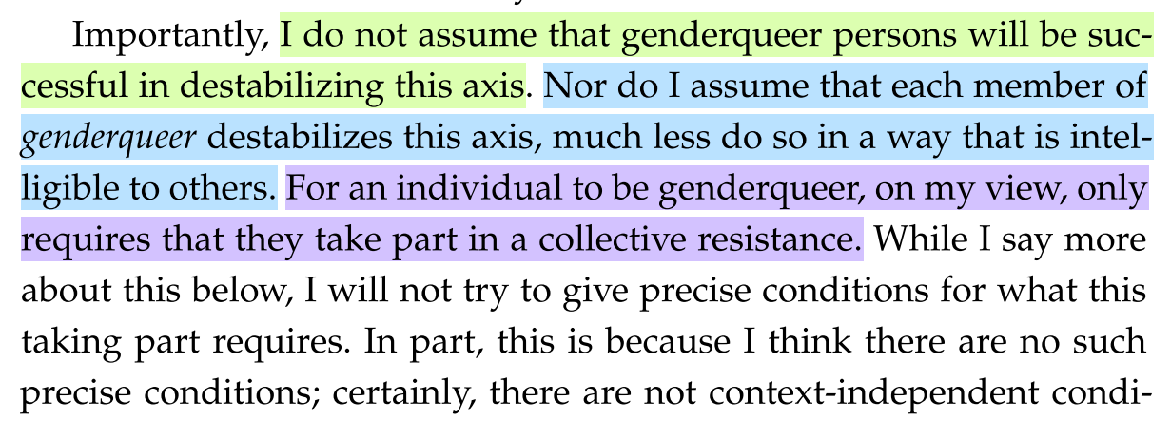

Slide 17
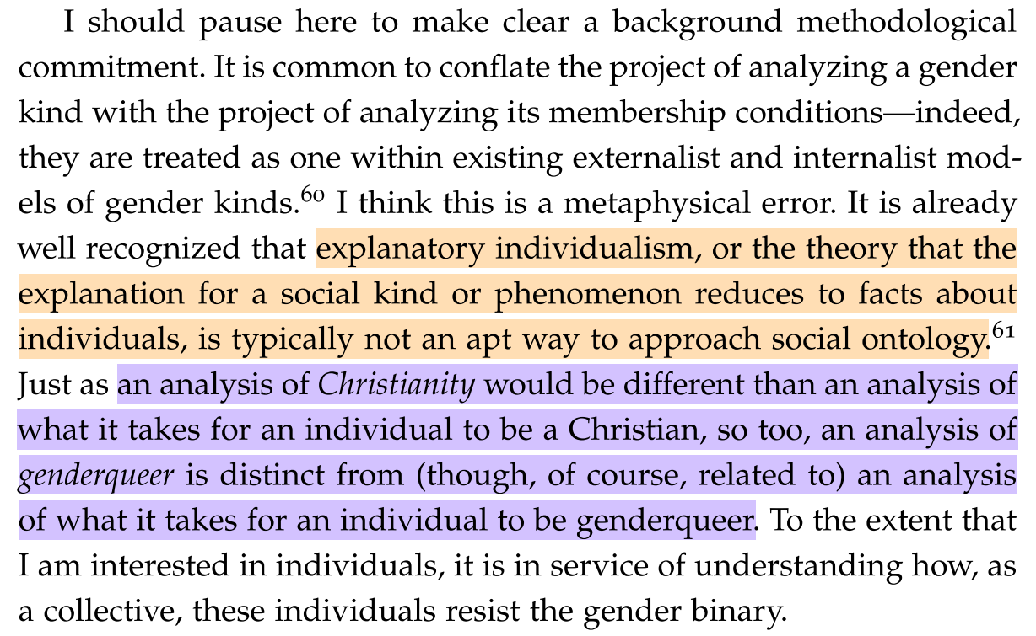

Slide 18
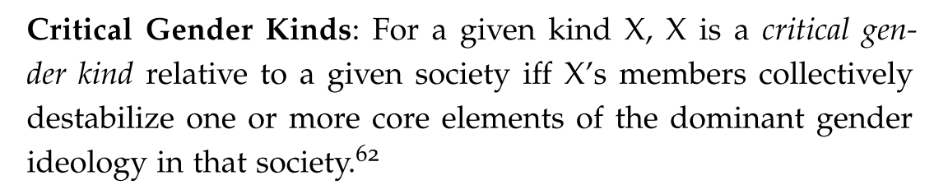
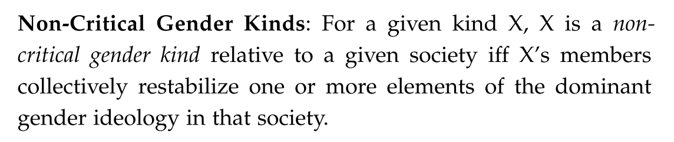

Slide 19
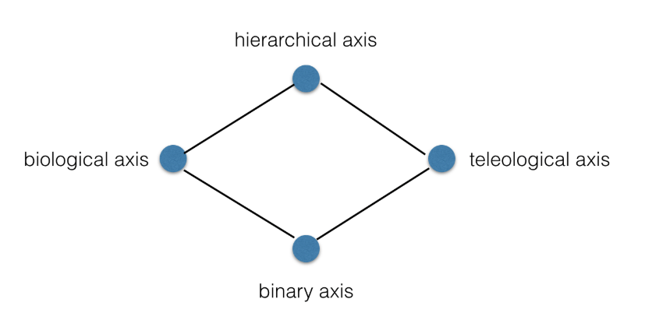

Slide 20
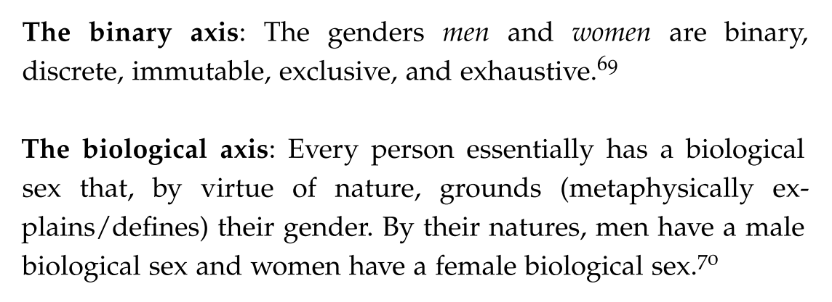
What to destablise

Slide 21
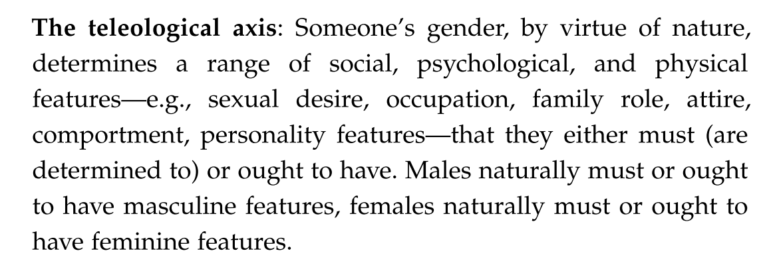
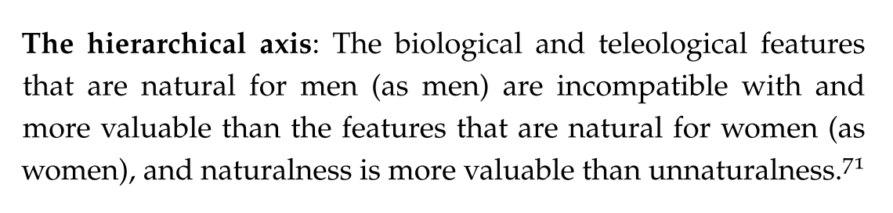

Slide 22
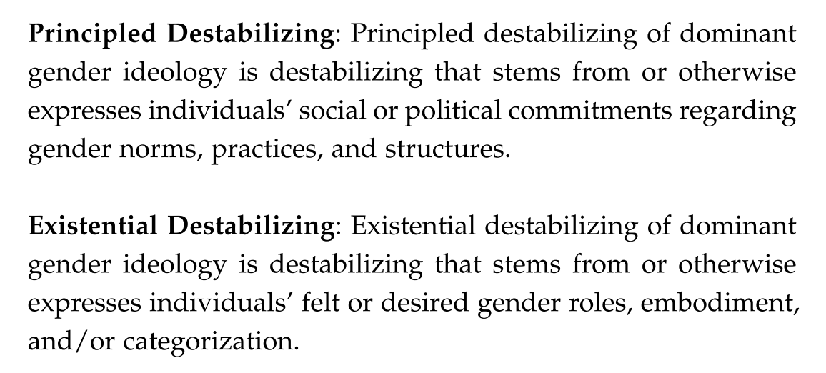

Slide 23
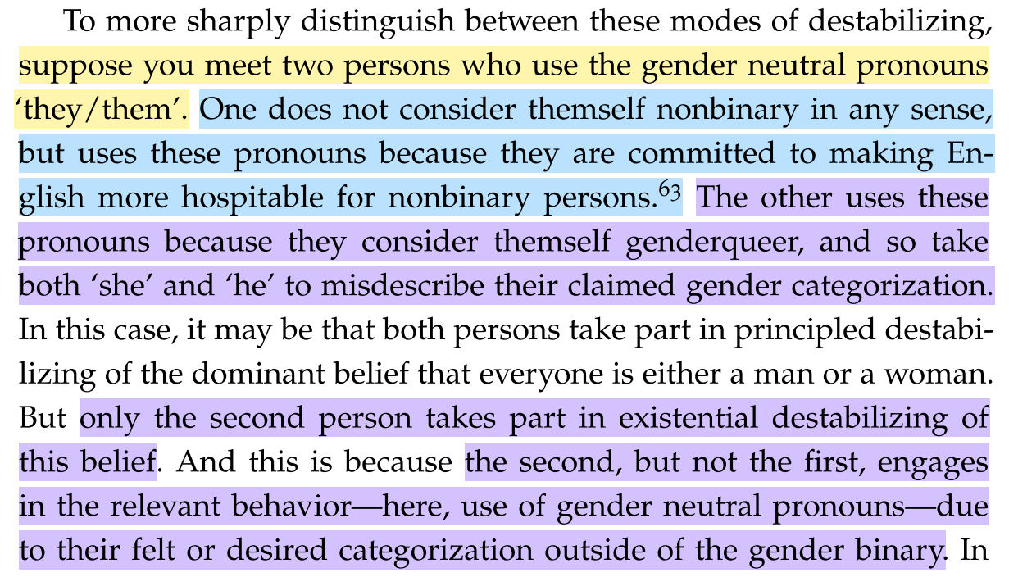

Slide 24
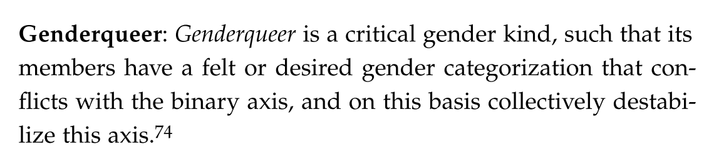

Slide 25
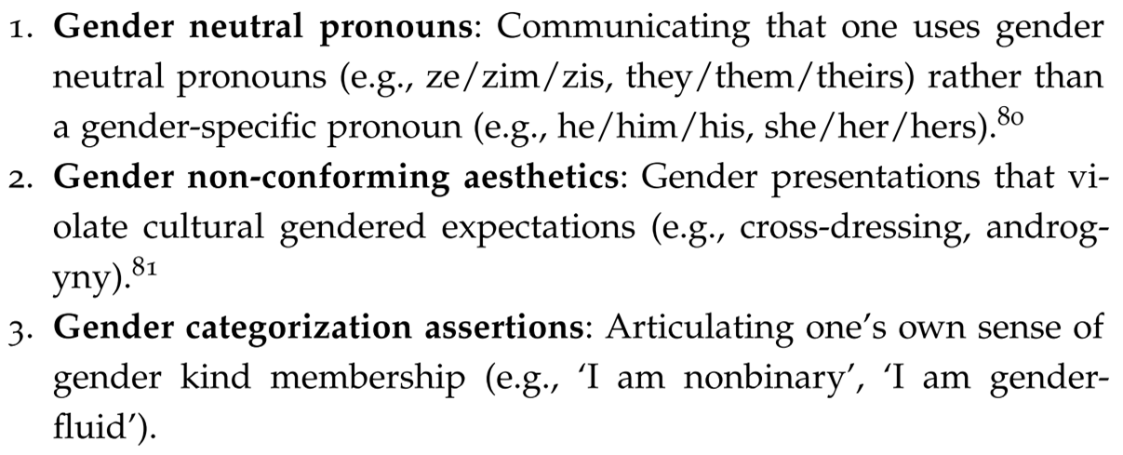
Examples of how genderqueer people “resist captivity” within the gender binary

Slide 26
