Slide 1
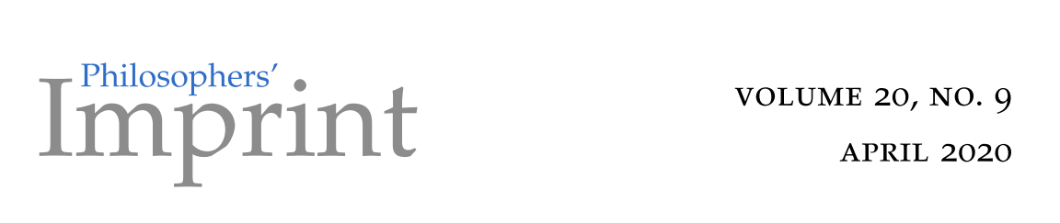
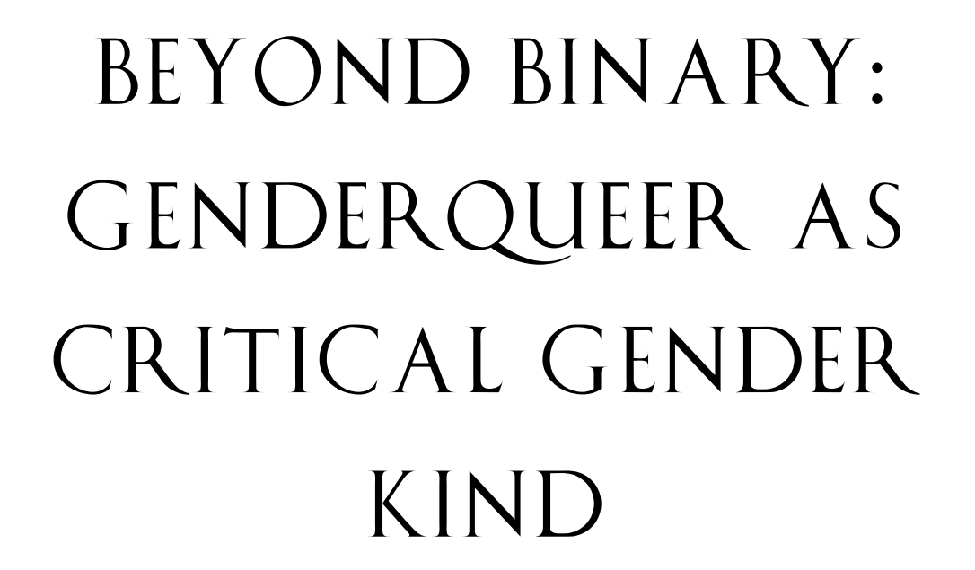
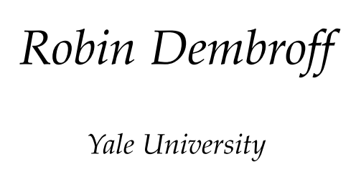

Slide 2
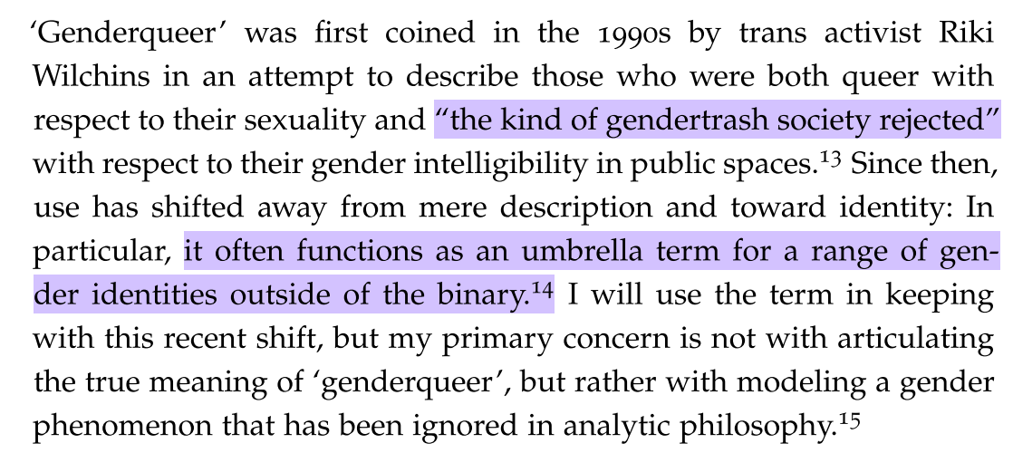

Slide 3


Slide 4



Non-binary
Trans
Genderqueer

Slide 5
Trans non-binary and genderqueer
Trans woman
Trans man
Non-binary
Trans non-binary
Genderqueer

Slide 6

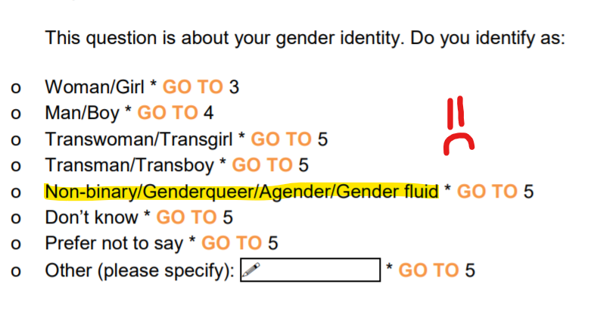

Slide 7
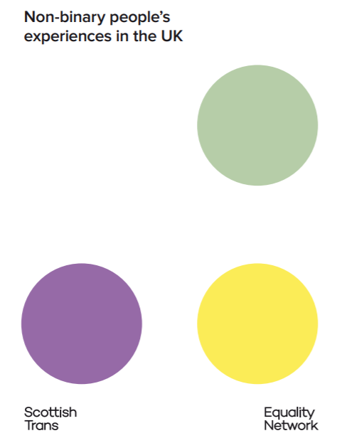
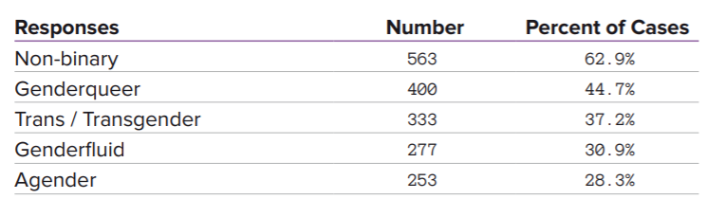

Slide 8
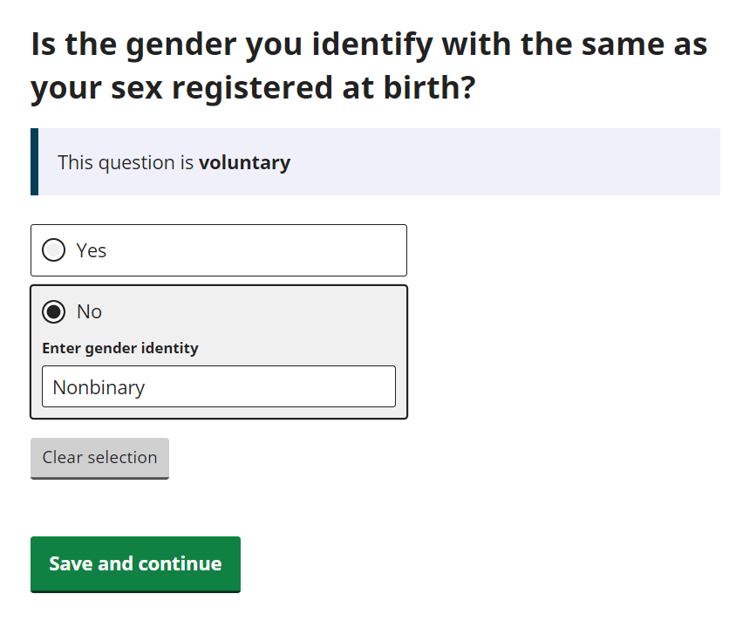
Will Census 2021 tell us what we want…?

Slide 9

Back to the paper

Slide 10
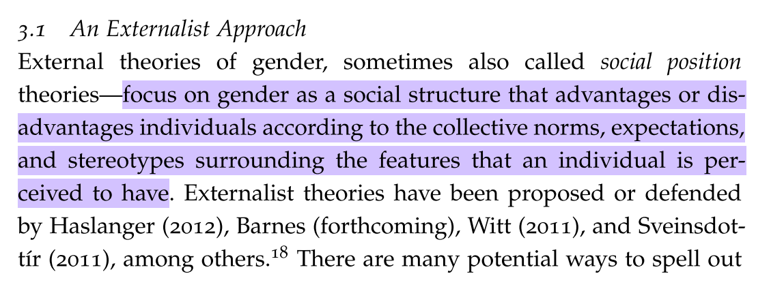
Externalist approaches (social position)

Slide 11
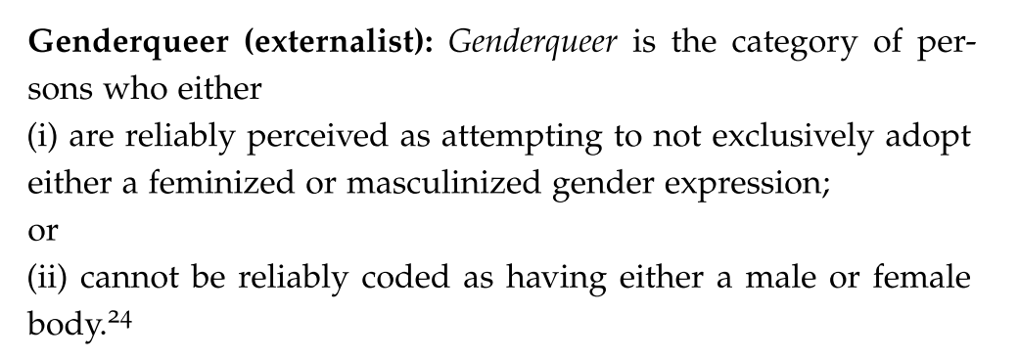

Slide 12
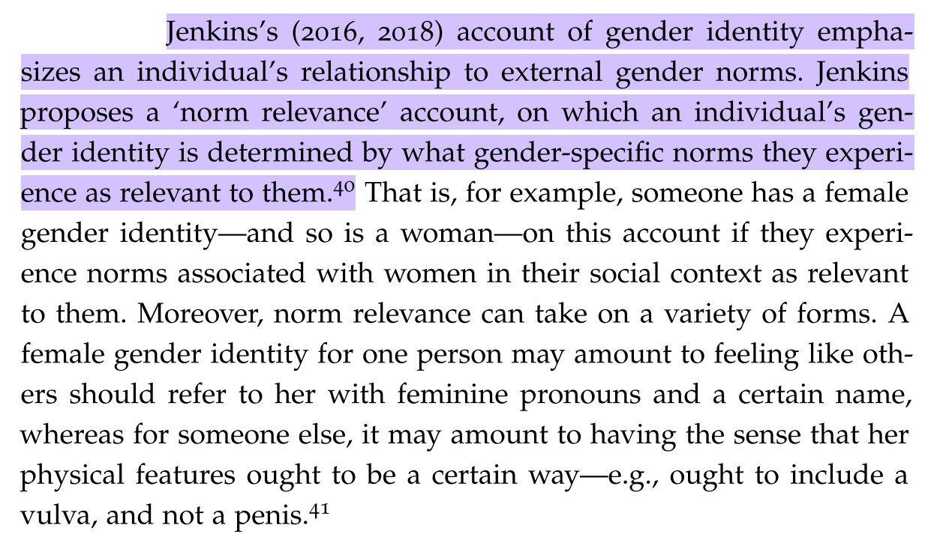
Internalist approach (identity)

Slide 13
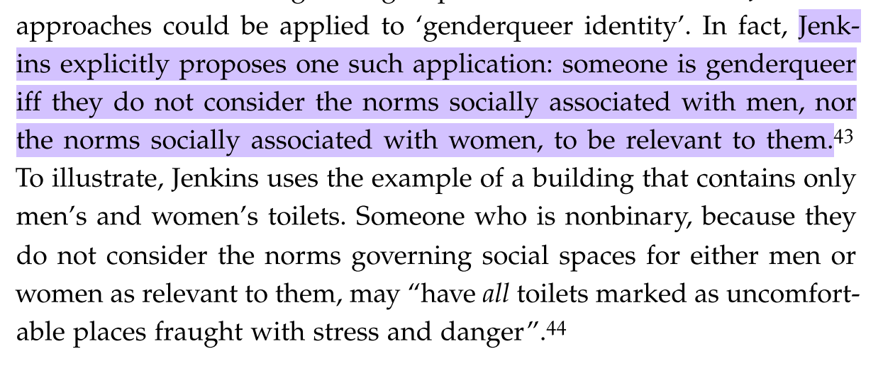

Slide 14
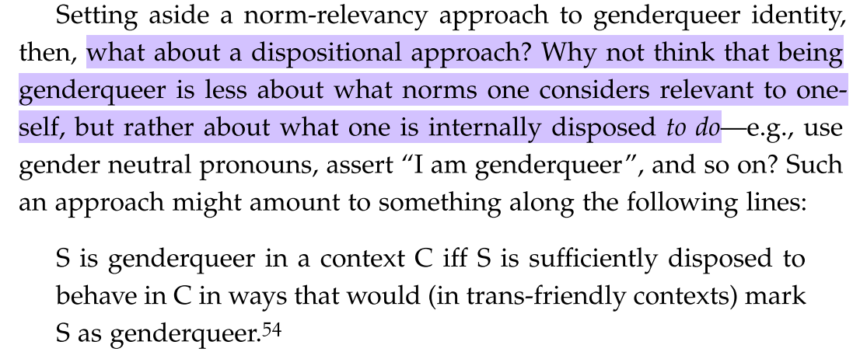

Slide 15
Dembroff’s critique of both approaches
Externalist (social position) | Internalist (psychological identity)
Genderqueer people reject particular (e.g., androgenous) gender expressions | Norm relevancy would require genderqueer people to reject all male and all female norms as being relevant – excludes many genderqueer people
Many non-genderqueer people reject binary expression norms, e.g., “Butch lesbians, queens, cross-dressing men and women…” | Discomfort complying with binary norms doesn’t work either since it would apply to many non-genderqueer people
Genderqueer people reject the idea that their way of being in the world should be seen through a binary masculine/feminine lens – they don’t reject particular masc/fem gender expressions | Disposition accounts reduce to linguistics, roughly “I tell people I’m genderqueer, therefore I am” – Dembroff wants to explore a non-linguistic definition

Slide 16
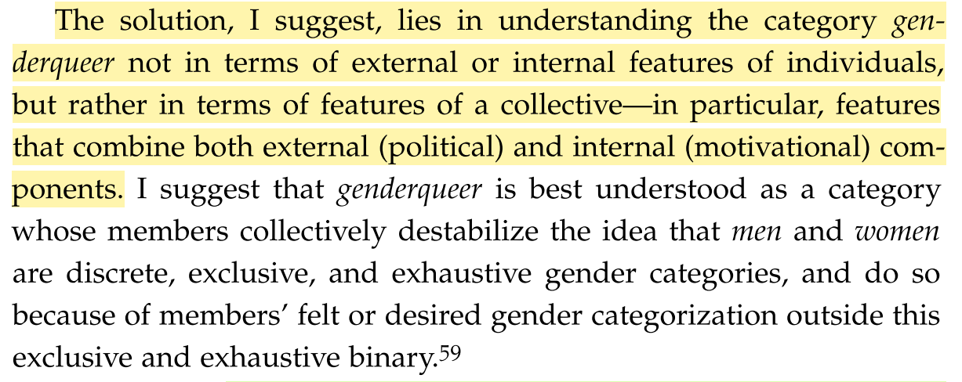

Slide 17
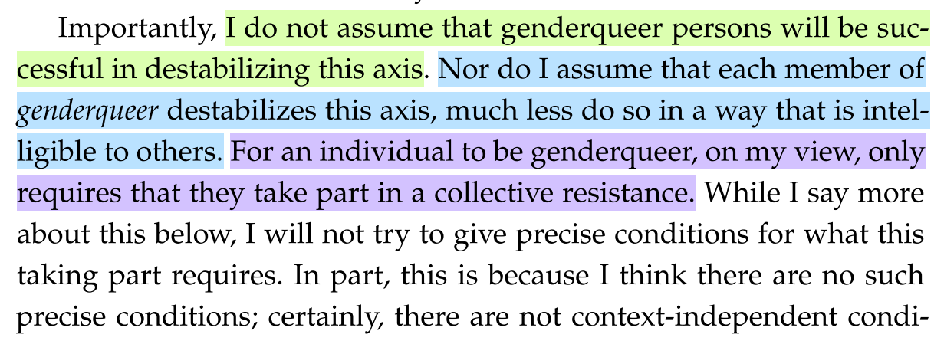

Slide 18
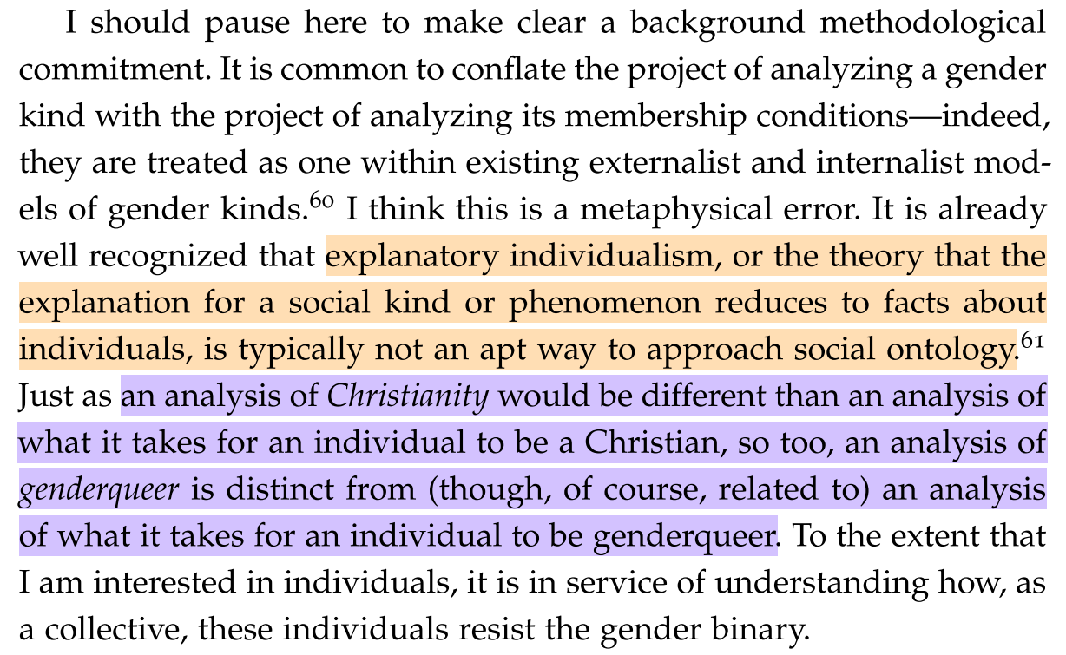

Slide 19
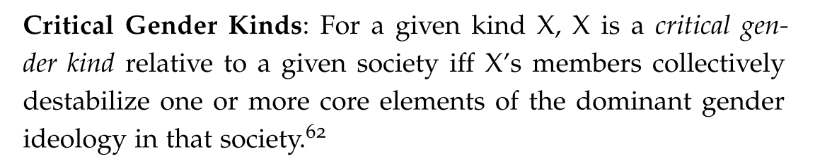
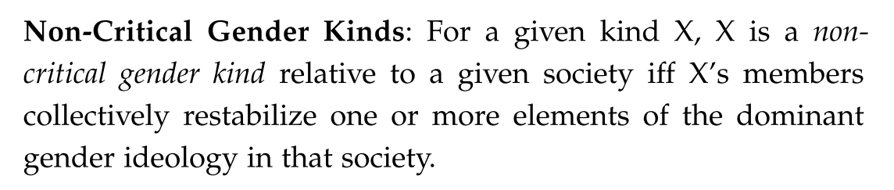

Slide 20
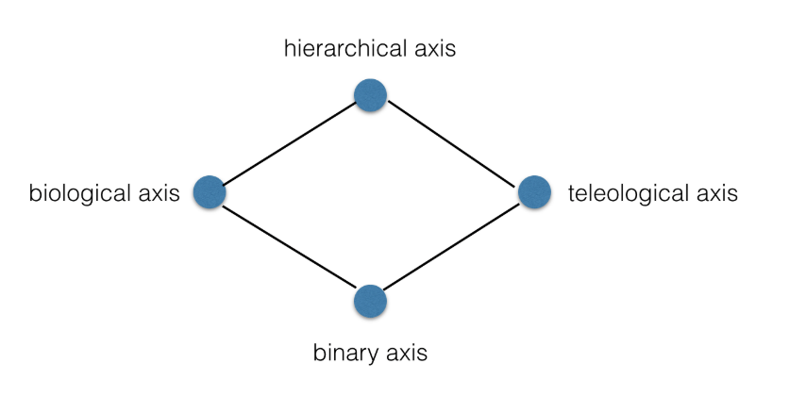

Slide 21
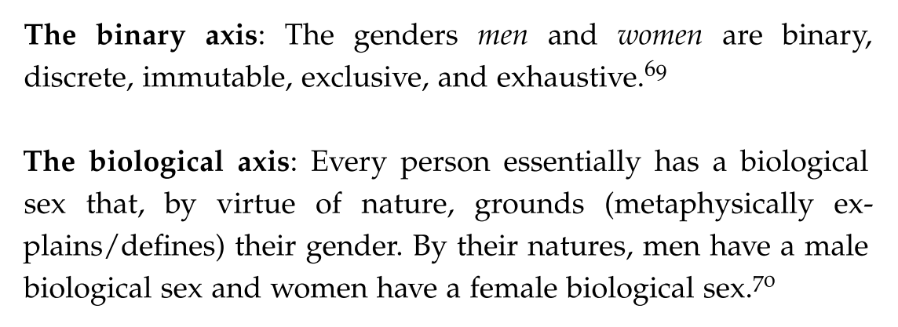
What to destablise

Slide 22
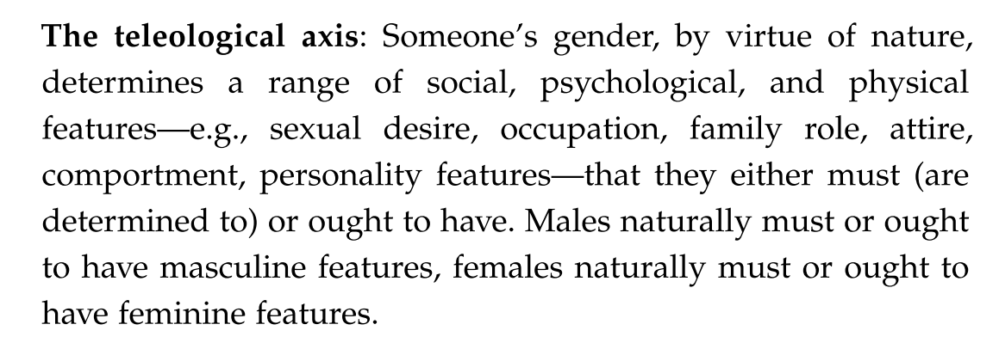
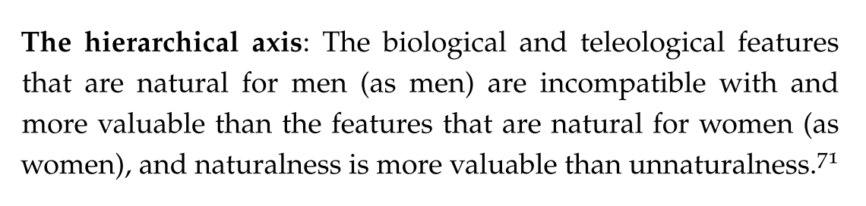

Slide 23
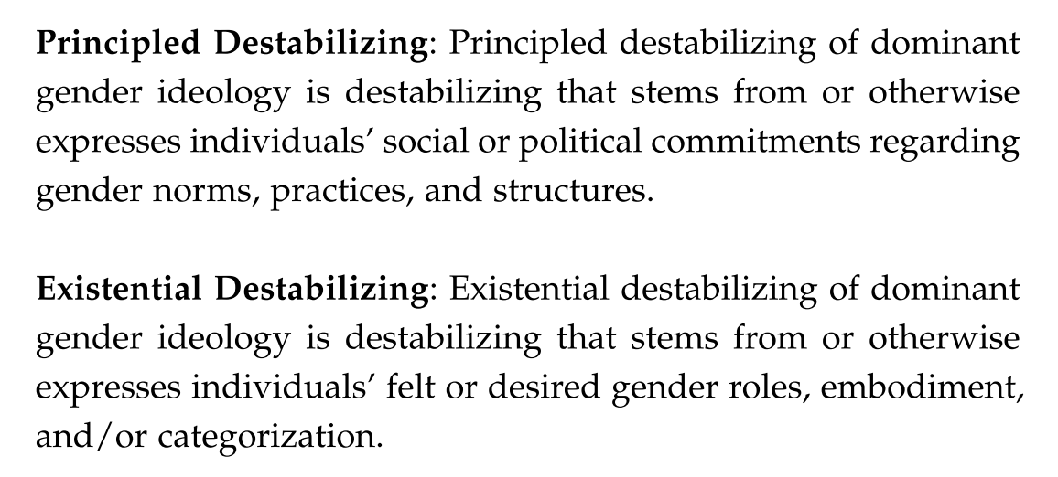

Slide 24
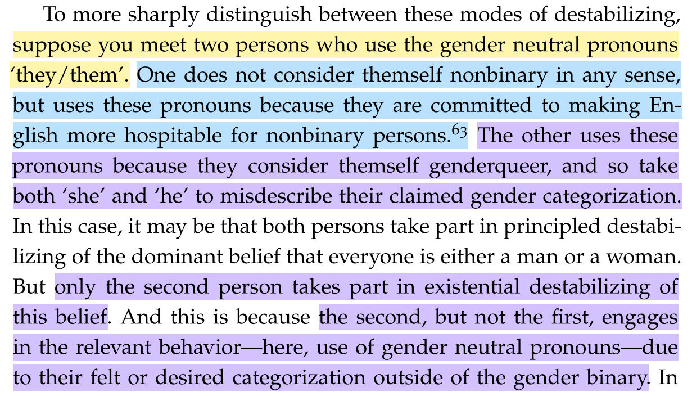

Slide 25
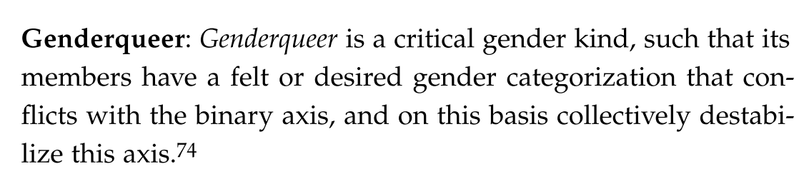

Slide 26
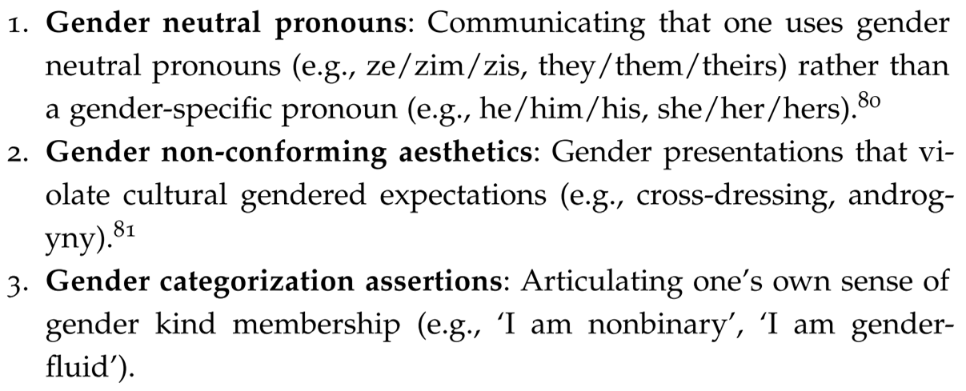
Examples of how genderqueer people “resist captivity” within the gender binary

Slide 27
