Slide 1
Incident
Problem
NEURA RANGERS
NEURATWIN
HALO
Twin
Cost
Bench
Know which transformer needs attention—and whether the action worked
Job
A digital twin for distribution transformer condition monitoring and predictive maintenance.
Next
Close
CPRI Track 2 · PowerNext-AI Hackathon
Notes:
Opening reveal. Let the white slide breathe for two seconds, then advance: the diamond opens into the NeuraTwin Halo title.

Slide 2
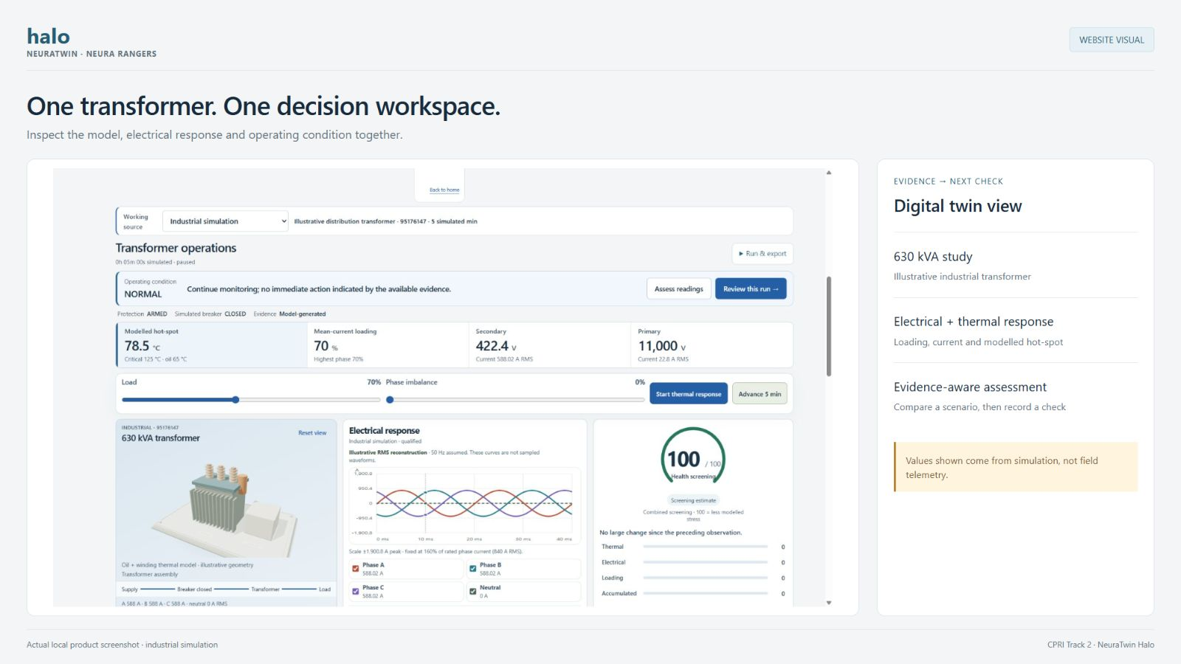
Incident
Problem
NEURA RANGERS
NEURATWIN
HALO
Twin
Cost
Bench
Know which transformer needs attention—and whether the action worked
Job
A digital twin for distribution transformer condition monitoring and predictive maintenance.
Next
Close
CPRI Track 2 · PowerNext-AI Hackathon
Notes:
“We are Neura Rangers. Our project is NeuraTwin Halo for CPRI Track 2: a digital twin for distribution transformer condition monitoring and predictive maintenance. An engineer needs more than a temperature reading. They need to know which transformer needs attention, why, and what to do next. NeuraTwin connects that decision to a prediction—and checks what happened afterward.”
MEDIA: fill the frame with your strongest actual transformer-twin screenshot or a short looping screen recording. Keep the title and team name unobstructed.

Slide 3
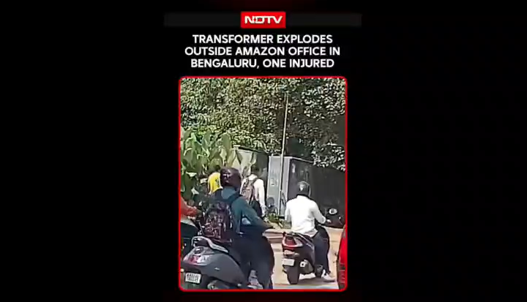
When the grid fails,
people feel it.
Incident
Problem
● Yelahanka RMU incident
● Reported 7 October 2026
Twin
A reported incident. Its cause is not inferred.
Cost
Close
Bench
Next
Job
Notes:
Play the clip for 10–15 seconds, then say: “This reported Yelahanka incident involved an RMU. We are focusing on distribution-transformer health: a related grid-reliability problem, not a diagnosis of this incident.” Do not infer its cause.
Source: https://www.newindianexpress.com/cities/bengaluru/2026/Oct/08/five-injured-as-rmu-transformer-explode-in-bengaluru
MEDIA: insert the local authorised clip with Insert > Video > This Device, fit it to the frame and set playback as desired. Delete the frame label and play icon afterwards.

Slide 4
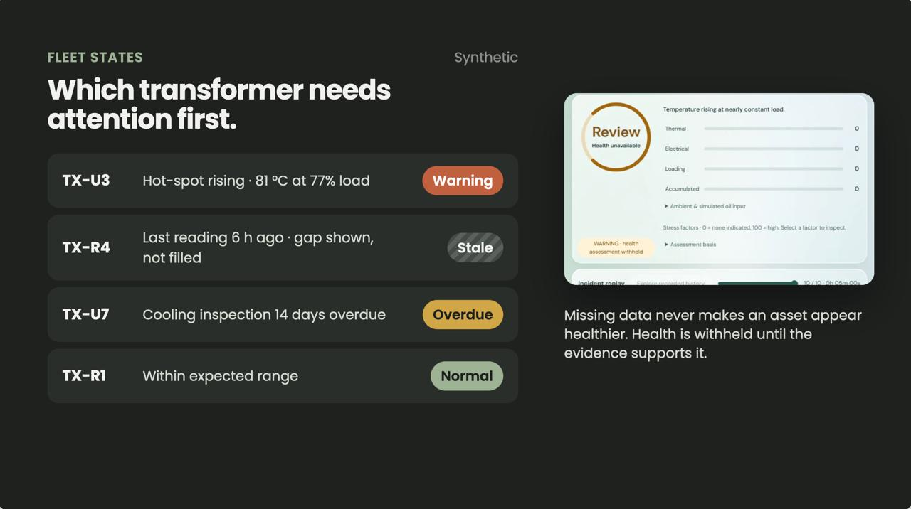
Which transformer
needs the next visit?
Incident
Problem
Twin
● Uneven visibility
● Deployment cost
● Limited field time
● Uncertain outcomes
Cost
Make every decision better informed and every visit more useful.
Bench
Job
Close
Next
Notes:
“Our target is the practical gap between collecting data and completing useful maintenance. We must improve decisions without requiring expensive instrumentation on every transformer.”
MEDIA: one engineer facing a small fleet of assets labelled warning, stale data, inspection overdue and insufficient evidence. A field photo or short clip works. Avoid invented failure statistics.
Chips (appear automatically after the transition): uneven visibility, deployment cost beyond sensor price, limited technician time, and alerts acknowledged without proof of resolution.

Slide 5
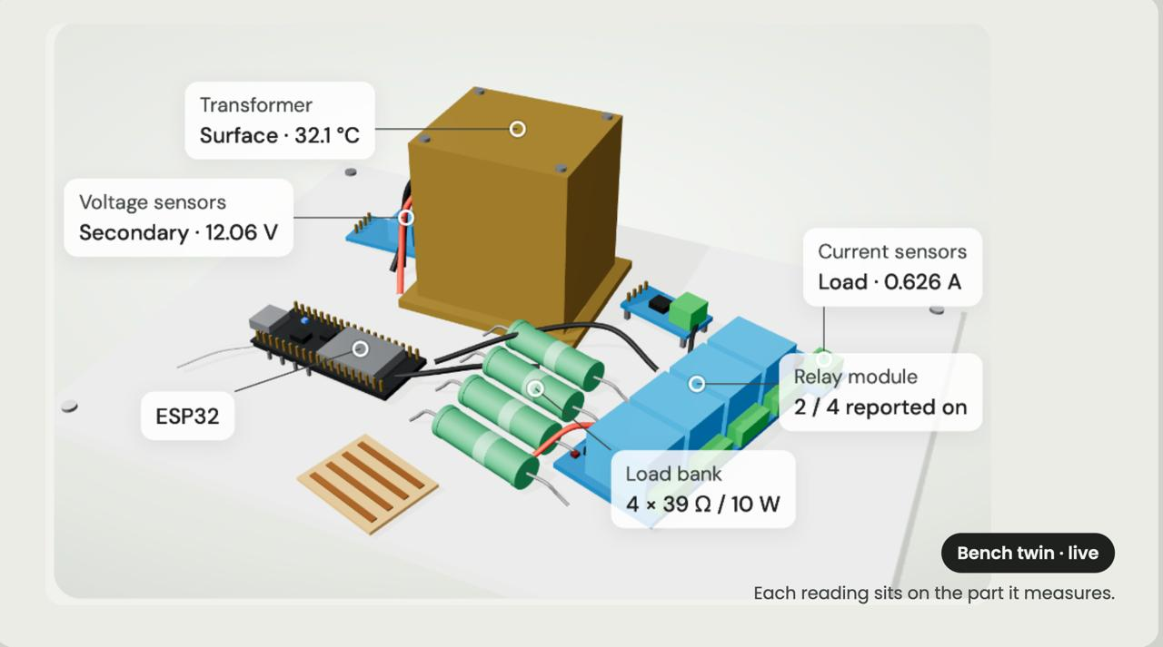
A twin that predicts
the effect of an action
Incident
Problem
Twin
Cost
1 Update state
2 Compare actions
3 Save forecast
4 Check later data
Bench
Every value shows its source and freshness.
Job
Next
Close
Notes:
“The model predicts how this asset should respond under stated conditions. When later measurements arrive, we test that prediction. That connection between the physical asset, model and decision gives the twin its substance.”
MEDIA: one large annotated transformer with measurements beside the relevant components, plus two clearly labelled scenario trajectories: continue and reduce load. Label supported thermal estimates.
Source for these notes: CIGRE transformer digital-twin framework, 2026.

Slide 6
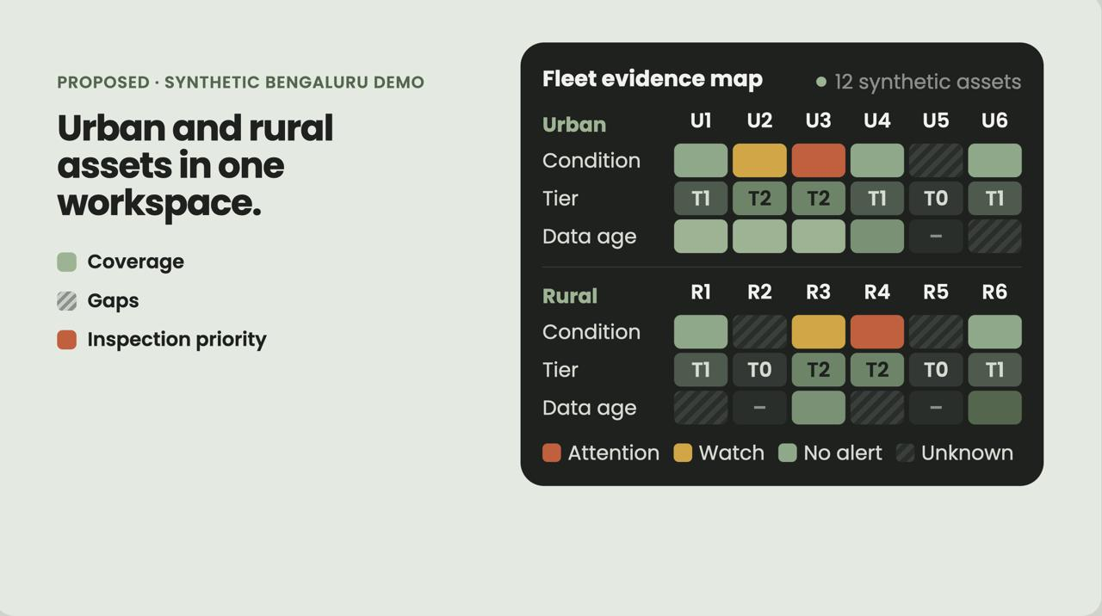
Incident
Lower the cost of
useful information
Problem
Twin
Cost
Bench
● Asset records → planning
● DT metering → screening
● Targeted sensing → validation
● Specialist tests → deep dives
Job
Missing data never makes an asset look healthier.
Next
Close
Notes:
“We do not propose the same sensor package everywhere. An asset with billing records gets planning support; a sufficiently instrumented asset can support validated predictions. During a communications gap, Halo shows how old the evidence is and when the current state becomes unknown.”
MEDIA: urban/rural fleet concept with visible data coverage, connectivity gaps and inspection priorities. Keep the amber tag unless this is built and demonstrated with real data.

Slide 7
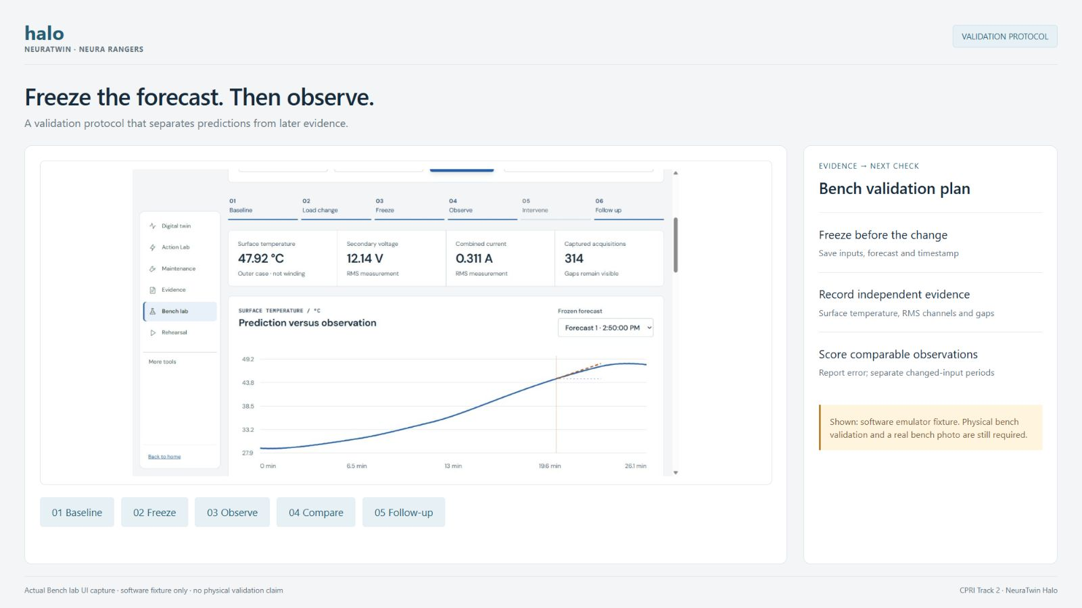
Incident
Problem
Freeze a forecast.Change the load.
Check the result.
Twin
Cost
Bench
Job
● Record baseline
● Save both forecasts
Next
● Apply load change
● Compare vs forecast
Bench = surface temperature only; oil-transformer studies stay separate.
Close
Notes:
“This is the central experiment. We save the prediction before changing the load, then compare it with what the sensor records. A command acknowledgement alone is not proof that the physical response occurred.”
MEDIA: actual hardware photo or video, plus an actual predicted-versus-observed trace with the intervention time marked. If the run is unfinished, keep the amber tag as VALIDATION PROTOCOL; if you play a recorded run because thermal changes take longer than the pitch, change it to RECORDED RUN. Never invent results.

Slide 8
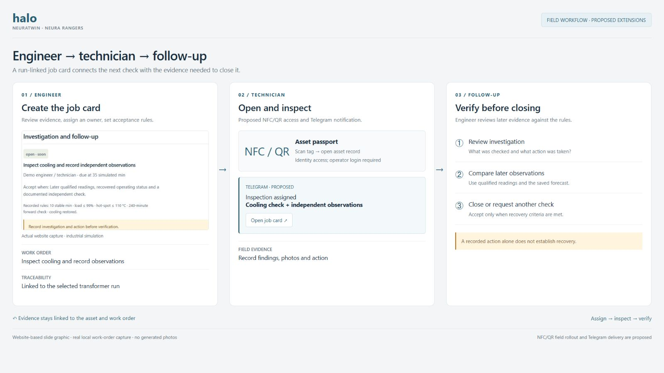
Incident
Problem
Twin
Complete the
maintenance job
Cost
Bench
Job
Next
1 Engineer reviews
2 Technician scans NFC/QR
3 Halo follows up1
4 Offline-ready · Telegram
Close
Load reduction is mitigation, not proof of repair.
Notes:
“The engineer can review remotely while the technician carries the evidence to the asset. The record preserves who acted, what they found and what happened afterward. Field actions follow approved utility procedures.”
MEDIA: one job card moving between engineer, technician and follow-up evidence. Show ownership and outcome (verified closure, escalation or inconclusive) more prominently than the NFC or Telegram logos. Remove the amber tag if the workflow is built.

Slide 9
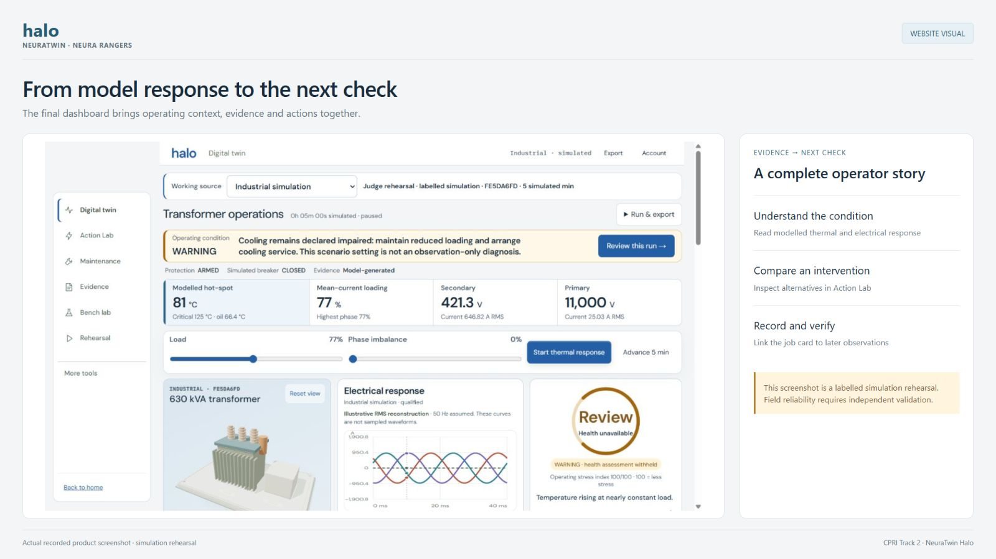
Incident
Problem
Twin
Cost
Better decisions per rupee
Bench
Job
Next
Close
● Forecast vs baselines
● Useful warnings, fewer dispatches
● Technician effort per closure
● Installed + recurring cost
Pilot request: authorised meter + maintenance records; supervised urban/rural trial.
NeuraTwin Halo makes the next maintenance decision explainable, and its result checkable.
Notes:
“Our next step is a supervised pilot that measures whether these decisions are useful and affordable. We reuse the evidence a utility already has, add sensing where it matters, and preserve the link between a prediction, an action and its observed result.”
Proposed advantage: available data becomes a component-level twin, an actionable job and a verifiable outcome. Pilot request: authorised meter and maintenance records, plus a small supervised urban/rural comparison against current practice.

Slide 10
Problem
Twin
Cost
Incident
Bench
Thank you.
Job
NEURA RANGERS · NeuraTwin Halo · CPRI Track 2
Next
1 Know what needs attention
Evidence shown with its freshness
2 See what an action would do
Forecasts saved before the change
Close
3 Check what actually happened
Follow-up evidence closes the job
From transformer readings to decisions backed by evidence.
Questions & live demonstration
https://github.com/Induj1/neuratwin-halo
Notes:
Close by restating the problem: imperfect visibility makes transformer-health decisions hard. Halo connects qualified readings, conditional forecasts, action comparison and a reviewable evidence trail. This is a software prototype; the next milestone is calibrated hardware and independent field evaluation.
Thank the judges. Say: “We are Neura Rangers, and this is NeuraTwin Halo for CPRI Track 2. We would be happy to show the live workflow and discuss the model assumptions, validation and deployment plan.” Use this slide for questions. Keep the simulator and a recorded backup ready.

