Slide 1
BASIC CALUCULATOR
Presented By:
NAME : INDUJA KAKARLA
ORGANIZATION : MICRO IT
TOPIC : BASIC CALUCULATOR

Slide 2
INTRODUCTION
The calculator is one of the simplest applications used in daily life. It performs basic arithmetic operations such as addition, subtraction, multiplication, and division. The Basic Calculator project is a simple and beginner-friendly application designed to perform basic arithmetic operations such as addition, subtraction, multiplication, and division. The project was developed as part of an internship to enhance foundational programming skills and understand how user interfaces interact with logic through inputs and outputs. It provides an interactive and intuitive platform for users to perform mathematical calculations with ease.

Slide 3
FEATURES
BASIC FEATURES
Addition (+) : Adds two numbers.
Subtraction (-) : Subtracts second number from first.
Multiplication (*) : Multiplies two numbers.
Division (/) : Divides first number by second (checks for divide-by-zero).

Slide 4
FEATURES
ADVANCED FEATURES
Modulus (%): Returns the remainder.
Power (^): First number to the power of second.
Clear Button: To reset all fields.
GUI Buttons: Instead of typing, users click on buttons.

Slide 5
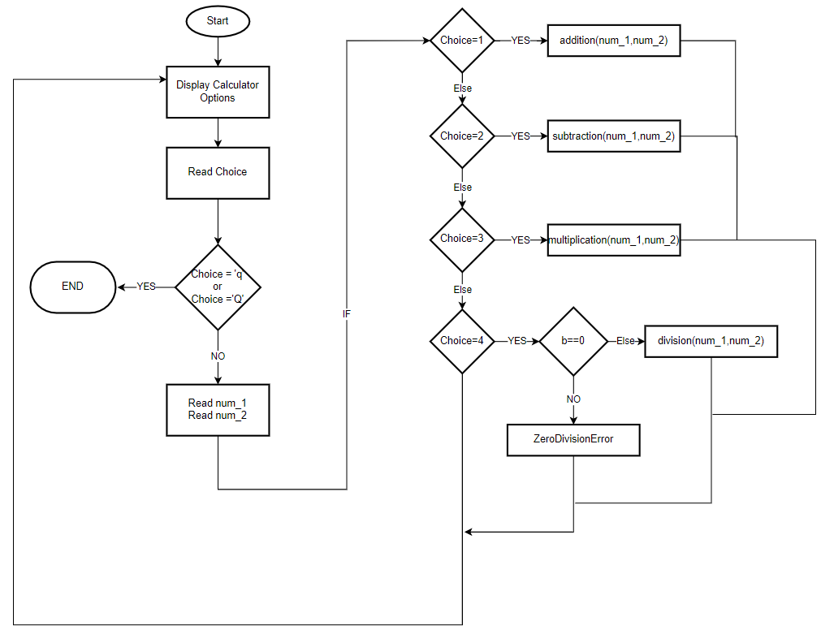

Slide 6
CONCEPTS USED
1. User Interface Design : Created an easy-to-use layout using HTML/CSS or GUI frameworks like Tkinter (Python) or Swing (Java).Used buttons for digits and operations, and a display area to show input and results.
2. Event Handling : Attached functions to button clicks for real-time input handling. Ensured the calculator responds to user actions without delays.
3. Conditional Statements & Logic :Used if-else conditions to check the type of operation and perform the correct calculation.
4. Data Types & Operations : Worked with integers and floating-point numbers. Performed arithmetic operations like +, -, *, /.
5. Input Validation : Prevented invalid inputs (e.g., division by zero)

Slide 7
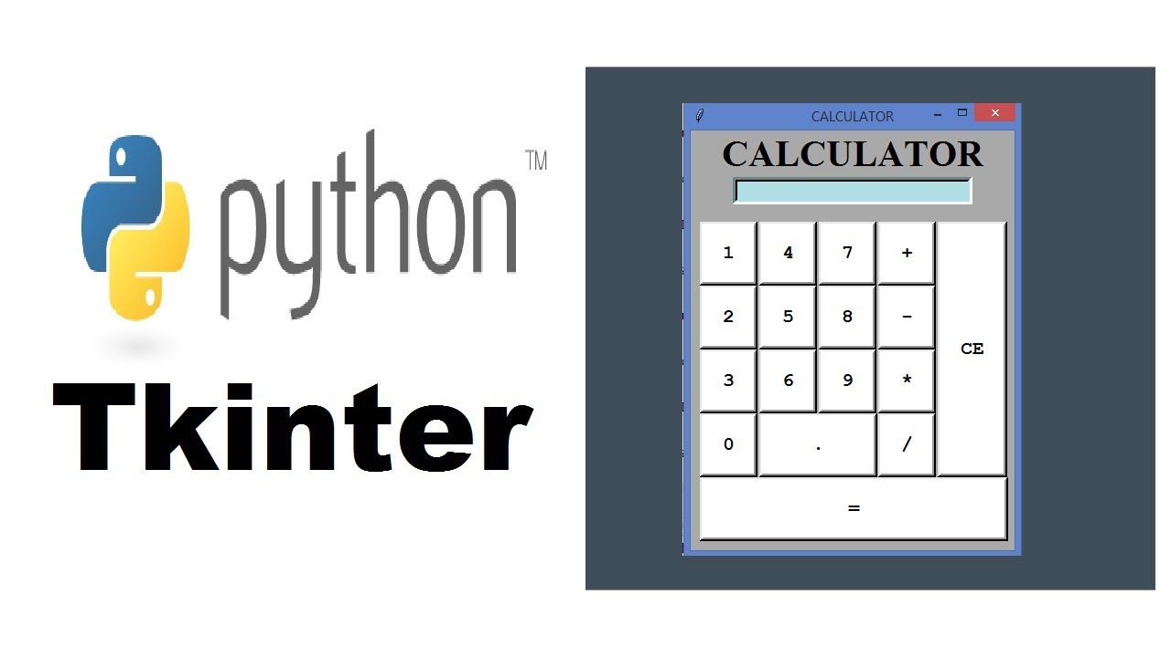

Slide 8
WORK FLOW OF THE CALUCULATOR
1. User Input: User enters two numbers and chooses an operation (either by typing or clicking).
2. Processing Logic: The calculator checks which operation to perform.
3. Calculation: Performs the operation using functions or expressions.
4. Display Output: Shows the result on screen.
5. Repeat/Clear: User can do more calculations or reset.

Slide 9
TECHNOLOGIES USED
You can customize based on what you did.
For example:
Python: Easy syntax, good for beginners. Can use Tkinter for GUI.
C/C++: Console-based calculator.
Java: Uses classes and methods.
JavaScript + HTML/CSS: For a web-based calculator.

Slide 10
OBJECTIVES
To build a calculator : To create a program that can perform arithmetic operations.
To practice logic building : Implement the logic for each operation like +, -, *, /.
To understand user inputs : Learn how to take and process user inputs.
To improve programming skills : Apply programming knowledge practically

Slide 11
CONCLUSION
The Basic Calculator project was a great learning experience and provided hands-on practice with core programming concepts. It helped me understand how a real-world application works from the backend logic to the frontend interaction. Through this project, I learned how to design a user interface, implement logic for real-time calculation, and manage user inputs effectively. It improved my confidence in programming and gave me the motivation to build more advanced projects in the future .This internship project helped build a strong foundation for developing more advanced applications in the future and increased my confidence in problem-solving and UI development.

Slide 12
THANK YOU

