Slide 1
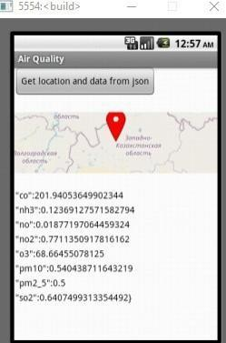
AIR QUALITY MONITORING
DESIGN:

Slide 2
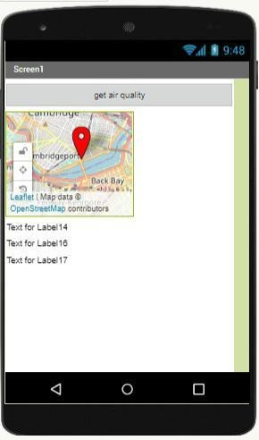

Slide 3
Air quality monitoring is crucial for assessing and addressing environmental challenges and
public health concerns. This project presents the design and development of an Air Quality
Monitoring System built using MIT App Inventor. The system integrates mobile technology with air
quality sensors to provide real-time data on air pollutants.
The system’s key features include a user-friendly mobile application for Android devices that allows users to monitor air quality in their vicinity. The application is designed to interact with various air quality sensors, collect data on pollutants such as particulate matter (PM2.5 and PM10), carbon monoxide (CO), nitrogen dioxide (NO2), and ozone (O3), and display this data in an intuitive and visually appealing format.
The project highlights the use of MIT App Inventor, a low-code development platform, for building the mobile application. The platform’s simplicity and accessibility make it an ideal choice for creating air quality monitoring applications that can be customized and deployed by a wide range of users.
This abstract provides an overview of the system’s design and its potential applications in environmental monitoring, public health, and citizen science. The project demonstrates the effectiveness of MIT App Inventor in developing mobile applications for air quality monitoring, contributing to the accessibility and democratization of environmental data for the benefit of society.
BLOCKS IN THE AIR QUALITY MONITORING :

Slide 4
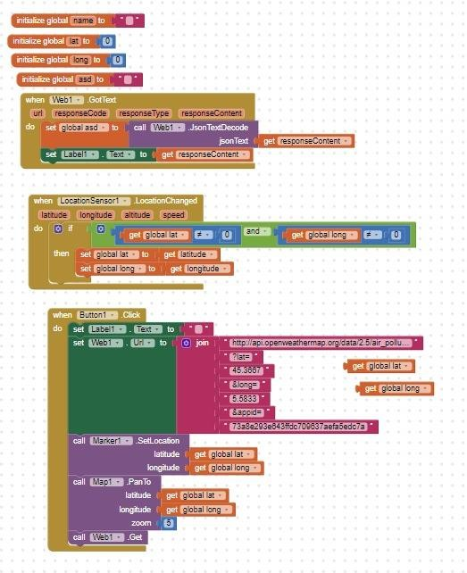

Slide 5
Air quality monitoring has become increasingly important in our modern world, with growing concerns about environmental pollution and its impact on public health. MIT App Inventor, a user-friendly visual programming platform, offers a unique opportunity to create mobile
applications that can contribute to air quality monitoring. This abstract highlights the fundamental building blocks and components essential for developing an air quality monitoring app using MIT App Inventor.
Sensor Integration: MIT App Inventor allows users to interface with various sensors such as air quality sensors, temperature sensors, and humidity sensors. These sensors play a critical role in collecting real-time data.
Data Collection and Processing: The app uses MIT App Inventor’s data collection
components to obtain readings from the integrated sensors. It then processes the data, converting it into understandable information on air quality.
User Interface Design: Designing an intuitive user interface is crucial for user
engagement. MIT App Inventor provides tools for creating user-friendly dashboards, charts, and interactive elements for displaying air quality information.

Slide 6
Real-Time Updates: Air quality can change rapidly, and MIT App Inventor offers features to ensure real-time updates and notifications to keep users informed about changes in the
environment.
Data Visualization: Visualizing air quality data through graphs and charts helps users interpret the information effectively. MIT App Inventor provides tools to create dynamic data visualizations.
Data Storage: MIT App Inventor allows for local data storage and cloud-based options, enabling users to access historical air quality data and trends.
Customization and Scalability: The flexibility of MIT App Inventor permits app developers to customize features and scale the app according to specific monitoring needs.
User Interaction: Interactive elements, such as user feedback and reporting options, promote community engagement and contribute to crowd-sourced air quality data.
In conclusion, MIT App Inventor offers a user-friendly platform for developing air quality monitoring apps by providing essential basic blocks for sensor integration, data collection, user
interface design, real-time updates, data visualization, data storage, customization, and user
interaction. This abstract provides an overview of the key components that make MIT App Inventor a valuable tool for creating applications that can contribute to improved air quality awareness and management.
DOWNLOAD LINK:

Slide 7
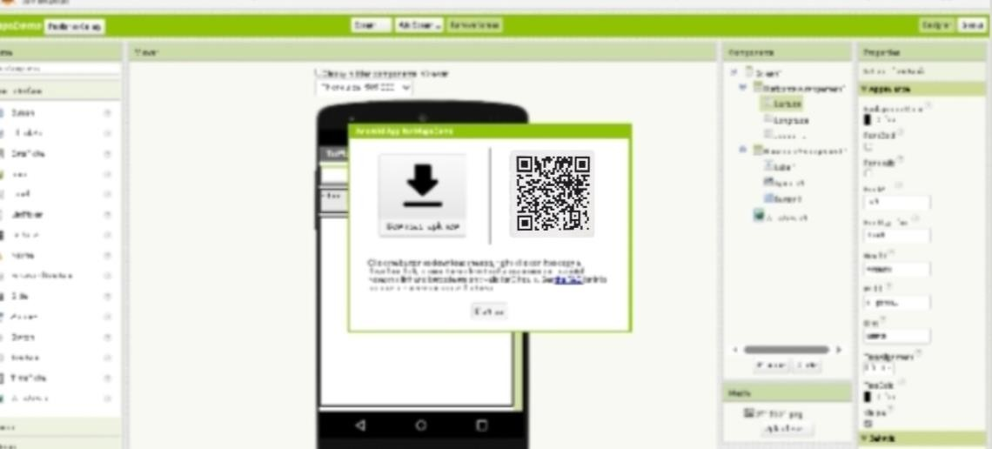

Slide 8
Air Quality Monitoring App using MIT App Inventor: A User-Friendly Solution for Environmental Awareness:
The rapid increase in urbanization and industrialization has led to a pressing concern for air quality monitoring. To address this issue, we present an innovative mobile application developed using MIT App Inventor, designed to empower users with real-time air quality
information. The app seamlessly integrates with various environmental sensors to collect data on pollutants such as particulate matter (PM2.5 and PM10), carbon dioxide (CO2), ozone (O3), and
nitrogen dioxide (NO2). The user interface is intuitive, providing easy navigation and visualization of the collected data, allowing users to grasp the current air quality status effortlessly.
This project focuses on enhancing environmental awareness by enabling users to make informed decisions about outdoor activities and personal health based on real-time air quality data. The application offers a user-friendly experience, allowing individuals to access the data conveniently on their smartphones. Moreover, the app promotes community engagement by
encouraging users to share their observations and contribute to a collective understanding of local air quality conditions.
The accompanying download link provides access to the Air Quality Monitoring App, empowering individuals, communities, and policymakers with valuable information to drive environmental initiatives, promote healthier lifestyles, and foster a sustainable future.

