Slide 1
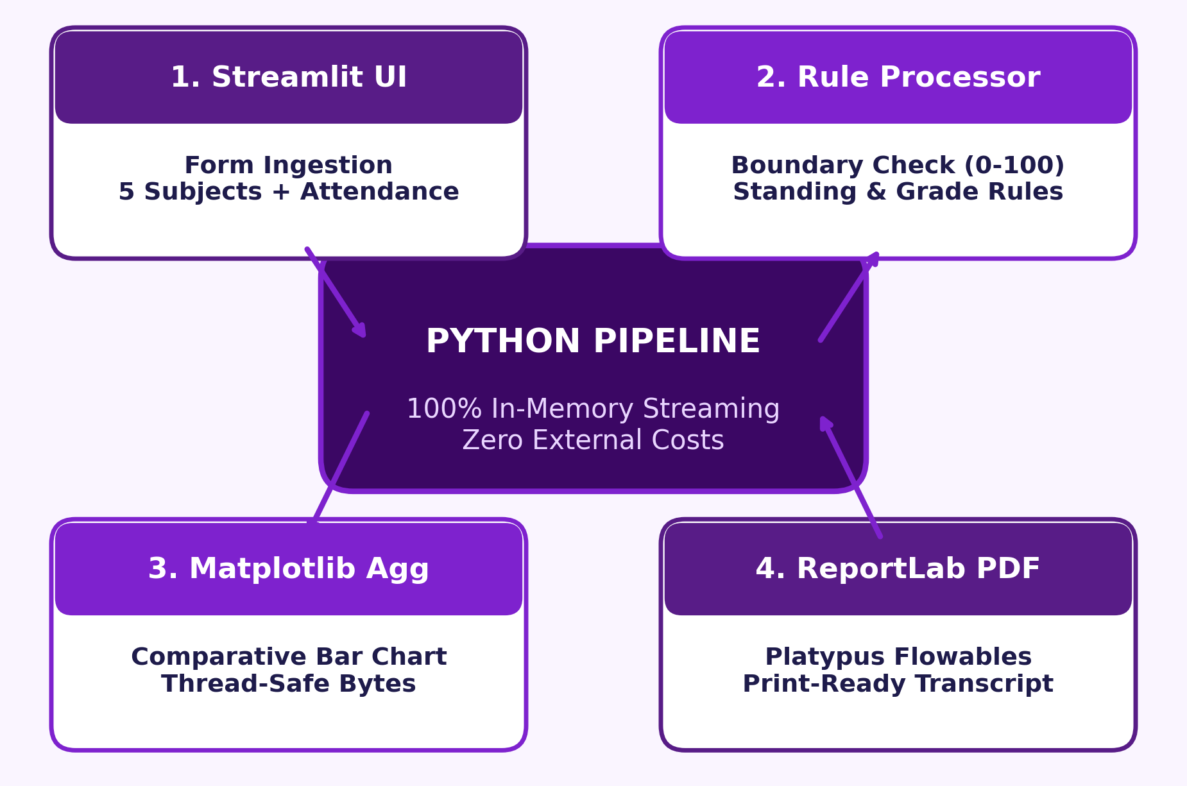
Personalized Report Generation using Templates and Python
Automated Academic Performance Appraisal & PDF Compilation System
• Academic Context: Postgraduate Coursework in Advanced Python Programming.
• Core Stack: Python 3, Streamlit (UI), Pandas, Matplotlib, ReportLab.
• Architecture: Decoupled Template Design with In-Memory Byte Streaming.
• Zero Cost: 100% Free & Open-Source — No cloud fees or paid APIs.
Advanced Python Programming | Personalized Report Generation | Slide 1 of 10

Slide 2
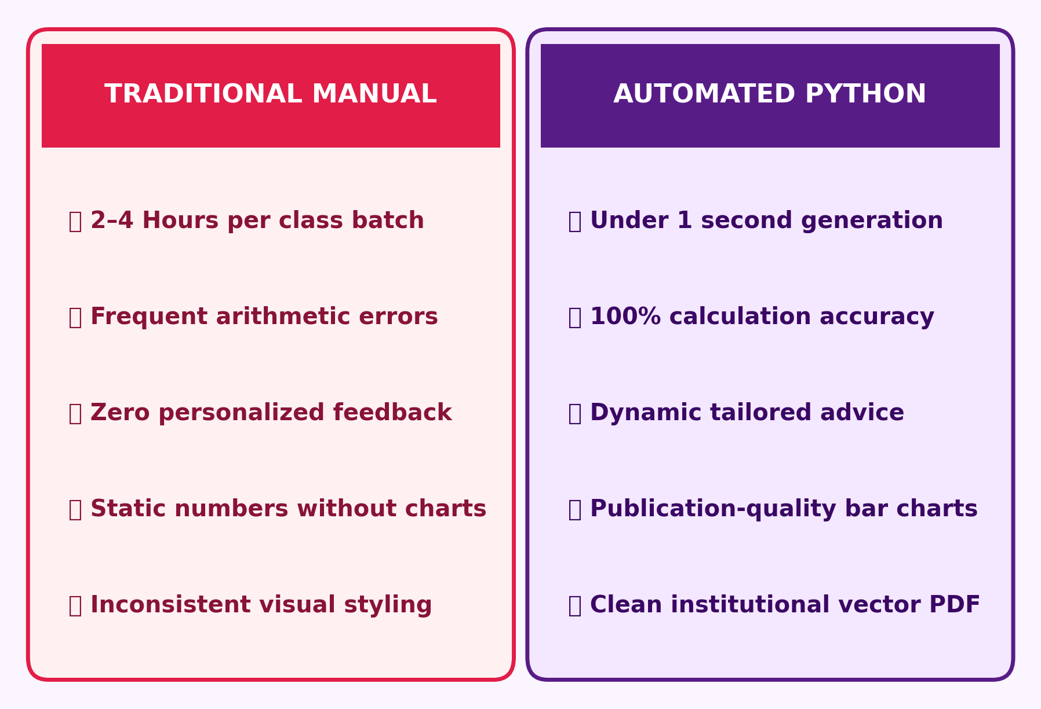
Problem Statement & Academic Motivation
Challenges in Traditional Student Progress Appraisal
• Administrative Burden: Manual spreadsheet reporting takes hours per batch.
• Calculation Errors: Averaging and grading manual mistakes harm accuracy.
• Lack of Guidance: Standard report cards omit personalized remedial advice.
• Absent Visual Analytics: Tables fail to visually highlight student strengths.
Advanced Python Programming | Personalized Report Generation | Slide 2 of 10

Slide 3
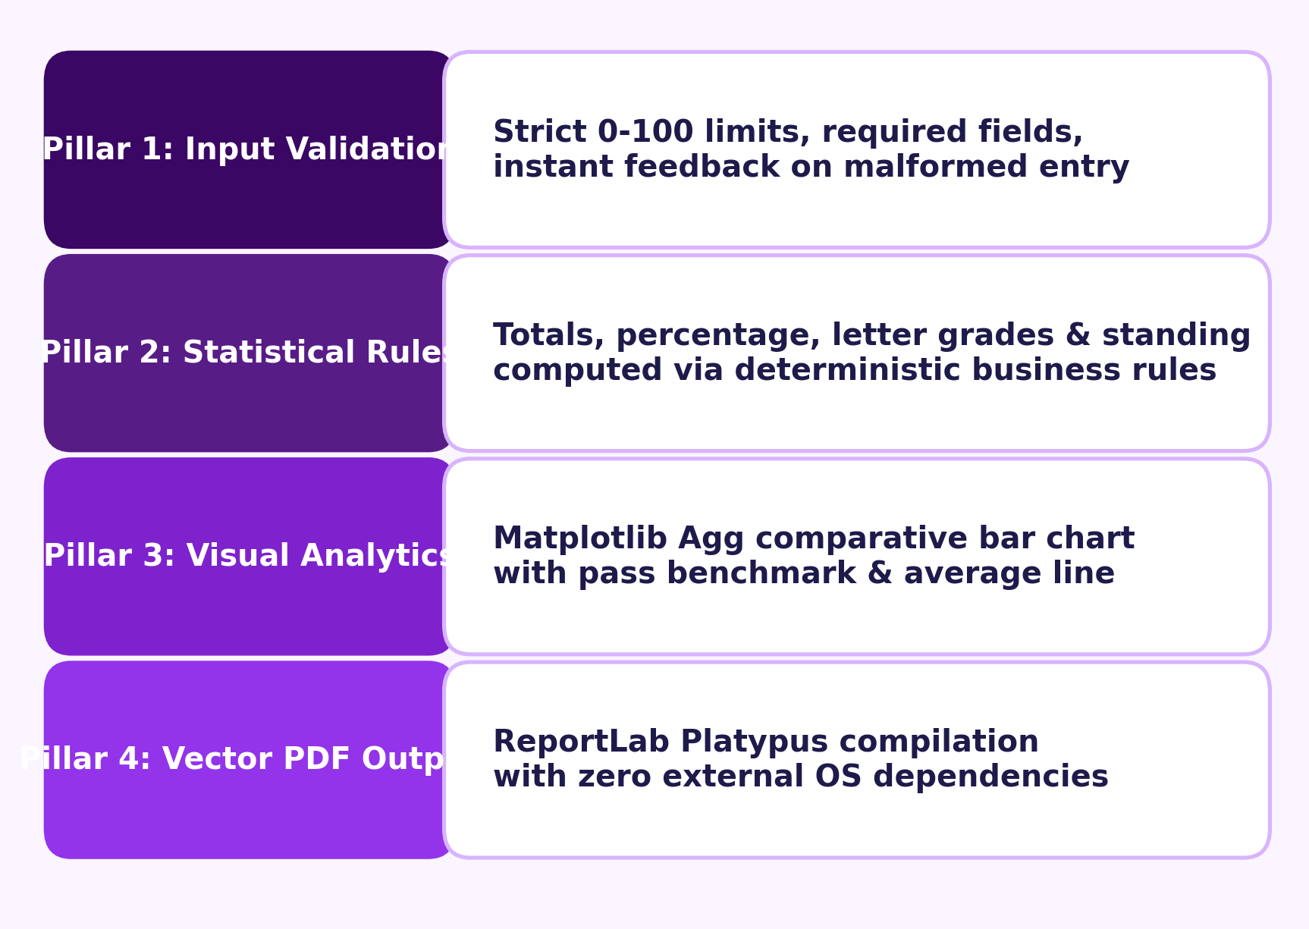
Proposed Solution & System Objectives
Automated, Decoupled Template-Driven Academic Pipeline
• Strict Input Validation: Enforces [0, 100] numerical score bounds.
• Statistical Engine: Automates totals, percentages, letter grades & standing.
• Personalized Advice: Identifies top & lowest courses with remedial guidance.
• Publication Output: Compiles vector PDF transcripts ready for print.
Advanced Python Programming | Personalized Report Generation | Slide 3 of 10

Slide 4
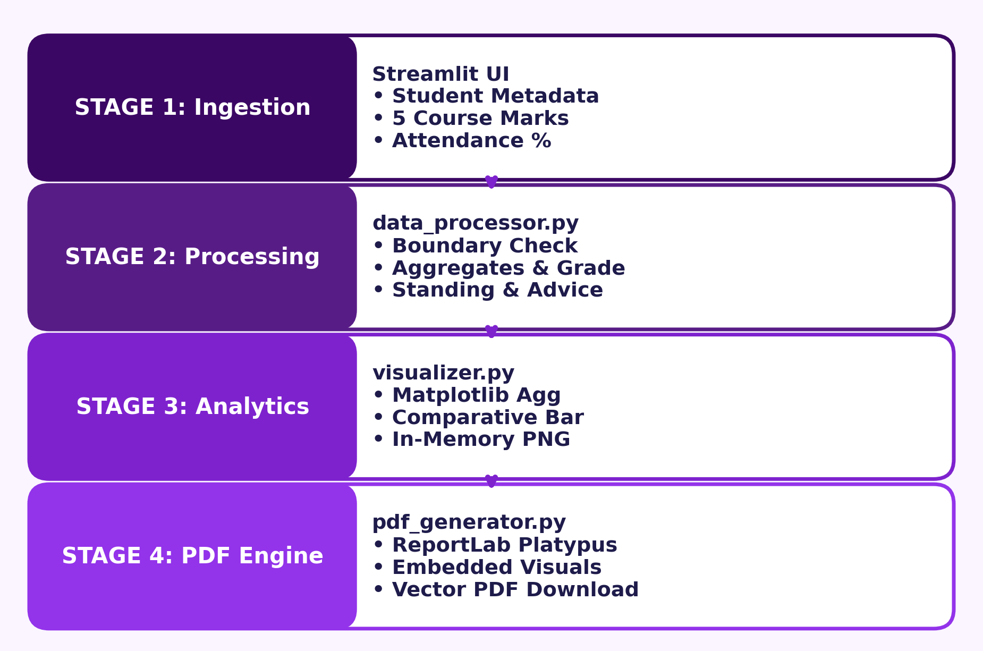
System Architecture & Processing Pipeline
4-Stage Modular Decoupled In-Memory Execution Flow
• Stage 1 (Ingestion): Streamlit UI collects student demographics & marks.
• Stage 2 (Processing): data_processor.py executes validation & calculations.
• Stage 3 (Analytics): visualizer.py generates comparative charts via Agg.
• Stage 4 (Compilation): pdf_generator.py binds data into ReportLab Platypus.
Advanced Python Programming | Personalized Report Generation | Slide 4 of 10

Slide 5
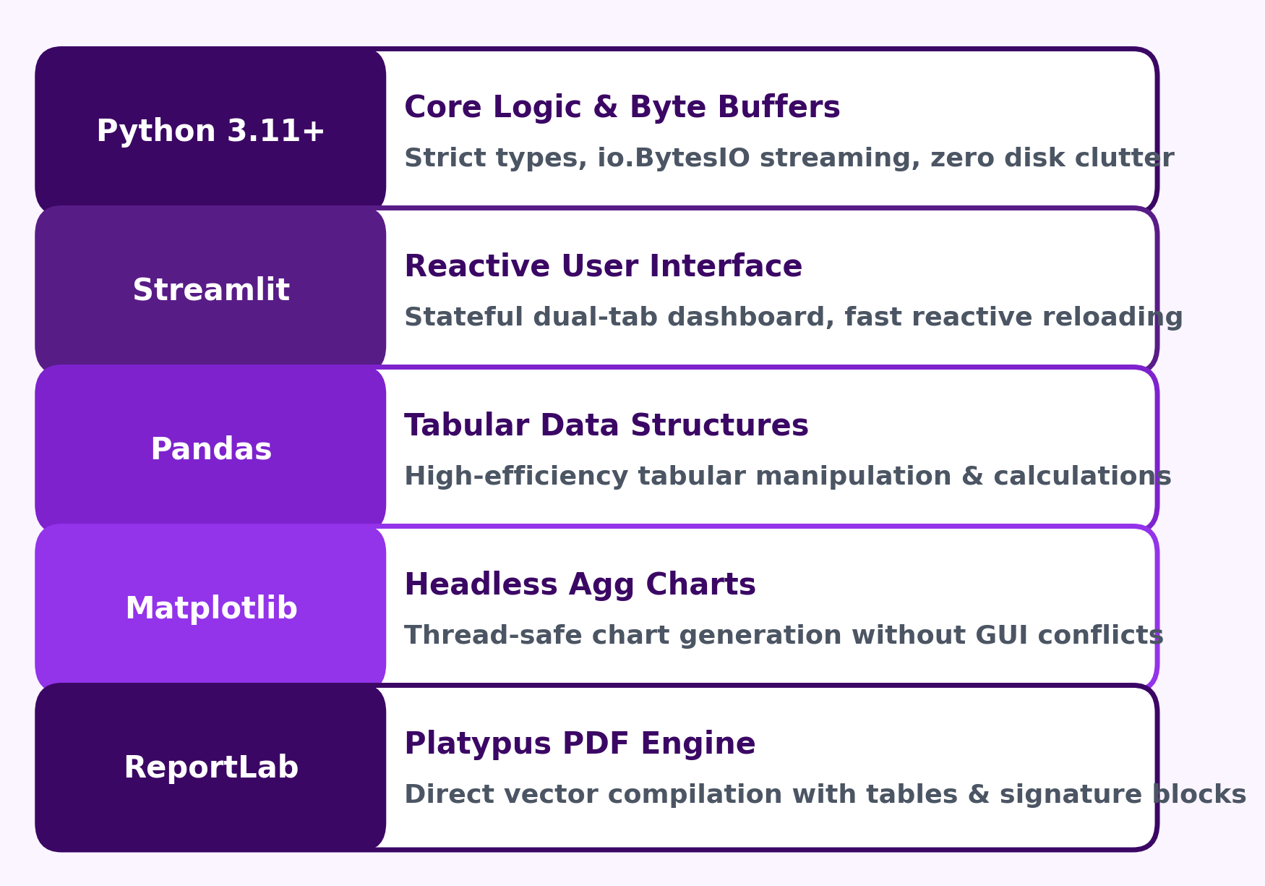
Technology Stack & Technical Rationale
100% Free, Lightweight & Open-Source Python Ecosystem
• Python 3.11+: Core logic with strict types and in-memory io.BytesIO.
• Streamlit: Interactive web UI with persistent session state.
• Pandas: Tabular data frame structures for student records.
• ReportLab: Native vector PDF compilation with Flowables.
Advanced Python Programming | Personalized Report Generation | Slide 5 of 10

Slide 6
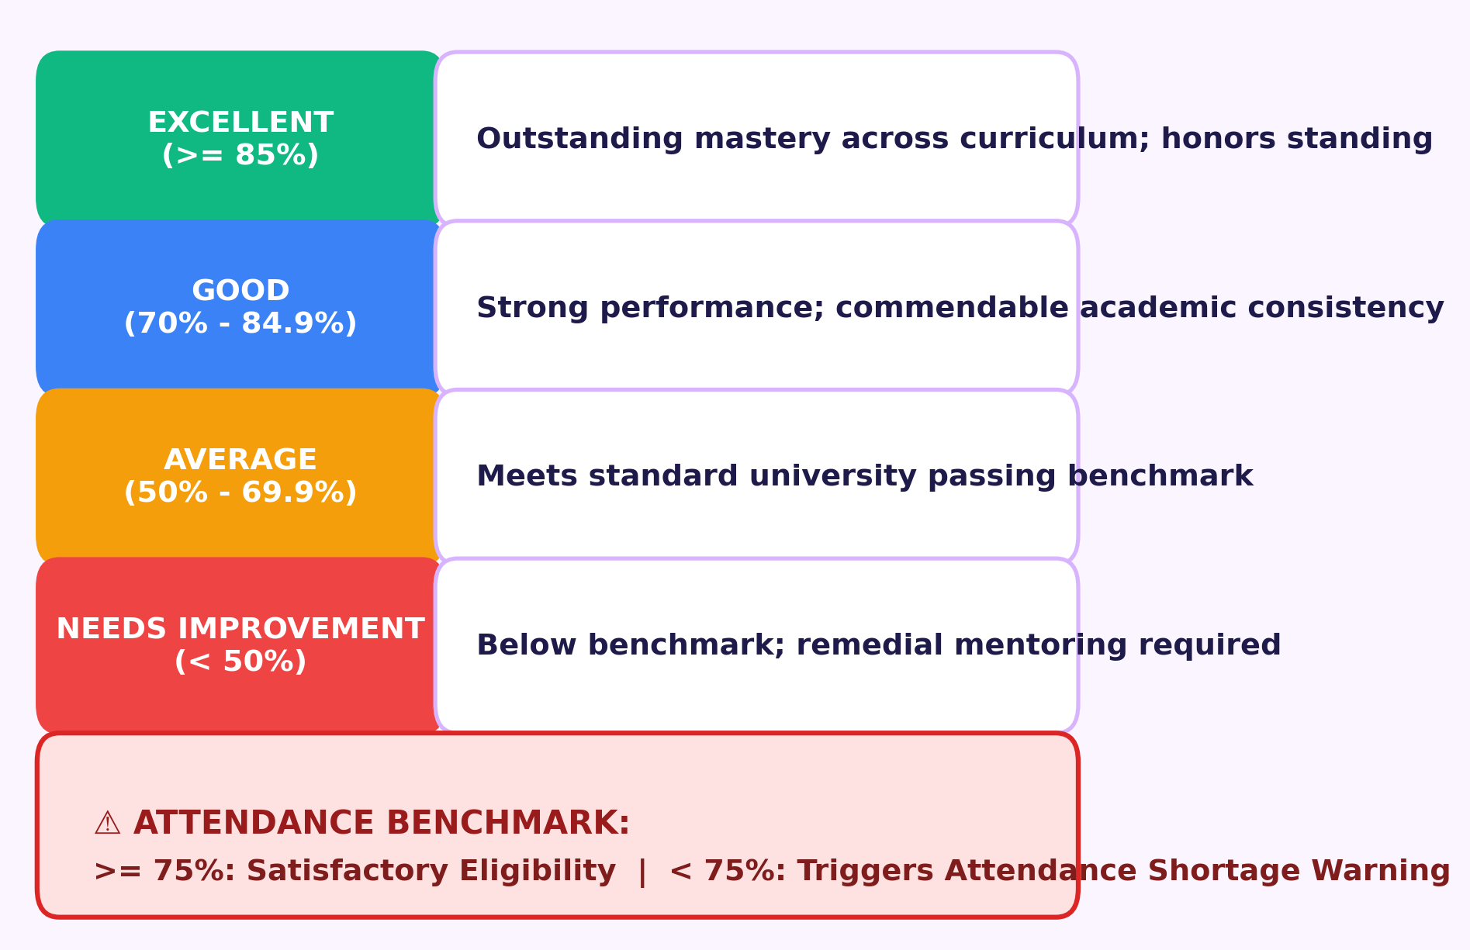
Input Validation & Academic Categorization
Clearly Defined University Evaluation Thresholds
• Boundary Checks: Name/Roll required; marks & attendance strictly in [0, 100].
• 4 Standing Tiers: Excellent (>= 85%), Good (70-84%), Average (50-69%), Needs Imprv (< 50%).
• Attendance Norms: Standard >= 75% required; < 75% triggers shortage alert.
• Remedial Engine: Praises strengths and recommends corrective actions.
Advanced Python Programming | Personalized Report Generation | Slide 6 of 10

Slide 7
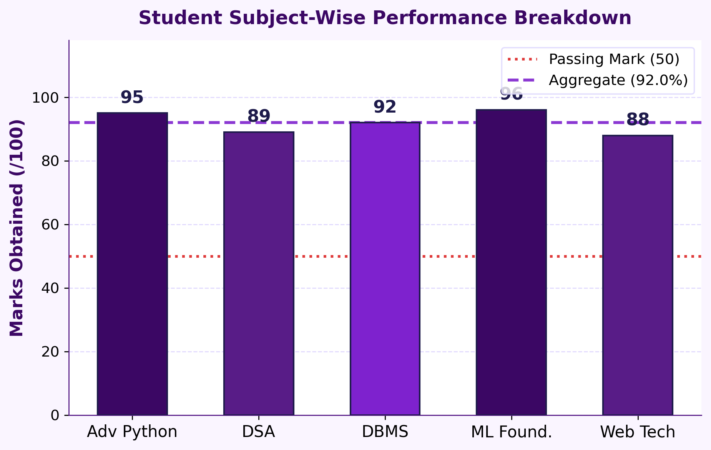
Dynamic Data Visualization Engine
Comparative Academic Performance Visual Analytics
• Tier Color Coding: Bars styled according to performance category.
• Benchmark Lines: Visual pass benchmark (50) and student aggregate line.
• Score Annotations: Numerical marks annotated on top of each bar.
• Zero Disk I/O: Charts rasterized to in-memory bytes for immediate PDF embed.
Advanced Python Programming | Personalized Report Generation | Slide 7 of 10

Slide 8
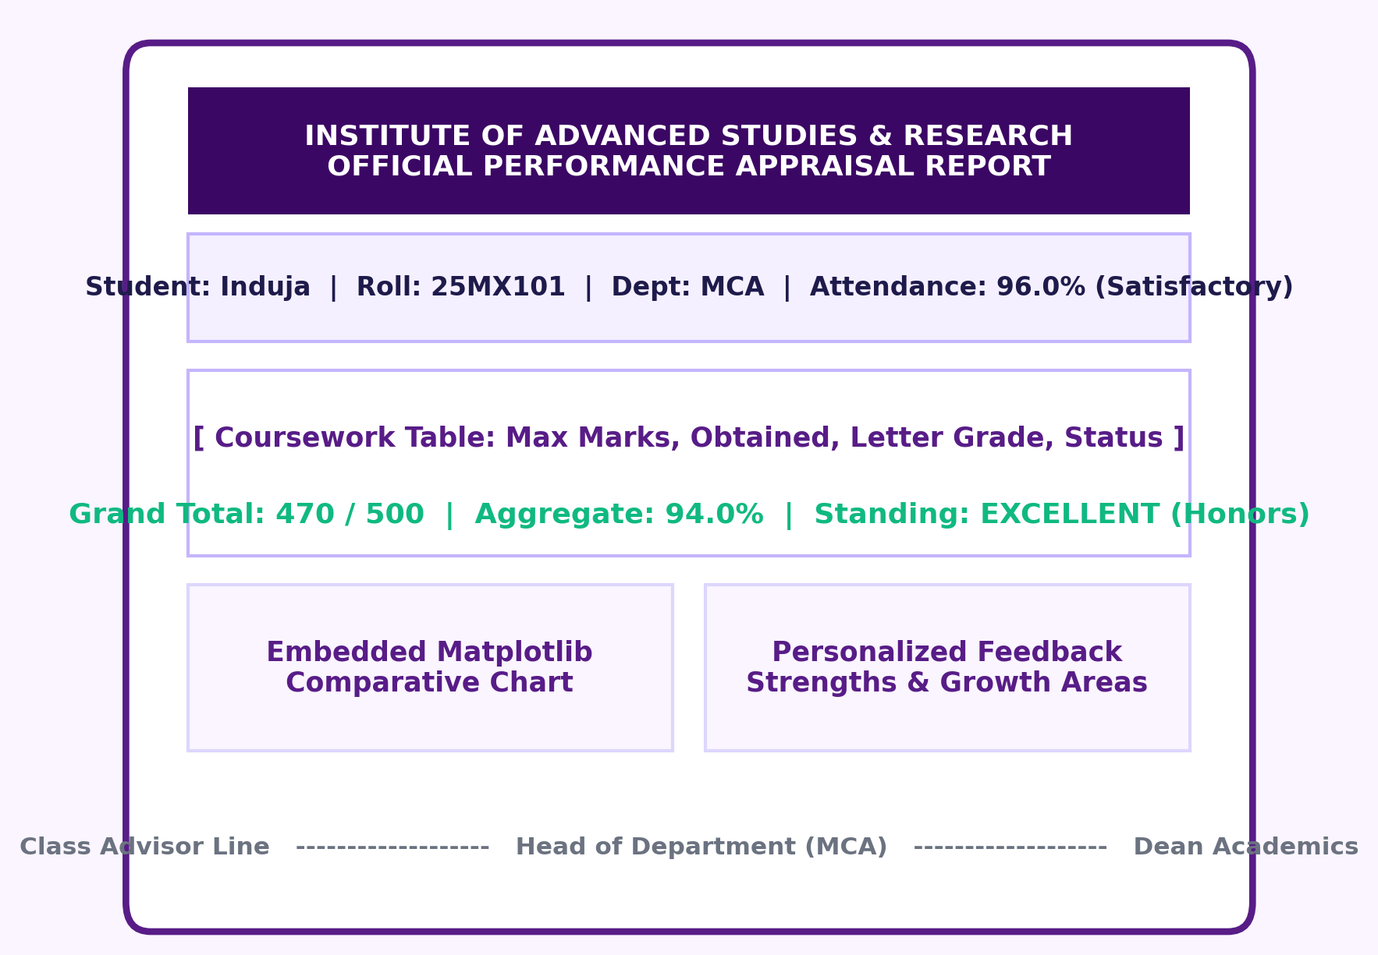
Template Decoupling & Vector PDF Output
Printable Academic Transcripts via ReportLab Platypus
• Template Decoupling: Static visual geometry separated from dynamic student data.
• Platypus Flowables: Automatic page budget management and clean pagination.
• Official Elements: Header branding, grade tables, embedded chart, signature lines.
• Vector Precision: High-resolution output suitable for official institutional archives.
Advanced Python Programming | Personalized Report Generation | Slide 8 of 10

Slide 9
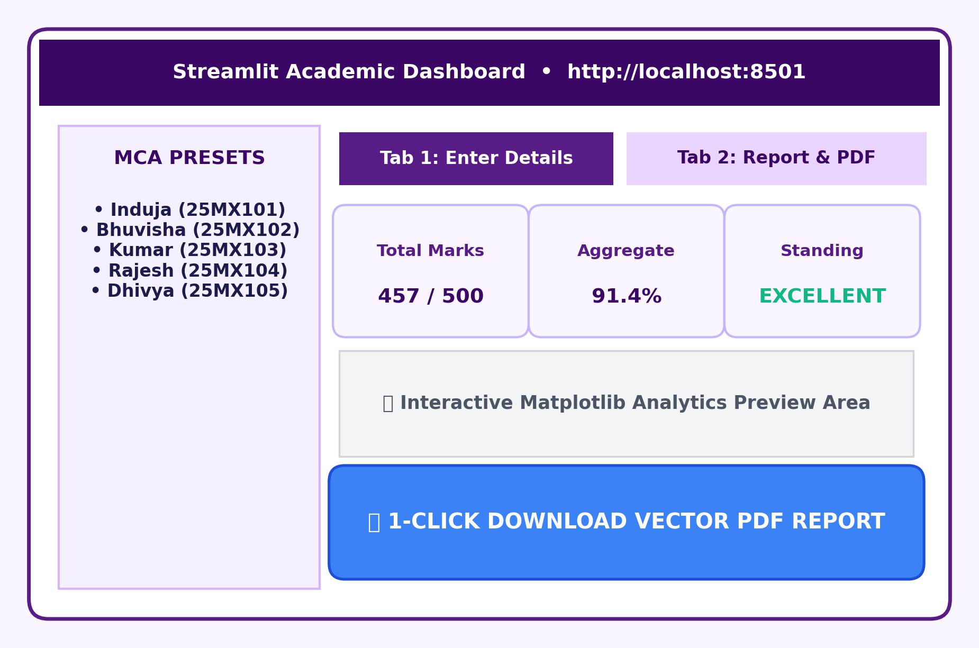
Application Interface & Demonstration Workflow
Reactive Dual-Tab Dashboard with Classroom Demo Presets
• 1-Click MCA Presets: Pre-loaded profiles: Induja, Bhuvisha, Kumar, Rajesh, Dhivya (25MX---).
• Dual-Tab Layout: Tab 1 for data input; Tab 2 for live report inspection.
• Live KPI Summary: Instant metrics for Total Marks, Aggregate %, Standing.
• In-Memory Download: 1-Click download of vector PDF without file locking.
Advanced Python Programming | Personalized Report Generation | Slide 9 of 10

Slide 10
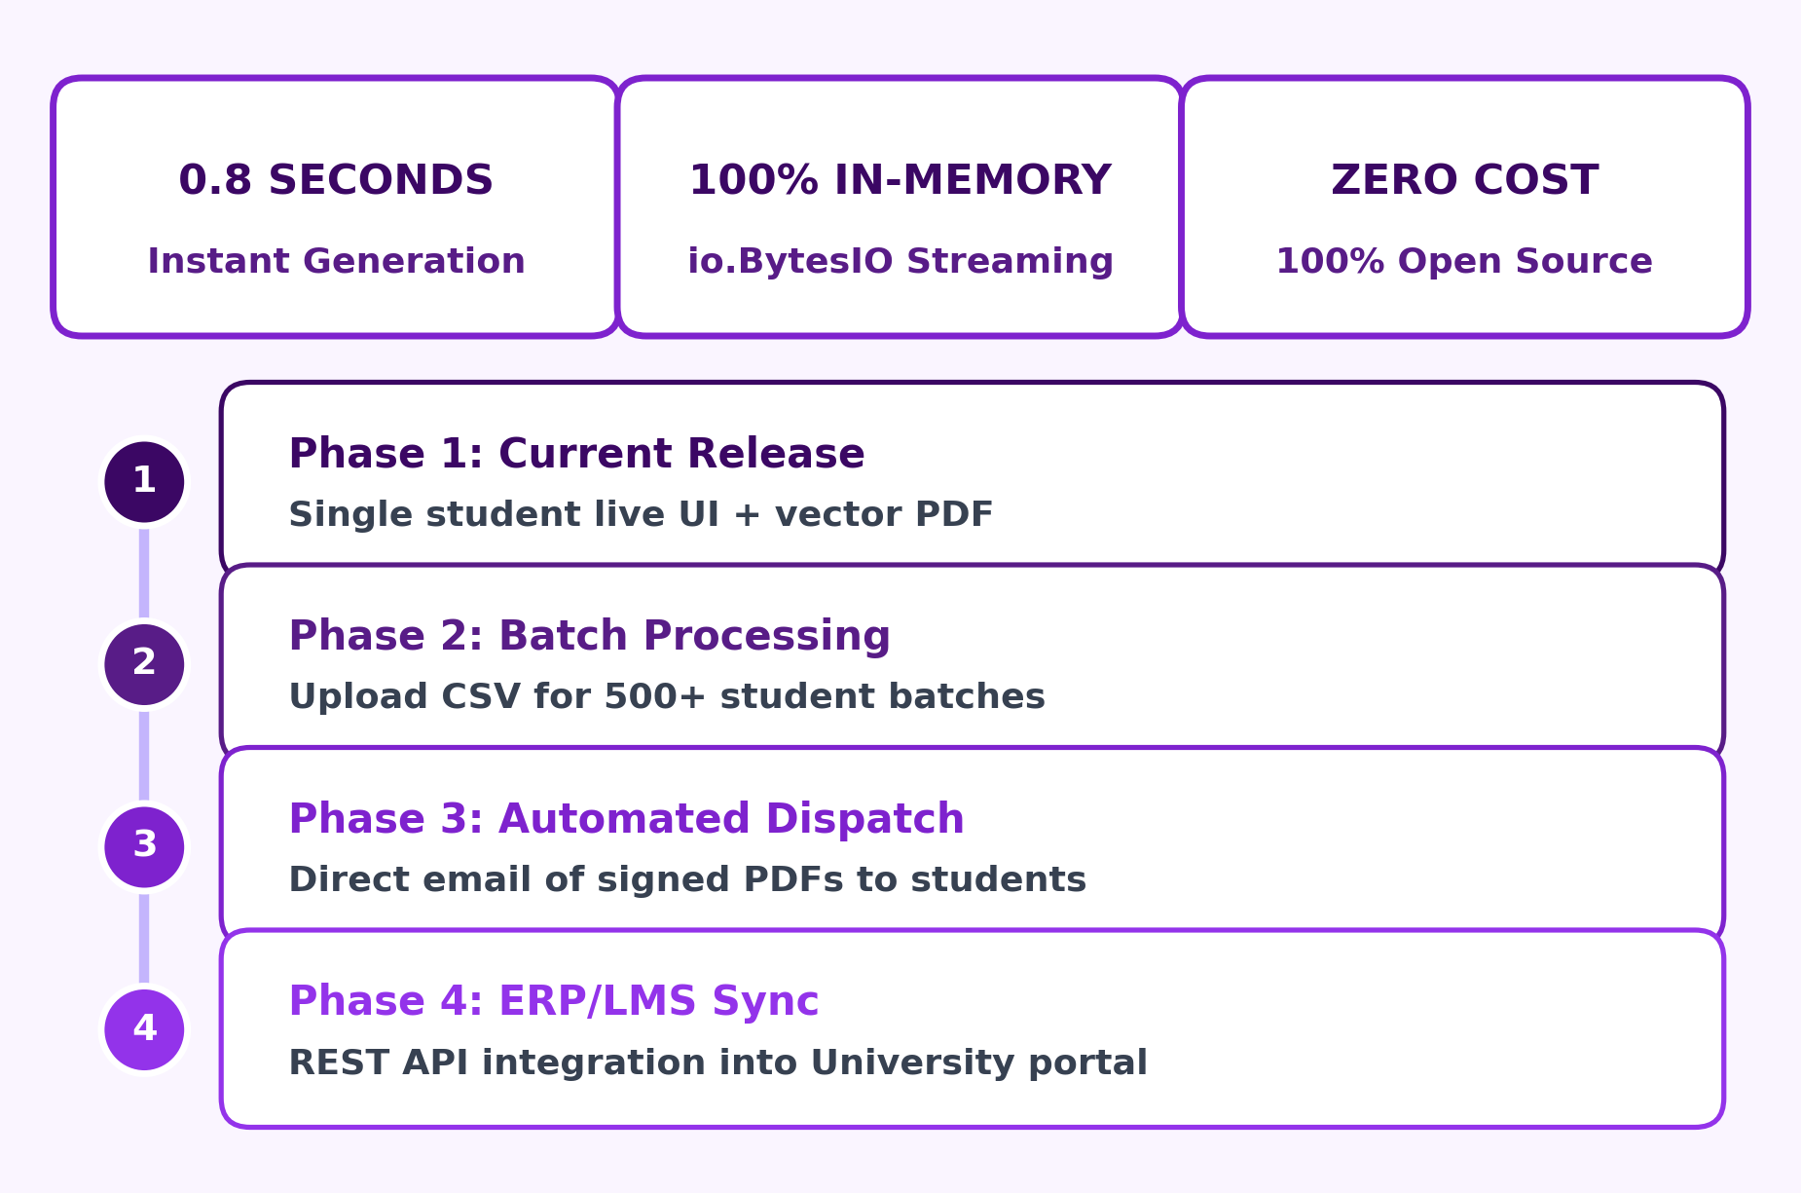
Conclusion, Future Scope & Viva Discussion
Project Accomplishments & Enterprise Scalability Roadmap
• 100% Automated: Eliminates administrative overhead and arithmetic errors.
• High Performance: Under 0.8s execution time via in-memory streaming.
• Scalability Roadmap: Batch CSV ingestion for 500+ students & email dispatch.
• Viva Evaluation: Floor is open for Questions, Code Walkthrough & Demo.
Advanced Python Programming | Personalized Report Generation | Slide 10 of 10

