Slide 1
Prediction of Customer Interest in Vehicle Insurance
By Indumathy R

Slide 2
Objective
Develop a predictive model to determine whether a customer is interested in purchasing vehicle insurance.

Slide 3
Problem Statement
Vehicle insurance requires customers to pay an annual premium to an insurance provider. Predicting customer interest in vehicle insurance enables companies to optimize their communication strategies, enhance customer outreach, and improve business performance.

Slide 4
Data Understanding
Dataset includes customer demographics, vehicle details, and policy information:
Unique ID, Gender, Age, Driving License
Region Code, Previously Insured, Vehicle Age, Vehicle Damage
Annual Premium, Policy Sales Channel, Vintage
Target Response (Interested/Not Interested)

Slide 5
Data Preprocessing & Exploration
Performed exploratory data analysis (EDA)
Converted categorical variables into numerical representations
Identified independent (X) and dependent (Y) variables
Scaled numerical values using StandardScaler
Train-test split applied

Slide 6
Model Selection & Implementation
Models Evaluated:
- Logistic Regression
- Decision Tree
- Random Forest
- AdaBoost
- XGBoost

Slide 7
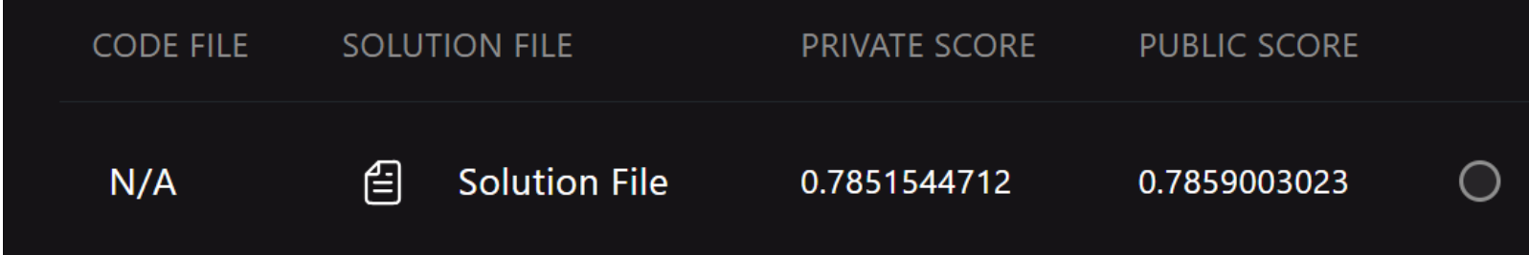
Handling Class Imbalance
Dataset imbalance (Class 0: 334,399 | Class 1: 46,710)
Applied Under-sampling & Over-sampling
Used SMOTE for synthetic minority class samples
Random Forest with under-sampling provided the best results
Below score obtained from hackathon site for RF – Under Sampling

Slide 8
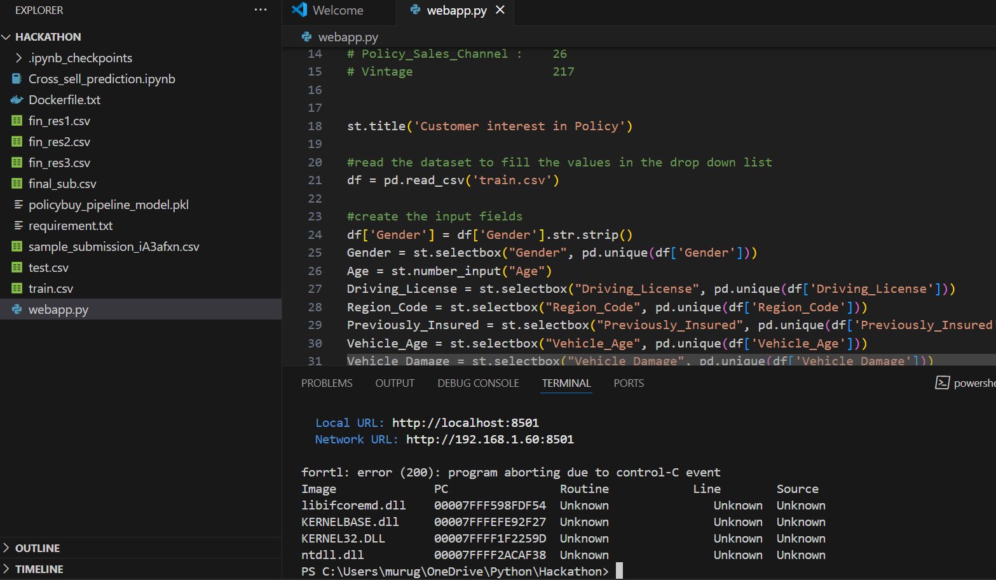
Deployment & Results
Pickled the RF Under sample model for deployment
Developed a web application using Streamlite
API created as webapp.py
Project available on GitHub
Deployed using Google Cloud Platform (GCP)

Slide 9
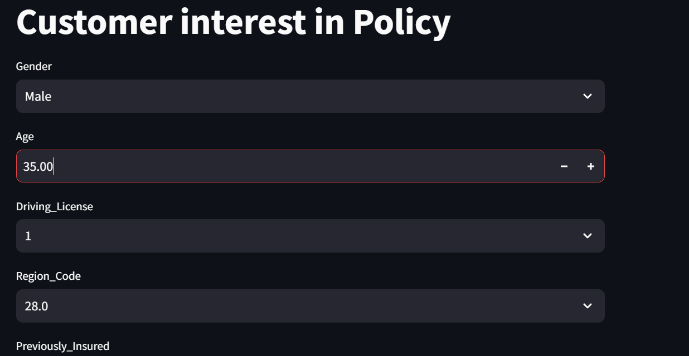
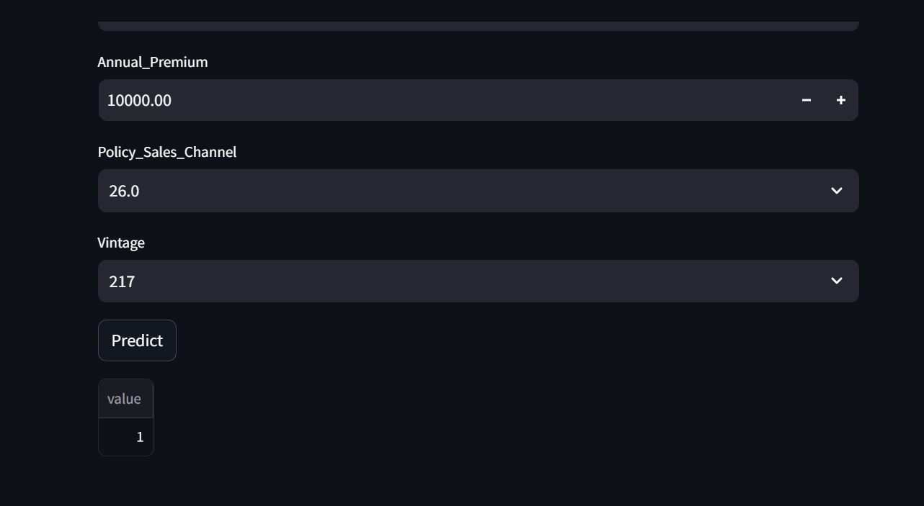
Webapp using Streamlite

Slide 10
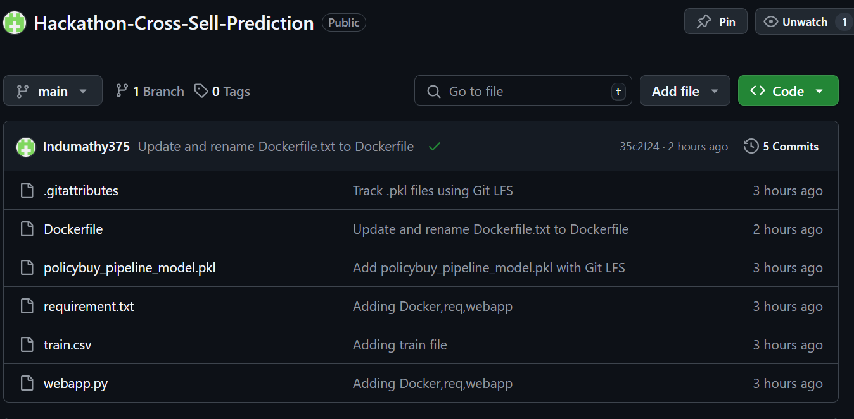
GitHub Link
GitHub Repository: https://github.com/Indumathy375/Hackathon-Cross-Sell-Prediction

Slide 11
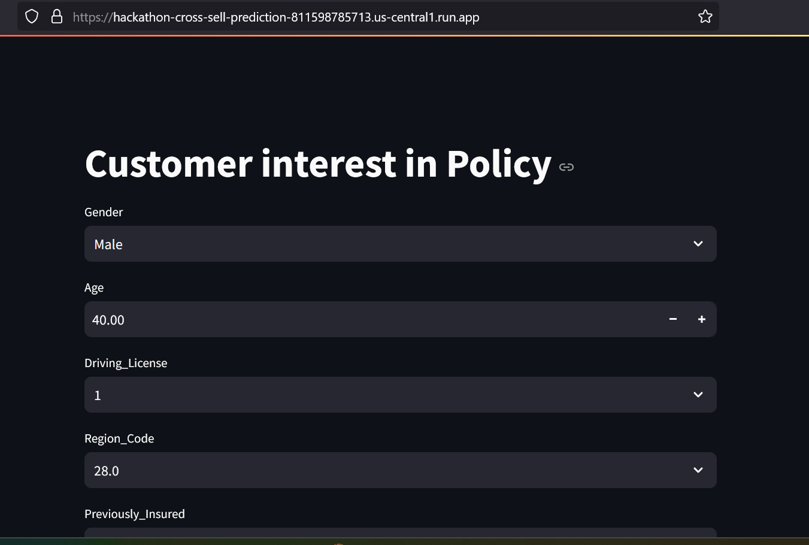
Deployment Link
GCP Deployment:
https://hackathon-cross-sell-prediction-811598785713.us-central1.run.app

Slide 12
Thank you!

