Slide 1
University of Milan Bicocca
A.Y. 2023/2024
Induni Sandapiumi Nawarathna Pitiyage - 906451
Streaming Data Management and Time Series Analysis

Slide 2
Introduction
This project aims to apply linear and machine learning models to the given time series to compare their predictive performance.
The models that have been incorporated in this project are: ARIMA, UCM and machine learning models.
The provided dataset for the analysis contains total 3009 entries with 3 columns.
The data have been recorded from 2007-01-04 to 2015-03-31 along with the day of the week in textual format and the final column named as, ‘avg_days’ which represent as a locating point number on the average number of days needed to close the requests that were closed that day.

Slide 3
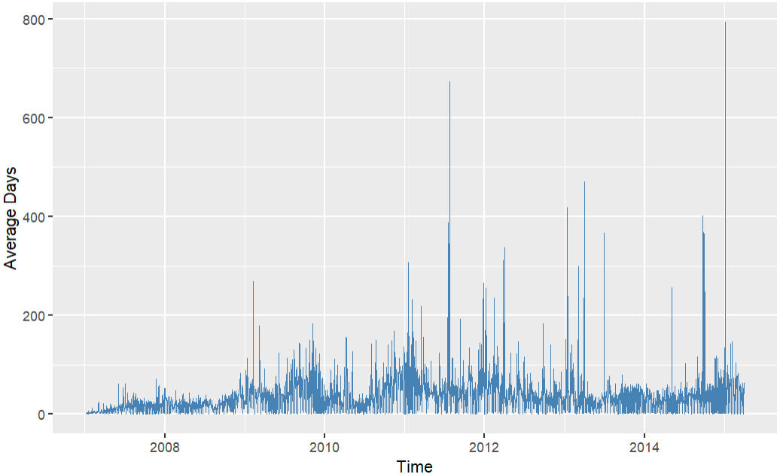
Data Pre-processing
The provided dataset is composed with missing values only for ‘avg_days’ attribute.
All the missing entries in the original dataset is imputed using forward fill (is also known as Last Observation Carried Forward or LOCF) imputation method.

Slide 4
To focus on the most relevant and stable periods and to improve model performance, original time series is trimmed from 2007-01-04 to 2008-12-31.
The trimmed dataset is partitioned into 2 sets, initial partition from 2009-01-01 to 2014-03-31 is composed with the data required for model training and the other partition from 2014-04-01 to 2015-03-31 for testing purposes.
To identify the outliers exists in both datasets, the 95th percentile is calculated. The values exceeding the threshold is considered as outliers and these outliers are replaced using the Last Observation Carried Forward (LOFC) technique.

Slide 5
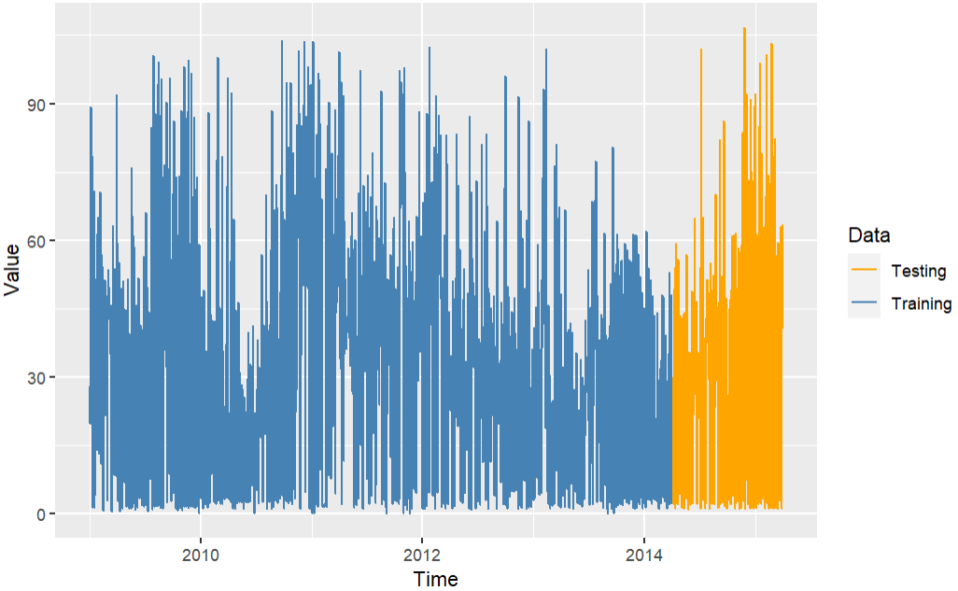
Outlier Correction in trimmed time series data using LOFC technique.

Slide 6
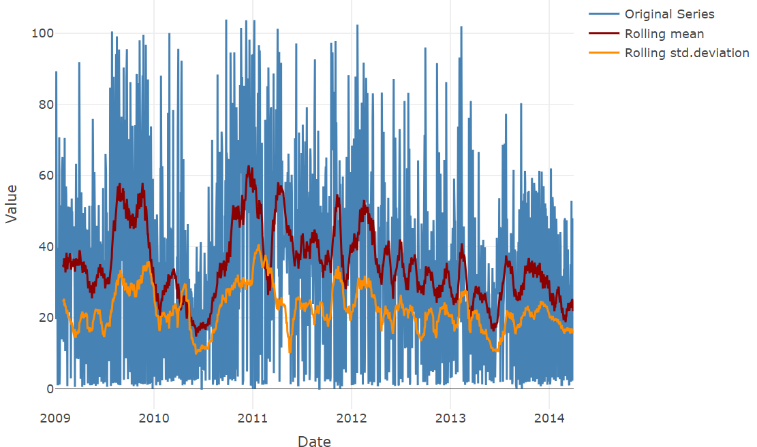
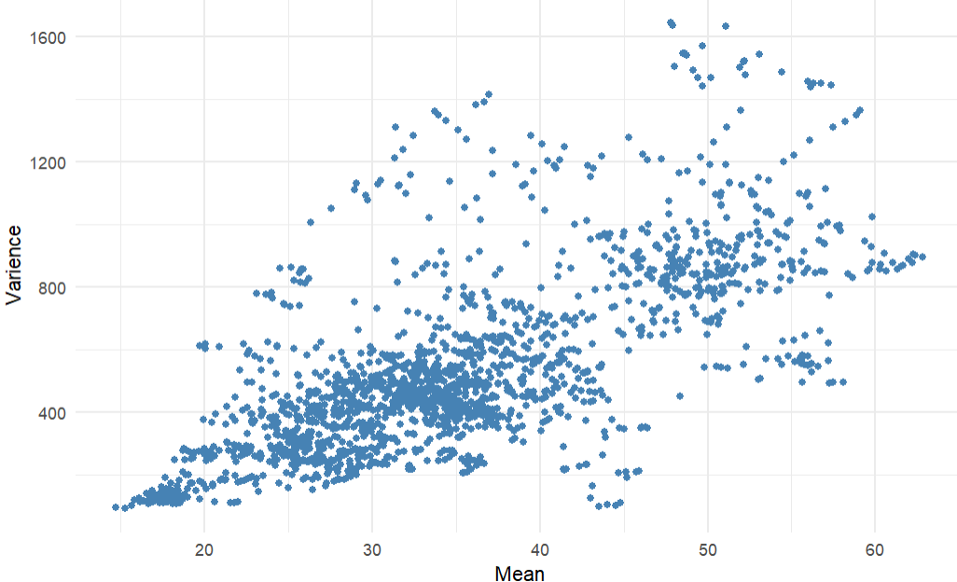
ARIMA
Rolling mean and Rolling Standard Deviation of the training data
Scatter plot of Rolling mean vs Rolling variance of the time series

Slide 7
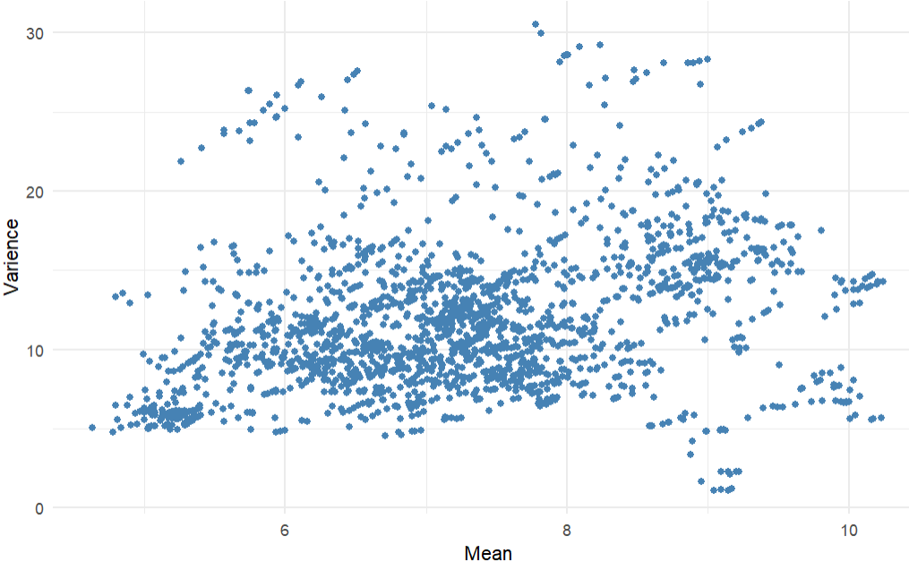
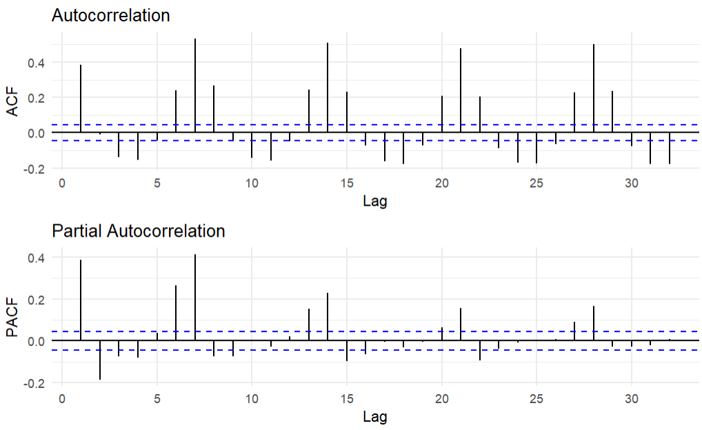
Scatter plot of Rolling mean vs rolling standard deviation of the Box-Cox transformed time series
ACF and PACF plots for Box-Cox transformed time series.
Box-Cox Transformation

Slide 8
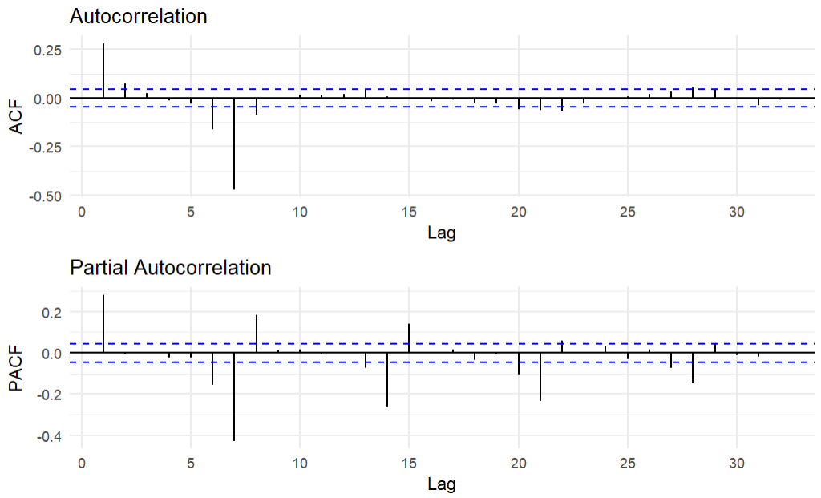
Seasonal Differencing
Seasonal Differencing
To analyse non-seasonal part of the ARIMA model (p and q parameters), the first 7 lags in ACF and PACF have been observed.
According to PACF plot the number of significant lags for p are equal to 1 while according to ACF plot number of significant lags for q are equal to 4.
To analyse the seasonal part of the ARIMA model (P and Q parameters), the lags at 7,14, 21…. in ACF and PACF have been observed. The number of significant lags for P is 0 and for Q is 3.
Since we did not difference non-seasonal part of the ARIMA model, d is equal to 0 while for seasonal part of the ARIMA model D is equal to 1.
The final ARIMA model deduce from the ACF/PACF plot is ARIMA (1,0,4)(0,1,3)7 .
ACF and PACF plots for seasonality differenced time series with lag 7

Slide 9
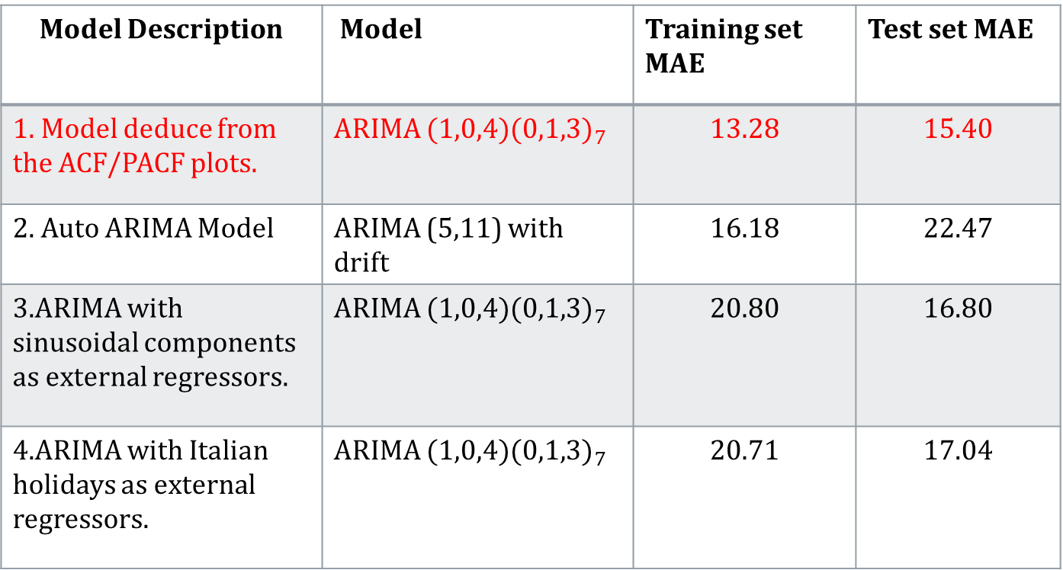
Summarizing the model performance for ARIMA models.
Model Description | Model | Training set MAE | Test set MAE
1. Model deduce from the ACF/PACF plots. | ARIMA ${(1,0,4)(0,1,3)}_{7}$ | 13.28 | 15.40
2. Auto ARIMA Model | ARIMA (5,11) with drift | 16.18 | 22.47
3.ARIMA with sinusoidal components as external regressors. | ARIMA ${(1,0,4)(0,1,3)}_{7}$ | 20.80 | 16.80
4.ARIMA with Italian holidays as external regressors. | ARIMA ${(1,0,4)(0,1,3)}_{7}$ | 20.71 | 17.04

Slide 10
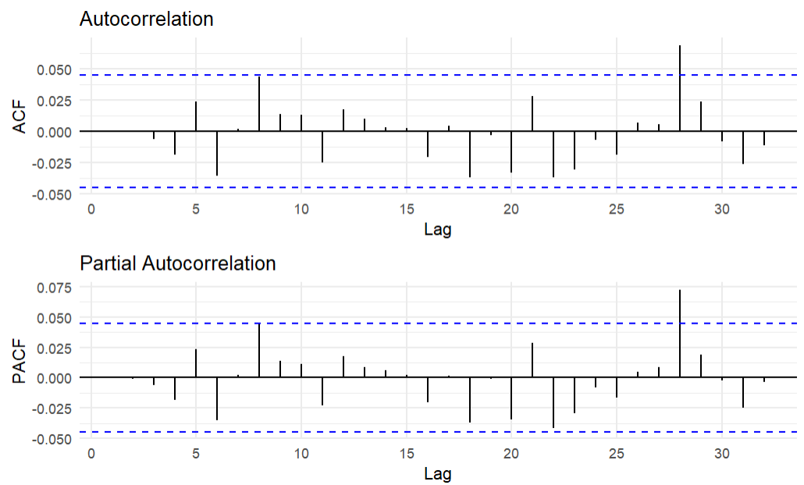
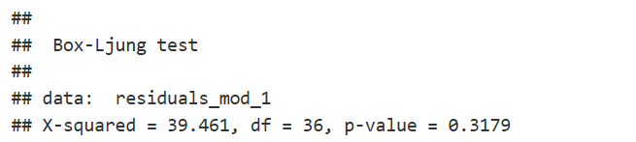
ACF (Auto-correlation function) and PACF (Partial Auto-correlation function) plots for first model’s residuals.
Residual Plots

Slide 11
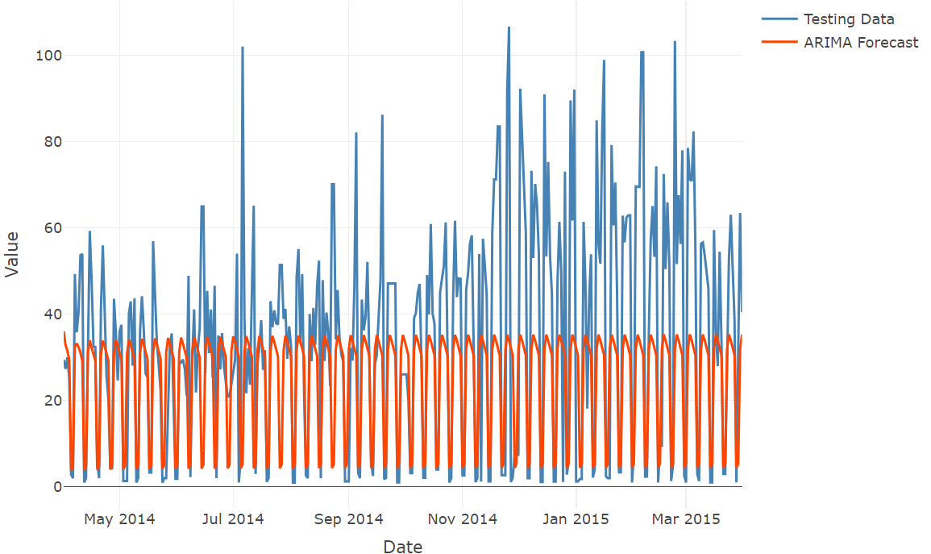
ARIMA Forecast of model 1 on the Test Data

Slide 12
UCM (Unobservant Component Models)
Summarizing the model performance for UCM models.
Model Description | Training set MAE | Test set MAE
1.Seasonal UCM with a weakly period (7 days). | 24.78 | 16.10
2.State-Space model with local linear trend and weekly seasonality component. | 26.61 | 15.48
3.State-Space model that combines random walk trend, weakly seasonality and yearly seasonality. | 26.58 | 17.07
4. State-Space model that combines second-order polynomial trend, weakly seasonality and yearly seasonality. | 26.58 | 17.07

Slide 13
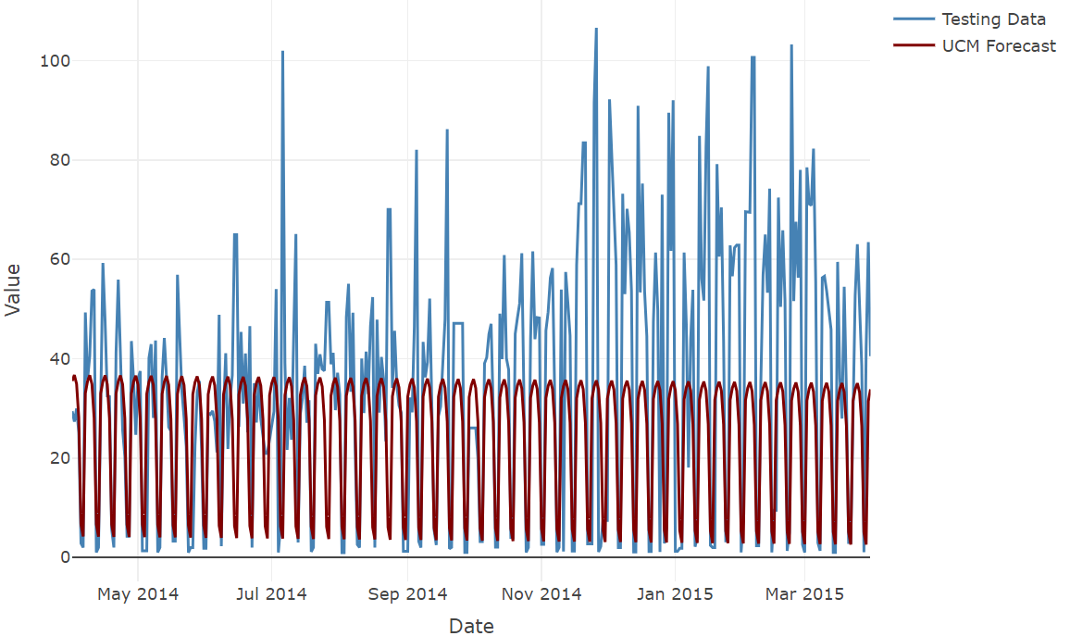
UCM Forecast of model 2 on Test data

Slide 14
Machine Learning Models
Machine Learning Model | Model Description | Testing set MAE | Testing set RMSE
Random Forest | 1.Random Forest model with the lag values. | 15.19 | 20.27
 | 2. Random Forest model with the lag values implemented using cross-validation method. | 15.54 | 20.44
k-Nearest Neighbours(k-NN) | 3. Recursive KNN model with lag values. | 20.35 | 20.57
 | 4. Recursive KNN model with lag values and transformed training samples. | 24.50 | 29.66
eXtreme Gradient Boost (XGBoost) | 5.XGBoost model with the lag values. | 14.67 | 20.00
 | 6. XGBoost model with the lag values implemented using cross-validation method. | 14.66 | 19.68

Slide 15
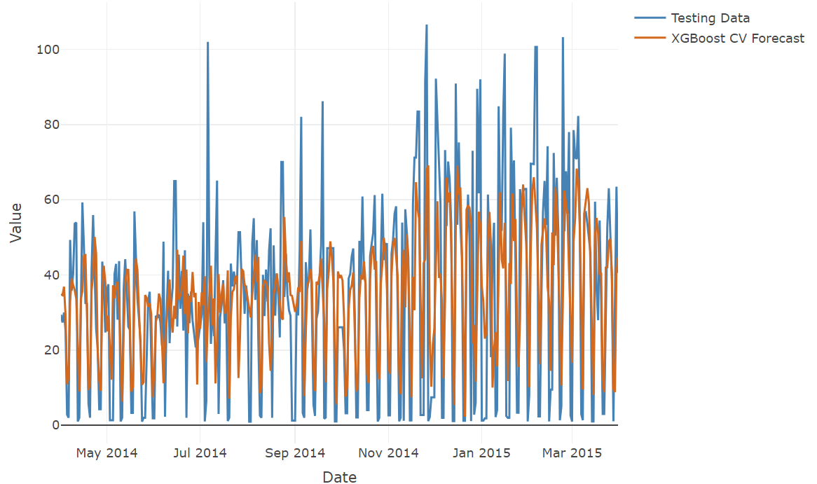
XGBoost implemented using cross-validation method forecast on test data.

Slide 16
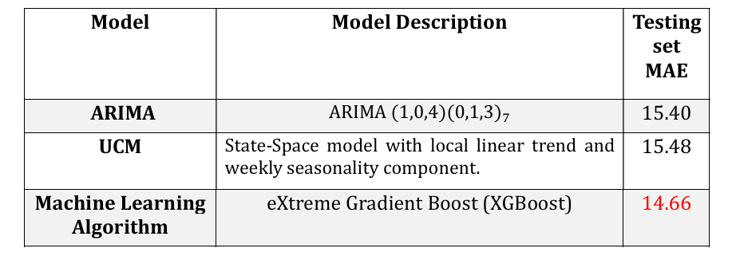
Conclusion
Out of all the models that incorporated in this project, machine learning eXtreme Gradient Boost (XGBoost) algorithm shows the best performance for the test set.

Slide 17
Thank You
For Your Attention!

