Slide 1
SUGGEST NAME OF THE APP

Slide 2
FLOW OF PROJECT
Step 1)
SignUP
Username , pwd, teamname ,emailID
Login
Username , pwd
Step 2)
Main Booking App
React Js
Components include => Navbar, DatePicker , Seat Allocation , Slider with buttons
Step 3)
Redirecting Data from Step 1 to 2
Deployment of The app

Slide 3
FLOW OF PROJECT
SIGNUP
LOGIN

Slide 4
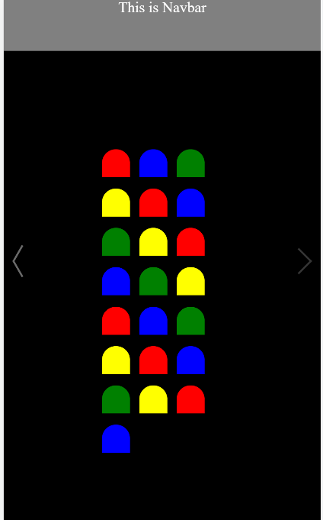
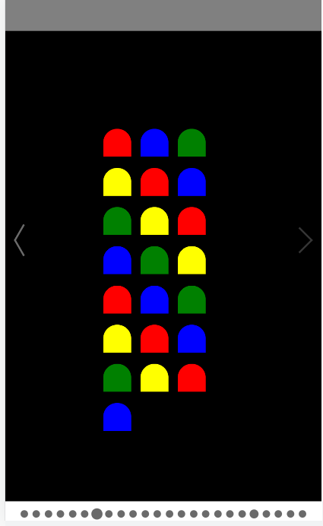

https://www.flaticon.com/free-icon/armchair_686648
TEAM NAME
DATE PICKER
PREVIOUS TEAM ALLOCATION
Book Seats Button Reflected in UI
Notification Popup
Send that to database

Slide 5
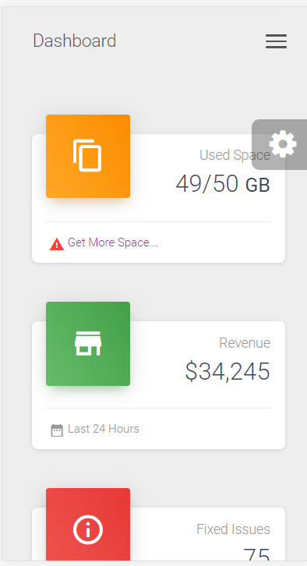
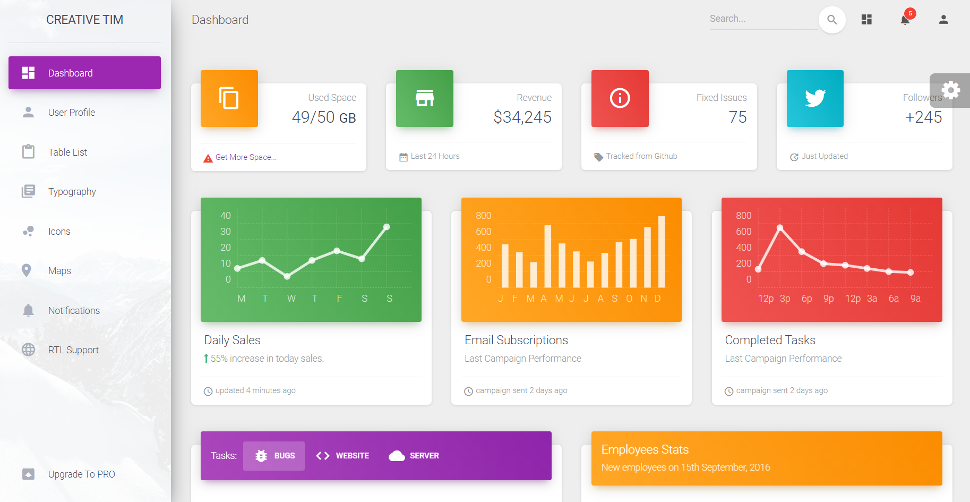
Admin Dashboard
https://www.creative-tim.com/

