Slide 1

CYBER BULLING
DETECTION

Slide 2
CONTENTS
1.
ABSTRACT
2.
INTRODUCTION
3.
METHODS
4.
FLOW OF THE PROJECT
5.
REQUIREMENTS
6.
APPLICATIONS
7.
CONCLUSON
8.
REFERENCES

Slide 3
ABSTRACT
The rise of social media has led to both positive and negative impacts, with a significant focus on combating cyberbullying, a serious issue, particularly affecting women's mental health. This project aims to utilize natural language processing and machine learning to detect online abusive messages.

Slide 4

INTRODUCTION
BULLYING DETECTION
Cyber bullying is the use of technology as a medium to bully someone. Although it has been an issue for many years, the recognition of its impact on young people has recently increased. Social networking sites provide a fertile medium for bullies, teens and young adults who use these sites are vulnerable to attacks. Through machine learning, we can detect language patterns used by bullies and their victims, and develop rules to automatically detect cyber bullying content.

Slide 5
Proposed Model
Multilevel classification is a technique used in cyberbullying detection to categorize different types or levels of cyberbullying behaviors or content. It allows for a more nuanced understanding of cyberbullying incidents, which can be essential for developing effective countermeasures.
Implement a multilevel classification system, which typically involves a hierarchy of classifiers. Each classifier is responsible for identifying a specific type or level of cyberbullying. For example, the first classifier may determine the broad category of cyberbullying (e.g., "harassment" or "hate speech"), while subsequent classifiers can further narrow down the specific level of severity (e.g., "mild" or "severe").

Slide 6
METHODS
Multilayer Perceptron
Multilayer Perceptron, an artificial neural network, processes text data through interconnected layers to classify and identify offensive content in cyberbullying detection.
Random Forest Classifier
Support Vector Machine
Random Forest is an ensemble machine learning model that combines multiple decision trees to improve classification and regression accuracy.
Support Vector Machines (SVM) are employed in cyberbully detection by mapping text data to high-dimensional spaces, separating offensive content from non-offensive, aiding in the identification and prevention of online harassment.
Decision Tree Classifier
Naïve Bayes Classifier
Decision tree classifiers are vital in cyberbully detection, creating a tree-like structure to analyze text data, determining the presence of offensive content in digital communications, enhancing the fight against cyberbullying.
Naive Bayes classifiers are employed in cyberbullying detection to probabilistically classify text data as offensive or non-offensive. They utilize conditional probability and feature independence to identify harmful online content accurately.

Slide 7
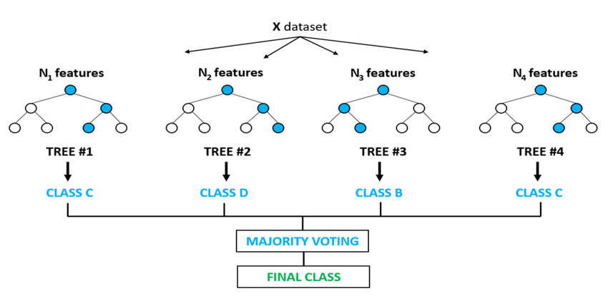
Random Forest Classifier
the Random Forest classifier operates by constructing a forest of decision trees, each utilizing various features from comments or user profiles. By analyzing these features, the classifier distinguishes between bullying and non-bullying instances. The combined decision of numerous trees helps improve accuracy, while the ensemble approach increases the model's robustness. This makes Random Forest an effective tool for identifying diverse cyberbullying behaviors and enhancing the overall precision and reliability of the detection system.

Slide 8
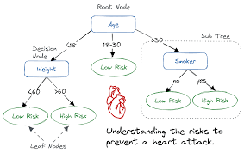
Decision Tree
A decision tree for cyberbullying detection is constructed by analyzing text data's features. It recursively divides the data into branches based on the most discriminating features. Leaf nodes provide classification results. When a new comment is evaluated, the tree's structure is traversed, leading to a classification as "bullying" or "non-bullying." Decision trees are interpretable but may struggle with complex patterns. In practice, they can be part of an ensemble method for improved accuracy.

Slide 9
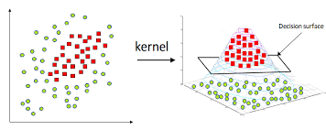
Support vector machine
Support Vector Machines (SVMs) are valuable tools in cyberbullying detection. They classify text data as cyberbullying or non-cyberbullying by finding the best hyperplane that maximizes the margin between these classes. This algorithm transforms text features into numerical vectors and can handle high-dimensional spaces.
SVMs excel in cases where a clear separation between cyberbullying and non-cyberbullying instances exists. However, selecting the right kernel function and tuning hyperparameters are critical for their performance. Careful handling of imbalanced datasets and an effective choice of features are essential to optimize SVM-based cyberbullying detection systems.

Slide 10
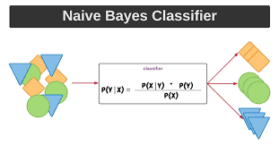
Naïve based classification
This approach relies on probabilistic calculations to determine the likelihood of a given text belonging to specific classes, such as "cyberbullying" or "non-cyberbullying." Naive Bayes assumes that features are conditionally independent, simplifying the computation of probabilities. Despite this simplification, Naive Bayes models are effective, simple to implement, and computationally efficient. They excel at handling large datasets with high dimensionality. Proper feature extraction, preprocessing, and dataset curation are key to maximizing the performance of Naive Bayes classifiers in cyberbullying detection.

Slide 11
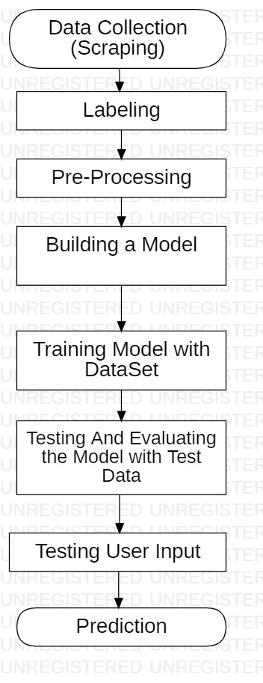
Flow of the project

Slide 12
Web Scraping
import googleapiclient.discovery
import googleapiclient.errors
api_service_name = "youtube"
api_version = "v3"
DEVELOPER_KEY = ""
youtube = googleapiclient.discovery.build(
api_service_name, api_version, developerKey=DEVELOPER_KEY)
request = youtube.commentThreads().list(
part="snippet",
videoId="WNrB1Q9Rry0",
maxResults=100
)
response = request.execute()
for item in response['items']:
print(item['snippet']['topLevelComment']['snippet']['textDisplay'])
Web scraping YouTube comments is an automated technique for gathering text data from the comment sections of YouTube videos. It's valuable for research, sentiment analysis, and content insights. Adherence to YouTube's terms of service and ethical guidelines is crucial to ensure responsible and legal data extraction.

Slide 13
Pre Processing
Formulas :
The comments which were collected from youtube had preprocessed using excel formula and extracted the exact telugu comments from the actual comment.
==GOOGLETRANSLATE(D4,"en","te")
=MID(F1,FIND("""",F1)+1,FIND("""",F1,FIND("""",F1)+1)-FIND("""",F1)-1)
Before : 2023-10-17T16:00:13.751Z "Waiting ikkada" "3" "@archanaacchu9215" "true" "true" "false" "false" "" "false" ""
After : వెయిటింగ్ ఇక్కాడా

Slide 14
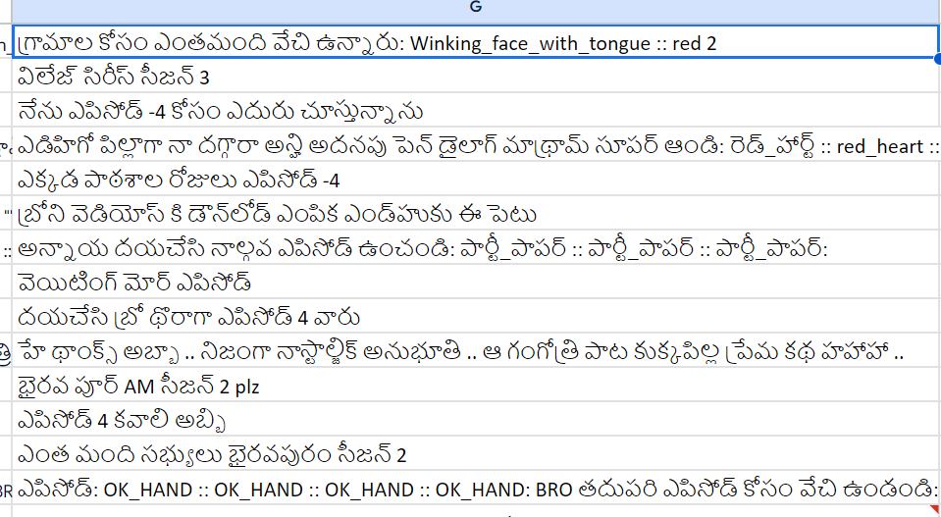

Slide 15
REQUIREMENTS
Functional Requirements
Non - functional Requirements
A Machine learning model that detects bullying text efficiently.
A model to pre-process the dataset.
Response time.
Maintainability
Hardware Requirements
Software requirements
python
numpy
sk-learn
pandas
re
Processor: 64-bit, quad-core, 2.5 GHz minimum
per core
RAM: 4 GB or more.
HDD: 20 GB of available space or more.
Keyboard: A standard keyboard.

Slide 16

APPLICATIONS
This can be used in the Social media Platforms for filtering bullying comments.
This system can be used social applications to identify users who
are bullying others and block them or take actions on them.
We can use this system on kids platforms to keep them safe from cyberbullying.
Helping parents ensure their children's online safety by monitoring and reporting cyberbullying incidents on their devices.

Slide 17
Pros & cons
ADVANTAGES
DISADVANTAGES
By using this model we can predict whether the given text is bullying text or not. But predictions may not be accurate.
The text may be viewed from different perspectives, so it is difficult to predict accurately.
For example Two friends use those bullying words in a sarcastic way, but our model predicts those texts as bullying texts. This is a major limitation.
Can identify the bullying words.
Helps to maintain social media bullying free.
Useful to avoid negativity among people.
Raise awareness and educate users about cyberbullying prevention, fostering a culture of respect.

Slide 18
CONCLUSION
In particular, cyberbullying has become more common and has begun to raise significantly. Also, usage of social media is rapidly increasing. So, there is a need for automatic cyberbullying detection features on social media platforms. This model predicts whether the given input is a cyberbullying text or not. But it can be improved with advanced algorithms and methods to overcome the limitations and can be used on different platforms as a filter or a mechanism to detect and take measures to reduce cyberbullying on the internet.

Slide 19
REFERENCES
Md Manowarul Islam; Md Ashraf Uddin; Linta Islam; Arnisha Akter; Selina Sharmin; Uzzal Kumar Acharjee , “Cyberbullying Detection on Social Networks Using Machine Learning Approaches”; 2020 IEEE Asia-Pacific Conference on Computer Science and Data Engineering (CSDE), 16-18 December 2020.
Rohith Gandhi, “Naive Bayes Classifier”; Towards Data Science, May 5, 2018.
Joe Tran, “Random Forest Classifier in Python”; Towards Data Science, May 2, 2020.
Nikolai Liubimov, “Introducing Label Studio, a swiss army knife of data labeling”; Towards Data Science, Jan 28, 2020.
Priyanka Dave, “How To Scrap YouTube Comments?”; Analytics Vidhya, Mar 27, 2021.

Slide 20
THANK YOU

