Slide 1
Briefing on Deep Learning for Natural Language Processing
Jack Xue, Ph.D. & MBA
Principal Data and Applied Scientist
January 22, 2020

Slide 2
Agenda
Data processing
Bag of Words (BoW)
Word Embedding & Convolutional Neural Network
Text Classification
Machine Translation & Recurrent Neural Network
Bidirectional Encoder Representations from Transformers (BERT)
https://machinelearningmastery.com/about/
https://arxiv.org/abs/1810.04805

Slide 3
Data Processing
NLTK
Scikit-Learn
How to convert text to word count vectors with CountVectorizer.
 How to convert text to word frequency vectors with TfidfVectorizer.
 How to convert text to unique integers with HashingVectorizer.

Slide 4
Bag of Words
1. The Problem with Text
2. What is a Bag-of-Words?
3. Example of the Bag-of-Words Model
4. Managing Vocabulary
5. Scoring Words

Slide 5
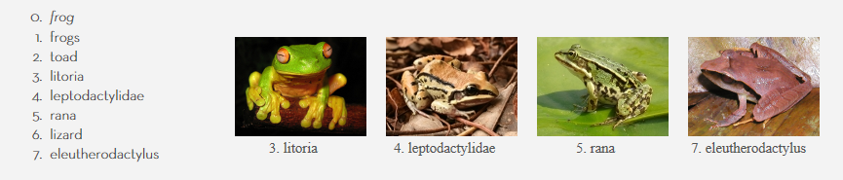
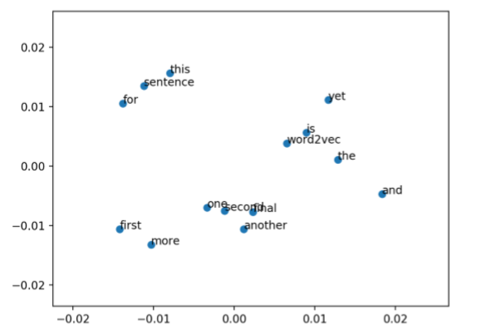
Word Embedding

Slide 6
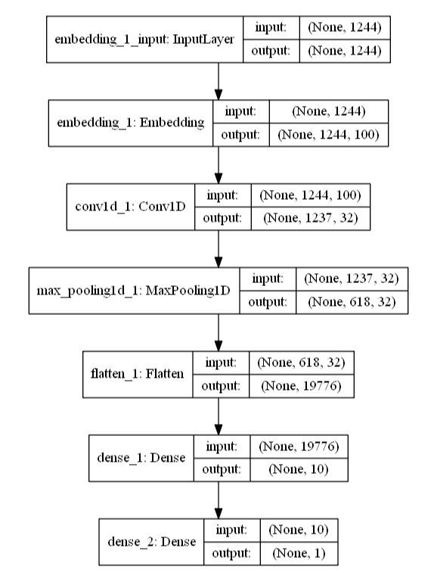
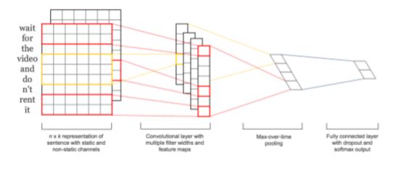
CNN for Text Classification

Slide 7
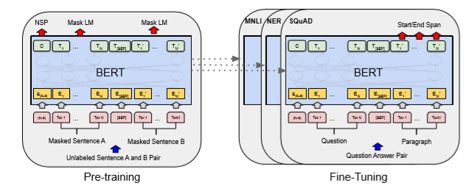
BERT – Google AI Language 2018

Slide 8
Sample Code
https://github.com/JackXueIndiana/DNN-NLP-Text-Classification

