Slide 1
Ajax, GreaseMonkey, and DWR
Mike Ball & Jim Kriz

Slide 2
Agenda
Ajax – Asynchronous JavaScript and XML
GreaseMonkey
Frameworks – Jim Kriz
  Demos with DWR a Java framework

Slide 3
Ajax history
Asynchronous JavaScript and XML
Adaptive Path author Jesse James Garrett writes article entitled: “Ajax a new approach to web applications”
  Gave a name to what we saw with
    Google Suggest
    Google Maps
  Defined a set of technologies
JJG article published February 18th, Ajax added to wikipedia March 15th.

Slide 4
Ajax definition
Asynchronous JavaScript and XML
Sometimes called Web 2.0
“Standards-based presentation with XHTML and CSS
Dynamic display and interaction using the Document Object Model
Data interchange and manipulation using XML and XSLT
Asynchronous data retrieval using XMLHttpRequest
JavaScript binding everything together” ^{[1]}

Slide 5
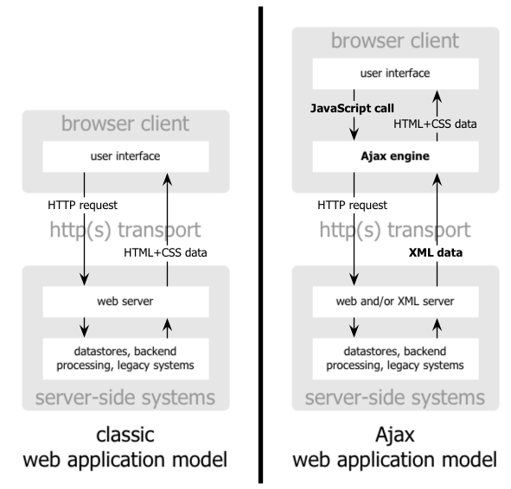
Ajax webflow
[1]

Slide 6
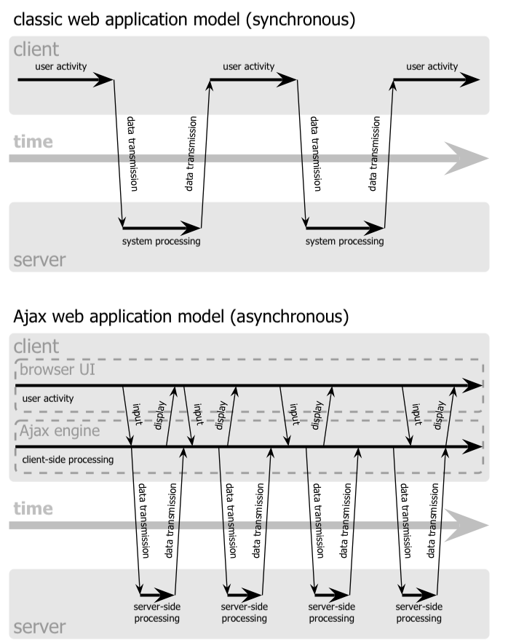
Ajax – How it’s different
“Eliminates start-stop-start nature of interaction by introducing and intermediary
  Ajax engine
Ajax engine is responsible for both rendering the interface and communicating with the server
Interaction with the server happens asynchronously
Every user interaction that would normally generate and HTTP request takes the form of a JavaScript call.”
[1]
[1]

Slide 7
Ajax – who’s using it
Google
  Groups, Suggest, Maps, Gmail
ESPN
Flickr switching from Flash to Ajax
Amazon search engine
Sark clients…
Maybe you know someone…
Look for internal apps to move first because of browser compatibility, security, ramp up

Slide 8
Ajax Examples (Demo)
Google Suggest
Google Maps
Raible’s video
Ball’s try at it
a9.com (example)
Backpack
Start

Slide 9
Ajax Technologies
XHTML – eXtensible HTML
  Well-formed XML that can be treated as a DOM
DHTML – Dynamic HTML – Not a w3c spec
  CSS – Cascading Style Sheets
  HTML 4.0 – Allows for CSS
  JavaScript
DOM – DOM for HTML
XMLHttpRequest – more…
DOMParser – Parse XML create a DOM in browser
XSLT Engine – Process stylesheet against XML in browser

Slide 10
XMLHttpRequest
“var req = new XMLHttpRequest();
var req = new ActiveXObject("Microsoft.XMLHTTP");
Methods…
  abort()
    Stops the current request
  getAllResponseHeaders()
    Returns complete set of headers (labels and values) as a string
  getResponseHeader("headerLabel")
    Returns the string value of a single header label
  open("method", "URL"[, asyncFlag[, "userName"[, "password"]]])
    Assigns destination URL, method, and other optional attributes of a pending request
  send(content)
    Transmits the request, optionally with postable string or DOM object data
  setRequestHeader("label", "value")
    Assigns a label/value pair to the header to be sent with a request” [2]

Slide 11
XMLHttpRequest
var req;
function loadXMLDoc(url) {
// branch for native XMLHttpRequest object
if (window.XMLHttpRequest) {
req = new XMLHttpRequest();
req.onreadystatechange = processReqChange;
req.open("GET", url, true);
req.send(null);
// branch for IE/Windows ActiveX version
} else if (window.ActiveXObject) {
req = new ActiveXObject("Microsoft.XMLHTTP");
if (req) {
req.onreadystatechange = processReqChange;
req.open("GET", url, true);
req.send();
}
}
}

Slide 12
Demo

Slide 13
Ajax Strategies
Ajax in many forms…
Lesser Ajax
  Straight XML/XMLHttpRequest
    Send request via XMLHttpRequest parse response (HTML or XML) back.
  Object Proxy/XMLHttpRequest (DWR)
    Use a toolkit that wraps RPC so that you send objects over and get objects back. XML implementation is hidden.
Great Ajax
  HTML presentation/XMLHttpRequest (Tapestry, Rails, SWF)
    Send request via XMLHttpRequest simply replace content with new HTML
    Sometimes called In-place Page updating

Slide 14
Ajax Strategies
HTML – Rico, Scriptaculous, TACOS, Rails
XML, Data – Dojo, Rico
XMLHttpRequest
Javascript – DWR, JSON-RPC

Slide 15
Rico, Dojo Demo
Rico and Dojo Demo

Slide 16
RESTful Web Services
architecture style of networked systems
Representational State Transfer
Representation of the resource is returned from the request
Puts the client application in a state
State continually transfers
  It’s the web!

Slide 17
REST a definition
"Representational State Transfer is intended to evoke an image of how a well-designed Web application behaves:
  a network of web pages (a virtual state-machine),
  where the user progresses through an application by selecting links (state transitions),
  resulting in the next page (representing the next state of the application) being transferred to the user and rendered for their use."

Slide 18
REST technologies
HTTP
URL
XML/HTML/GIF/JPEG/etc (Resource Representations)
text/xml, text/html, image/gif, image/jpeg, etc (MIME Types)

Slide 19
RESTful Web Services
Another way of saying “simple” Web Services (SOAP is not simple. It is?!?)
Commonly used, often without knowing it…
Remember this: “Web Services don’t have to be SOAP/WSDL” to be Web Services
  so if somebody get’s up in your grill about XML/HTTP not really being a Web Service, come back with the RESTful Web Services.
  Amazon provides their WS as both SOAP and REST. And Amazon is awesome, right?

Slide 20
RESTful Web Services example
Give me some parts:
  http://www.parts-depot.com/parts
Here are your parts:
<?xml version="1.0"?>
<p:Parts xmlns:p=http://www.parts-depot.com xmlns:xlink="http://www.w3.org/1999/xlink">
<Part id="00345" xlink:href="http://www.parts-depot.com/parts/00345"/>
<Part id="00346" xlink:href="http://www.parts-depot.com/parts/00346"/>
<Part id="00347" xlink:href="http://www.parts-depot.com/parts/00347"/>
<Part id="00348" xlink:href="http://www.parts-depot.com/parts/00348"/>
</p:Parts>

Slide 21
RESTful Web Services example
Give me a part:
  http://www.parts-depot.com/parts/00345
Here is your part:
<?xml version="1.0"?>
<p:Part xmlns:p=http://www.parts-depot.com xmlns:xlink="http://www.w3.org/1999/xlink">
<Part-ID>00345</Part-ID>
<Name>Widget-A</Name>
<Description>This part is used within the frap assembly</Description>
<Specification xlink:href="http://www.parts-depot.com/parts/00345/specification"/>
<UnitCost currency="USD">0.10</UnitCost>
<Quantity>10</Quantity>
</p:Part>

Slide 22
RESTful Web Services
GETs – Get a representation of data
POSTs – Submit data that will change state, return representation

Slide 23
REST Web Services Characteristics
Client-Server: a pull-based interaction style: consuming components pull representations.
Stateless: each request from client to server must contain all the information necessary to understand the request, and cannot take advantage of any stored context on the server.
Cache: to improve network efficiency responses must be capable of being labeled as cacheable or non-cacheable.
Uniform interface: all resources are accessed with a generic interface (e.g., HTTP GET, POST, PUT, DELETE).
Named resources : the system is comprised of resources which are named using a URL.
Interconnected resource representations: the representations of the resources are interconnected using URLs, thereby enabling a client to progress from one state to another.
Layered components: intermediaries, such as proxy servers, cache servers, gateways, etc, can be inserted between clients and resources to support performance, security, etc.

Slide 24
REST Web Services Design
The key to creating Web Services in a REST network (i.e., the Web) is to identify all of the conceptual entities that you wish to expose as services. Above we saw some examples of resources: parts list, detailed part data, purchase order.
Create a URL to each resource. The resources should be nouns, not verbs.
    For example, do NOT use this:
  http://www.parts-depot.com/parts/getPart?id=00345 Note the verb, getPart.
    Instead, use a noun:
  http://www.parts-depot.com/parts/00345
Categorize your resources according to whether clients can just receive a representation of the resource, or whether clients can modify (add to) the resource. For the former, make those resources accessible using an HTTP GET. For the later, make those resources accessible using HTTP POST, PUT, and/or DELETE.
All resources accessible via HTTP GET should be side-effect free. That is, the resource should just return a representation of the resource. Invoking the resource should not result in modifying the resource.
No man/woman is an island. Likewise, no representation should be an island. In other words, put hyperlinks within resource representations to enable clients to drill down for more information, and/or to obtain related information.
Design to reveal data gradually. Don't reveal everything in a single response document. Provide hyperlinks to obtain more details.
Specify the format of response data using a schema (DTD, W3C Schema, RelaxNG, or Schematron). For those services that require a POST or PUT to it, also provide a schema to specify the format of the response.
Describe how your services are to be invoked using either a WSDL document, or simply an HTML document.

Slide 25
REST and Ajax
REST represents the best way to get data back to an Ajax application
SOAP and WSDL are much too complicated.
Browsers can do this, XMLHttpRequest, DOMParser, XSL Engines
Reusable api’s are on the way…

Slide 26

GreaseMonkey
FireFox – “Rediscover the web”
Allows for Extensions
  Tabbed browsing, Web Development
GreaseMonkey is born…
  adrian holovaty writes an extension to fix a site he loves and hates (after a redesign) called allmusic.com
  Aaron Boodman and Jeremy Dunck want to make it easy to write extensions for Firefox and they see Holovaty’s solution
    Develop GreaseMonkey
    Someone writes a script for it that will remove Michael Jackson news stories ( /. Picks it up…)
    The world goes crazy for GreaseMonkey

Slide 27
GreaseMonkey – how it works
Configure your javascript file to run on a web page
Load your javascript (user.js) file into FireFox w/ GreaseMonkey
Browse to the desired page
Runs your javascript file

Slide 28
GreaseMonkey – Prove it!
How about Hello World first…

Slide 29
GreaseMonkey – That’s it?
No
It also includes a handy-dandy API that makes some Ajax things simple like:
  A wrapper around XMLHttpRequest
  Manage client side state
  Log to a console instead of billion alert calls
  XPath, treewalkers

Slide 30
GreaseMonkey – Do something useful…
Book Burro plug-in
Ball’s go at it…
More…
  Amazon plugin to check your local public library for book availability
  Add links to IMDB for popular torrent sites
  Autologin to sites where you have saved passwords
  And of course remove any unsightly Michael Jackson news stories
Anyone have a favorite?

Slide 31
GreaseMonkey - Ajax
What do these things have in common?
  GreaseMonkey takes Ajax to another level, now I can change other peoples pages.
So what? It’s only in FireFox…
  Sorry IE plugin is available (Trixie), Opera too
  BTW, people are starting to call them User Scripts, that sure sounds friendly
What does this mean to my site?
  Keeping client side state? Hidden fields?
  Used to be able to disable it, but GreaseMonkey .5 is unstoppable!

Slide 32
Ajax Summary
Tools
Pitfalls
Future
Conclusion

Slide 33
Ajax Tools
Java
  DWR
  JSON-RPC
Java MVC
  Tapestry TACOS
  Struts – ajaxtags, Rico and Dojo below…
  JSF – AjaxFaces, Creator
  SWF (Simple Web Framework)
Microsoft
  Atlas
  Ajax.NET
  Elegant ASP.NET
Ruby
  Rails (prototype.js)
RIC – Rich Internet Client
  Rico – Demo (prototype.js)
Perl and PHP
  SAJAX
Browser
  Dojo – Demo (prototype.js)
  JackBe
  Script.aculo.us (prototype.js)

Slide 34
Ajax Pitfalls
Use Get and Post appropriately
Test in multiple browsers.
Debugging still is unpleasant in javascript (Venkman debugger)
Accessibility
Security anyone?
  XMLHttpRequest is in the browser’s sandbox so cookies, etc. are the same.
  But be careful what you expose.
What if they hit the back button?
  Uh-oh, maybe we can change what that does. How is that user friendly? Hmm, hopefully they won’t notice.
What about bookmarking? Oh, my…
And the list goes on...

Slide 35
What’s next for Ajax
Greater or Lesser Ajax?
A popular tool? DWR?
IBM, MS, Sun, and BEA will jump on this.
  MS released Atlas
  Macromedia?

Slide 36
Conclusion
Ajax represents the tipping point of a paradigm shift for next generation web applications using best-of-breed technologies.
No it doesn’t, it’s just gives a name to something that has been possible but unutilized.
Ajax is being adopted by large enterprises to provide a more satisfying user experience.
Ajax solves problems regarding:
  Usability
  Modularity
  Reusability
While creating new ones:
  Security
  Scalability

Slide 37
Resources
[1] Ajax: A New Approach to Web Applications ~ Jesse James Garret, Adaptive Path 2/18/2005
[2] Dynamic HTML and XML: The XMLHttpRequest Object ~ Mac Developer Connection
[3] http://www.xfront.com/REST-Web-Services.html
[4] http://www.xml.com/pub/a/2004/08/11/rest.html

Slide 38
DWR:
Direct Web Remoting
Jim Kriz
SARK Inc.
Notes:
We all work with data
Often it is sensitive to someone
It has to be either stored, or communicated
We need to do this securely through cryptography
Moving from optional to mandatory – even required by law (financial, medical, govt)
But cryptography is a sea of acronyms and math theories – where to start?

Slide 39
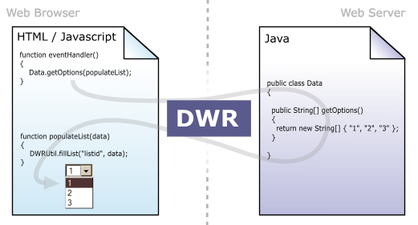
What is Direct Web Remoting?
“DWR is AJAX and XMLHttpRequest made easy”

Slide 40
Foundation of DWR - XMLHttpRequest
APIs available in Javascript and VBScript
Can transfer XML to and from the browser
Allows dynamic updates of pages without refreshing the entire page
  No plugins required
Example: Google Suggest

Slide 41
Foundation of DWR - AJAX
AJAX - Asynchronous JavaScript and XML
HTML for presentation
DOM and JavaScript for dynamic display and interaction
XML and XMLHttpRequest for interchanging data with server

Slide 42
DWR Features
Simplifies AJAX and XMLHttpRequest
  APIs for calling server objects – no need to learn complex XMLHttpRequest JavaScript code
Handles marshalling/unmarshalling of parameters
  Can convert primitive types, and several collections & more complex types
  Developer can create custom converters
Provides a framework to expose Java beans as remote objects
Can access beans in a user’s session, or new beans created in a variety of ways
Simple setup
Works with existing frameworks, does not replace them
  No special interfaces/classes required to be implemented or extended

Slide 43
Possible Uses of DWR
Dynamic form validation
Asynchronous population of lists/text
Anywhere you want to update portions of a web page without affecting other content
  See DWR Examples
Biggest advantage to user: Web page begins to work more like desktop application

Slide 44
Server Side Components
Code and framework to expose Java classes as RPC style calls using AJAX principles
Single Servlet to accept calls from browser
  Security is handled by servlet container
XML configuration file
  Expose individual beans, or entire packages
  Works with Spring
  Conversions for common types, including Java Beans (POJOs) - User-defined conversions allowed
Debug mode for testing RPCs

Slide 45
Server Side Setup – Dwr.jar
Download dwr.jar from http://www.getahead.ltd.uk/dwr/download.html
  Place in WEB-INF/lib
Updated frequently

Slide 46
Server Side Setup – Web.xml
Configure DWR servlet or servlets
<servlet>
<servlet-name>dwr-invoker</servlet-name>
<display-name>DWR Servlet</display-name>
<servlet-class>uk.ltd.getahead.dwr.DWRServlet
</servlet-class>
</servlet>
<servlet-mapping>
<servlet-name>dwr-invoker</servlet-name>
<url-pattern>/dwr/*</url-pattern>
</servlet-mapping>

Slide 47
Server Side Setup – Web.xml
Servlet takes two optional init-param elements
Config – points servlet to an alternate configuration file
<init-param>
<param-name>config</param-name>
<param-value>WEB-INF/dwr-alt.xml</param-value>
<description>What config file do we use?</description>
</init-param>
Debug – turns on/off the DWR test page
<init-param>
<param-name>debug</param-name>
<param-value>true</param-value>
<description>Do we startup in debug/test mode?</description>
</init-param>

Slide 48
Server Side Setup – dwr.xml
Configures Java objects to expose as RPCs
<dwr>
<allow>
<convert converter="bean" match="com.dynastore.bean.*"/>
<create creator="spring" javascript="Customer">
<param name="beanName" value="customer"/>
</create>
<create creator="new" javascript=“Demo“>
<param name=“class“ value=“com.example.Demo“/>
</create>
</allow>
</dwr>

Slide 49
Client Side Components
Javascript library for making remote calls
  Automatically generated for exposed classes
Hides XML manipulation from developer
  Automatically marshalls/unmarshalls data
Hides browser-specific AJAX code from developer
  Concentrate on functionality, not browser compatibility
Asynchronous calls to server components
  Callback mechanism to allow updates to be made once reply is received

Slide 50
Client Component Details – Engine.js
JavaScript Engine
Required for any pages using DWR
Included in jsp/html page:
<script type='text/javascript' src='/[YOUR-WEB-APP]/dwr/engine.js'></script>
Exposes DWREngine object
Handles all cross-browser issues

Slide 51
Client Component Details – Interface
Dynamically-generated JavaScript for each exposed bean
Required to use a particular exposed bean
Included in jsp/html page:
<script type='text/javascript'
src='/[YOUR-WEBPP]/dwr/interface/ExposedJavaObject.js'>
</script>
Exposes an object with the name of your Java object
Methods match the server-side object

Slide 52
Client Component Details – Util.js
General JavaScript Utilities
Optional in DWR pages
Included in jsp/html page:
<script type='text/javascript‘
src='/[YOUR-WEB-APP]/dwr/util.js'>
</script>
Exposes DWRUtil object

Slide 53
DWRUtil - Overview
Dynamic table methods – drawTable(), addRows(), alternateRowColors()
List/option manipulation – addOptions()
DOM element manipulation – getText(), getValue(), getValues(), setValue(), setValues()
CSS utilities
A default GMail-style “Page Loading” message

Slide 54
More Technical Features
Call batching
  Can send many calls in a single round-trip request
  Supports call ordering
Custom error handling
Remoting hooks
  Get notified right before or right after a call – change state of forms, etc
Remoting method choice
  XMLHttpRequest or IFrame
Can select GET or POST for requests

Slide 55
DWREngine - Batching
Call batching - beginBatch and endBatch
DWREngine.beginBatch();
ExposedJavaObject.aMethod();
ExposedJavaObject.anotherMethod();
DWREngine.endBatch();
Executes aMethod and anotherMethod in a single round-trip call to the server
As with other calls, these are asynchronous

Slide 56
DWREngine - Call Ordering
By default, all calls are asynchronous, so may not return in the order they were sent
Can be altered to be synchronous
DWREngine.setOrdered(true);
ExposedJavaObject.aMethod();
ExposedJavaObject.anotherMethod();
This will wait for completion of aMethod before making the call to anotherMethod
Can affect application performance and end-user experience

Slide 57
DWREngine – Error Handling
By default, errors and warnings are hidden from the user
Engine includes simple message handler – uses javascript alert() function
DWREngine.setErrorHandler(DWREngine.defaultMessageHandler);
DWREngine.setWarningHandler(DWREngine.defaultMessageHandler);
Can define custom message handlers
  Write to javascript console, perhaps

Slide 58
DWREngine – Remoting Hooks
Hooks allow for “alerts” before and after remote calls
Useful for changing state of form buttons, etc.
DWREngine.setPreHook( function() { myForm.submitButton.disabled=true;
});
DWREngine.setPostHook(function() { myForm.submitButton.disabled=false;
});
ExposedJavaObject.aMethod();

Slide 59
DWREngine – Remoting Options
Write code to gracefully “fall back” if XMLHttpRequest is not available/enabled:
  “newmethod” should be DWREngine.XMLHttpRequest (default) or DWREngine.IFrame
DWREngine.setVerb(newverb);
Select GET or POST for sending requests
  “newverb” should be “GET” or “POST” (default)
DWREngine.setMethod(newmethod);

Slide 60
Related Projects
JSON-RPC-Java- http://oss.metaparadigm.com/jsonrpc
TACOS (Tapestry) - http://sourceforge.net/projects/tacos
CFAjax (ColdFusion) - http://www.indiankey.com/cfajax
AJAX .NET - http://ajax.schwarz-interactive.de/csharpsample/default.aspx

Slide 61
JSON-RPC Overview
JSON – JavaScript Object Notation
  Data interchange format with bindings for C#, Java, Javascript, Perl, etc
JSON-RPC – RPC protocol
  Similar to XML-RPC, but uses lightweight JSON format rather than XML
XMLHttpRequest
  Also used by DWR

Slide 62
JSON-RPC Advantages
JSON is far more lightweight than XML
  Requests/responses travel faster over the wire
Leverages J2EE security model
More advanced marshalling/unmarshalling of complex data types & collections
Concentrates on providing a standard wire protocol with bindings for many languages, not just Java/JavaScript
  Changing server-side language does not necessitate changing client

Slide 63
JSON-RPC Drawbacks
JSON-RPC is more complex than DWR
  Steeper learning curve for developers
  More client-side coding required of developer
DWR project is more active
  Features and fixes are being released more frequently
  JSON is concentrating more on developing JavaScript APIs (catching up with DWR)
No Spring integration

Slide 64
TACOS Overview
TACOS – Tapestry Components
  Remote presentation components for Tapestry framework
Allows partial page updates, but returns presentation object, rather than data
Provides Tree, Partial page, PartialForm, and DirtyForm components
Can work without JavaScript
Is in early development, but looks promising

Slide 65
Why We SHOULDN’T Use AJAX
An interesting blog entry
Several issues highlighted:
  Asynchronous nature of requests can easily lead to poorly functioning/annoying user interfaces
  Difficult to measure performance
  Difficult to test JavaScript, though tools are becoming available
    Venkman, Selenium and WaTiR

Slide 66
Links
DWR - http://www.getahead.ltd.uk/dwr
Matt Raible’s Opinion - http://raibledesigns.com/page/rd?anchor=using_dwr_with_spring_and
  There’s a great movie showing his usage of AJAX

Slide 67
Questions?

