Slide 1
Indy Java User’s Group
March 7, 2001
6:00p.m

Slide 2
Introductions
Your name
Company you work for
Experience with Java
One of your favorite things

Slide 3
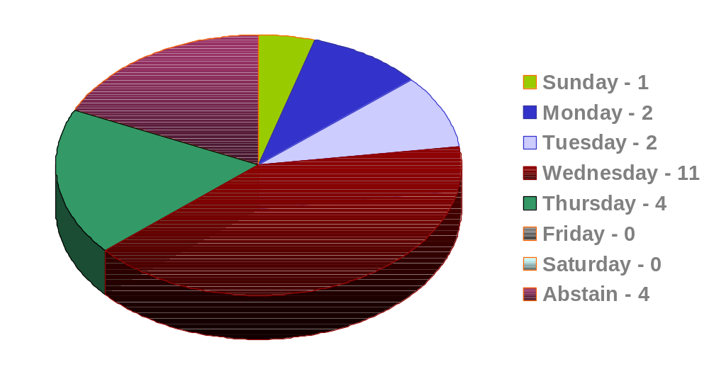
Day of week for meetings

Slide 4
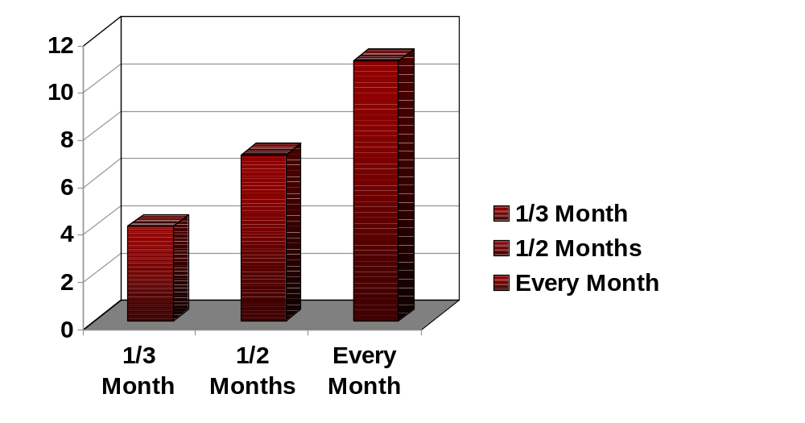
Frequency of meetings

Slide 5
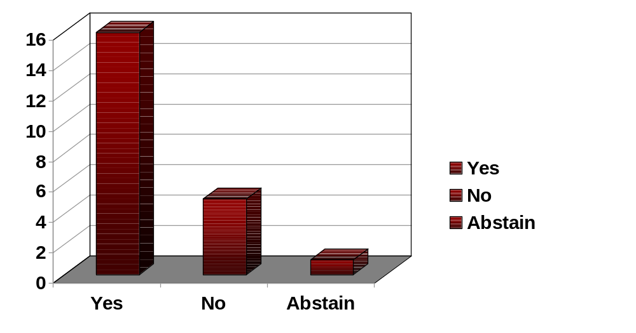
Willingness to present

Slide 6
Mission Statement
Promote the use of the Java language and components across all levels of interest in the greater Indianapolis area, by serving as a resource for knowledge, experience and career opportunities.

Slide 7
Resource for Knowledge
Free resources (books, etc)
Monthly meetings
www.indyjug.net

Slide 8
Resource for Experience
Presentation opportunities
Open Source projects
Volunteer

Slide 9
Resource for Career
Business sponsorships
Java Certification
www.indyjug.net

Slide 10
Things to Remember
www.indyjug.net
Get involved
Ask questions

