Slide 1
Indianapolis Java User Group JSR-168 Portal Presentation
Introduction:
Kurt Desserich
Notes:
Fist Off:
- Thank you for coming to the Indy Java User Group
- I would also like to take this time to introduce a little information about myself:
- I am not an export, but wanted to learn more about Portal Technologies.
- I also wanted to practice my public speaking in a relatively safe environment.

Slide 2
Agenda
Portal & Portlets Defined
  Business Case
  Basic Portal Page and Creation
JSR-168
  Portlet Container
  Portlet Servlet Comparison
  Implementations
Liferay Portal Overview
  LifeRay Intro
  LifeRay Design
Portlets
  Sample Code
  Demo

Slide 3
1. Portal Definition
A portal is a Web-based application that provides personalization, single sign-on, and content aggregation from different sources, and hosts the presentation layer of information systems. Aggregation is the process of integrating content from different sources within a Webpage. A portal may have sophisticated personalization features to provide custom content to users. Portal pages may have different sets of portlets creating different content for users.
  http://www.javaworld.com/javaworld/jw-08-2003/jw-0801-portlet.html
Notes:
Around 1995 the Internet really started to catch on. Real value started to be created when companies put their information online. Soon after this, many companies were started that had the goal of organizing all this information. The term "Portal" was created that described a Web Application that was designed to present a ton of information in a concise and centered way, thereby making the Internet easier to use. Popular examples would be Yahoo.com or Netscape.com, etc.

Slide 4
1.1 Then what is a Portlet?
Portlets are Java-based Web components, managed by a portlet container, that process requests and generate dynamic content. Portals use portlets as pluggable user interface components that provide a presentation layer to information systems.
  http://www.javaworld.com/javaworld/jw-08-2003/jw-0801-portlet.html
Notes:
Portlets are reusable components that provide access to applications, Web-based content, and other resources. Web pages, Web services, applications, and syndicated content feeds can be accessed through portlets.

Slide 5
1.2 Why Create A Portal Solution?
To solve specific business need usually associated with content aggregation.
  I.E. Establish customized portals for different audiences associated to a business or business need (employees, CMR, investors, business partners, and customers )
Resulting in:
  Revenue benefits
  Operational cost reductions
  Increased employee productivity
  Unification of applications

Slide 6
1.3 Portal Page and Creation
Portlet
Modes &
Controls
Client Device
Portlet
Window
Portal Page
Portal Server
Portlet Container
<Portlet A Content>
Portlet A
<Title>
Portlet
Fragment
Portlet B
<Portlet B Content>
<Portlet C Content>
<Title>
<Title>
Portlet C
<Portlet D Content>
<Title>
Portlet D

Slide 7
2. JSR-168 Basic Goals:
Define the runtime environment, or the portlet container, for portlets
Define the API between portlet container and portlets
Provide mechanisms to store transient and persistent data for portlets
Provide a mechanism that allows portlets to include servlets and JSP (JavaServer Pages)
Define a packaging of portlets to allow easy deployment
Run JSR 168 portlets as remote portlets using the Web Services for Remote Portlets (WSRP) protocol
ENABLE INTEROPERABILITY
AMONG PORTLETS AND PORTALS

Slide 8
2.1 Portlet Container
A portlet container provides a runtime environment for portlets implemented according to the JSR 168 Portlet API. The portlet container is not a stand-alone container like the servlet container; instead it is implemented as a thin layer on top of the servlet container and reuses the functionality provided by the servlet container.
Notes:
Portlet Container controls the instantiation, use, and then destroys the portlets

Slide 9
2.2 Portal Engine/Server
Allows portlets to be integrated in the portal
Notes:
Portlet Container: the runtime environment for portlets

Slide 10
2.3 Portlets Within Portlet Container
Web Server
Portal Server
Client
Applications
Portal Engine
Portal API
Portlet/Servlet
Container
Portlet 1
Portlet 2
Information Feeds
Client
Portlet n
Structured & Unstructured Data
Client
Notes:
So how does do these technologies work together? :
The portal Web application processes the client request and then calls the portlet container to retrieve each portlet's content. The portlet container provides the runtime environment for the portlets and calls the portlets via the Portlet API.

Slide 11
2.4 Portlet -- Servlet
Both…
  Are java components and end in “let”
  Have container managed life-cycles
  Generate dynamic content
Only Portlet
  Generate HTML fragments
  Have container managed Window states and modes: Normal/Maximized/Minimized States, View/Edit/Help Modes
  Are not bound to a URL
And Only Servlets
  Have access to the URL of the client requests
Notes:
Why not just use servlets and JSPs?
- Servlet’s do not support a personalized interface and persited personalization information
- Servlet architecture does not define aggregation

Slide 12

2.5 Reference Implementation
Pluto offers developers a working example platform from which they can test their portlets, however, Pluto’s simple portal component is built only on the portlet container and only provides a minimum Portal implementation.
http://portals.apache.org/pluto/
Notes:
Pluto serves as portlet container that implements the Portlet API
Pluto provides for portlets to reside, but nothing else. Portal features that are not included would be layout and security.

Slide 13


2.6 Sophisticated/Commercial Implementations
Enterprise Information Portals (EIPs) concentrate on the portal itself more than just the portlet container, and considers requirements from other groups and areas:
http://www-106.ibm.com/developerworks/websphere/
        http://www.liferay.com/home/index.jsp
http://portals.apache.org/jetspeed-1/
Notes:
The above conform to JSP 168
Other Portlet Solutions Include:
- Mentum Group jPorta
- RedHat CCM (formerly ArsDigita)
- SharePoint
Which one you choose will depend primarily on what you specifically need.
jPorta offers a simple solution that is easy for JSP developers to implement.
Both Jetspeed and Liferay offer fairly robust J2EE solutions that will offer a full portal framework.
Liferay contains a great feature set and good documentation.
Jetspeed also has a fairly good feature set and will support JSR-168.
Finally, the RedHat solution is a good one for any company who wants the look-and-feel of a portal and a content manager to back it up.
- http://javaboutique.internet.com/reviews/Enterprise_Portals/index-5.html

Slide 14
3. Liferay Overview
LifeRay is an open-source enterprise portal J2EE solution which relies on patterns and EJBs built on the Struts platform for an underlying framework. LifeRay has support for:
  All of the major databases
  The main J2EE application servers (JBoss/Jetty, JBoss/TomCat, Oracle AS, Pramati, WebLogic, Orion, etc.)
  Single sign-on capabilities
  Multiple languages
  Searching via Apache Lucene
Notes:
- Skins

Slide 15
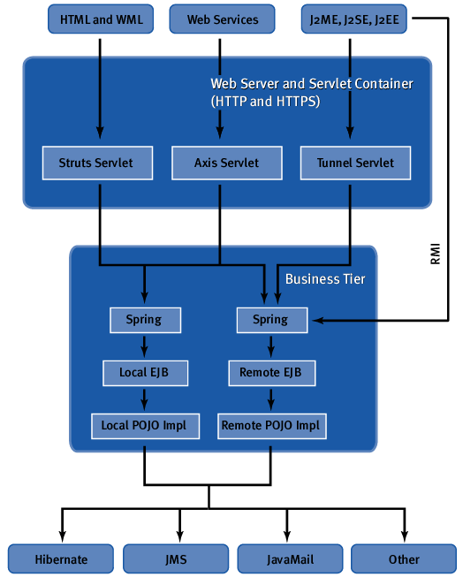
3.1 LifeRay Architecture Overview
Users can access the portal from traditional and wireless devices.
Developers can access the portal from the exposed APIs via SOAP, RMI, and our custom tunneling classes.

Slide 16
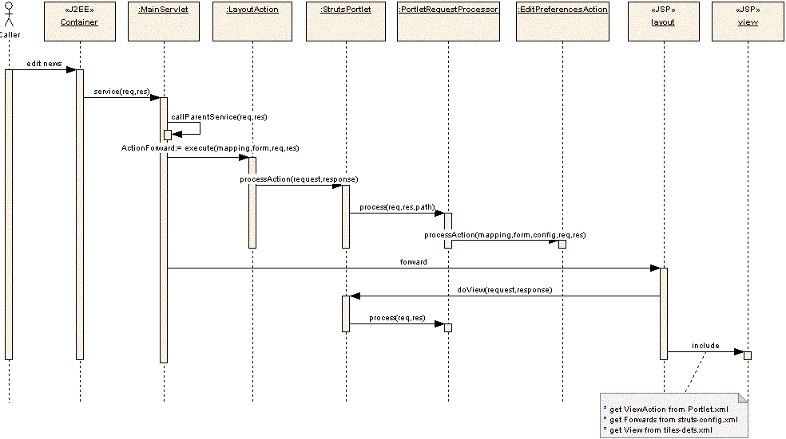
3.2 LifeRay & Struts

Slide 17
4.0 Portlet Interface and LifeCycle
Creation of Portlet
  Loading of the classes
  Invocation of the constructor
  init()
Processing Requests
  render(RenderRequest, RenderResponse)
  processAction(ActionRequest, ActionResponse)
Death of the Portlet
  destroy()
<<interface>>
PortletRequest
<<interface>>
PortletResponse
<<interface>>
ActionRequest
<<interface>>
RenderRequest
<<interface>>
ActionResponse
<<interface>>
RenderResponse
Notes:
The portal container must provide implementations of these capabilities

Slide 18
4.1 Know Your GenericPortlet
Base class for Portlet Specification
Implements Portlet and PortletConfig interfaces of the portlet API
Key Methods:
  doDispatch()
  doView()
  doHelp()
  doEdit()
Notes:
GenericPortlet implements Portlet interface

Slide 19
4.2 Writing Content via RenderResponse
Portlets can produce content using the RenderResponse writer or it may delegate content generation to a servlet or jsp
  setContentType(String type)
  getResponseContentType()
  getResponseContentTypes()

Slide 20
4.3 HelloWorldPortlet
package com.liferay.portlet.helloworld;
import java.io.IOException;
import javax.portlet.*;
public class HelloWorldPortlet extends GenericPortlet {
public void doView(RenderRequest req, RenderResponse res)
throws IOException, PortletException {
res.setContentType(“text/html”);
res.getWriter().print("Hello World, I am a Portlet in a Portal Framework!");
}
public void processAction(ActionRequest req, ActionResponse res)
throws IOException, PortletException {
}
}

Slide 21
4.5 Demo Introduction
LifeRay
  Portal
  Site Explanation
  Development
Notes:
Companies that use liferay:
- Marsh & McLennan: Risk Management and Consulting Services
- Oakwood Worldwide: Largest temporary housing provider worldwide.
- Bangkok Airways
- BT Group
What is your experience with Portals?
- How many use a portal for personal use like my.yahoo.com?
- How many people use a portal for company use?
- How many have worked on portal or portlet development?

Slide 22
Thank you!
More Information:
JavaBoutique Review Of Jetspeed, jPorta, Liferay and RedHat CCM (formerly ArsDigita)
  http://javaboutique.internet.com/reviews/Enterprise_Portals/
JavaWorld Introducing the Portlet Specification
  http://www.javaworld.com/javaworld/jw-08-2003/jw-0801-portlet.html/
Sean Goggins presents Liferay to the St. Louis JUG.
  http://www.ociweb.com/javasig/knowledgebase/2004-09/

