Slide 1
Indianapolis Java User Group
Portal Presentation - Part 2
Introduction:
Kurt Desserich
Notes:
Fist Off:
- Thank you for coming to the Indy Java User Group
- I would also like to take this time to introduce a little information about myself:
- I am not an export, but wanted to learn more about Portal Technologies.
- I also wanted to practice my public speaking in a relatively safe environment.

Slide 2
Agenda
1. Review
  Portal & Portlets Defined
  Basic Portal Page
  JSR-168
  Portlet Container
2. Market Analysis
3. IBM WebSphere Portal
Modes
States
Lifecycle

Slide 3
Part One
Lets review about portals and portlets.

Slide 4
Portal, Portlets, and Portlet Containers Defined
Portal: Web-based application that provides personalization, single sign-on, and content aggregation from different sources, and hosts the presentation layer.
Portlet: Java-based Web components, managed by a portlet container, that process requests and generate dynamic content. Portals use portlets as pluggable user interface components that provide a presentation layer to different resources.
Portlet Container: The runtime environment for portlets. The portlet container is not a stand-alone container like the servlet container; instead it is implemented as a thin layer on top of the servlet container and reuses the functionality provided by the servlet container
http://www.javaworld.com/javaworld/jw-08-2003/jw-0801-portlet.html
Notes:
NEW:
Aggregation is the process of integrating content from different sources within a Webpage. A portal may have sophisticated personalization features to provide custom content to users. Portal pages may have different sets of portlets creating different content for users.
Portlet Container controls the instantiation, use, and then destroys the portlets
OLD:
The term "Portal" was created that described a Web Application that was designed to present a ton of information in a concise and centered way, thereby making the Internet easier to use.
Portlets are reusable components that provide access to applications, Web-based content, and other resources. Web pages, Web services, applications, and syndicated content feeds can be accessed through portlets.

Slide 5
Basic Portal Page
Portlet
Modes & States
Client Device
Portlet
Window
Portal Page
Portal Server
Portlet Container
<Portlet A Content>
Portlet A
<Title>
Portlet
Fragment
Portlet B
<Portlet B Content>
<Portlet C Content>
<Title>
<Title>
Portlet C
<Portlet D Content>
<Title>
Portlet D
Notes:
The portlet container receives the content generated by the portlets.
Typically, the portlet container hands the portlet content to a portal server.
The portal server creates the portal page with the content generated by the portlets and sends it to the client device (i.e. a browser) where it is displayed to the user.

Slide 6
JSR-168 Basic Goals:
Define the runtime environment, or the portlet container, for portlets
Define the API between portlet container and portlets
Provide mechanisms to store transient and persistent data for portlets
Provide a mechanism that allows portlets to include servlets and JSP (JavaServer Pages)
Define a packaging of portlets to allow easy deployment
Run JSR 168 portlets as remote portlets using the Web Services for Remote Portlets (WSRP) protocol
ENABLE INTEROPERABILITY
AMONG PORTLETS AND PORTALS

Slide 7
2.3 Portlets Within Portlet Container
Web Server
Portal Server
Client
Applications
Portal Engine
Portal API
Portlet/Servlet
Container
Portlet 1
Portlet 2
Information Feeds
Client
Portlet n
Structured & Unstructured Data
Client
Notes:
So how does do these technologies work together? :
The Portal Web Application processes the client request and then calls the portlet container via Portlet API to retrieve each portlet's content.

Slide 8





Part Two
What does the portal market look like?

Slide 9
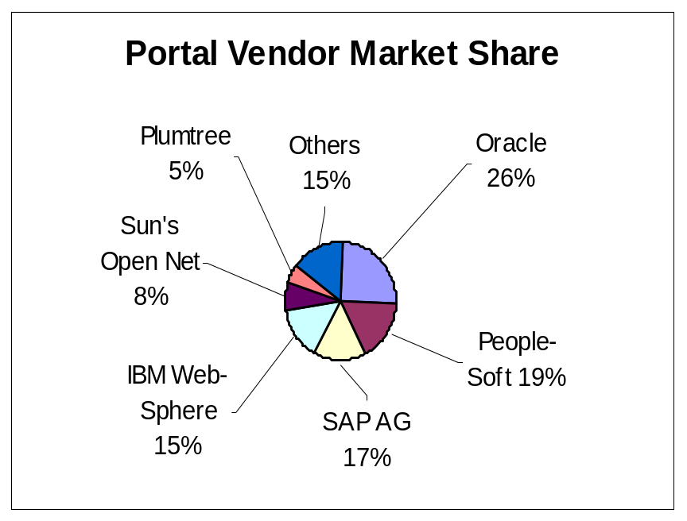
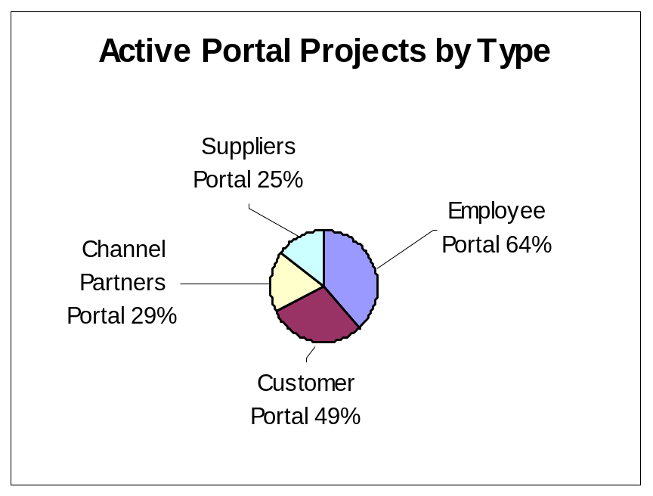
2) Market Analysis by Jupiter Research on 02/14/03
More than 80% of polled companies said they now have or will deploy within a year a portal site for their employees.
Source Network World http://www.nwfusion.com/news/2003/0214studyoracl.html
Notes:
Vendors in the sector remains highly fragmented
Oracle's lead is probably due to bundling. Oracle offers its portal software as a free add-on to its application server.
Jupiter's report cites software from IBM and Plumtree Software Inc. as the strongest products in the category.
That means consolidation: with the usual-suspect major players, such as IBM, Oracle, PeopleSoft, BEA Systems and Microsoft and two dedicated portal vendors, like Plumbtree
Why Create A Portal Solution?
To solve specific business need usually associated with content aggregation.
I.E. Establish customized portals for different audiences associated to a business or business need (employees, CMR, investors, business partners, and customers )
Resulting in:
Revenue benefits
Operational cost reductions
Increased employee productivity
Unification of applications

Slide 10
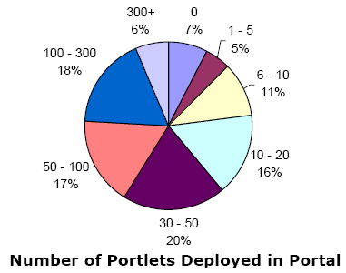
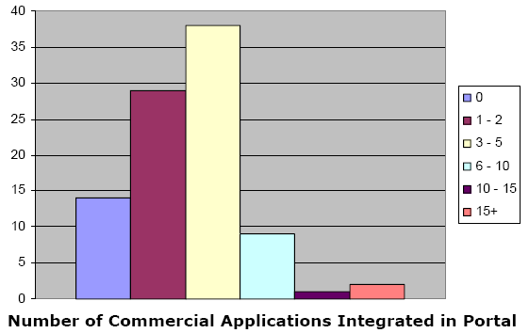
Development Opportunities (and ROI) by Plumbtree Research 2003
http://www.plumtree.com/pdf/corporate_portal_market_2003_abridged.pdf#search='Portal%20Revenues%20Market%20Share
Notes:
the median number of documents available in a Plumtree portal deployment ranges between 1,000 – 10,000,

Slide 11
Part Three
WebSphere Portal Implementation, an extension of JSR 168 by IBM, and a look at the API in action.

Slide 12
IBM WebSphere Portal Offerings
WebSphere Portal for Multiplatforms (Enable/Extend), which is the base edition of WebSphere Portal. The Enable edition runs on Windows 2000/2003, Linux (SuSe, Red Hat, z/Linux), AIX, Solaris, HP-UX, and iSeries.
WebSphere Portal - Express for Multiplatforms, (Express/Express Plus) which enables small and mid-size businesses, as well as departments within larger companies, to more easily deploy sophisticated employee, business partner, and customer portals. Both editions run on Windows 2000/2003, Linux/Intel (SuSe, Red Hat), and iSeries.
Notes:
Enable/Extend has one key differentiating feature: Personalization
The Express Plus edition includes collaboration capabilities that help teams work together more effectively.

Slide 13
IBM WebSpere Development Environments
WebSphere Studio Site Developer (WSSD)
An easy-to-use integrated development environment with high productivity RAD tools for building and maintaining dynamic Web applications, Web services and Java applications.
WebSphere Studio Application Developer (WSAD)
A comprehensive integrated development environment with high productivity tools for building and maintaining Web services, portals and Java™ 2 Enterprise Edition (J2EE) applications.
  WebSphere Studio Application Developer, Version 5.1.2 (WSAD V5.1.2) includes Portal Toolkit 5.0.2.2 and IBM WebSphere Portal 5.0.2.1 (development purpose only).
Rational Application Developer for WebSphere Software (?RADWS?)
The newest version of Application Developer. Quickly design, develop, analyze, test, profile and deploy Web, Web services, Java, J2EE and Portal applications with a comprehensive Eclipse-based IDE
Notes:
Needed to add DB2 UDB

Slide 14
Portal/Portlets – Configuration J2EE Model
Enterprise Archive (EAR) deployment descriptor (application.xml) defines:
  Each Portlet’s WebApp Archived (WAR) file associated to a unique ID and security roles
The Portlet WebApp Archive (WAR) must contain two descriptor documents: the Web application deployment descriptor (web.xml) and the portlet deployment descriptor (portlet.xml)
  The WebApp deployment descriptor (web.xml) defines each portlet as a servlet within the Web application, including unique identifiers for each portlet, the portlet class, and initialization parameters.
  The portlet deployment descriptor (portlet.xml) describes details for each portlet.
Notes:
The definition of the servlets in the Web application deployment descriptor must be in the same order as the definition of portlets in the portlet deployment descriptor.
The DTD for the portlet deployment descriptor is located at wp_root/app/web/dtd/portlet_1.1.dtd.

Slide 15
Portlet (or PortletAdaptor) Lifecycle
init() The portlet is constructed, after portal initialization, and then initialized with the init() method. The portal always instantiates only a single instance of the portlet, and this instance is shared among all users, exactly the same way a servlet is shared among all users of an application server.
initConcrete() After constructing the portlet and before the portlet is accessed for the first time, the concrete portlet is initialized with the PortletSettings.
service() The portal calls the service() method when the portlet is required to render it's content. During the life cycle of the portlet, the service() method is typically called many times. For each portlet on the page, the service() method is not called in a guaranteed order and may even be called in a different order for each request.
destroyConcrete() The concrete portlet is taken out of service with the destroyConcrete() method. This can happen when an administrator deletes a concrete portlet during runtime on the portal server.
destroy() When the portal is terminating, portlets are taken out of service, then destroyed with the destroy() method. Finally the portlet is garbage collected and finalized.
Notes:
This represents the methods called on all portlets. Other methods are called for portlets that implement listeners.
Base class for Portlet Specification
Implements Portlet and PortletConfig interfaces of the portlet API

Slide 16
Portal Modes Portlet.Mode object:
PortletRequest.getMode() and getPreviousMode()
View: doView() When a portlet is initially constructed on the portal page for a user, it is displayed in its view mode. This is the portlet's normal mode of operation.
Help: doHelp() If this mode is supported by a portlet, the portlet provides a help page for users to obtain more information about the portlet.
Edit: doEdit() If this mode is supported by a portlet, the portlet provides a page for users to customize the portlet for their own needs. For example, a portlet can provide a page for users to specify their location for obtaining local weather and events. Users must be logged into the portal to access edit mode.
Configure: doConfigure() If this mode is supported by a portlet, the portlet provides a page for portal administrators to configure a portlet for all users of the portlet.
Notes:
Portlet modes allow a portlet to display a different user interface, depending on the task required of the portlet.
Portlets declare support for these modes in the portlet deployment descriptor. All portlets must support the VIEW mode.
The Portlet API provides the PortletRequest.getMode() and PortletRequest. getPreviousMode() methods for the portlet to determine the current or previous mode.

Slide 17
Portal States PortletWindow.State object: PortletWindow.getWindowState()
Maximized: When a portlet is maximized, it is displayed in the entire body of the portal, replacing the view of other portlets.
Minimized: When a portlet is minimized, only the portlet title bar is displayed on the portal page.
Normal: When a portlet is initially constructed on the portal page, it is displayed in its normal state - arranged on the page along with other portlets. When the portlet is maximized or minimized, a restore icon returns the portlet to normal state.
Notes:
Portlet states allow users to change how the portlet window is displayed within the portal.
Portlets declare support for these states in the portlet deployment descriptor.
The Portlet API provides the PortletWindow.getWindowState() method to determine the portlet's current state.

Slide 18
<<interface>>
PortletRequest
PortletRequest
<<interface>>
ActionRequest
<<interface>>
RenderRequest
Request Attributes:
  PortletRequest attributes are identical to HTTPServletRequest attributes
  Pass objects between portlets, servlets, and JSPs
Request Properties:
  Allows access to container or server properties
  Vender Dependant (Not Portable)
Request Parameters:
  Name (String) value Pair (One or More)
Request Security:
  getAuthType()
  getRemoteUser()
  isUserInRole()
  getUserPrincipal()
Notes:
As of the 1.0 API/SPEC, the PortletRequest methods are the same in subclassed interfaces

Slide 19
<<interface>>
PortletResponse
PortletResponse
<<interface>>
ActionResponse
<<interface>>
RenderResponse
PortletResponse Base Interface: Only 3 Methods:
  setProperty(String name, String value)
  addProperty(String name, String value)
  encodeURL()
RenderResponse Interface: Many Methods:
  createActionURL()
  setContentType()
  setTitle()
  getLocal()
  …
ActionResponse Interface: Many Methods
  setWindowState()
  setPortletMode()
  sendRedirect()
  …
Notes:
PortletResponses are light. Most of the methods are in the subclassed interfaces.
Portlets can produce content using the RenderResponse writer or it may delegate generation of content to a servlet or JSP.

Slide 20
Thank you!
More Information:
JSR 168 Portlet API 1.0
  http://portals.apache.org/pluto/multiproject/portlet-api/apidocs/index.html
IBM developerWorks WebSphere Portal Zone
  http://www-128.ibm.com/developerworks/websphere/zones/portal/
JavaWorld Introducing the Portlet Specification
  http://www.javaworld.com/javaworld/jw-08-2003/jw-0801-portlet.html/

