Slide 1

Rapid Persistence Layer Development with Hibernate http://www.hibernate.org
Tyler Mendenhall
E-gineering, LLC
Notes:
Introductions.

Slide 2
Intro to Hibernate
"Hibernate is an object/relational mapping tool for Java environments. The term object/relational mapping (ORM) refers to the technique of mapping a data representation from an object model to a relational data model with a SQL-based schema." -- Preface Hibernate Documentation
Hibernate supports many different relational databases.
Many other open source tools use Hibernate as their persistence layer.
Hibernate includes tools to make O/R persistence an integrated part of the build process.

Slide 3
Intro to Hibernate
IANAHE - I am NOT an Hibernate Expert.

Slide 4
Intro to Hibernate: Objectives
This presentation will consist of some background information on Hibernate and some complete examples that show the basic functionality of Hibernate.
Obviously there is more than one way to use Hibernate.

Slide 5
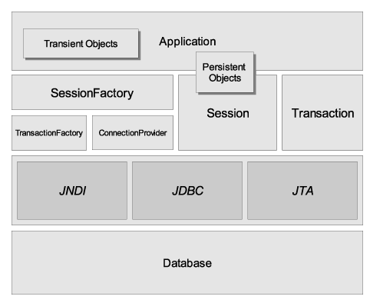
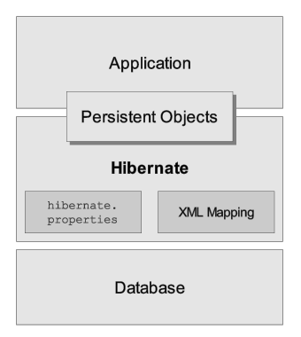
Hibernate Basics

Slide 6
Hibernate Basics
SessionFactory
A threadsafe (immutable) cache of compiled mappings for a single database.
A factory for Session.
Expensive to create.

Slide 7
Hibernate Basics
Session
A single-threaded, short-lived object representing a conversation between the application and the persistent store.
Wraps a JDBC connection.
Factory for Transaction.
Holds a mandatory (first-level) cache of persistent objects, used when navigating the object graph or looking up objects by identifier.

Slide 8
Hibernate Basics
Persistent Objects and Collections
Short-lived, single threaded objects containing persistent state and business function.
These might be ordinary JavaBeans/POJOs, the only special thing about them is that they are currently associated with (exactly one) Session.
As soon as the Session is closed, they will be detached and free to use in any application layer (e.g. directly as data transfer objects to and from presentation).

Slide 9
Hibernate Basics
Transient Objects and Collections
Instances of persistent classes that are not currently associated with a Session.
They may have been instantiated by the application and not (yet) persisted or they may have been instantiated by a closed Session.

Slide 10
Hibernate Basics
Transaction
(Optional) A single-threaded, short-lived object used by the application to specify atomic units of work.
Abstracts application from underlying JDBC, JTA or CORBA transaction.
Multiple transactions per Session.

Slide 11
Hibernate Basics
  ConnectionProvider
  (Optional) A factory for (and pool of) JDBC connections. Abstracts application from underlying Datasource or DriverManager. Not exposed to application, but can be extended/implemented by the developer.
  TransactionFactory
  (Optional) A factory for Transaction instances. Not exposed to the application, but can be extended/implemented by the developer.

Slide 12
Hibernate Tools
The Hibernate Mapping File
Best Practices suggest having one file per entity.
Database Schema Generation
net.sf.hibernate.tool.hbm2ddl.SchemaExportTask
net.sf.hibernate.tool.hbm2ddl.SchemaUpdateTask
Java Code Generation
net.sf.hibernate.tool.hbm2java.Hbm2JavaTask
Notes:
These can be a part of your build process, or a one-off process to jumpstart
the development effort.

Slide 13
Hibernate Tools
The Hibernate Mapping File
Best Practices suggest having one file per entity.
Database Schema Reverse Engineering
(Bottom Up development)
Middlegen
XDoclet can also be used to directly embed the mapping file information in the source code.
Object Driven Design
(Top Down development)
AndroMDA
XMI -> *.hbm.xml
Notes:
These can be a part of your build process, or a one-off process to jumpstart
the development effort.

Slide 14
Hibernate Configuration
hibernate.properties
hibernate.dialect=net.sf.hibernate.dialect.HSQLDialect
hibernate.connection.driver_class=org.hsqldb.jdbcDriver
## in Ant you can get away with a relative path
## however using this through Eclipse requires an explicit path
hibernate.connection.url=
jdbc:hsqldb:c:/workspace/HibernateNotebook/data/music
hibernate.connection.username=sa
hibernate.connection.password=

Slide 15
Hibernate Configuration
Currently supported Dialects
DB2390Dialect DB2400Dialect DB2Dialect FirebirdDialect
FrontBaseDialect GenericDialect HSQLDialect Informix9Dialect InformixDialect IngresDialect InterbaseDialect MckoiDialect MySQLDialect NoArgSQLFunction Oracle9Dialect OracleDialect
PointbaseDialect PostgreSQLDialect ProgressDialect SAPDBDialect SQLServerDialect StandardSQLFunction Sybase11_9_2Dialect SybaseAnywhereDialect SybaseDialect
Or you can choose to extend the Abstract Dialect object to add support to whatever database you are using. A Dialect “Represents a dialect of SQL implemented by a particular RDBMS. Subclasses implement Hibernate compatibility with different systems.” -- Hibernate Documentation

Slide 16
Hibernate Mapping Files *.hbm.xml
Problem Statement:
Create a database system to store electronic music files from various sources. We need to keep track of individual tracks, who performed them, and comments for each track.
This example is taken primarily from the example presented in “Hibernate: A Developer's Notebook” by James Elliot.
Any similarities are intentional; any differences are either mistakes or modifications made for clarification.
Assumption: We are looking only at data objects and their relationships no "business" logic will be considered.

Slide 17
Hibernate Mapping Files
Track
id: int
title: String
filePath: String
playTime: Date
added: Date
volume: short
comments: Set
artists: Set
Artist
id: int
name: String
tracks: Set
This is a Many-To-Many relationship:
An artist can have many tracks and a track can
be created by several artists.
String: comment
This is a one to many relationship: a Track has
multiple comments. (Composite object)

Slide 18
Hibernate Mapping File Demo
Mapping file structure
Schema Generation
Code Generation
Populate the database with records
Query the records
Modify existing records
Delete Records

Slide 19
References
http://www.hibernate.org/
http://boss.bekk.no/boss/middlegen/
http://www.andromda.org/
http://xdoclet.sourceforge.net/xdoclet/tags/hibernate-tags.html
Email- tyler@mendenhallway.com
Please no Spam just questions.

Slide 20
Questions?

Slide 21
Door Prizes
Notes:
Ask questions:
Who are the GoF members?
Erich Gamma
Richard Helm
Ralph Johnson
John Vlissides
What’s Alex’s last name?
How do you say E-gineering?

