Slide 1
Java Frameworks
Indy Java Users Group
January 29, 2003

Slide 2
Introduction
David Stevenson – FUSION Alliance
Senior Software Developer
9+ years of OOA & OOD experience
4+ years Java experience
Sun Certified Java Programmer
Developed systems for DOD and several Fortune 500 companies

Slide 3
Agenda
What are frameworks
Why do we need frameworks
Advantages of frameworks
Identify common frameworks
Architectural frameworks
Example

Slide 4
What are frameworks?
Components/tools used to create applications.
Tried and tested.
Fulfill a specific need.
Easy interface.
Extensible.
May be based on established Design Patterns.
Notes:
Lowest Level frameworks are the Java APIs

Slide 5
Why do we need frameworks?
In today’s economy, clients expect more for less.
With a standard set of building blocks available, we can concentrate on the implementation of the business logic.
It allows for either a shortened development timeframe or the ability to deliver more functionality.
Cost – Schedule – Quality
Notes:
Frameworks can help with the cost / schedule.
Cost can be lowered by using junior developers that are trained in the frameworks.

Slide 6
Some more advantages derived from the use of frameworks
Allows faster prototyping.
Improved application quality:
  Fewer opportunities to introduce defects.
Easier learning curve for new developers:
  Simplified APIs & better documentation
  Experienced peers for available for support
  Examples exists displaying proper usage.
Consistent design across applications.
Easier for the maintenance activity.

Slide 7
Identify some common frameworks
The following are horizontal frameworks.
Logging
Configuration
Exception Hierarchy
Database Management
JNDI Lookup

Slide 8
Logging Framework
Provide a simple to use interface with a flexible output capability (format and location).
This will facilitate its use for application development debugging as well as application health monitoring.
Recommend that this framework be built as a Service Provider Interface. Therefore, this framework will support any logging engine that implements the interface.
Notes:
Service Provider Interface - Applications use the API without modification to access multiple services.

Slide 9
Logging Framework
Possible Logging Engines include:
StdOut
Log4J
JDK 1.4 Logging API

Slide 10
Logging Framework
Recommend a set of logging standards for developers to follow.
Guidelines for Debugging
  Method Entry/Exit
  Key Decision Points
  LogIt.debug(“descriptive message” + value);
Guidelines for Exceptions
  LogIt.error(“message”, thrownException);
Notes:
Use of logging for debugging versus a debugger.

Slide 11
Configuration Framework
Provide a single access point for readily accessing configuration and semi-dynamic information in order to avoid hard coding into application code.
Allows for the hiding of vendor specific information.
Support standard Java properties files
test.data=test
Should consider supporting XML files

Slide 12
Configuration Framework
Can be used to minimize use of J2EE container environment entry lookups.
Recommend supporting the return of more than just java.lang.String types.
Configurator.get(“test.data”); -> “test”
Configurator.getLong(“test.long”); -> 99

Slide 13
Exception Hierarchy
Provide a consistent exception handling representation and processing for application development.
Provide a base class that handles exception messages and can capture the thrown exception for logging purposes.

Slide 14
Exception Hierarchy
Consider extending the base exception class to handle tier and system exceptions.
IntegrationSystemException
BusinessSystemException
BusinessException
PresentationException

Slide 15
Database Management Framework
Easy to use interface to get a connection to a database.
Return a connection based on an alias.
  Connection from a DriverManager
  Connection from a DataSource
DriverManagers and DataSources are created during an initialization process.

Slide 16
Database Management Framework
Framework could implement the Singleton Design Pattern.
Connections are returned using static calls:
  DatabaseHelper.getInstance().getConnection(“alias”);

Slide 17
JNDI Lookup Framework
Abstract all JNDI usage and to hide the complexities of initial context creation and JNDI lookups including EJB Home lookups.
Framework could be based on the Service Locator Design Pattern

Slide 18
Architectural Frameworks
A base structure used for the rapid development of a family of applications.
Based on Proven Design Patterns
Consists Extensible Components
Provided with Implementation Guidelines and Examples

Slide 19
Architectural Frameworks
Examples
MVC
Object – RDMS Mapping
Business Service using EJBs

Slide 20
MVC Framework
The goal of a Model-View-Controller framework is to achieve decoupling among the software components that are responsible for encapsulating business functions, rendering the content and controlling the navigation or flow.

Slide 21
Jakarta Struts MVC Framework
Implements the following Design Patterns.
  Front Controller
  Service to Worker
  View Helpers
  Composite View

Slide 22
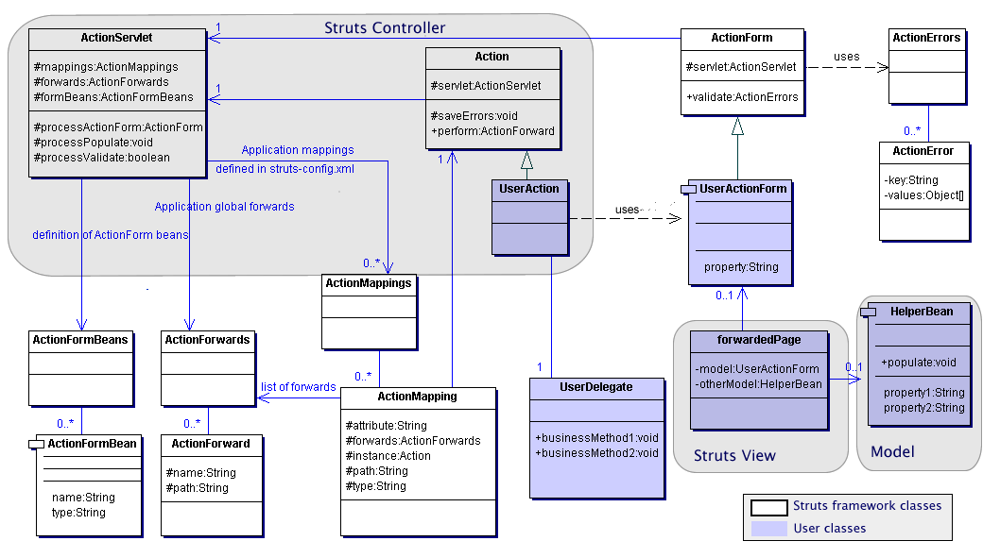
Jakarta Struts MVC Framework
Notes:
The ActionServlet is the core of the controller framework. It is a servlet that receives requests from the browser and forwards it depending on the configuration file: struts-config.xml
Upon initialization of the ActionServlet, the configuration file is parsed in order to dispatch mapping information in instances of ActionMapping, ActionForward, and ActionFormBean.
A browser request is handled as follows:
The URL is processed to determine the mapping to use (processMapping)
The ActionForm associated with the mapping is retrieved/created (processActionForm)
The ActionForm is populated with the request parameters (processPopulate)
The ActionForm is validated and forwards back to the input form if any errors occur (processValidate) Actual validation is controlled by validate flag.
Action class is created and used by the ActionServlet. It is a wrapper around business logic.
To use, subclass and override the perform() method.
The perform method processes the request and returns an ActionForward instance describing where and how control should be forwarded.
It has the ability to save Error Messages into the next request.
The ActionForm represents a general concept of data that is set or updated by a HTML form. Struts automatically sets the state of the ActionForm using the corresponding parameters from the HTTPRequest.

Slide 23
Jakarta Struts MVC Framework
Controller Servlet configuration is handled by entries in struts-config.xml
<?xml version=“1.0” encoding=“ISO-8859-1”>
<struts-config>
<!-- ===== ActionForm Definitions ===== -->
<form-beans type=“org.apache.struts.action.ActionFormBean”>
<form-bean name=“userForm” type=“com.dastevenson.forms.UserActionForm” />
</form-beans>
<!-- ===== Global Forward Definitions ===== -->
<global-forwards type=“org.apache.struts.action.ActionForward”>
<forward name=“home” path=“/index.jsp” />
</global-forwards>
<!-- ===== Action Mapping Definitions ===== -->
<action-mappings type=“org.apache.struts.action.ActionMapping”>
<action path=“/user” type=“com.dastevenson.actions.UserAction” name=“userForm” scope=“request”>
<forward name=“results” path=“/forwardedPage.jsp” />
</action>
</action-mappings>
</struts-config>
Notes:
form-beans : is the set of form-bean descriptors for this application
form-bean : describes a particular form bean that implements the ActionForm class
global-forwards : is the set of global forward elements for the application, a global forward may be overridden by a local forward element
forward : describes a mapping of a logical name used within the application to a mappable resource identified by a context-relative URI path
action-mappings : is a set of action elements for the application
action : describes a mapping from a request path to the corresponding Action class that should be used to process this request

Slide 24
Jakarta Struts MVC Framework
Use of the Struts framework is handled by entries in web.xml
<servlet>
<servlet-name>action</servlet-name>
<servlet-class>org.apache.struts.action.ActionServlet</servlet-class>
<init-param>
<param-name>application</param-name>
<param-value>ApplicationResources</param-value>
</init-param>
<init-param>
<param-name>config</param-name>
<param-value>/WEB-INF/struts-config.xml</param-value>
</init-param>
<load-on-startup>2</load-on-startup>
</servlet>
<servlet-mapping>
<servlet-name>action</servlet-name>
<url-pattern>/ssl/*</url-pattern>
</servlet-mapping>
<taglib>
<taglib-uri>/WEB-INF/struts-bean.tld</taglib-uri>
<taglib-location>/WEB-INF/struts-bean.tld</taglib-location>
</taglib>
<taglib>
<taglib-uri>/WEB-INF/struts-html.tld</taglib-uri>
<taglib-location>/WEB-INF/struts-html.tld</taglib-location>
</taglib>
<taglib>
<taglib-uri>/WEB-INF/struts-template.tld</taglib-uri>
<taglib-location>/WEB-INF/struts-template.tld</taglib-location>
</taglib>

Slide 25
Jakarta Struts MVC Framework
General guidance
Try to design one Action to handle a specific work flow.
Only use session scope if the workflow will span more that one JSP.
Use Business Delegates in Action classes to handle the actual processing and let the Action deal with forwarding decisions based on the Business Delegate results.

Slide 26
Business Service Framework
This framework design is based on the following Design Patterns
Business Delegate – Wraps the workflow management of the Session Facade.
Session Facade – The session bean for work-flow management.
Data Access Objects – one for each table in the database.
Value Objects – one for each table in the database.

Slide 27
Business Service Framework
Stateless Session Beans are used for CRUD operations that are called by the Session Facade.
Read-Only Entity Beans – Used for retrieving values from Look-Up tables.
The interfaces for DAOs, EJBs and the Business Delegate expect a Container of Value Objects.

Slide 28
Business Service Framework
Client Side
VO Container
Business Delegate
Session Facade EJB
Client Object
VO
VO
VO

Slide 29
Business Service Framework
Server Side
Session Facade EJB
Session EJB
Session EJB
Session EJB
DAO
Database
Session EJB
Entity EJB

Slide 30
Example
User Registration Application
MVC front-end
Business Service to MySQL database

Slide 31
Q & A
Questions?

