Slide 1

Introduction to RubyOnRails - a J2EE replacement?
Russell Scheerer – russell.scheerer@gmail.com

Slide 2
Overview
Rails Stack
Conventions
Evolving your Database
Object Relational Mapping
A Look into Rails MVC
Building an AJAX Cart
Things we missed
References

Slide 3
J2EE on Struts versus Ruby on Rails
Apache Tomcat
Servlet Container
Webrick/Mongrel
ActionServlet
Controller
DispatchServlet
Action
ActionForm
JSP
View
RHTML
ActionController
Hibernate
Model
ActiveRecord
Datastore
Datastore
Notes:
At a high level, Rails maps pretty easily to overall MVC concepts of Struts, but as you will see, Rails is quite different. Ruby is simply a language like Java, and Rails is the framework like J2EE. The main difference is through the advantages Rails has because of the dynamic nature of Ruby unlike a strongly typed langugage such as Java or C.

Slide 4
Convention Over Configuration
Notes:
The Rails motto is ‘Convention over Configuration’. By following a set of simple conventions the developer is left thinking about the problem domain rather than the mundane tasks web developers typically have to re-create solutions to in J2EE such as reading/writing from a database, mapping urls and parameters to actions/views, etc... Rails provides a large set of convenience features that appear to be ‘magic’ but are actually possible by having a set of conventions as well as leveraging the dynamic power of the Ruby language.

Slide 5
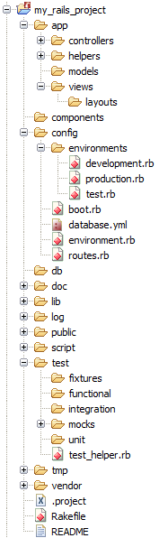
Rails Default project structure
Consistent MVC architecture
Testing framework baked right in!
  Mock Data for Database
  Tests for Controllers
  Tests for Models
Notes:
Here is a look at the default Rails project structure after creating a new project. Creating a new project is simple using Rails: you can simply invoke ‘rails my_rails_project’ from the command line and all of this will be created for you. The idea behind such a large structured project has many benefits. The first is this is the convention, which allows many of the Rails features to just know where to look to appropriately load and find models/controllers/views/etc… Second, this default structure provides a familiar project layout when switching from one project to the next. The developer can quickly find what piece of the code he is looking for since all Rails projects are structured the same way.
Added benefit – Rails provides a robust testing framework right inside each project. This reminds the developer that he ‘should’ be testing his code with well written tests.
The fixtures directory will contain mock data for each model/table that is loaded for each test using the test database.
The functional directory will contain tests for each of the controllers. Test here should test each action in the controller for success and error cases.
The integration directory will contains higher level user scenarios (use cases) which may involve navigating through several pages, logging on, logging off, etc. Integration tests involved the entire Rails stack and are a good way to test your application from a user’s point of view.
The unit directory will contain tests for each model. These are lower level tests ensuring model validation, error reporting, and various other methods are working properly.

Slide 6
Naming Conventions
Model Naming
Table | line_items
File | app/models/line_item.rb
Class | LineItem
Controller Naming
URL | http://.../store/list
File | app/controllers/store_controller.rb
Class | StoreController
Method | list
Layout | app/views/layouts/store.rhtml
View Naming
URL | http://.../store/list
File | app/views/store/list.rhtml (or .rxml, .rjs)
Helper | module StoreHelper
File | app/helpers/store_helper.rb
Notes:
Here is a small set and critical set of naming conventions in Rails.
Model
The Rails convention for Model / Database table mapping is shown above. Ruby contains a nice inflection utility for strings which is used extensively by Rails to map a singular form Class name to a plural form for the table name.
Controller
The basic URL routing Rails provides is shown above with the first argument indicating which controller and the next argument indicating which action/method to invoke
If no method/action is provided, then index is assumed.
The first argument following the controller and action is assumed to be a parameter named id. So, given a URL http://.../products/show/1 we could infer that the show method/action of the products controller will be invoked with a parameter id with a value of 1.
View
Views are automatically looked up by Rails based on name. For normal HTML we’d use a .rhtml extension, for XML; .rxml, for JavaScript actions; .rjs You can see from the table above how easy it is to map a controller and its actions to the corresponding views. Following conventions such as this keeps the developer from having to explicitly render certain views, or constantly map URLs and parameters to Controller actions, etc…
An additional convention for views is to name a view with a preceding underscore. Ex. _cart.rhtml. The underscore tells Rails that this view happens to be a view partial (think JSP fragment). These can be easily rendered from other views with a single object or collection.

Slide 7
Magic DB Column Names
created_at | Automatically updated with a timestamp during row’s creation
created_on | Automatically updated with a date during row’s creation
updated_at | Automatically updated with a timestamp of a row’s last update
updated_on | Automatically updated with a date of a row’s last update
lock_version | Rails will track row version numbers and perform optimistic locking if a table contains lock_version
type | Used by single-table inheritance to track the type of a row
id | Default name of a table’s primary key column
xxx_id | Default name of a foreign key reference to the table named with the plural form of xxx
xxx_count | Maintains a counter cache for the child table xxx
position | The position of this row in a list if acts_as_list is used
parent_id | A reference to the id of this row’s parent if acts_as_tree is used
Notes:
Rails has a variety of ‘magic’ column names it uses for various purposes. The most notable column is id – Rails assumes all tables have a single primary key column named id.
When creating tables through migrations (will see later on) you do not need to specify this column since Rails will create it automatically. You can override this behaviour if you really want to, but Rails frowns upon this and doesn’t make it easy for you on purpose. ☺

Slide 8
Evolve Your Database
Notes:
You can use Rails to manage and evolve your database schema.

Slide 9
Without SQL!?!
Notes:
The best part… WITHOUT SQL!! This can happen because almost all database interaction has been abstracted away from the developer through the magic of ActiveRecord.

Slide 10
It all starts with database.yml
config/database.yml
# MySQL (default setup). Versions 4.1 and 5.0 are recommended.
development:
adapter: mysql
database: rails_app_development
username: some_user
password: some_password
host: localhost
# Warning: The database defined as 'test' will be erased and
# re-generated from your development database when you run 'rake'.
# Do not set this db to the same as development or production.
test:
adapter: mysql
database: rails_app_test
username: some_user
password: some_password
host: localhost
production:
adapter: mysql
database: rails_app_production
username: some_user
password: some_password
host: localhost
Notes:
This all starts with the database.yml file. Here you specify the database adapter you wish to use as well as the connection details of the development, test, and production databases.
Yes DB2 is supported! As well as many other popular databases.
Obviously the Development database is for your development activities. The Test database is used for unit/functional testing. And of course… well you already know what I’m going to say.

Slide 11
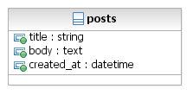
comp:~/rails_app/$ ./script/generate migration create_posts
1.
db/migrate/001_create_posts.rb
class CreatePosts < ActiveRecord::Migration
def self.up
create_table :posts do |t|
t.column :title, :string
t.column :body, :text
t.column :created_at, :datetime #magic name
end
end
def self.down
drop_table :posts
end
end
2.
comp:~/rails_app/$ rake db:migrate
Notes:
Lets create out first table named ‘Posts’ – following the convention: table names are always in plural form… remember?
Notice the syntax… SQL free… database vendor neutral… Rails leaves those details to the database adapter implementation so that YOU the developer do not have to worry about it.
NOTE: Each migration has a static method called up and down. This may seem silly at first but it allows for you to rollback any changes you may have made to the schema in this particular migration file. Which brings us to the next slide…

Slide 12
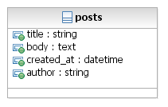
comp:~/rails_app/$ ./script/generate migration add_author_name
1.
db/migrate/002_add_author_name.rb
class AddAuthorName < ActiveRecord::Migration
def self.up
add_column "posts", "author_name", :string
#Update all existing Posts with a default author name
Post.find(:all).each { |post| post.update_attribute :author_name, "Anonymous"}
end
def self.down
remove_column "posts", "author_name"
end
end
2.
comp:~/rails_app/$ rake db:migrate
“Ooops, need to rollback, no problem!” –Happy Rails Developer
3.
comp:~/rails_app/$ rake db:migrate VERSION=1
Notes:
After we started implementing our project we realized we needed to add another column to track the Post author. EASY!
Step1. Just create another migration!
In this example we simply add a column to an existing table, and use a combination of Rails and Ruby power to update any existing Posts with an ‘Anonymous’ author.
Also, notice the down method. This again is for rolling back changes
Step 2. Simply invoke the db:migrate task again and Rails knows to only invoke the pending changes from the current version.
Step 3. See how easy it is to rollback to a previous version? Just specify VERSION=x to the db:migrate command and Rails will invoke the down method to remove the column.
“But wait! How does Rails know what version its at?” Well, when we ran our first migration Rails automatically created a table for us named ‘Schema’ with a single column named ‘version’. Pretty simple huh?
“But how does Rails know which migrations to invoke?” Simple… by following a simple naming convention of your migration files… notice the version number in the filename? You could do this by hand if you wish, but Rails will do this for you when using the migration generation (from Step 1).

Slide 13
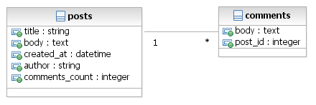
comp:~/rails_app/$ ./script/generate migration add_comments
1.
db/migrate/003_add_comments.rb
class AddComments < ActiveRecord::Migration
def self.up
create_table "comments" do |t|
t.column :body, :text
t.column :post_id, :integer #magic name
end
#Add a counter cache column to Posts
add_column "posts", "comments_count", :integer, :default => 0 #magic name
Post.update_all "comments_count = 0"
end
def self.down
drop_table "comments"
remove_column "posts", "comments_count"
end
end
2.
comp:~/rails_app/$ rake db:migrate
Notes:
Again, after implementing some more of our application or talking to the customer we see we need to add comments to posts. Simple!
Step 1. create another migration. You can add as much as you want into a single migration. In this example we’ll create a new table, add a new column to our existing table ‘posts’ and update all existing posts to have a default value for the new column.
Notice the magic column names
post_id – signifies that this is a foreign key reference to the posts table. This does not however setup the true foreign key index/constraint in the database… but you could easily add that to this migration (and probably should).
comments_count – this is the counter cache column. Rails will automatically update this column when comments are added/removed. This will allow for more efficient counter lookups.
Step 2. invoke the migration as normal.

Slide 14
Object Relational Mapping
Notes:
ActiveRecord – the ObjectRelationMapping framework for Rails provides very powerful functions for working with your relational database schema.

Slide 15
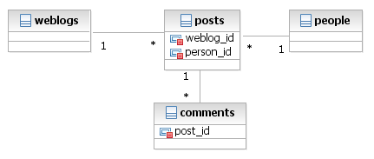
Foreign Key Conventions
WITHOUT XML!!
Try that with Hibernate, Cayenne, Ibatis, or your favorite Java ORM.
Simple foreign key convention gives us.
class Post < ActiveRecord::Base
belongs_to :weblog
has_many :comments
belongs_to :author, :class => "Person"
end
Notes:
For the given schema above (which follows Rails conventions for foreign key column names) we can easily code those references into our Model object.
With this setup we can quickly code the following to retrieve all comments for a given post, then adds a new comment to the collection. And all of this happened without any XML or writing any SQL.
my_post = Post.find(1)
all_comments = my_post.comments
my_post.comments << Comment.new(:body => ‘some new comment’)

Slide 16
A Look Into Rails MVC

Slide 17
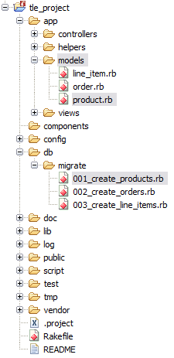
Model
class Product < ActiveRecord::Base
has_many :line_items
has_many :orders, :through => :line_items
validates_presence_of :title, :description, :image_url
validates_numericality_of :price
validates_uniqueness_of :title
validates_format_of :image_url,
:with => %r{\.(gif|jpg|png)$}i,
:message => "must be a URL for a GIF, JPG, or PNG image"
protected
def validate
errors.add(:price, "should be at least 0.01" ) if price.nil? || price < 0.01
end
end
class CreateProducts < ActiveRecord::Migration
def self.up
create_table :products do |t|
t.column :title, :string
t.column :description, :string
t.column :image_url, :string
t.column :price, :decimal
end
end
def self.down
drop_table :products
end
end
Notes:
Here is an example of a Migration and Model for Products.
Notice the many-to-many relationship declaration on line 3 of the Product class. We can simply jump to the orders tables through a simple call. Rails knows how to build the SQL join for us.. How nice!
Also, take a look at the various validations we can enforce on our Model. These validations post errors to an errors collection in the base class. These can easily present themselves into your views for user friendly interfaces. Note: other validations are available.

Slide 18
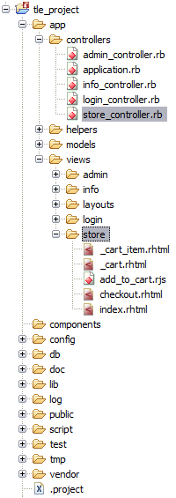
Controller
class StoreController < ApplicationController
before_filter :find_cart, :except => :empty_cart
def index
@products = Product.find(:all)
end
def add_to_cart
begin
product = Product.find(params[:id])
rescue ActiveRecord::RecordNotFound
logger.error("Attempt to access invalid product #{params[:id]}")
redirect_to_index("Invalid product")
else
@current_item = @cart.add_product(product)
redirect_to_index unless request.xhr?
end
end
#... empty_cart and checkout actions were here
def save_order
@order = Order.new(params[:order])
@order.add_line_items_from_cart(@cart)
if @order.save
session[:cart] = nil
redirect_to_index("Thank you for your order")
else
render :action => :checkout
end
end
private
# redirect_to_index action was here
def find_cart
@cart = (session[:cart] ||= Cart.new)
end
end
Notes:
Each controller method maps to an ‘action’ that can be invoked from a view/url
Notice the ‘before_filter’ statement… It says before you invoke any action, call the find_cart method except when are trying to empty the cart. Pretty cool huh? find_cart simply retrieves the cart from the session or creates a new one if one doesn’t exist already.
Variables defined with the @ sign indicate this is a class variable (Ruby language construct – not Rails). These variables can then be directly accessed within your views without doing any sort of lookups or definitions because Rails makes them available for us.

Slide 19
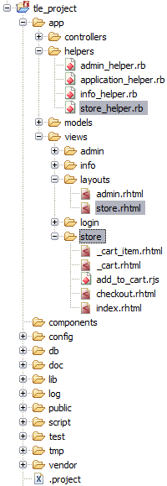
View
module StoreHelper
def hidden_div_if(condition, attributes = {})
if condition
attributes["style"] = "display: none"
end
attrs = tag_options(attributes.stringify_keys)
"<div #{attrs}>"
end
end
Underscore signifies template partial (fragment)
<div class="cart-title">Your Cart</div>
<table>
<%= render(:partial => "cart_item", :collection => cart.items) %>
<tr class="total-line">
<td colspan="2">Total</td>
<td class="total-cell"><%= number_to_currency(cart.total_price) %></td>
</tr>
</table>
<%= button_to "Checkout", :action => :checkout %>
<%= button_to "Empty cart", :action => :empty_cart %>
Partial rendering a partial
Notes:
Here we see two parts to the View story. One the bottom you see the actual view itself (think JSP), but above you’ll see the view helper. Helpers can be thought of custom tags in the J2EE world, except they don’t require any XML or any special code to invoke them. Since they are just Ruby code, and your view templates embed Ruby you can directly invoke them. You’ll find several helper methods being used in the view shown above.
Again, through naming conventions and Ruby magic all of this is available without special import statements or tag declarations.

Slide 20
An AJAX Cart
Notes:
Lets build a simple AJAX cart… For those of you who have been under a rock for the past couple of years… AJAX just means update the page inline without the browser submitting an entire new request and refreshing the entire page. This is usually accomplished through JavaScript calling an action/servlet with and XmlHttpRequest and retrieving the XML response, then updating the page.

Slide 21
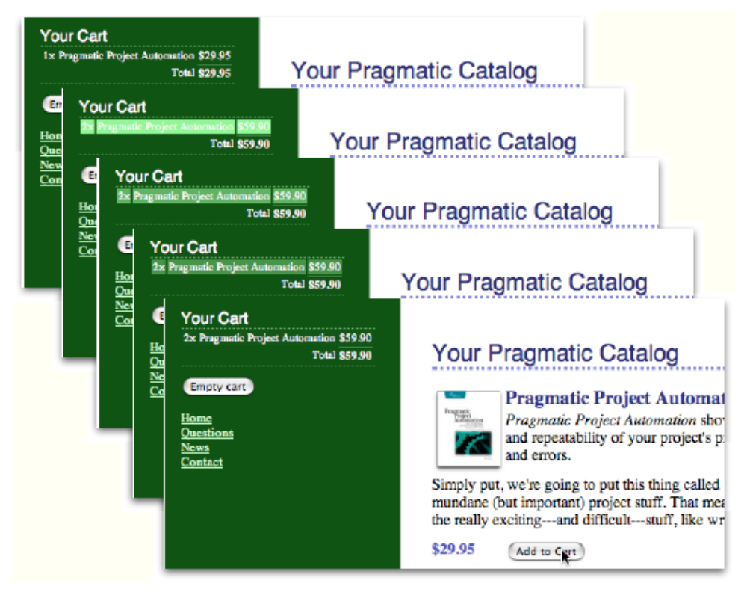
Cart Overview
Notes:
Here, we will click the ‘Add to Cart’ button and dynamically update our cart on the page as well as add a nifty highlight-fade visual effect.

Slide 22
View with form_remote_tag (AJAX link)
app/views/store/index.rhtml
<h1>Your Pragmatic Catalog</h1>
<% for product in @products -%>
<div class="entry">
<img src="<%= product.image_url %>"/>
<h3><%= h(product.title) %></h3>
<%= product.description %>
<div class="price-line">
<span class="price"><%= number_to_currency(product.price) %></span>
<!-- START:form_remote_tag -->
<% form_remote_tag :url => { :action => :add_to_cart, :id => product } do %>
<%= submit_tag "Add to Cart" %>
<% end %>
<!-- END:form_remote_tag -->
</div>
</div>
<% end %>
Notes:
Here is our view for the store index. We see it iterates over all products and creates a new DIV. The AJAX magic is obtained through the highlighted area…
The form_remote_tag helper method says that when the user clicks the submit ‘Add to Cart’ button it will invoke the add_to_cart action with the given product’s id via an AJAX call.
What really happens here is that IF the browser has JavaScript enabled, then a form tag will be written out along with a bunch of canned JavaScript to invoke the action under the covers through an XmlHttpRequest. IF the browser does not support JavaScript then a regular form tag will be rendered.
Now lets take a look at the add_to_cart action…

Slide 23
Controller action
app/controllers/store_controller.rb
class StoreController < ApplicationController
#...
def add_to_cart
begin
product = Product.find(params[:id])
rescue ActiveRecord::RecordNotFound
logger.error("Attempt to access invalid product #{params[:id]}")
redirect_to_index("Invalid product")
else
@current_item = @cart.add_product(product)
redirect_to_index unless request.xhr?
end
end
#...
end
Only redirect if not XmlHttpRequest a.k.a.(AJAX) otherwise add_to_cart.rjs will be executed
Notes:
Here, the add_to_cart method simply finds the product by the given id parameter and adds it to the cart if its found.
Notice we keep track of the ‘current_item’ when adding it to the cart by using the @ sign.
Now the real magic happens on the highlighted line. Redirect to the index action UNLESS its an XmlHttpRequest. Which it is in this case because we used the form_remote_tag. This allows us to do something in both an enabled and disabled JavaScript environment.
So what happens next if we don’t redirect??? Well, using the conventions Rails looks up a file named app/views/store/add_to_cart.r*. In this case we have an RJS file… lets take a look.

Slide 24
RJS ‘script’ – AJAX without JavaScript?
app/views/store/add_to_cart.rjs
page.replace_html("cart", :partial => "cart", :object => @cart)
page[:cart].visual_effect :blind_down if @cart.total_items == 1
page[:current_item].visual_effect :highlight,
:startcolor => "#88ff88",
:endcolor => "#114411"
Notes:
This is pretty simple. Using regular Ruby and the built-in APIs we can update the page.
First we replace the html with the id ‘cart’ with the output from the cart partial with the updated cart object (from the controller)
Next, we show the cart with a blind_down visual effect if this is the first item we’re adding (cart is hidden at first)
Last, we apply the visual effect to highlight the ‘current_item’ – remember we tracked this in the controller on the previous slide.
All Done.. Simple Right?

Slide 25
Cart Overview – A Second Look

Slide 26
What we didn’t cover
Testing Examples
URL Route Customization
Customizing Models for ‘legacy’ tables
Responding to different MIME types
ActionMailer – easily sending mail
Deployment with Capistrano
  http://manuals.rubyonrails.com/read/book/17
  http://topfunky.com/clients/peepcode/free-episodes/peepcode-free-deprec.mov
Webservices using REST
  Video http://www.scribemedia.org/2006/07/09/dhh/
  Presentation Slides http://media.rubyonrails.org/presentations/worldofresources.pdf
Other various Rails features

Slide 27
References
http://www.rubyonrails.org/screencasts
http://www.rubyonrails.org/docs
http://www.pragmaticprogrammer.com/titles/rails/index.html
http://www.ruby-lang.org
http://wiki.rubyonrails.org/rails
IDE used in screen shots – RadRails http://www.radrails.org

Slide 28
End

