Slide 1


Intro To JMeter
Testing a Web-Based Application
Christian Desserich

Slide 2
History
Started by Stefano Mazzocchi
Originally developed to test JServ (an Apache project since replaced by Tomcat)
Functionality has been added to test a variety of server-based applications:
    JDBC
    LDAP
    FTP
    SMTP
    Etc...

Slide 3
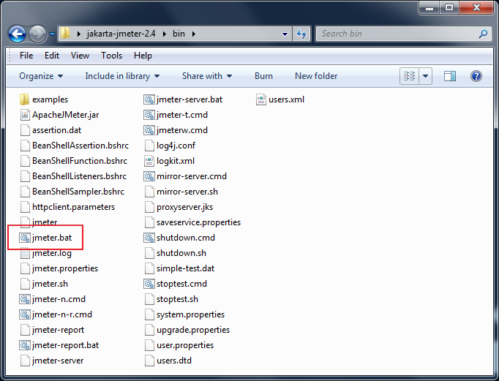
Installation/Running
Simple compressed download
    (http://jakarta.apache.org/site/downloads/downloads_jmeter.cgi)
Extract anywhere
Several launch scripts
jmeter.bat
launches
the GUI

Slide 4
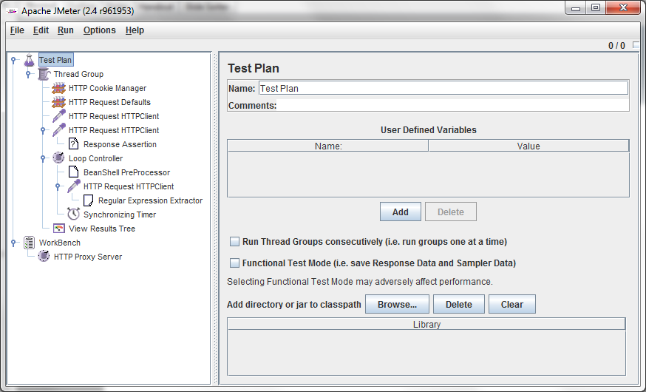
The GUI
Test Plan is the parent element of the tree
Test elements are added to the tree to flesh
out the functionality of the test plan
The workbench is a temporary parent element
where test elements can be manipulated.

Slide 5
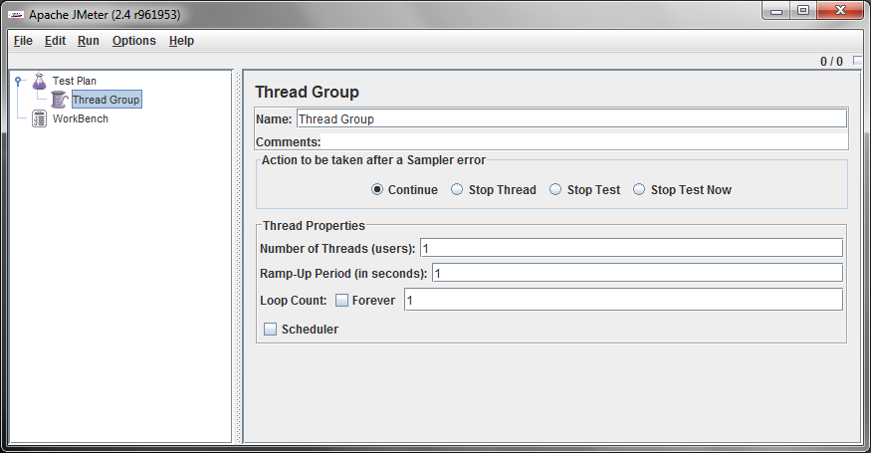
Test Elements: Thread Group
Represents user group
Each thread will execute the test plan
What to do if test
encounters an error
Number of users
Total ramp-up time for
all threads to become
active (in seconds)
Number of iterations

Slide 6
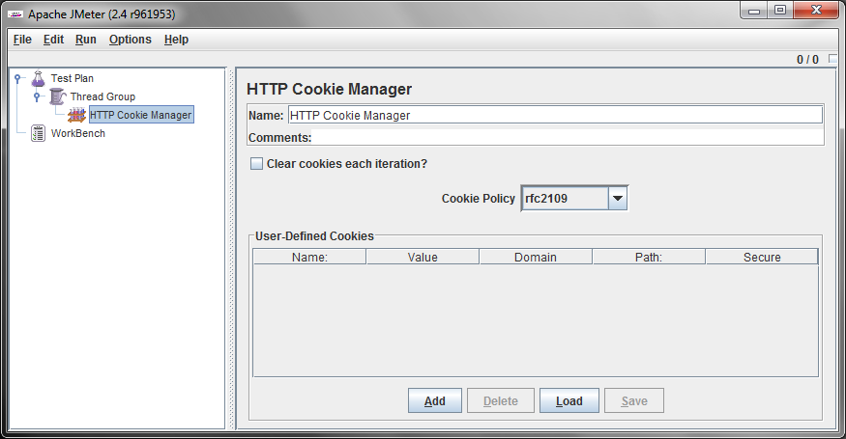
Test Elements: Config Elements
Abstract common settings, handle cookies, variables, input data, etc.

Slide 7
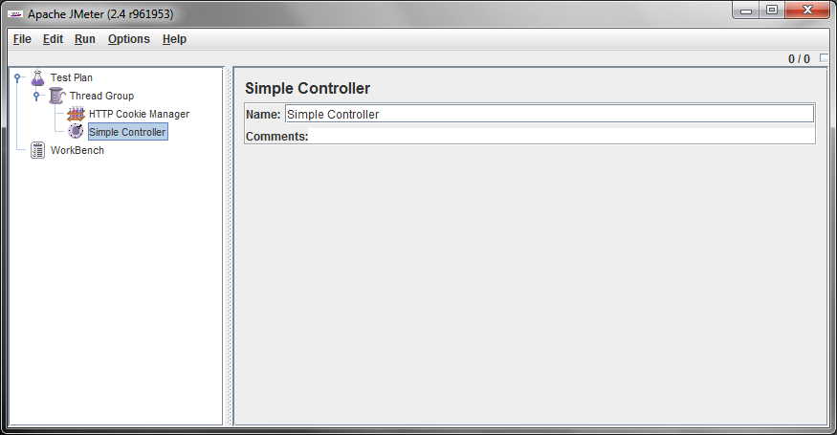
Test Elements: Logic Controllers
Control test plan execution
Loop, If, Interleave, Random, ForEach, etc.

Slide 8
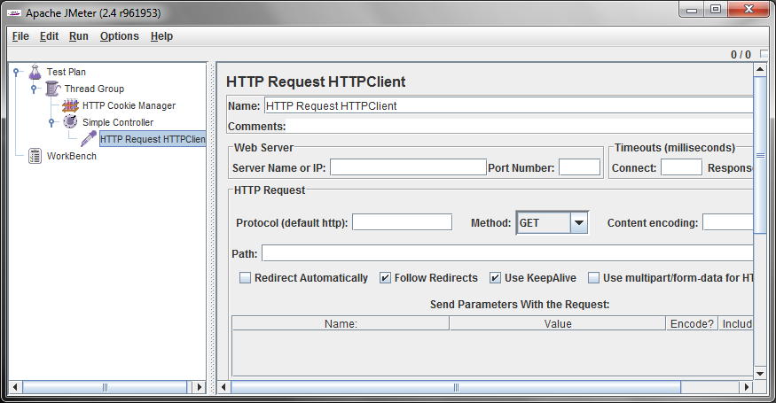
Test Elements: Samplers
Requests
HTTP, FTP, JDBC, WebService(SOAP), etc.
Port
Host (ex. java.sun.com)
Protocol (https?)
Path (ex. /java/index.html)

Slide 9
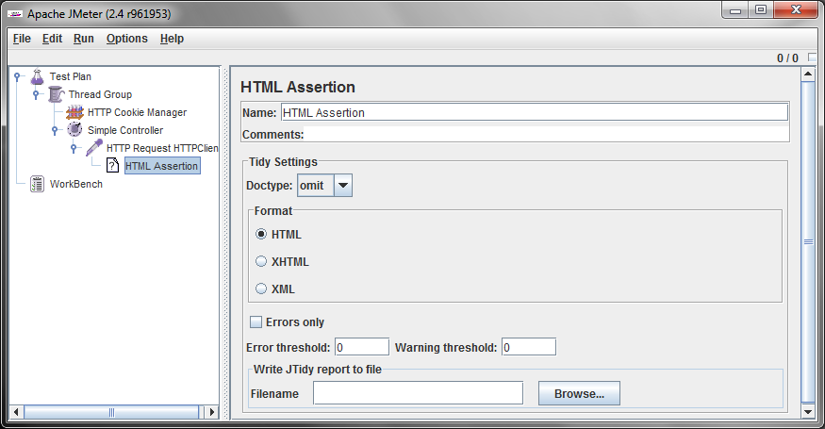
Test Elements: Assertions
Report pass/fail for some condition
HTML, Response, Duration, XML, etc.

Slide 10
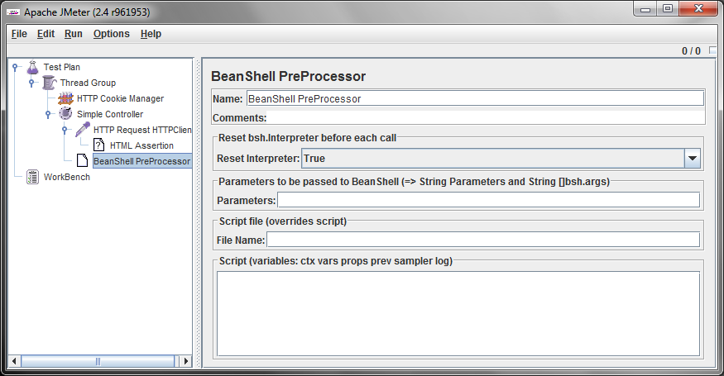
Test Elements: Pre Processors
Set up for one or more test elements
BeanShell scripting, HTML link parsing, params, etc.

Slide 11
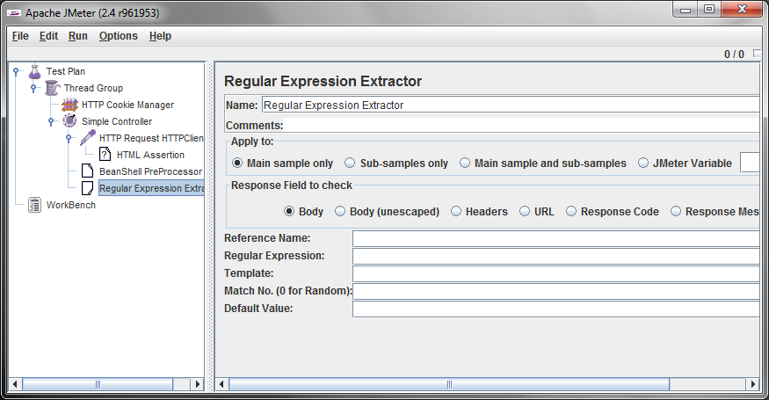
Test Elements: Post Processors
Extract values, setup for next request
BeanShell scripting, RegEx Extracting, etc.

Slide 12
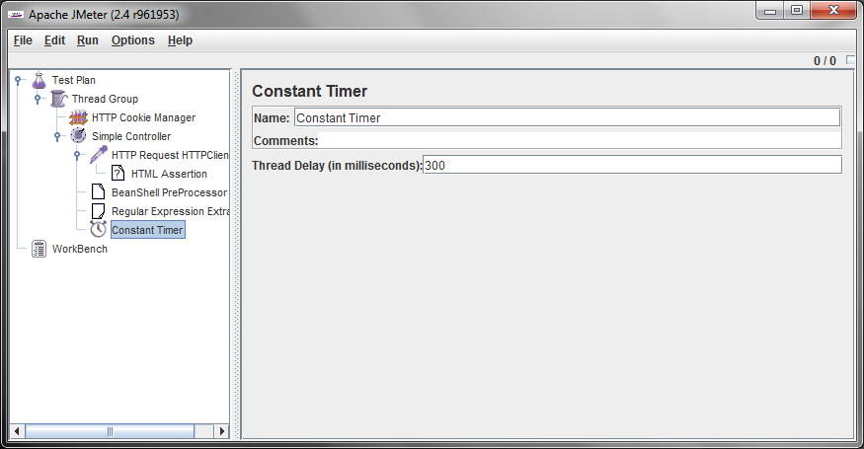
Test Elements: Timers
Control thread and test element timings
Random, Synchronize, Constant, etc.

Slide 13
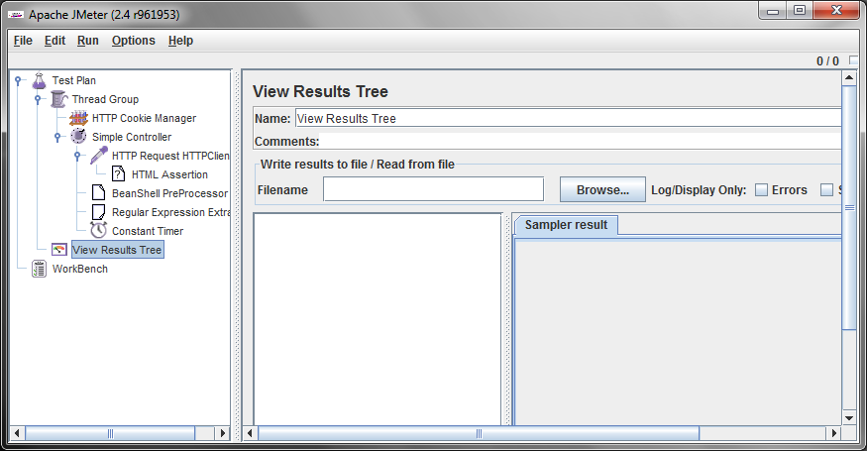
Test Elements: Listeners
Display test results in the GUI
Will also save results to configurable .csv or .xml file

Slide 14
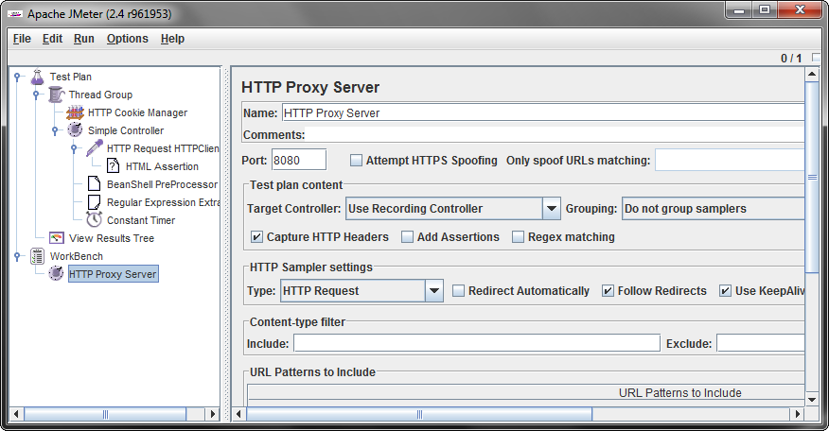
Non-Test Elements: Proxy Server
Used for recording!
Can add Samplers to any controller

Slide 15
Example
Let's Build a Test Plan!

Slide 16
HTTP Req vs. HTTP Req HTTPClient
HTTP Request is default Java HTTP implementation
HTTP Request HTTPClient is Apache Commons HttpClient
The default (Java) implementation has some idiosyncrasies (from JMeter component reference):
  There is no control over how connections are re-used. When a connection is released by JMeter, it may or may not be re-used by the same thread.
  The API is best suited to single-threaded usage - various settings (e.g. proxy) are defined via system properties, and therefore apply to all connections.
  There is a bug in the handling of HTTPS via a Proxy (the CONNECT is not handled correctly). See Java bugs 6226610 and 6208335.

Slide 17
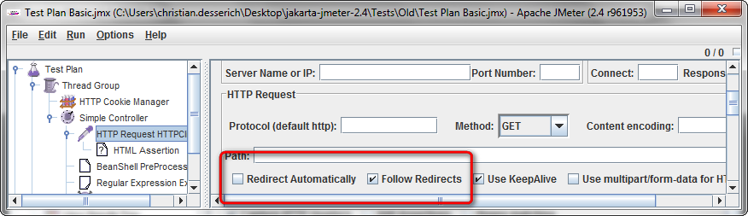
Redirect Auto vs. Follow Redirects
Redirect Automatically setting does not generate Samples for the redirect requests
  In general, this setting isn't typically used as it does not handle the cookies on redirection
Follow Redirects setting generates redirect requests as sub-samples

Slide 18
Sources
JMeter Users Manual
  http://jakarta.apache.org/jmeter/usermanual/index.html
Great blog post about testing Seam
  http://kalgtech.blogspot.com/2009/10/load-testing-seam-application-using.html
JMeter tutorial
  http://www.devx.com/webdev/Article/17950

Slide 19
Thank You
Thank you for listening!
To access the links, files, and slide show for this presentation go to:
http://blogs.e-gineering.com/Christian/entry/jmeter_jug

